Slide 1


Slide 2

Class Timeline: Programming
Week 1 - 2
HTML Basics
Week 2 - 4
CSS
Week 5
Advanced HTML & CSS
Week 6 – 7
Javascript
Week 8
Group Presentation
Week 9 – 10
Javascript
Week 11
Extra Topic
Week 12
Final Presentations

Slide 3
What Websites are Made Of
HTML
Structure
= Skeleton
CSS
Design
= Clothes
Javascript
Function
= Muscle

Slide 4
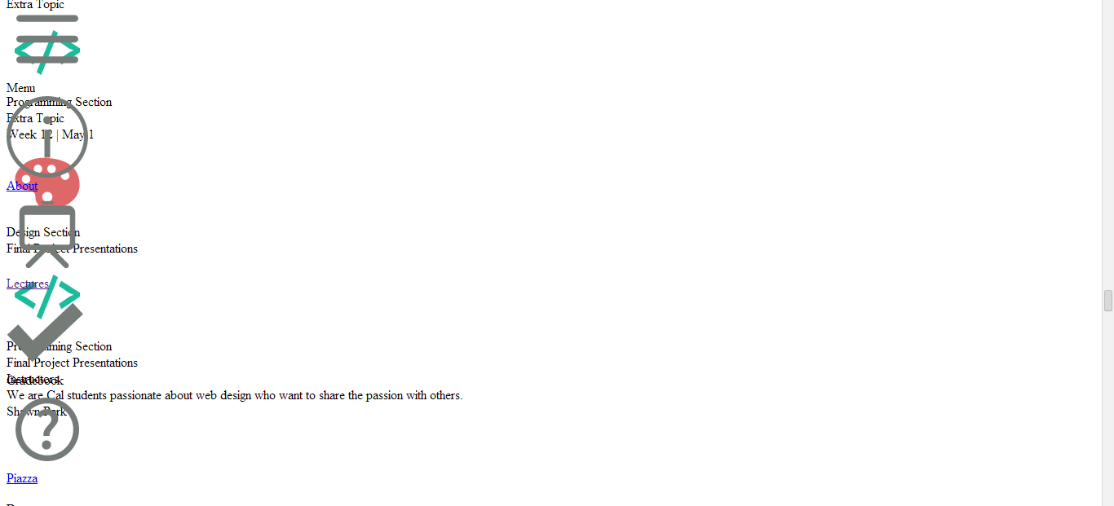
Pure HTML

Slide 5
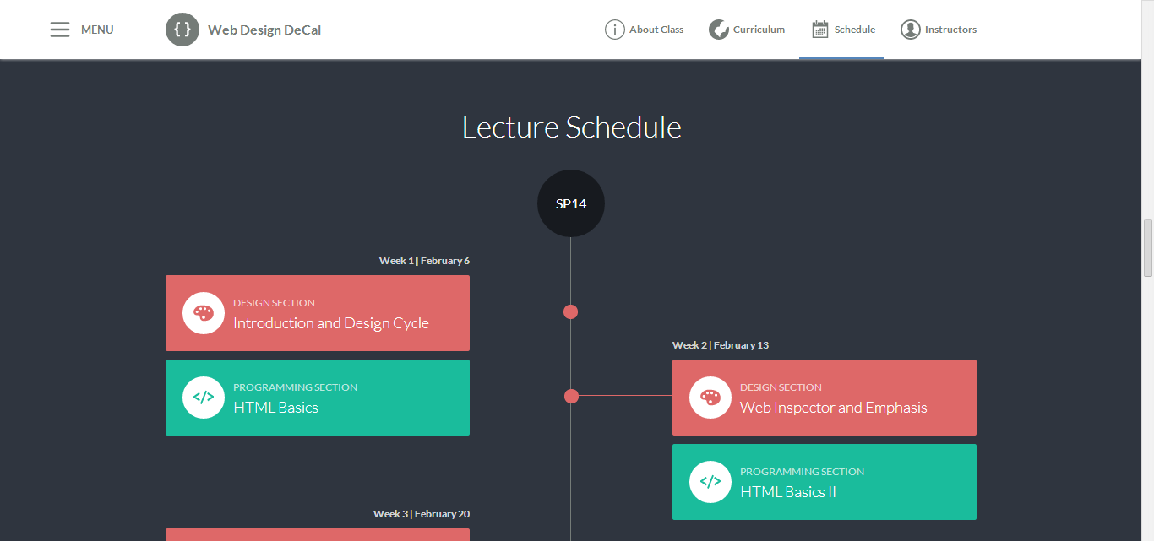
HTML + CSS

Slide 6
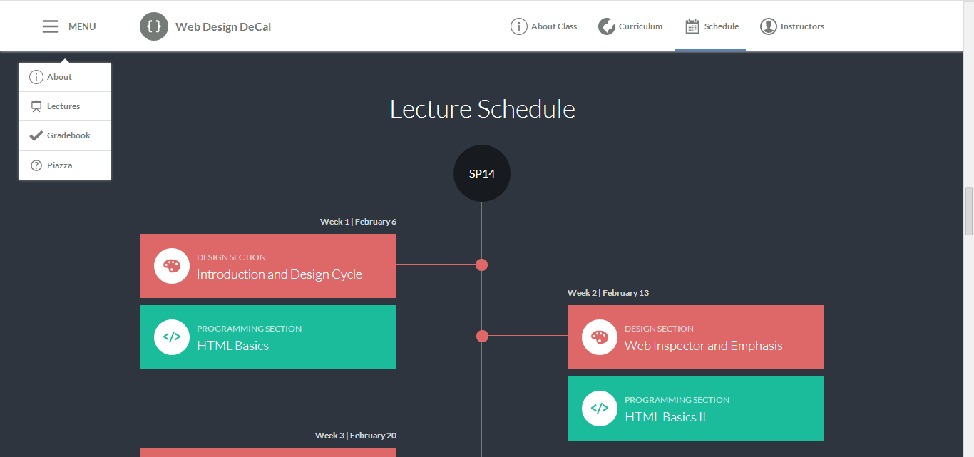
HTML + CSS + JS

Slide 7
Today’s Outline
Editors & File Structure
HTML Structure
HTML Syntax
1st In-Class Activity (yay!)

Slide 8
Goal Today:
Getting up and running in HTML

Slide 9
Editors & File Structure

Slide 10
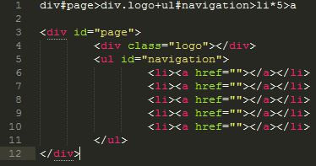
Editors
A text editor is a program that edits plain text files
For us, we want one that is code-friendly and highlights a code’s syntax
Our picks:
Sublime Text 2 (free!), TextMate (mac, free!), Coda 2 ($$)

Slide 11
Relative and Absolute Paths
Before we start, know these 2 key differences
Relative Path
Path to a file relative to current file
Example: Link to “page.html” or “pictures/sp14/decal.png”
Absolute Path
Complete path to a file or webpage
Example: Link to “C:/Users/Jeff/Desktop/page.html” or “http://www.youtube.com”

Slide 12
Relative and Absolute Paths
Example: You are currently in index.html. How would you access site.css by relative path?
C:/
workspace/
index.html
about.html
css/
site.css
decal.html
Answer: “css/site.css”

Slide 13
Relative and Absolute Paths
Example: You are currently in index.html. How would you access site.css by absolute path?
C:/
workspace/
index.html
about.html
css/
site.css
decal.html
Answer: “C:/workspace/css/site.css”

Slide 14
Relative and Absolute Paths
To go up a folder (going back), use two dots and a slash (../)
C:/
workspace/
index.html
about.html
css/
site.css
decal.html
To access decal.html from index.html: “../../decal.html”
“Up two levels”

Slide 15
HTML Structure

Slide 16
Tags
Tags start with a left bracket < and end with a right bracket >
This is a paragraph tag: <p>
There are opening tags and closing tags. Closing tags start with </ instead
Example: </p>
Together, a set of tags is called an element
<p></p> is a paragraph element
You can add content between a opening and closing tag
Example: <p>Hello Class!</p>

Slide 17
Tags
Opening tags must have a closing tag
Not acceptable: <p>Hello!
Close it: <p>Hello!</p>
There are exceptions for special tags
Example: <br>
This is a line break tag
Also: <link type=“text/css” rel=“stylesheet” href=“style.css”>
This is a link tag to your css file (we will go over this later)

Slide 18
Basic HTML Structure
All webpages have 3 core elements to them:
HTML tag
Head tag
Body tag
The head and body tags are within the HTML tags
HTML
Head
Body

Slide 19
Basic HTML Structure
All HTML pages must start with the <html></html> tags
This tells the browser to render meaningful HTML code
Inside the HTML tags, put <head></head> tags
<html>
<head>
</head>
</html>
Notice we indented the <head></head> tags. This is for readability purposes (you could put everything in one line too, but we indent to make it easier for us to read)

Slide 20
Basic HTML Structure - Header
What goes in <head></head> ?
Title of page, links to css & javascript files, search engine keywords and description, website info, etc.
Everything not rendered on the page (the content)
Title
<title></title> tags
Defines the title displayed on browser windows/tabs

Slide 21
Basic HTML Structure - Header
<html>
<head>
<title>First Webpage</title>
</head>
</html>

Slide 22
Basic HTML Structure - Body
What goes in <body></body> ?
Content for your page
This is what the viewer sees
Heading Tags
<h1></h1>, <h2></h2>, …, <h6></h6>
6 default heading sizes. 1 is the largest, 6 is the smallest
Paragraph Tags
<p></p>
Adds some space above and below your paragaph

Slide 23
Basic HTML Structure - Body
Other Useful Tags
<br> for a line break (jumps to next line for a text)
<strong>…</strong> for bold text
<em>…</em> for italicized text
<hr> for a single horizontal line

Slide 24
Images & Links

Slide 25
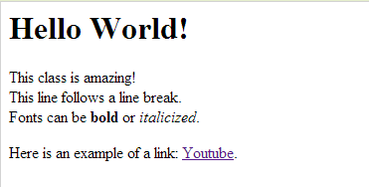
Images & Links
Links
<a>…</a> tags
Also called anchor tags
Example:
<a href=“http://www.youtube.com”>Youtube</a>
href is an example of an element attribute
Attributes are followed by = and “…”, with something in “…”
href needs a url inside the “…”. Can be relative or absolute
Between the <a>…</a> tags is the text displayed on the browser

Slide 26
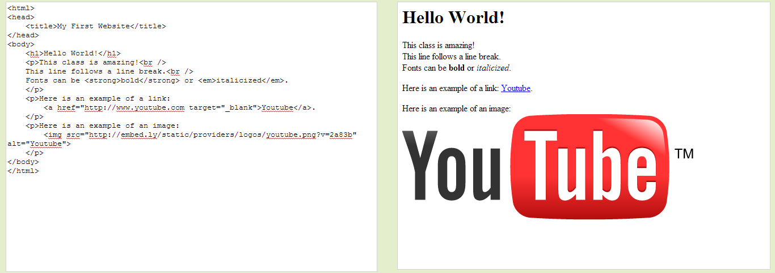
Images & Links
Images
<img> tag
Image tags rely a lot on HTML attributes (like href in anchor tags)
src attribute
Defines the image source (either relative or absolute path)
Example: <img src=“/path/to/filename.png”>
height & width attributes
<img src=“/path/to/filename.png” height=“100” width=“100”>
Note: Number is in # of pixels
alt attribute
Example: <img ... alt=“yo!”>
Displayed if image is unavailable, or is read if using screen reader

Slide 27
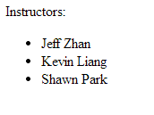

Lists
Unordered Lists (bullets)
<ul> <li>Jeff Zhan</li>
<li>Kevin Liang</li> <li>Shawn Park</li> </ul>
Ordered Lists (numbers)
<ol> <li>Jeff Zhan</li>
<li>Kevin Liang</li> <li>Shawn Park</li> </ol>

Slide 28
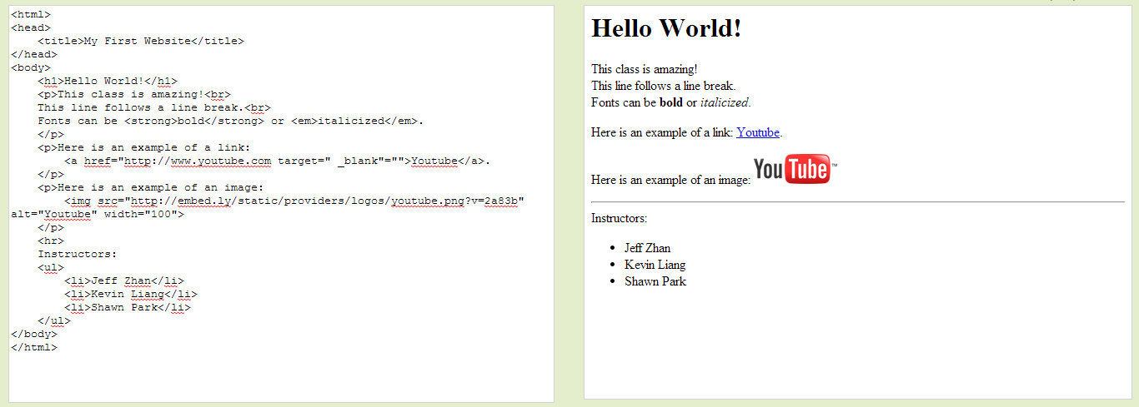
Lists

Slide 29
Summary
Relative Paths are paths to a file relative to your current location
Absolute Paths are the complete paths to a file
HTML pages have 3 main elements:
HTML tags
Head tags
Body tags
Head tags define things not visible to the user
Body tags define things visible to the user
Images and Links take in attributes and depend on relative/absolute paths
All lecture material, handouts, and homework can be found at:
http://www.thewebdesignworkshop.co (an absolute path!)

Slide 30
Bonus Slides!

Slide 31
Structure of your Environment
Many ways to structure your website. Here is one way:
workspace/
index.html
assets/
js/
site.js
css/
site.css
images/
image1.png

Slide 32
Head Tags
Besides <title></title>, what else can you do?
Meta Tags
<meta> tags define information on your page
It is an exception to the opening/closing tag pair
Search Engine Description:
<meta name=“description” content=“Google shows this”>
Takes a name and content attribute
“Favicon” – The icon next to your website title on the browser:
<meta property="og:image" content=“/path/to/image.png"/>
Takes a property and content attribute
Content is a relative/absolute path to your 16x16 or 32x32 favicon image (in .png or .gif preferably)

Slide 33
Div and Span Tags
We will see this in the next few lectures
<div></div> tags are the primary tags we will use in the future
They are essentially tags with no special properties (like <strong> or <h1>)
You customize them with CSS
They are stacked vertically, meaning you cannot have two divs side by side unless you alter the CSS
<span></span> tags are used from time to time
Like a div tag, they have no special properties
You customize them with CSS
They are stacked horizontally, meaning you can have two spans side by side

