Slide 1


Slide 2

Review
HTML
Structure
= Skeleton
CSS
Design
= Clothes
Javascript
Function
= Muscle

Slide 3
Review
What 3 elements are essential in HTML?
HTML tags
Head tags
Body tags
What is the image element for a file called “panda.png”?
<img src=“panda.png”>

Slide 4
Today’s Outline
HTML Tables
Divs & Spans
IDs & Classes
Intro to CSS
CSS Properties
Linking to CSS

Slide 5
Goal Today:
Style Websites and Make Beautiful Pages

Slide 6
HTML Tables

Slide 7
HTML Tables
A table is useful for organizing lots of data and content
<table>… </table> tags
Inside a table, we have rows and columns
<tr>…</tr> is a row
<td>…</td> is a column
<th>…</th> is a special column (header column)
Each row contains several columns

Slide 8
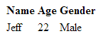
HTML Tables
<table>
<tr>
<th>Name</th>
<th>Age</th>
<th>Gender</th>
</tr>
<tr>
<td>Jeff</td>
<td>22</td>
<td>Male</td>
</tr>
</table>

Slide 9
Divs & Spans

Slide 10
Divs and Spans
<div></div> tags are the primary tags we will use from now on
They are essentially tags with no special properties (like <strong> or <h1>)
You customize them with CSS
They are stacked vertically, meaning you cannot have two divs side by side unless you alter the CSS
<span></span> tags are used from time to time
Like a div tag, they have no special properties
You customize them with CSS
They are stacked horizontally, meaning you can have two spans side by side

Slide 11
IDs and Classes

Slide 12
IDs and Classes
IDs and Classes are both attributes to HTML elements
They look like this: <div id=“main-content”> or <p class=“intro”>
IDs
Unique to a single HTML file (no other IDs on page can have the same ID)
Classes
There can be one or more of the same class on a given page
IDs and Classes are important concepts for CSS. This is how CSS will select certain elements and style them

Slide 13
Intro to CSS

Slide 14
Intro to CSS
CSS stands for Cascading Style Sheets
They go in another file with an extension of .css
Link to the CSS file from your HTML file (in the <head></head> tags)
Basic Structure of CSS:
SELECTOR
p { color: red; font-size: 16px; }
PROPERTY
VALUE

Slide 15
Intro to CSS
SELECTOR
p { color: red; font-size: 16px; }
PROPERTY
VALUE
A “selector” can be the HTML element name, its ID name or Class name
It is followed by braces { }, with CSS property-value pairs in between
Properties define a CSS style
They are followed by a colon : and a value
Close property-value pairs with a semicolon ; (important!!)

Slide 16
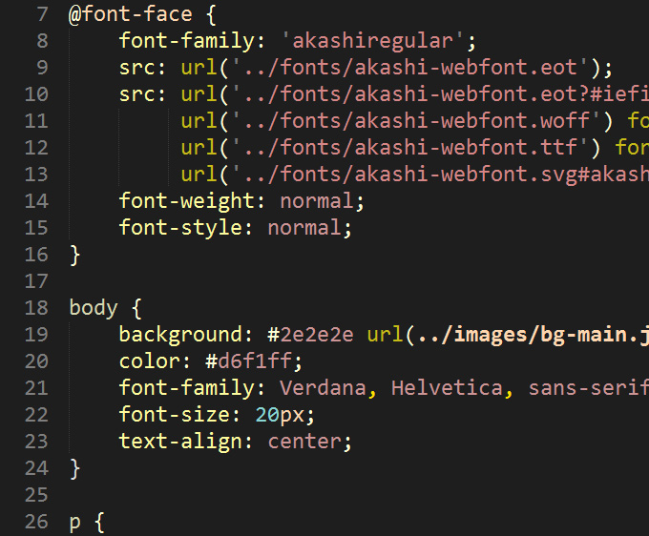
Intro to CSS
Sample CSS Documents

Slide 17
Intro to CSS
Selecting elements to style is simple
Use either the HTML element name, its class or its id
<p>Hello World!</p>
Select this element with p
Style p: p { color: red; }
What if you have multiple paragraphs, but want to style just the first one?
You can use IDs:
<p id=“intro”>Hello World!</p><p>My name is Bob.</p>
Select the ID intro:
#intro { color: red; }

Slide 18
Intro to CSS
Select elements by ID with a pound symbol #
Example: #intro { font-size: 16px; }
Select elements by Class with a dot symbol .
Example: .items { line-height: 26px; }
How would you select “Second Paragraph”? What about both divs?
<div id=“first” class=“paragraph”>
First Paragraph
</div>
<div id=“second” class=“paragraph”>
Second Paragraph
</div>
Answer 1: #second { … }
Answer 2: .paragraph { … }

Slide 19
CSS Properties

Slide 20
CSS Properties
There are a lot of properties! We will teach you the most essential
color
Changes the color of your text
Value is either a default color value (red, blue, etc.), RGB or HEX value (we will go over this next week)
background-color
Changes the background color of your HTML element
Value is either a default color value (red, blue, etc.), RGB or HEX value (we will go over this next week)

Slide 21
CSS Properties
text-align
Values: left, center, right, justify
text-decoration
Values: underline, overline, line-through
font-size
Value in px (ex: 16px or 24px)
Other ways to define font too (but we won’t go over them)
font-weight
Values: normal, bold, bolder, or lighter
Or use values from 100, 200, …, to 900
400 = normal, 700 = bold

Slide 22
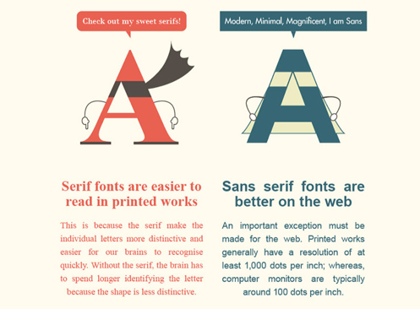
CSS Properties – Font Family
Before we talk about font-family, let’s go over some basics
There are 2 types of fonts: Serif and Sans-serif

Slide 23



CSS Properties – Font Family
On the web, we call commonly used fonts “web-safe”, meaning all browsers can render the fonts without trouble
Here is a list of web-safe “serif” fonts:

Slide 24




CSS Properties – Font Family
Here is a list of web-safe “sans-serif” fonts:

Slide 25
CSS Properties – Font Family
Let’s see the CSS property for using a font-family
font-family
Example: font-family: Arial;
Usually there are more than one font-family value
Example: font-family: Helvetica, Arial, Verdana, sans-serif;
This means the font-family Helvetica will be used
If Helvetica is not supported by the browser, the next font is used
These are called fallback fonts
The last fallback font in this example is sans-serif (what the browser chooses as the default sans-serif)
If no fallback fonts or no font defined, default serif font used

Slide 26
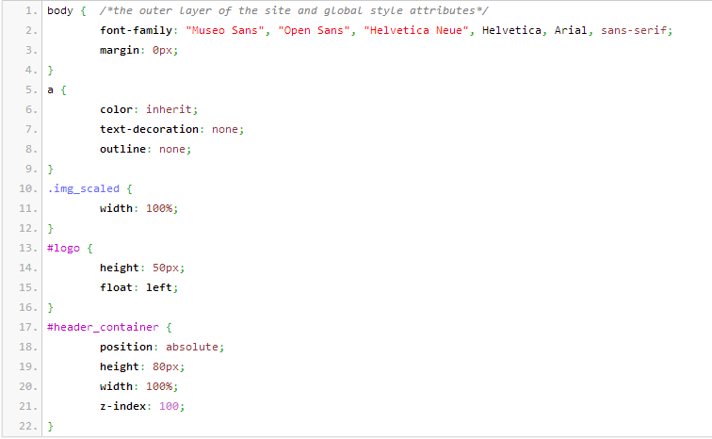
CSS Properties – Font Family

Slide 27
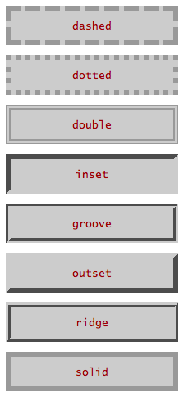
CSS Properties – Font Family
Lastly, there is border
border
Takes in 3 values, space-separated
1st value: border-width in px (pixels)
2nd value: border-style
3rd value: color
Example: border: 1px solid #999;
Thin solid gray border around your element

Slide 28
Linking to CSS

Slide 29
Linking to CSS
3 ways to style CSS
Inline CSS
Internal Stylesheet
External Stylesheet
We will only cover the External Stylesheet, the most commonly used and best way to utilize CSS

Slide 30
Linking to CSS
In your HTML file’s <head></head> tags, include the following line
<link rel=“stylesheet” type=“text/css” href=“/path/to/style.css”>
It is a lot to take in! Thankfully, you can copy this line for all your HTML pages and just change the href attribute to any .css file
Just know this is a <link> tag, linking your HTML page to your CSS file

Slide 31
Summary
HTML Tables are useful for organizing data and content
Divs & Spans are non-special elements that can be customized with CSS
IDs are unique to a page, Classes are not
CSS styles require a selector and a property-value pair
Selecting elements by IDs and Classes, and styling them
A lot of CSS properties!
Linking HTML to CSS files
All lecture material, handouts, and homework can be found at:
http://www.thewebdesignworkshop.co

Slide 32
Bonus Slides!

Slide 33
Font-Face
Sometimes you may want to use a custom font
We can use the CSS3 rule @font-face
Example (put this at the top of your CSS file) @font-face { font-family: someName;
src: url(/path/to/font.otf);
}
Name your font in the font-family property
Put the relative/absolute path to your font in src (.ttf, .otf, .woff)
To use your custom font “someName”, simply use it as you would any other font
Example: p { font-family: someName, Arial, sans-serif; }

Slide 34
Other ways to link CSS
Inline CSS
Very poor design choice, but you may see them in old websites (or if the web developer is lazy)
They utilize the HTML attribute style=“…”, and styles are inserted in the attribute
Example: <p style=“color: red; font-size: 14px;”>Hi!</p>
Internal Stylesheet
A little better than inline CSS
Inside the <head></head> tags, you insert <style></style> tags
<style>
p { color: red; font-size: 14px; }
</style>

