Slide 1


Slide 2

Review
What are some CSS properties that we went over last week?
Given the following HTML, how would you make the element with the text “Red” have a red background color and white text?
<div id=“blue” class=“colors”>Blue</div>
<div id=“red” class=“colors”>Red</div>
<div id=“green” class=“colors”>Green</div>
#red {
background-color: red;
color: white;
}

Slide 3
Review CSS

Slide 4
Today’s Outline
CSS Box Model
CSS Color

Slide 5
Goal Today:
To Structure your Web Pages

Slide 6
CSS Box Model

Slide 7
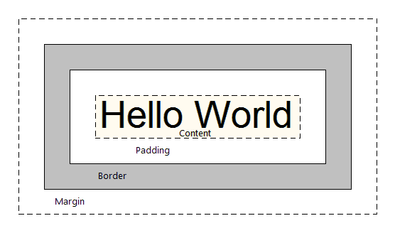
CSS Box Model
The CSS Box Model is the standard way of structuring your elements and web pages. It allows us to add space and borders to an element

Slide 8
CSS Box Model
Facebook makes use of the Box Model everywhere

Slide 9
CSS Box Model
4 Key components
Content
Padding
Border
Margin
Content is everything inside an element
Example: In <p>Hello World</p>, “Hello World” is the content
Border is the line that surrounds an element
Padding is the space between the content and border
Margin is the space from the border and nearby elements

Slide 10
CSS Box Model
We went over border last week
border
Takes 3 values: width, style, color
Example: border: 1px dashed blue;
Padding and Margin can take in 1, 2, 3 or 4 values
1 Value:
padding: 10px; = 10 pixels of space all around, from content to border
2 Values:
margin: 5px 10px; = 5 pixels of space above and below border, 10 pixels of space to the left and right of border
Corresponds to top & bottom, left & right

Slide 11
CSS Box Model
3 Values:
padding: 10px 5px 20px; = Corresponds to top, left & right, bottom
4 Values:
margin: 10px 5px 20px 15px; = Corresponds to top, right, bottom, left (clockwise)

Slide 12
CSS Box Model
Padding
Content
Border
Margin
Hello World!
In this example, a possible style for the element is:
padding: 15px;
border: 2px solid #ccc; /* light-gray */
margin: 5px 10px;

Slide 13
CSS Box Model
Padding
Content
Border
Margin
Hello World!
Also know that if you add a background-color to your image, it will color in the content and the padding portions of the element
Background-color will not affect the margin!!!

Slide 14
CSS Box Model
Currently we have divs that stack vertically. What does this mean?
Divs are, by default, blocks
They take up the entire row
By default, you cannot stack divs side by side
They look like this:

Slide 15
CSS Box Model
In order to stack horizontally, you must alter the CSS style for display
display
There are 3 important values for display: block, inline-block, inline
block
“block” displays respect all margins, paddings, height & width
Except, they have an auto-line break after it (next element goes directly below it)
inline-block
Exactly like a block but it has no line break after it
inline
Can have left & right margins/paddings, but no top & bottom ones. Also has no height/width. Allows elements next to them

Slide 16
CSS Box Model
Block Example
This has padding/margins.
Stacked vertically.

Slide 17
CSS Box Model
Inline-Block Example
Side by side
With margin/padding
And you can set the width/height

Slide 18
CSS Box Model
Inline Example (essentially a <span> tag)
No top/bottom
No height/width
But you can stack horizontally.
See?

Slide 19
CSS Box Model - Examples
Inline Example (essentially a <span> tag)
The quick brown fox jumps over the lazy dog.
<div>
The quick <span id=“bold”>brown fox</span> jumps over the lazy dog.
</div>

Slide 20
CSS Box Model - Examples
What happens if instead of <span>, you use <div>?
<div>
The quick <div id=“bold”>brown fox</div> jumps over the lazy dog.
</div>
The quick
brown fox
jumps over the lazy dog.

Slide 21
CSS Box Model - Examples
Now if add the CSS properties to id=“bold”:
display: inline-block & padding: 0 40px
<div>
The quick <div id=“bold”>brown fox</div> jumps over the lazy dog.
</div>
The quick brown fox jumps over the lazy dog.
You can add width, padding, and margins to your elements!
Amazing!

Slide 22
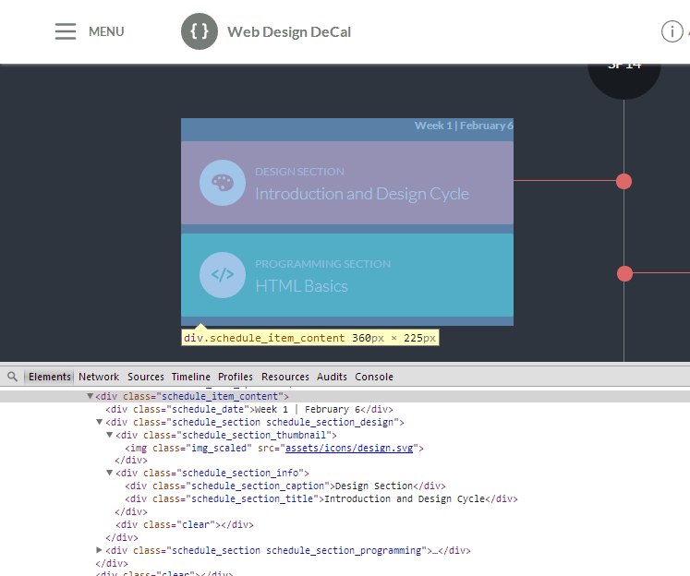
CSS Box Model

Slide 23
Demo

Slide 24
Centering a Div
Text or Div Element
Centering text is easy, use text-align: center
What if you want to center a <div> that has a certain width?
Center me! I want this box to be in the center! :)

Slide 25
Centering a Div
Text or Div Element
By default, if you give your <div> a width (say 200px), it will automatically be on the left
Center me! I want this box to be in the center! :)

Slide 26
Centering a Div
Text or Div Element
To center a <div>, add 2 CSS properties to the element:
margin-left: auto; margin-right: auto;
Margin-left and margin-right auto lets the browser place your element in the center of page, or center of the above element (if it is not <body>)

Slide 27
Centering an Image
Image
What about centering an image? (<img> tags)
Again, by default it is on the left

Slide 28
Centering an Image
Image
To center an image, like text, add margin-left/right to auto
Also, specifically add display: block

Slide 29
Centering an Image
Image
Remember that <div> elements by default are display: block
<img> tags by default are not display: block, so we must type in display: block manually, to tell the browser that the image takes up the entire row

Slide 30
CSS Color

Slide 31
CSS Color
Color is important for font colors, background colors, borders, etc.!
Color on the web can be represented in 3 ways:
A default color value
Hex Value
RGB Value
What do these mean?
Default Color
16 pre-defined CSS colors
Example: red, blue, black, white, maroon, etc.
Too limited may not be what you want!

Slide 32
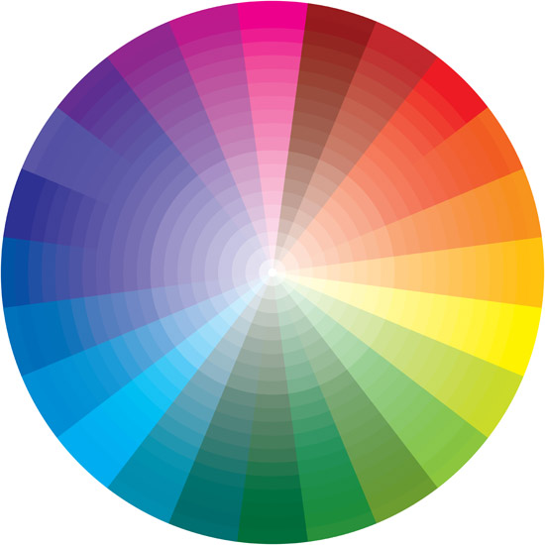
CSS Color
Hex Color (Hexadecimal)
Millions of ways to define a color!
Syntax: Pound sign # followed by 6 digits/characters from 0 to 9 and A to F
Example: #FF0000 (red), #339CCD (light blue), #888888 (gray)
0-9 & A-F = 16 possible values
16*16*16*16*16*16 = 16 Million Ways
To Define 1 Color!

Slide 33

CSS Color - Hex
Hex values are 6 digits, or 3 bytes
Each byte is 2 digits and represents a “color”
Red corresponds to the 1st byte, Green to the 2nd, Blue to the 3rd
A “0” indicates no color. Increasing the value to 1, 2, etc. increases the color. An “F” indicates full color (lightest)
Example: #0000FF
Equivalent to “no reds”, “no greens”, “full blues” = Pure Blue
What is “Purple”?
Answer: #FF00FF! It is a mix of pure red and pure blue. Other shades may include #AA00AA or #330033.

Slide 34
CSS Color - Hex
Screens and monitors are black by default
When you have #000000 (no color), this means you get black
When you have #FFFFFF (all colors), you get white
Thus, some red on a black surface = dark red: #330000
Another fun tip! If a color’s byte has 2 repeating digits (88, FF, 00), and all 3 bytes have repeating digits, you can do a shorthand by using the single digit
Example: #FF0000 → #F00
#CC88DD → #C8D
#000000 → #000

Slide 35
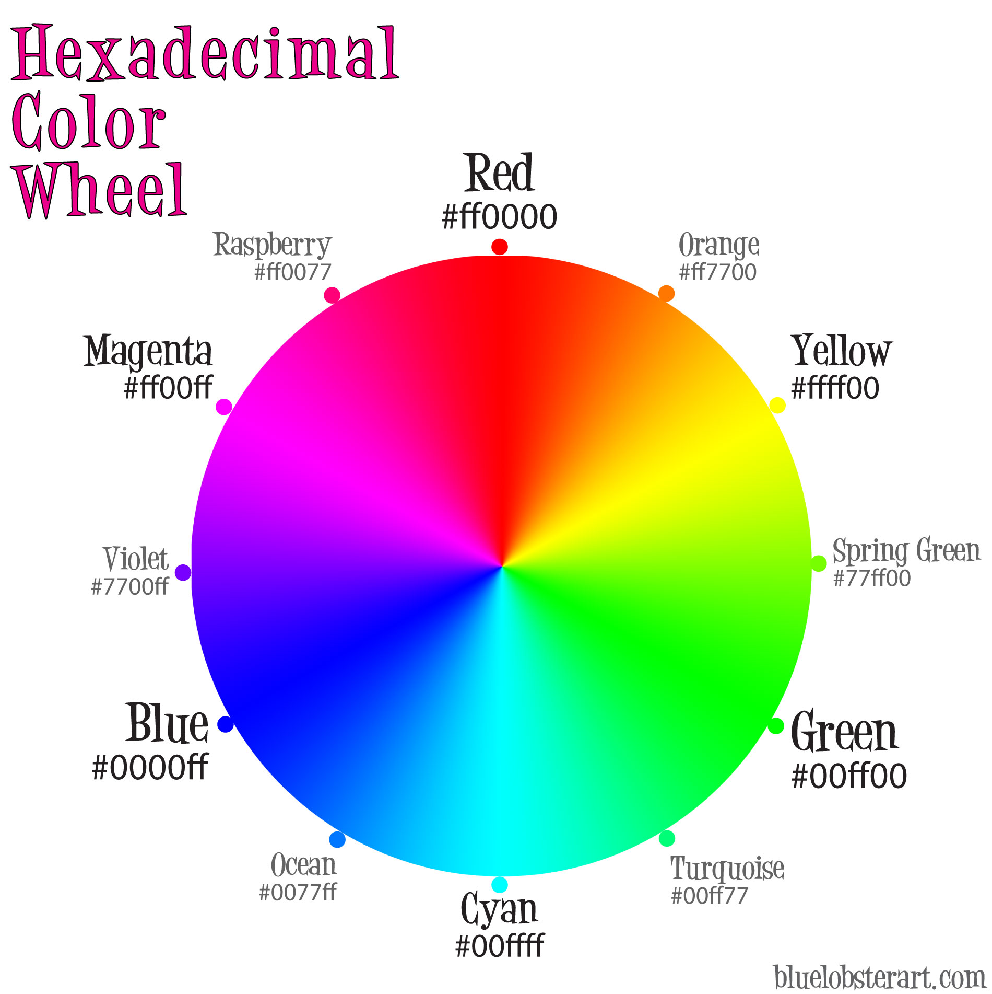
CSS Color - Hex

Slide 36
CSS Color - RGB
RGB colors
Syntax: rgb(255, 0, 0)
rgb(…) takes in 3 values: red, green, blue
Similar to Hex. 0 in rgb is 00 in hex, 255 in rgb is FF in hex
Examples:
rgb(255, 0, 0) vs. #FF0000
rgb(51, 156, 205) vs #339CCD
Which to use? RGB or Hex?
Hex is great, supported by all browsers
Hex is used excessively in Photoshop, Illustrator, etc.
Easy to memorize over digits

Slide 37
Summary
Color is represented in 3 ways
Default colors
Hex colors
RGB colors
The CSS Box Model has 4 components
Content
Padding
Border
Margin
All lecture material, handouts, and homework can be found at:
http://www.thewebdesignworkshop.co

Slide 38
Bonus Slides!

Slide 39
CSS Color - RGBA
RGBA colors
Like RGB, with another value: Alpha
Alpha controls the transparency of your color
Ex: 1 is the pure color, 0 is invisible, 0.6 is transparent
Syntax: rgba(255,255,255,1)
First three values are R, G, B from 0 to 255

