Slide 1
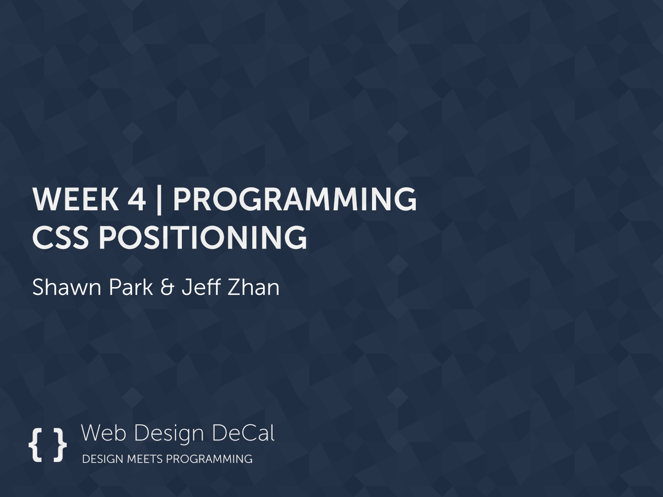

Slide 2

Review
We learned about the CSS Box Model. What are the 4 components of it?
Padding
Content
Border
Margin
Hello World!

Slide 3
Today’s Outline
CSS Positioning
CSS Floats

Slide 4
Goal Today:
To Structure your Web Pages
Even Better

Slide 5
CSS Positioning

Slide 6
CSS Positioning
4 types of positioning in CSS:
position: static
position: relative
position: absolute
position: fixed
By default, all your divs and elements are position: static

Slide 7
position: static
Default position, follows the natural flow of the page
Cannot use offsets: top, left, bottom, right

Slide 8
position: relative
Offsets element using position values (top, left, right, bottom)
Example: Set top to -10px, left to -10px

Slide 9
position: absolute
Element is moved relative to first non-static parent (default: top: 0, left: 0)
<div> is position
relative
<div> is position
absolute
Example: Set left to 10px, top to 5px

Slide 10
position: absolute
Element is moved relative to first non-static parent element
<div id=“container”>
<div id=“content”>
Hello World!
</div>
</div>
#container { position: relative; }
#content {
position: absolute;
top: 20px;
left: 20px;
}

Slide 11
position: absolute
If no non-static parent element found, move relative to <body>
<body>
<div id=“content”>
Hello World!
</div>
<body>
#content {
position: absolute;
top: 20px;
left: 20px;
}

Slide 12
position: absolute
Example of div relative to div relative to div (div-ception!!)
<div id=“container”>
<div id=“content”>
<div id=“inner-content”>Hello World!</div>
</div>
</div>
#container { position: relative; }
#content { position: absolute; top: 20px; left: 20px;}
#inner-content { position: absolute; top: 30px; left: 10px; }
#inner-content will be relative to #content
So in total, it is 50px from top of #container, 30px left of #container

Slide 13
position: absolute
<body>
<div id=“relative1”>
<div id=“relative2”>
<div id=“absolute1”> ….
What are possible top, right, bottom, left values for #absolute1?
#relative1
#relative2
#absolute1
<body>
#absolute1 is moved relative to #relative2.
So… bottom: 0, left: 5px (example)

Slide 14
position: absolute
<body>
<div id=“relative1”>
<div id=“absolute1”>
<div id=“relative2”> ….
What are possible top, right, bottom, left values for #absolute1?
#relative1
#relative2
#absolute1
<body>
#absolute1 is moved relative to #relative1.
So… top: 0, right: 0 (don’t even need to type px)

Slide 15
Demo

Slide 16
position: fixed
Element stays on the screen, even when scrolling. Positioned relative to browser window
<div> is position
fixed
Example: Set left to 10px, top to 5px

Slide 17
position: fixed
Element stays on the screen, even when scrolling. Positioned relative to browser window
<div> is position
fixed

Slide 18
Floats

Slide 19
Float
(ex: www.jsfiddle.net/r9M8Q)
What is a float?
They allow your elements to be part of the flow on the page
Second <div>
One <div>

Slide 20
Float
If you made one div position: absolute…
Overlapping
Position: absolute
One <div>

Slide 21
Float
(ex: www.jsfiddle.net/r9M8Q)
If you were to recreate the page with <div> elements set to display: inline-block…
Not efficient!

Slide 22
Float
(ex: www.jsfiddle.net/r9M8Q)
float
2 properties
float: left
float: right
Even if an element is a <div> or has display: block, float will essentially bypass these properties and act like display: inline-block, but automatically floating left or floating right
The following element will be next to the floated <div>

Slide 23
Float
(ex: www.jsfiddle.net/r9M8Q)
No floats, just <div>

Slide 24
Float
(ex: www.jsfiddle.net/r9M8Q)
First box, float: left

Slide 25
Float
One Use Case: Menus
Home
About
Experiences
Contact

Slide 26
Float
Floating Menu Items (each with set width)
Home
About
Experiences
Contact
Notice no gaps!
If you use display: inline-block for these 4 elements:
Home
About
Experiences
Contact
display: inline-block produces gaps on the sides

Slide 27
Float
If you use display: inline-block for these 4 elements:
Home
About
Experiences
Contact
display: inline-block produces gaps on the sides
Work-around:
Add margin-right: -4px
Or…
Awkward! Use margin-right: -4px, or floats!
<div>Home</div
>About</div >Experiences</div
>Contact</div>
<div>Home</div><!--
--><div>About</div><!--
--><div>Experiences</div><!--
--><div>Contact</div>

Slide 28
CSS Clear
clear
clear: both
Individually, clear: left and clear: right
If one element floats left, the following element will appear beside it
Use clear: both for the following element to break the float, so it appears below the floating element

Slide 29
CSS Clear
First box, float: left

Slide 30
CSS Clear
Second box, using clear: both

Slide 31
Summary
4 ways to position
static
relative
absolute
fixed
2 ways to float
left
right
All lecture material, handouts, and homework can be found at:
http://www.thewebdesignworkshop.co

