Slide 1


Slide 2

Review
We learned about 3 types of positioning.
How would you offset the green box 10px from the top & right of the blue box?
position: relative
position: static

Slide 3
Review
We learned about 3 types of positioning.
How would you offset the green box 10px from the top & right of the blue box?
position: relative
position: absolute
position: relative

Slide 4
Review CSS Positioning

Slide 5
Today’s Outline
CSS Pseudo Classes
HTML5
CSS3
Browser Compatibility
CSS Specificity
Extras

Slide 6
Goal Today:
Learn the latest trends &
wrap up HTML & CSS

Slide 7
CSS pseudo-classes

Slide 8
CSS pseudo-classes
Adds effects to your selectors
Syntax:
.selector:pseudo-class { …css styles … }
Ex: a:visited { … }, #box1:hover { … }
Common pseudo-classes:
:visited = Links you’ve visited
:active = Links when you click on them (happens in milliseconds)
:hover = When mouse is over element
:focus = When typing in the current <input> tag (we go over <input> tags later on)
Remember :hover! Most likely you will use this the most ;)

Slide 9
CSS pseudo-classes
:hover

Slide 10
CSS pseudo-classes
:active (happens briefly)
Click this Link
Click this Link
:visited
Click this Link

Slide 11
CSS pseudo-classes
:focus
Name:
Name:
Age:
Age:
Year:
Year:
Major:
Major:

Slide 12
HTML5

Slide 13

HTML5
Allows use of CSS3
New semantic tags: <header>, <footer>, etc.
Multimedia tags:
<video>
<audio>
Can now draw graphics with:
<canvas>
Combined with JS, you can also do:
Drag and Drop
Geolocation

Slide 14
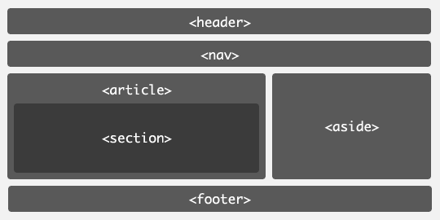
Semantic Tags
Semantic Tags
Just <div> tags, but with meaning
Easier to distinguish structure of a site

Slide 15
<video>
Great way to showcase videos you uploaded or video files on the web (non-Youtube videos)
Syntax:
<video width=“640” height=“480” controls> <source src=“clip.mp4” type=“video/mp4”> Browser does not support this </video>
2 lines inside <video>: Source tag & text, in case browser does not support HTML5 <video> (Chrome, Firefox, Opera, Safari, and IE9+ supports)

Slide 16
<video>
Syntax:
<video width=“640” height=“480” controls> <source src=“clip.mp4” type=“video/mp4”> Browser does not support this </video>
You can add attributes to <video> tag
controls = Shows play, pause, etc. buttons
autoplay
loop
muted

Slide 17
HTML5
Other HTML5 tags require Javascript
For now, know semantic tags + <video>
With Javascript:
Grab Geolocation
Draw Graphics on a Canvas
Do more with <video> and <audio>

Slide 18
CSS3

Slide 19
CSS3
Latest CSS version
Border-radius & shadows
Opacity
Animations & 2D/3D transformations
Gradients, text effects, etc.

Slide 20
border-radius
You can now round your 90 degree corners
Syntax:
border-radius: 10px;
You can also use percentages (up to 50%)
border-radius: 50%;
If your element is a square, this turns it into a circle. Why?
50%

Slide 21
box-shadow
Add shadow to your elements
Syntax (parentheses optional):
box-shadow: h v (blur) (spread) (color) (inset)
E.g.: 0 5px 5px #aaa;
Great for subtle effects and modals (e.g. Facebook Photo Viewer)

Slide 22
Opacity
Allows transparency of elements
Syntax (parentheses optional):
opacity: 0.5;
Values from 0 (invisible) to 1 (fully visible)
Important!
Not the same as display:none
display: none hides the element (takes no space on page)
opacity: 0 simply makes the element invisible (but still takes up space on the page)

Slide 23
Transitions
Move, scale, and change the color of elements (and lots more!)
Essentially changing from state 1 to state 2
Syntax:
transition: 0.2s;
Time is usually very short (<1s)
#box {
width: 100px;
height: 100px;
background-color: red;
transition: 0.2s;
}
#box:hover {
width: 200px;
height: 200px;
background-color: blue;
}

Slide 24
2D Transformations
Translate, scale, rotate, skew
Translate:
transform: translate(xvalue, yvalue);
E.g. transform: translate(10px, 80px);
Rotate:
transform: rotate(45deg);
Scale:
transform: scale(xtimes, ytimes);
E.g. transform: scale(2, 4);
Skew:
transform: skew(xdeg, ydeg);
E.g. transform: skew(10deg, 40deg);

Slide 25
3D Transformations
Translate, scale, rotate… but wicked!
Like 2D transforms… but with “3d”
Takes 3 args:
transform: translate3d(x,y,z);
transform: rotate3d(x,y,z, deg);
transform: scale3d(x,y,z);
Examples (3 args & 1 arg for specific):
transform: rotateY(45deg);
transform: scaleZ(2);
transform: scale3d(1,1,2);
transform: rotate3d(0, 1, 0, 60deg);

Slide 26
Demo

Slide 27
Browser Compatibility

Slide 28
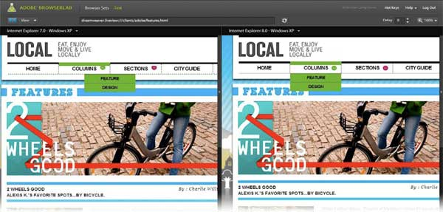
Browser Compatibility

Slide 29

Browser Compatibility
CSS3 led to browsers rendering websites differently
Cross-Browser Compatibility – Web Developers’ worst nightmare
The Big 5 Browsers:
Google Chrome
Mozilla Firefox
Apple’s Safari
Opera
Internet Explorer

Slide 30
Browser Compatibility
Some browsers use their own CSS styles
Vendor Prefixes
Add them to the beginning of CSS3 styles (border-radius, transitions, transform, etc.)
Chrome, Safari, and Opera (recently converted from -o-)
-webkit-
Ex: -webkit-border-radius, -webkit-transition
Firefox
-moz-
Ex: -moz-box-shadow

Slide 31
Browser Compatibility
Usually when using CSS3 styles (except opacity), use a trio of three CSS3 styles
Ex:
-webkit-border-radius: 3px; -moz-border-radius: 3px; border-radius: 3px;
Now, what about Internet Explorer?

Slide 32

Browser Compatibility
Internet Explorer is dreadful
Each version is different from another
IE6
No CSS3 Support
No top, left, right, bottom for position: absolute
IE8
First use of display: inline-block
IE9
First full support of CSS3
Uses –ms- vendor prefix
IE10 (most stable current release)
For most part, no longer need –ms- prefix

Slide 33
Browser Compatibility
Support IE with separate styles
Syntax:
<!-- [if lt IE9]> <link rel=…. href=“iestyles.css”> <![endif]>
Add after normal <link> tag
Extra
lt = less than
gt = greater than
lte = less than

Slide 34
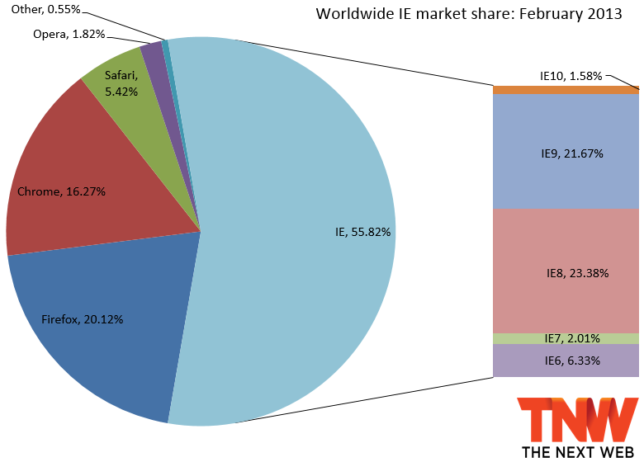
Browser Compatibility

Slide 35
CSS Specificity

Slide 36
CSS Specificity
Determines which CSS rule is applied (based on precedence)
If 2 selectors apply to the same element, 1 has higher precedence
IDs (#) more precedence over Classes (.)
<div id=“box1” class=“box”>
#box1 { … style is used over .box … }
Use spaces to signify parent-child relationship
<div class=“panel”> <div class=“title”>
.panel .title { … style is used over just .title … }

Slide 37
CSS Specificity
Precedence:
#panel1 > .panel
<div id=“panel1” class=“panel”>
<div class=“title”></div>
<div class=“body”>
<div class=“author”>
</div>
</div>
</div>
.panel .title > .title
#panel .title > .panel .title
#panel .body .author > .author
div.panel > .panel

Slide 38
Extras

Slide 39
Extras
Shorthands
margin: 0 auto;
= margin: 0 auto 0 auto;
= margin-top: 0, margin-left: auto, … etc…
background-color: #ff8800;
= background-color: #f80;
Comments
CSS
/* Multi-line comment */
// Single line comment
HTML
<!-- This is a multi-line comment in HTML -->

Slide 40
Extras
Combinations
#box1, #box2 { color: red; height: 80px; }
= #box1 { color: red; height: 80px; } #box2 { color: red; height: 80px; }

Slide 41
Summary
CSS pseudo-classes
HTML5
Semantic Tags & Video
CSS3
Border-radius & Box-shadow
Transitions & Transformations
Browser-Compatibility
Important for CSS3
Always use 3 CSS3 prefixes: -webkit-, -moz-, (regular)
CSS Specificity
All lecture material, handouts, and homework can be found at:
http://www.thewebdesignworkshop.co

Slide 42
Bonus Slides

Slide 43
CSS Specificity
Surprisingly, you can think of CSS specificity as a calculator
This calculator weighs 4 categories with different point values:
Inline Styles – 1000
E.g. <p style=“color: blue;”></p>
IDs – 100
E.g. #box, #title
Classes, attributes, pseudo-classes – 10
E.g. .panel, :hover, :focus
Elements & pseudo-elements – 1
E.g. img, h1, :after, :before, :first-line

Slide 44
CSS Specificity
Examples:
body #container .panel .title:hover
1 + 100 + 10 + 10 + 10 = 131
p a.mysite
1 + 1 + 10 = 12
Also note, that you can also attach class selectors to generic elements
E.g. a.mysite
This means “select the <a> element with the class mysite”

Slide 45
CSS3 Gradients
Gradients are easy to do with CSS3
Syntax:
background: linear-gradient(red, blue);
Simply add a color 1 and a color 2, and CSS will generate the transition from 1 to 2
background: linear-gradient(left, red, blue);
Add an optional direction if you like as the first argument
Starts from left, and goes right
background: linear-gradient(top left, red, blue);
Combine two directions (starts at top left)
background: linear-gradient(#f00, #0f0, #00f);
Multiple color stops
Also can use HEX colors or RGB

Slide 46

HTML Structure
Now that we are wrapping up HTML, you can hone in on “good structure” of a web page
Consider looking into Bootstrap or Foundation just to see how they structure their elements, or the 960 Grid system

Slide 47
CSS Structure
Same for CSS, it’s time to hone in on your CSS structure!
For the body selector, always add margin: 0 and padding: 0
This prevents the browser from using a default margin/padding for <body>
Allows your site to look the same across all browsers
Keep your CSS clean, avoid repetitive code chunks
E.g. h1, h2 { … same styles…} vs h1 {…} and h2 {…}
Test your CSS across browsers (eventually we will cover mobile)
Use @font-face to use custom fonts, but always have fall-backs
Keep @font-face, body, and important tags/dependencies at the top of your CSS file
Consider using LessCSS (lesscss.org) if you know coding
Allows use of variables (e.g. repetitive colors now 1 variable)

