Slide 1
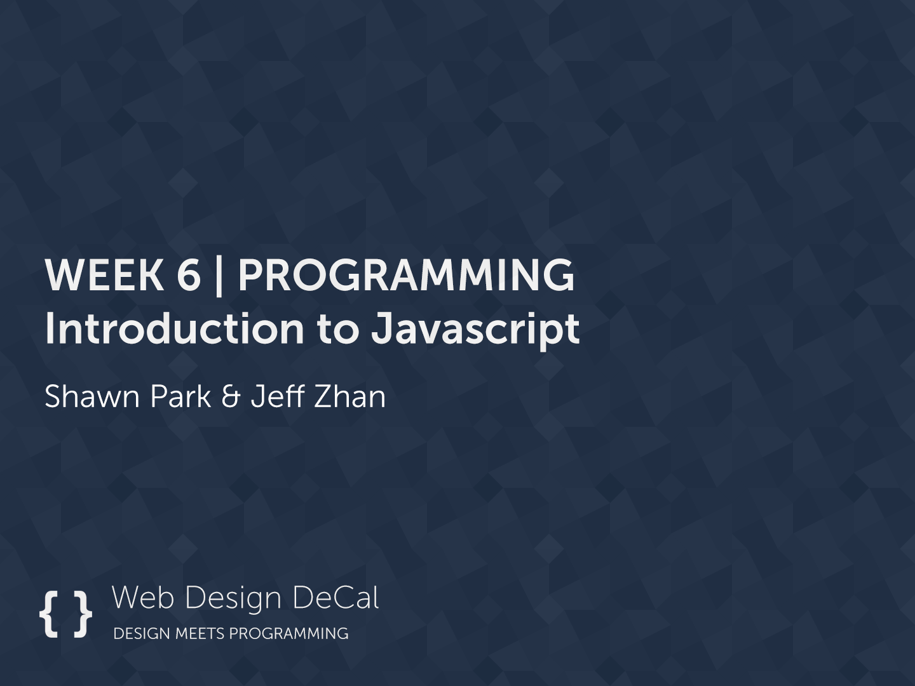

Slide 2


Today’s Outline
Intro to JavaScript
Basic Syntax
Conditional Statements
Loops

Slide 3
Goal Today:
Learning JavaScript

Slide 4
Intro to JavaScript

Slide 5
Intro to JavaScript
JavaScript is the scripting language of the web
Not the same as Java!
Like CSS, you can select elements and manipulate their actions
Hide/Unhide menus
Photo Slider (carousel)
Popup modals (like Facebook’s Photo Viewer)
Form Validation
One-Scroll Homepage

Slide 6
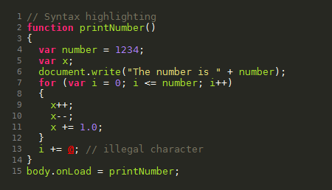
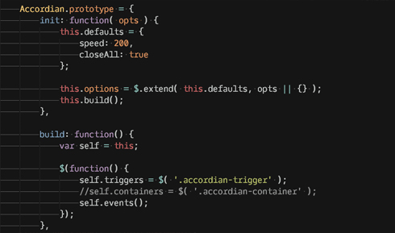
Intro to JavaScript
Sample JavaScript:

Slide 7
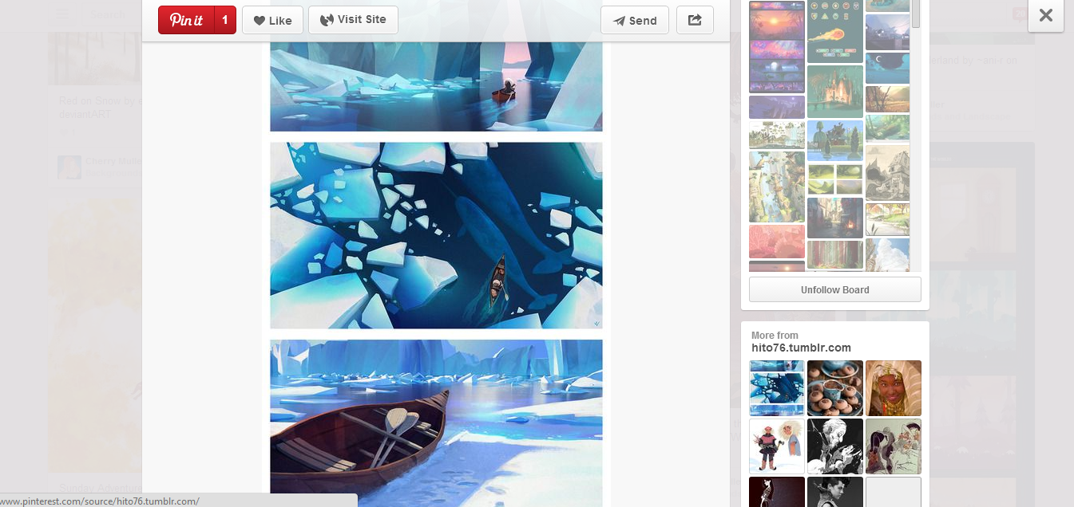
Intro to JavaScript - Examples
Pinterest - Modals

Slide 8
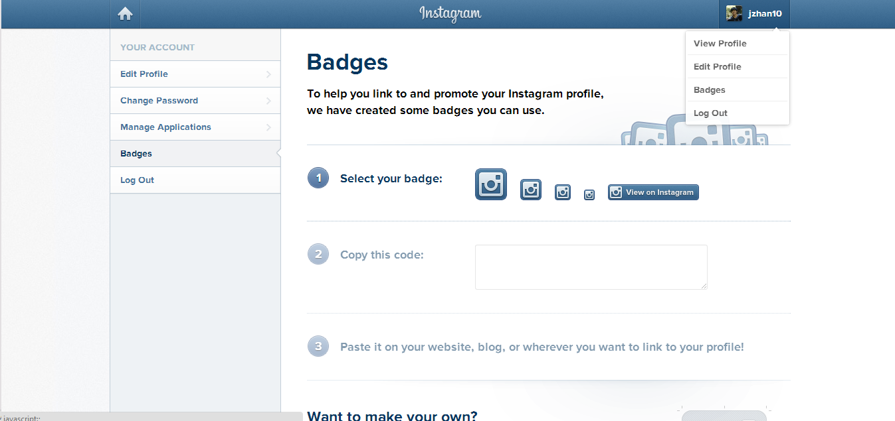
Intro to JavaScript - Examples
Instagram - Toggling Menus

Slide 9
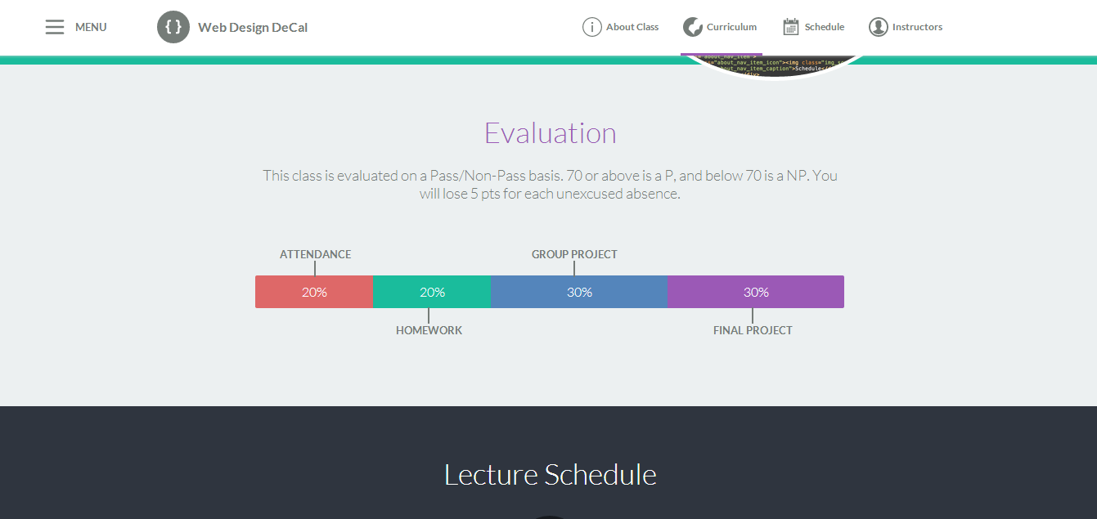
Intro to JavaScript - Examples
Decal Site – Menu Changes with Scroll

Slide 10
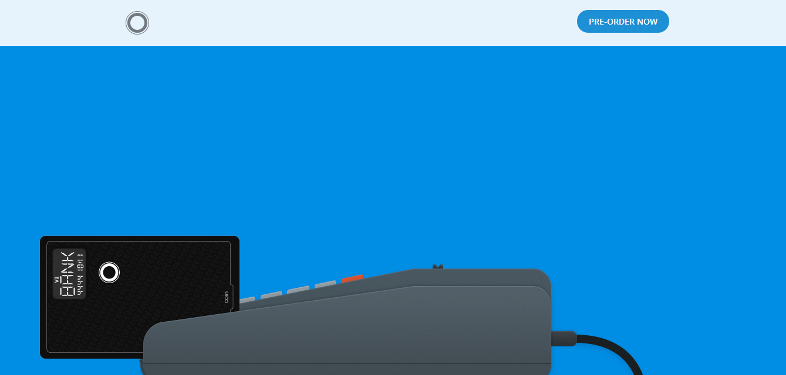
Intro to JavaScript - Examples
Coin – JavaScript animations while scrolling

Slide 11
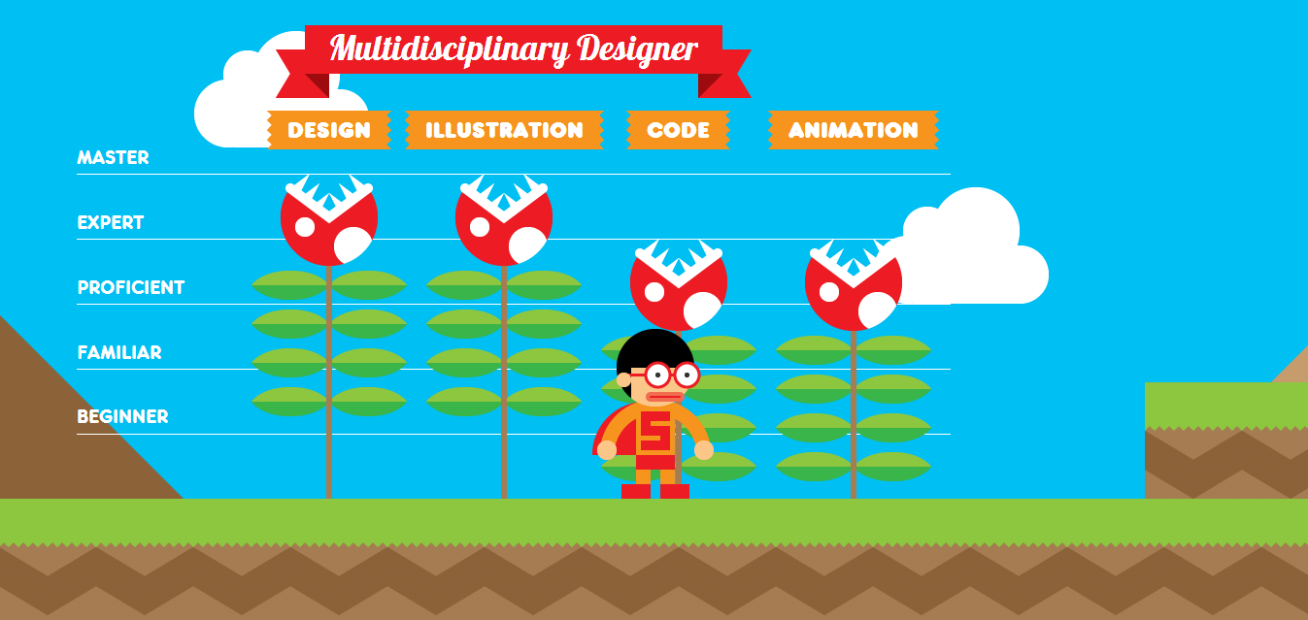
Intro to JavaScript - Examples
Interactive Resume (http://www.rleonardi.com/interactive-resume/)

Slide 12

Intro to JavaScript - Examples
GameTrailers – Photo Slider

Slide 13
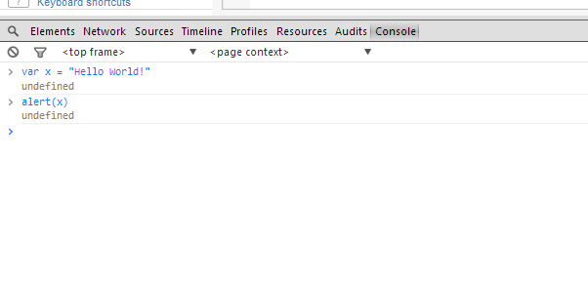
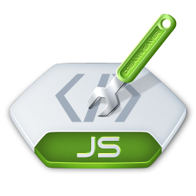
Intro to JavaScript
How to you use Javascript?
Like CSS, you link to a separate .js file that contains your file
<script type=“text/javascript” src=“home.js”></script>
You can also test JavaScript in Chrome’s console (Inspector Element window) and on JSFiddle.net
Let’s start coding!

Slide 14
Basic Syntax
Variables
They take in numbers, text, booleans (true/false) and functions
var x = 8;
var y = “John”
var z = ‘Smith’
var a = true;
Text (in computer science, we call them “strings”) can be surrounded by single or double quotes
Concatenation
You can add numbers or combine “strings”
var a = x + x;
var b = y + “ “ + z;
var c = 5 + “ five”;
“a” now stores 16. “b” stores John Smith.
Note: only use “var” to initialize (if the variable name has never been used before)

Slide 15
Basic Syntax
Shorthand increment/decrement
var x = 1;
x = x + 1;
// x is now 2
x += 1;
// x is now 3
x++;
// x is now 4
x--;
// x is now 3
To increment by 1, there are 3 ways:
1) x = x+1
2) x += 1
3) x++
Same goes for decrementing

Slide 16
Conditionals
If… Else…
If something do this, else do that
If(x > 9000) {
alert(“Over 9000!”);
} else {
console.log(“Weak”);
}
alert(…) is a JavaScript function that creates a popup.
console.log(…) outputs whatever is inside onto the console (e.g. Chrome’s console).
Both useful for debugging.
Plain If, and If…Else If… Else If…
if(z < 9000) {
alert(“Not Saiyan”);
}
if(z == 1000) {
…
} else if (z == 2000) {
…

Slide 17
Conditionals
Comparisons
<, >, >=, <=
== and === (3 equal signs checks value and type)
var x = 3;
x == 3 // true
x === “3” // false
x === 3 // true
And/Or - &&/||
if((x==3) && (y==5)) {
…
if(x || y) {
….

Slide 18
Conditionals
Not Equal - !=, !== (not same type too)
if(x != y) {
…
}
Remember, you can use ( ) parentheses to separate your logic. (e.g. if((x != 3) && (y != 4)) )

Slide 19
Arrays
Variables can also store more than 1 value
var x = new Array(“Porsche”, “BMW”, “Ferrari”);
or
var x = [“Porsche”, “BMW”, “Ferrari”];
or
var x = new Array();
x[0] = “Porsche”;
x[1] = “BMW”;
x[2] = “Ferrari”;

Slide 20
Arrays
Access an array with […]
First value is always the array position. Positions start at 0
var x = [“Porsche”, “BMW”, “Ferrari”];
alert(x[0]); // Will alert “Porsche”
Set values for an array
x[2] = “Tesla”;
You can get an array’s length with arrayname.length
x.length // returns 3. However, max position is 2, since we start at 0

Slide 21
Loops
For Loop
Loop through items/arrays
3 components
for(var i=0; i < 10; i++)
1st value initializes variable. i++ increments i by 1 after loop is complete. Loop while i < 10, and stop when condition is not met.
var cars = [“Porsche”, “BMW”, “Tesla”];
for(var i = 0; i < cars.length; i++) {
alert(cars[i]);
}
// alerts each value in cars, one by one

Slide 22
Loops
While Loop
Loop through items/arrays
1 component
while(i < 30) { … }
Initialize (var i = 0) before while loop, increment (i++) inside
var i = 0;
while(i < 30){
alert(i);
i++;
}
// alerts values 0 to 29
Warning!
If you don’t increment, or don’t fail the conditional statement at some point, you end up in a never-ending loop! Not good!

Slide 23
Loops
For vs. While
For loops are more compact
But while loops are fast to type
for(var i=0; i<100; i++) {
alert(i);
}
var i = 0;
while(i < 100) {
alert(i);
i++
}
Output: 0, 1, 2, … , 98, 99

Slide 24
Loops
For In Loops
For loops designed for arrays
var states = [“New York”, “Florida”, “Texas”, “California”];
for(state in states) {
alert(state);
}
Always in format “... In …”. First value is the current element in the array, starting from position 0, and loops through the array 1 by 1. Extremely popular and useful!

Slide 25
Functions
Functions are a set of JavaScript code, that can perform some action, return a result, or do computation
They take in 0 or more arguments (values to be passed in)
Arguments are by default type var, so arr can be any var
function printOddValues(arr) {
var odd = true;
for(element in arr) {
if(odd){
console.log(element+” “);
odd = false;
} else {
odd = true;
}
}
}
Once you have a function, you can call it!
var arr = [1, 2, 3, 4, 5, 6, 7];
printOddValues(arr);
Output: 1 3 5 7
var arr = [“OH”, “CA”, “PA”, “NY”];
printOddValues(arr);
Output: OH PA

Slide 26
Functions
Functions can return values, and you can save them in a variable (for future use)
function calculateExp(value, times) {
if(times < 0) {
return -1;
} else if(times == 0) {
return 1;
} else {
var count = 1, total = 0;
while(count <= times) {
total += value;
}
return value;
}
}
Let’s call this function!
var x = calculateExp(5, 3);
alert(x);
Output: 125
var x = calculateTimes(10, -999);
if(x != -1){
alert(“No neg nums please”);
}
Output: “No neg nums please”

Slide 27
Demo

Slide 28
Summary
Syntax
var takes in numbers, strings, booleans, and functions
Conditionals
Loops
for & while
Functions
Set of JavaScript code
Accessing HTML
getElementById
getElementsByClassName
All lecture material, handouts, and homework can be found at:
http://www.thewebdesignworkshop.co

Slide 29
Bonus Slides
(for those eager to start jQuery early)

Slide 30
jQuery
Functions and variables are cool… but can we do more with JavaScript?
jQuery, a JavaScript library, comes in handy!
jQuery allows you to access HTML elements and do all sort of things!
Click events
Keyboard presses
Scrolling animations
Modal popups
Toggling menus
Smoother hovers and animations
Etc.

Slide 31
jQuery
How do we add jQuery to our page?
Either insert the first element below, or download the jQuery .js file and link to it
Important! Add this before any links to your own .js files!
<script src="http://code.jquery.com/jquery-1.11.0.min.js"></script>
Above: Link to an online copy of jQuery
<script src=“assets/js/jquery-1.11.0.min.js"></script>
Above: Link to a local copy of jQuery

Slide 32
jQuery
Initializing jQuery
Now that we linked to the jQuery library, we can use it in our own .js files
To start using jQuery, use the following syntax:
$(document).ready(function(){
… your javascript here …
});
$ - Calls the jQuery library
(document) – Selects the entire HTML page
.ready – When all the HTML is loaded…
function(){ … } – …do everything inside this function

Slide 33
jQuery
Sample
$(document).ready(function(){
function add(x, y) {
return x + y;
}
var total = add(3, 4);
alert(total); // should open a popup with the number 7
});

Slide 34
jQuery
The heart of jQuery is accessing HTML elements
Like $(document), we use this same syntax $(…)
Except in …, we replace with the element’s CSS selector
Example:
$(‘body’)
$(‘.box’)
$(‘#container .box’)
$(‘a’)
Essentially you use put in CSS selectors, wrapped in quotes, into $(…) to select an element
Once you select an element, you can access different values, properties, or functions to the element

Slide 35
jQuery – Accessing Content
3 common ways to access element content
.text() – Grabs all text inside an element
.html() – Grabs all HTML inside an element
.value – Grabs the value attribute or an element (useful for inputs)
<div id=“box”>
<div class=“title”>
Hello World!
</div>
</div>
$(‘#box”).text() → Hello World!
$(‘#box”).html() →
<div class=“title”>Hello World!</div>
You could test the above using console.log($(‘#box’).text()) or alert($(‘#box’).html());

Slide 36
jQuery – Accessing Content
Value
Useful to get search results, form input, etc.
<input type=“text” id=“name”>
$(‘#name”).value → Jeff
Jeff
Note: Not only can you get values, you can also set them, using =
E.g. Set new HTML: $(‘#box’).html(‘<p>Yo</p>’);
Set text in input box: $(‘#name’).value = “Billy”;

Slide 37
jQuery – Event Listeners
Event Listeners are always on the page, “listening” for an event to occur (and react to these events)
Events include:
Clicking
Key presses
Scrolling
Hovering (smoother than CSS)
Tons more

Slide 38
jQuery – Event Listeners
Event Listeners are attached to jQuery selected elements
E.g. $(‘#box’).click(function() { … });
Syntax:
.click(function(){ … });
.hover(function(){ … });
.ready(function(){ … }); // Remember this one?
Always pass a function(){ … } to an event listener! (event handlers)
$(‘#box’).click(function(){
alert(“You are so cool.”);
});
Browser binds click event to #box. It continues to “listen” as user is on page, and when user clicks on #box, a popup will appear!

Slide 39
jQuery – Event Listeners
More examples
$(‘#box’).hover(function(){
alert($(this).html());
});
Inside your event listener function, you can refer to the current element (say #box) with simply $(this).
$(‘.box’).hover(function(){
alert($(this).html());
});
This hover now applies to all class box. $(this) only refers to the element you hovered on, not to all elements with class box!
$(‘.box’).click(function(){
$(this).html(‘Replacing’);
});
Click on any element with class .box, and you replace all HTML code inside the element with the text ‘Replacing’;

Slide 40
jQuery – Event Listeners
Other useful events:
.toggle(function(){ … }, function(){ … });
Essentially click, but clicking once does one thing, clicking again does another
Useful for toggling menus
$(‘#menu-icon’).toggle(function(){
$(‘#menu’).show();
}, function(){
$(‘#menu’).hide();
});

