Slide 1
The Agile Inception Deck

Slide 2
streak_keeper
Notes:
Project name – pick a cool sounding name for your project
Sponsors – list your project sponsors here (the people with the money)
Putting your sponsors name boldly out there for all to see is a great way to get their engagement and attention (necessary for any successful project).

Slide 3

Why are we (am I) here?
To visualize my working time
To embed message committing when finished with the task
Let it keep time
To reduce work-time of workers
<#1 reason for doing this project>
Notes:
Write down all the reasons why your company would want to spend money on this project in the first place.
Then pick and highlight the most important one.

Slide 4
The elevator pitch
For [anyone who wants to keep track of their learning time]
who [wants to see the time they’ve spent in their study]
the [streak_keeper]
is a/an [application]
that [tracks time they’ve studied, what they did, and motivates learners how much they were able to study].
Unlike [google ToDo]
our project [it will alarm to break after studying for a set amount of time].

Slide 5
Product box
streak_keeper
<Stressless, Fast, Cool>
> Keep tracks of your work
> Reminds you to take break
> Motivates you by showing how much you’ve worked
Notes:
If you could walk into a store, and buy the shrink wrapped version of your software, what the design of the box look like and what would it say?
Point here is to get your team looking at your project through the eyes of your end customer.

Slide 6
The NOT list
IN | OUT
Visual graph
Timer
Work message commit
UNRESOLVED
Notes:
List all the big ticket items you are (and are NOT) going to deliver within the scope of this project.
Before starting your project move all the UNRESOLVED ones to either IN or OUT.

Slide 7



Your project community
<community#3>
Your core team
<team#2>
<group#1>
Everyone else !
... is always bigger than you think!
Notes:
List everyone you are going to have to interact with at some point during the course of your project.
Goal is to start building relationships with these people and let them know we are coming down the tracks (before we actually get there).

Slide 8







Technical solution
JavaScript
PostgreSQL
Rust
Message Data
Web Application
- Visual
- User Inputs
Time Data
Technologies:
<JavaScript, SQL, Rust(maybe)>
<libraries -> TBD>
<PostgreSQL>
My question is:
Will I have both the executable and database on a rental server, running 24/7?
Notes:
This is about letting people know how we plan on building this thing.
If there are any tools or libraries assumptions you are making list them here.
Also if there are areas of the application architecture that are risky highlight those too.

Slide 9
Technical solution
Notes:
This is about letting people know how we plan on building this thing.
If there are any tools or libraries assumptions you are making list them here.
Also if there are areas of the application architecture that are risky highlight those too.

Slide 10
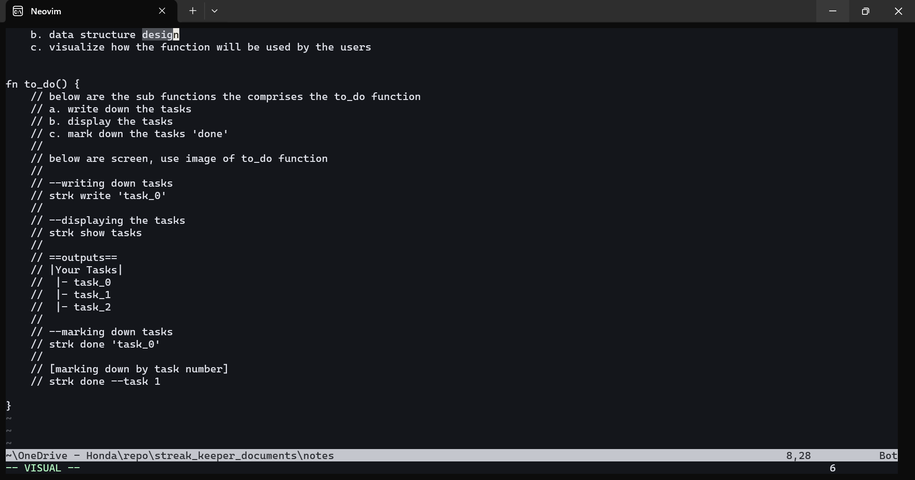
fn to_do () { }
Notes:
This is about letting people know how we plan on building this thing.
If there are any tools or libraries assumptions you are making list them here.
Also if there are areas of the application architecture that are risky highlight those too.

Slide 11



Technical solution
Technologies:
<JavaScript, SQL, Rust(maybe)>
<libraries>
<PostgreSQL>
<technology>
Danger!
Out of scope
Notes:
This is about letting people know how we plan on building this thing.
If there are any tools or libraries assumptions you are making list them here.
Also if there are areas of the application architecture that are risky highlight those too.

Slide 12

What keeps us up at night
<scary thing #1>
<scary thing #2>
<scary thing #3>
Notes:
This is your chance to call out any craziness you’ve heard while building the deck, and having a frank conversation with your sponsors and your team about how you are going to handle it.
This is perhaps on of the most powerful slides in the deck – it’s your chance to ask for whatever you need to be successful and the consequences if you don’t get it.
Use it!

Slide 13
The A-Team
# | Role | Competencies/Expectations
1 | Analyst | Comfortable with just-in-time analysis. Likes to test. Comfortable with rapid iterative development.
2 | Developers | C#, MVC.NET, jQuery, SQL Unit testing, refactoring, TDD, continuous integration
0.5 | Project manager | Responsible for outward facing communication Status reports, scope, budget, and reporting upwards
Notes:
Set expectations around who you are going to need and what kind of skills they will need to have to pull this off.
Use names if specific people are important (i.e. Billy is the only guy who can do X).

Slide 14

How big is this thing?
Ship it!
Construction
UAT
Training
~3months
1 wk
1 wk
This is a guess. Not a commitment.
Notes:
Give your sponsors some idea of how big this thing is (1, 3, or 6 monther).
Before you can complete this slide you and the team should create and estimate a high-level story list for the project.
This isn’t a commitment (too many unknowns). It’s just a really rough guess. Don’t treat it as anything else.

Slide 15
Trade-off sliders
 | The classic four
 | Feature completeness (scope)
 | Stay within budget (budget)
 | Deliver project on time (time)
 | High quality, low defects (quality)
OFF
ON
OFF
ON
OFF
ON
OFF
ON
 | Other important things
 | Ease of use
 | Don’t make me think!
 | Detailed audits (log everything)
 | <insert yours>
OFF
ON
OFF
ON
OFF
ON
OFF
ON
Notes:
When push comes to shove, something has to give. Here we want to be clear on what that is.
On agile projects we flex on scope. But there could be others factors at play here so get ready to listen as you customer tells you which forces can bend (scope) and which are written in stone (usually budget).
Slider rules:
1. No two sliders can occupy the same level.
2. List other important project factors down below.

Slide 16

The first release
Ship it!
Construction
UAT
Training
~3months
1 wk
1 wk
1 person, 3 ½ months
Notes:
Stakeholders are usually interested in two things:
How much is this going to cost.
When is it going to be done.
Here we do our best to answer those two questions so they can decide if the project is still worth doing by showing them what it’s going to take.

Slide 17

Learn more
http://agilewarrior.wordpress.com
Buy the book!
Twitter:
@jrasmusson
Notes:
That’s it! Create your deck.
Put it somewhere visible for all too see.
And update it when things change.
Good luck!

