Slide 1
Analyzing Goodreads
David Holland
CS-4412 W01 Spring 2026
Kennesaw State University
April 30th, 2026

Slide 2
Table of Contents
Introduction
Discovery Questions
Discovered Patterns
Approaches used
DQ1, DQ2, DQ3
LDA Analysis
Results
Validity
Limitations
Questions
Conclusion

Slide 3
Introduction
Our team analyzed the 2017 UCSD Goodreads dataset.
This data was scraped from public user data on the Goodreads.com website
The dataset contains three groups of data: meta-data of books, public shelves, and users’ detailed book-reviews.
Contains over 2,360,655 books (400,390 book series)
876,145 users (112,131,203 reads and 104,551,549 ratings)

Slide 4
Discovery Questions
DQ1: What are the hidden associations between specific book genres and user-defined "shelves"? (Do readers of "Romantasy" (Romance Fantasy) also show high interest in other genres like fantasy?
DQ2: Can we identify distinct Reader Personas based on interaction metrics? By clustering users based on their average rating variance, review frequency, and review length our goal is to discover if it is possible to classify readers into different groups?
DQ3: What type of patterns emerge from highly-voted reviews compared to low-voted ones?

Slide 5
Discovered Patterns
DQ1: The FP-Growth algorithm did not find any strong association rules linking “Romantasy” or other related genres. We assume that readers who tag books with “Romantasy” treat it as a standalone category only a descriptive category
DQ2: We were able to group readers into 4 different groups: Harsh consumer, Generous consumer, Powered reader, and standard reviewer
DQ3: Analyzed engagement with reviews and relevance in the community. We discovered that longer reviews and star ratings do not correlate with higher community engagement

Slide 6
Approaches used
FP-Growth algorithm: Treating user’s shelves as transaction to discover rules with high-lift and confidence to identify relationships between genres
K-means clustering: Used to answer DQ2. Apply on standardized numerical features
Latent Dirichlet Allocation (LDA): Allow us to discover patterns within user’s reviews and try to find community engagement

Slide 7
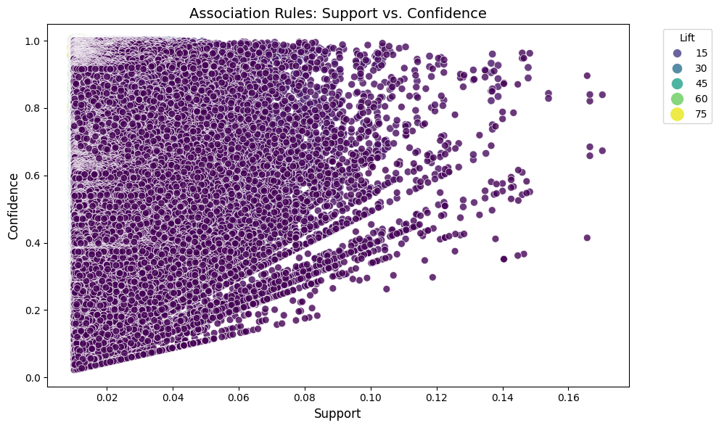
Discovery Question 1
Our initial hypothesis for the first discovery question was proven to be false. The FP-Growth algorithm we created did not find any strong association rules linking Romantasy genres to other categories.
Readers do not typically engage in cross-pollination and only use it as a descriptive tag.

Slide 8
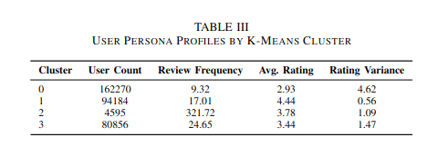
Discovery Question 2
  A K-Means analysis was created to group readers together in four different groups based off their activity on the site.
  Cluster 0 Harsh Consumer: Third largest reading group but group with least amount of read books. Usually finds a 5 star book or more likely hates what they read
  Cluster 1 Generous Consumer: Biggest reading group; Only rates books occasionally but rates books highly and rarely rates them any lower.
  Cluster 2 Powered reader: Smallest reading group; Averages a review every single day and reviews the most books and firm in ratings
  Cluster 3 Standard reviewer: Second biggest group. Tend to be more active than cluster 1. Reviews a lot of books with little impact to the reader

Slide 9
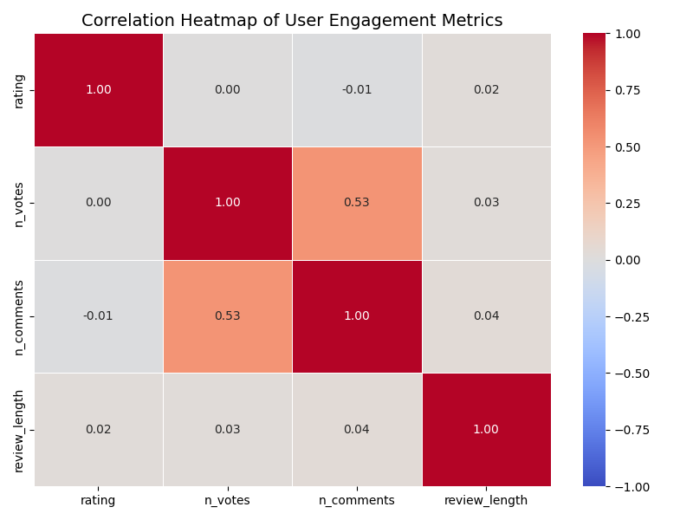
Discovery Question 3
Examined what patterns emerge from highly up-voted reviews compared to low engagement reviews.
Our Pearson correlation analysis disproved our hypothesis our team discovered that while social interactions tended to scale together they were driven by factors other than the review

Slide 10
LDA Analysis
As discussed for DQ3, our team could not find a correlation as to what drove user engagement so our team analyzed the reviews deeper using a Latent-Dirichlet Allocation
We analyzed 3 distinct themes that drove community interaction on Goodreads
Analytical Critique: Reviews focusing on world-building and pacing of the books. Suggests these reviews were popular and favored more
Emotional Reactionaries: Reviews focused on feelings specifically mentioning “book hangovers” and crying after finishing. These readers loved the book so much they couldn’t get over it.
Administrative / ARC disclaimers: Interesting one. Theses readers were mainly bloggers or disclosed that they received Advanced Reader Copies before the book launched

Slide 11
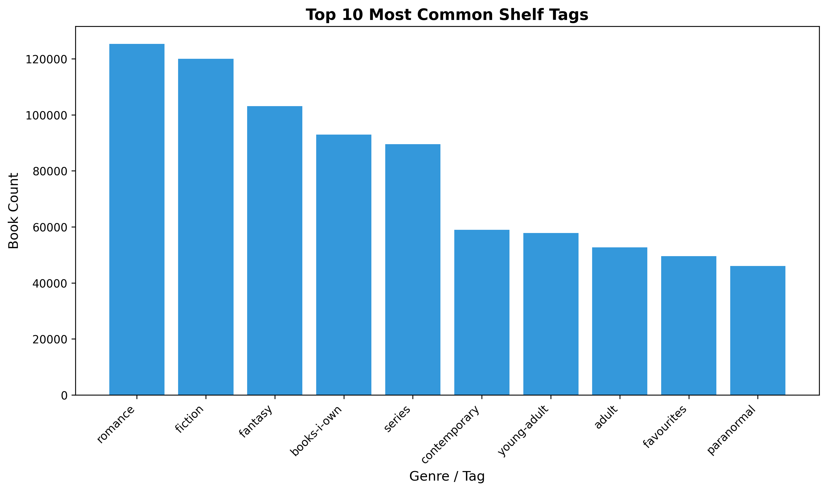
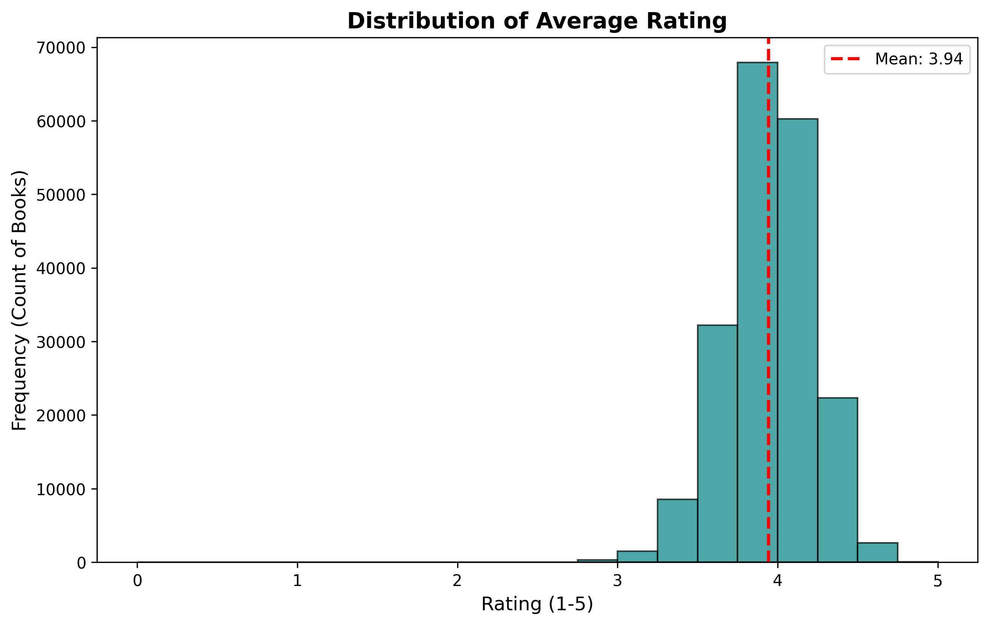
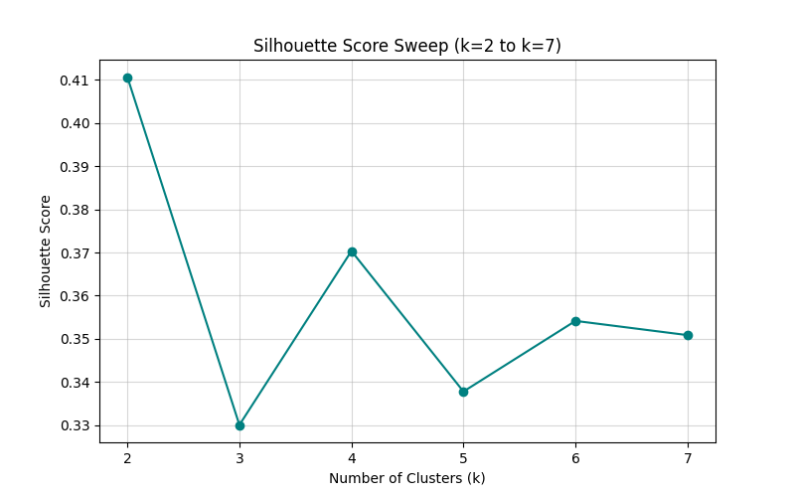
Results

Slide 12
Validity
Our team relied on the Elbow method and silhouette scores of 0.50 to show that the 4 clusters of reader groups found during the K-Means analysis are statistically significant
Our LDA analysis explains our findings from our Pearson corelation tests

Slide 13
Limitations
The UCSD Dataset was from 2017 so while it is recent enough to get a good picture of the current landscape
2017 was on the tail end of the “YA Dystopian craze”
The 2020 Pandemic created a bunch of new readers and exploded the popularity of “Enemies to Lovers” and other Fantasy romance genres.
If there was another dataset created our team expects our results to be significantly different

Slide 14
Conclusion
Our team successfully analyzed the 2017 UCSD Goodreads dataset that examined the different type of readers and user interactions on the site.
Our team were able to describe different types of readers and what drove them to reviews.
We suspect that authors could use our work in help writing their own books to make their own books more successful.

Slide 15
Questions
How confident am I that these patterns are real?
What would I do differently with more time or data?
  Find a newer dataset, the 2020 Pandemic saw a increase in readers and massive popularity boom for Fantasy and “Romantasy”. We suspect our results would vary significantly if there was a dateset made around 2021.
How confident am I that this pattern is real and not an artificial?
  Size of the dataset, booktubers, etc...

