Slide 1
Crystal Vorster
Project 1
Website Development
IVWD206

Slide 2
My application is :
A Mix-and-Match memory card game with pixelated animals.
The game was created by me on Visual Studio Code.
The animals were created by me on Corel draw.

Slide 3
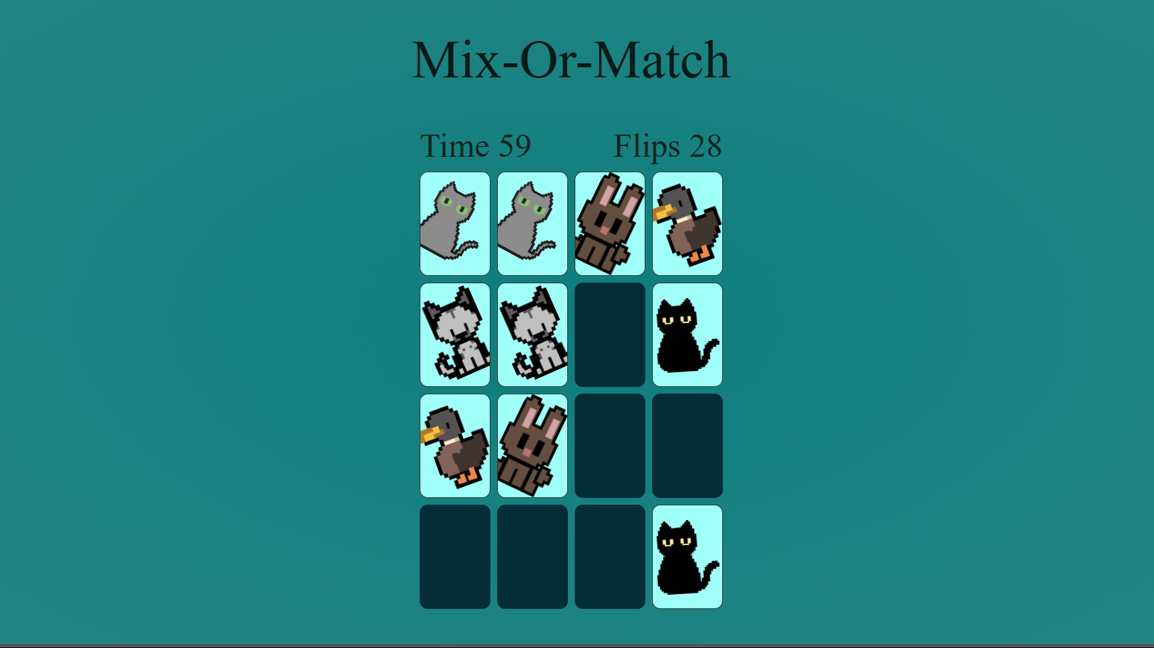
The look:

Slide 4








The cards :

Slide 5
The cursor :

Slide 6
The coding:
I used a HTML document for the photos and to create a home page where the game will be displayed.
I used a CSS document for the layout and the movement of the cards.
Lastly, I used a JavaScript document to calculate the cards , if it a match or not and if they have everything correct. I also added a timer.

Slide 7
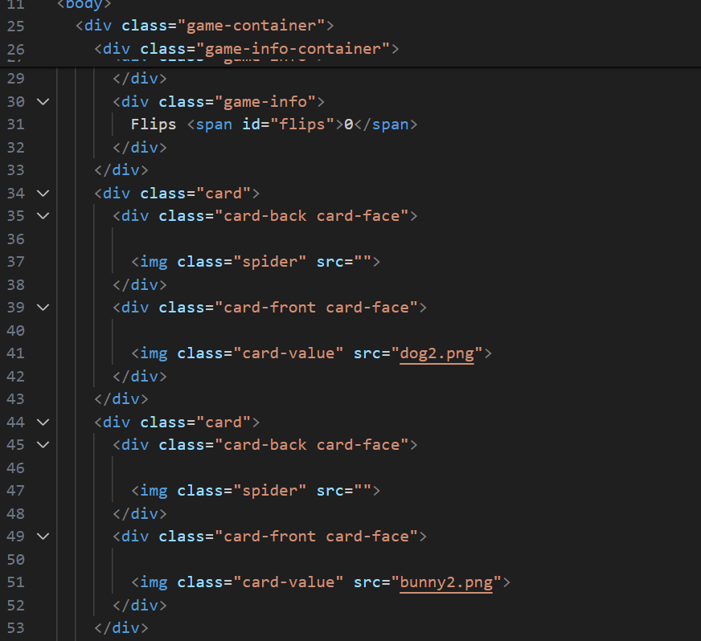
HTML:

Slide 8
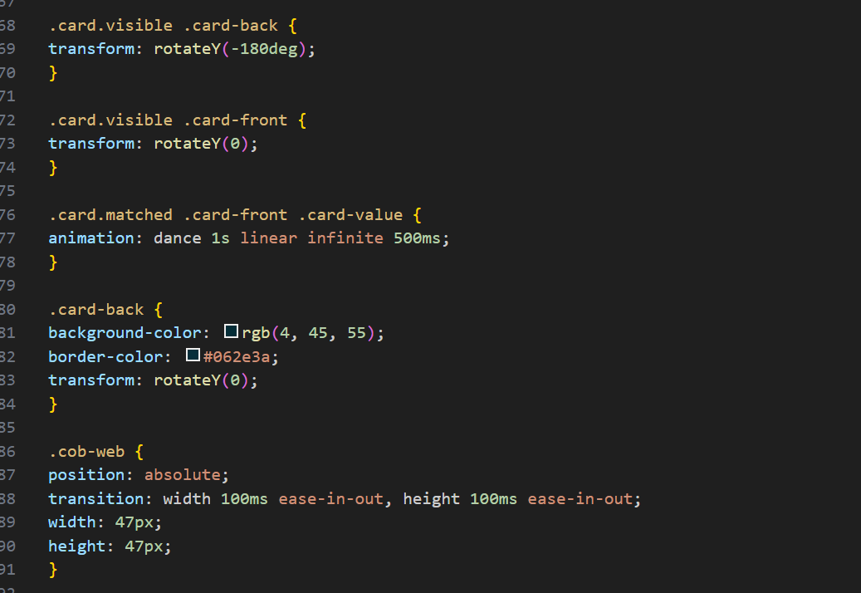
CSS:

Slide 9
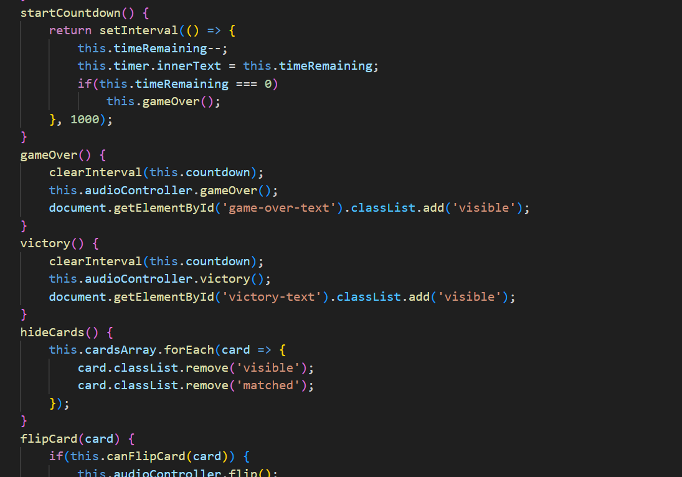
JavaScript:

Slide 10
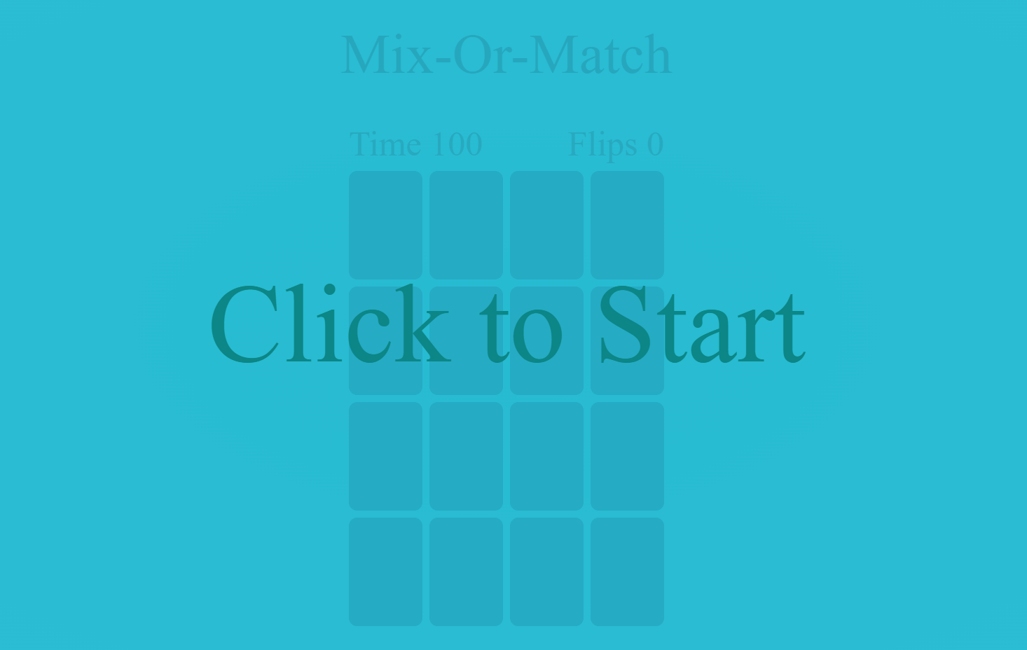
START:

Slide 11
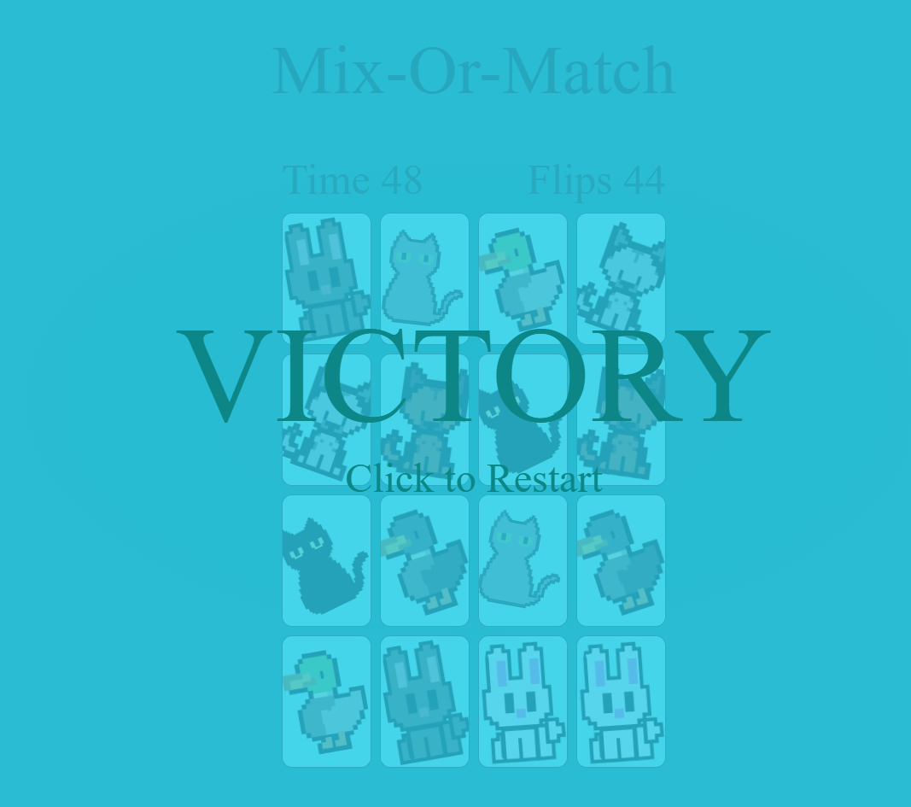
VICTORY:

Slide 12
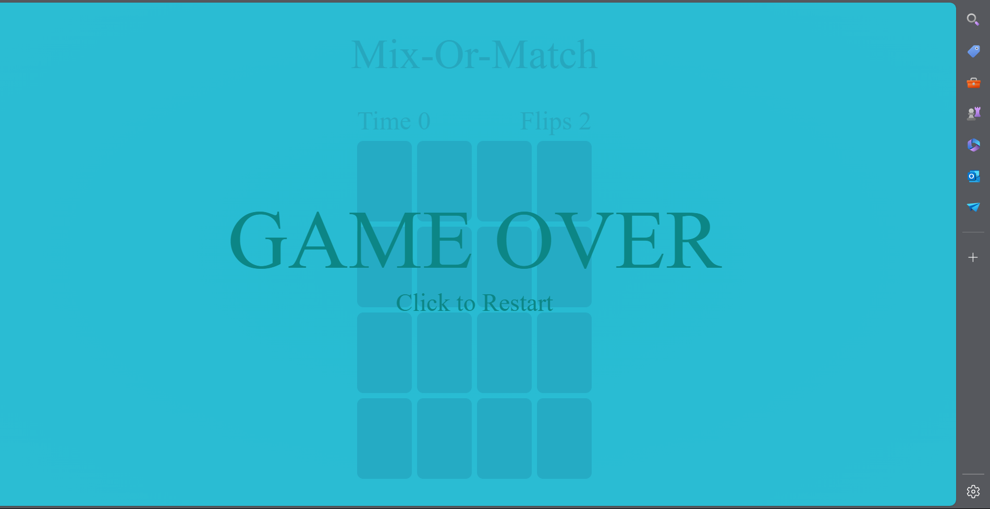
GAME OVER:

Slide 13

Thank you.

