Slide 1

Installing and Configuring Tomcat

Slide 2
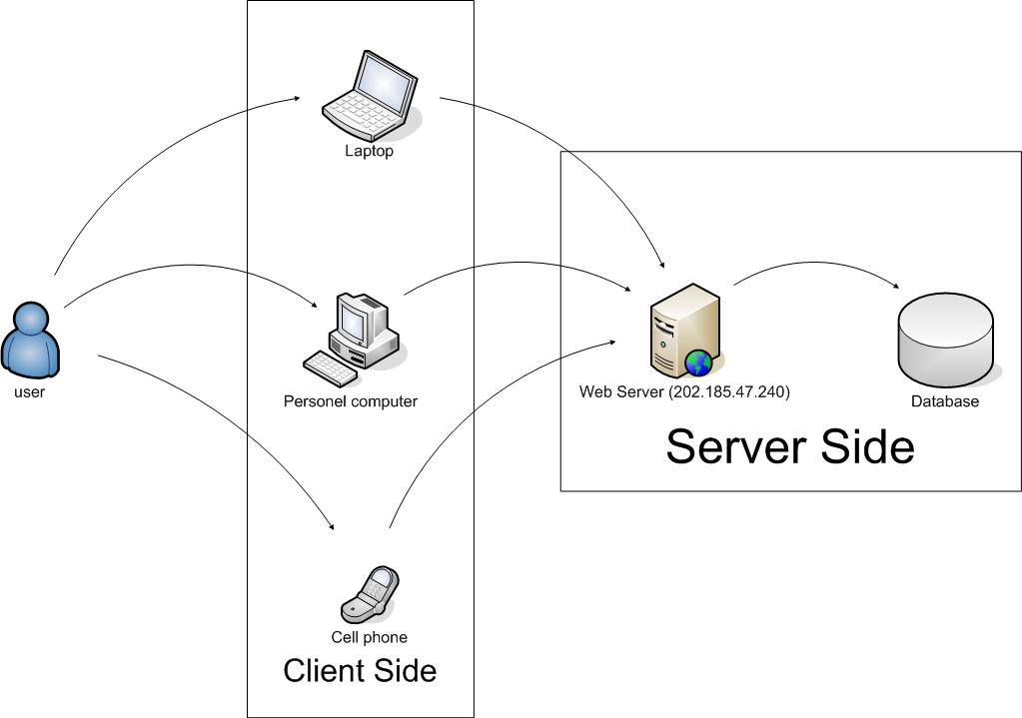
Architecture.

Slide 3
Typical html Request/Response cycle
1. requests URL for html page
2. retrieves
html page
client
server
3. sends html page to client
4. browser interprets
html page & displays

Slide 4
The Apache Jakarta Project
The Apache Jakarta Project “creates and maintains open source solutions on the Java platform for distribution to the public at no charge”
Apache Jakarta Tomcat--or just “Tomcat”--is one of those projects
Tomcat is a container for servlets
  Tomcat can act as a simple standalone server for Web applications that use HTML, servlets, and JSP
  Apache is an industrial-strength, highly optimized server that can be extended with Tomcat

Slide 5

The Java Virtual Machine.
Traditionally, source code had to be compiled for the target hardware and OS platform:
Windows
Compiler
i386 binary
Solaris
Compiler
Source.cpp
SPARC binary
Mac
Compiler
PPC binary

Slide 6
The Java Virtual Machine.
Java source files (.java) are compiled to Java bytecode (.class)
Bytecode is interpreted on the target platform within a Java Virtual Machine
i386 VM
Java
Compiler
Java
Bytecode
Source.class
Source.java
SPARC VM
PPC VM

Slide 7

Java VM Responsibilities
The Java VM does more than interpret bytecode:
  The class loader loads appropriate java classes. Possibly from the network.
  All classes are verified to contain only legal bytecodes and not permitted any illegal stack or register usage.
  A SecurityManager can limit access to resources such as the local file system or the network.
  Any unreferenced memory (Objects) are returned to the system by the Garbage Collector thread.
Many database servers, application servers, web servers and browsers contain a Java virtual machine
  eg: Oracle, Tomcat (web server), WebSphere (app server), BEA Weblogic (app server), and Netscape and IE.

Slide 8
The Java Software Development Kit (SDK)
The Java SDK comes in three versions:
  J2ME - Micro Edition (for handheld and portable devices)
  J2SE - Standard Edition (PC development)
  J2EE - Enterprise Edition (Distributed and Enterprise Computing)
The SDK is a set of command line tools for developing Java applications:
  javac - Java Compiler
  java - Java Interpreter (Java VM)
  appletviewer - Run applets without a browser
  javadoc - automated documentation generator
  jdb - Java debugger
The SDK is NOT and IDE (Integrated Development Environment)
  Command line only. No GUI.

Slide 9
Setup Environment
I will assume everyone will be using Windows.
Also make sure you have the Java SDK installed on your PC.
  The SDK includes the java compiler and some other tools as well as the runtime environment.
  You need the compiler to run tomcat.

Slide 10
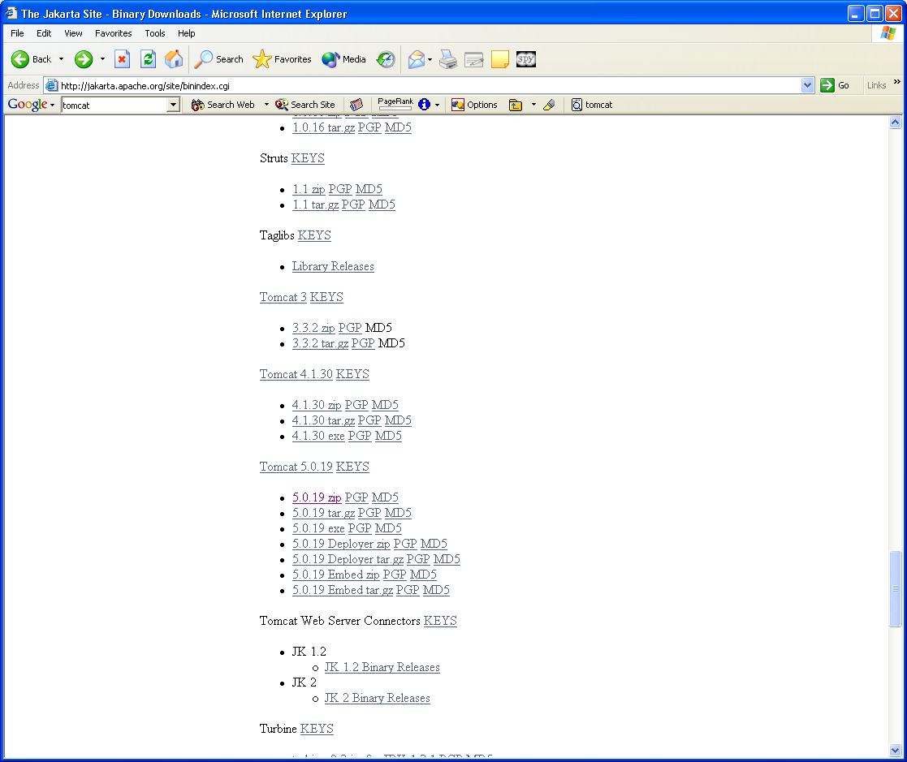
Installing Tomcat
Go to the Jakarta binaries web site:
  http://jakarta.apache.org/site/binindex.cgi
Click the link for 5.0.19.zip.
  Right click and save to your desktop

Slide 11
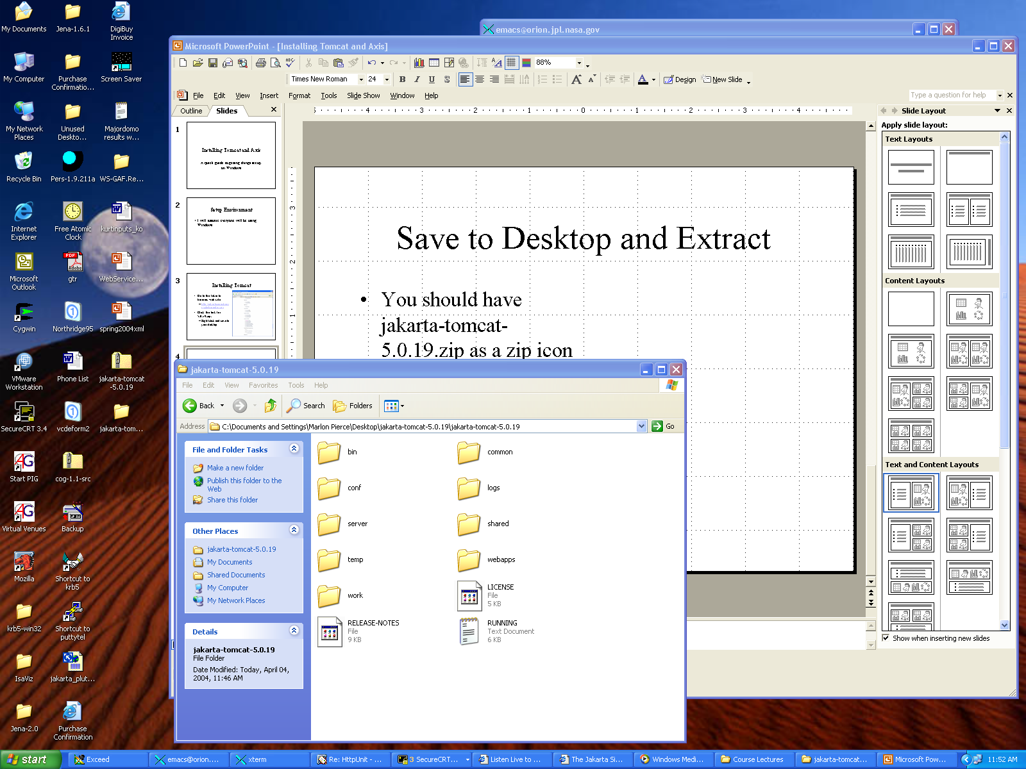
Save to Desktop and Extract
You should have jakarta-tomcat-5.x.zip as a zip icon on your desktop.
Right click and choose
“Extract All”.
This will create a jakarta-tomcat-5.x folder also on your desktop.

Slide 12
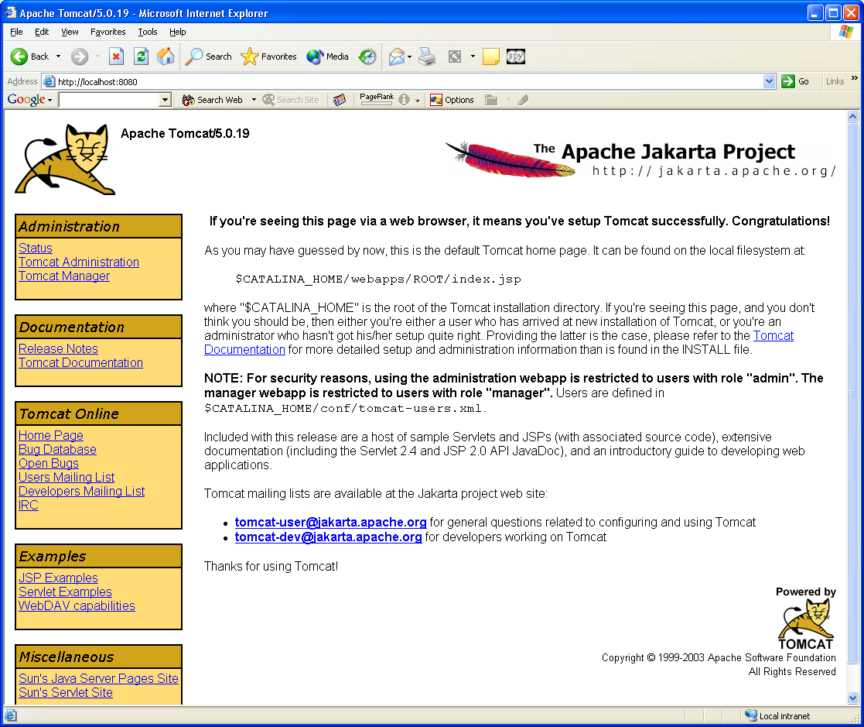
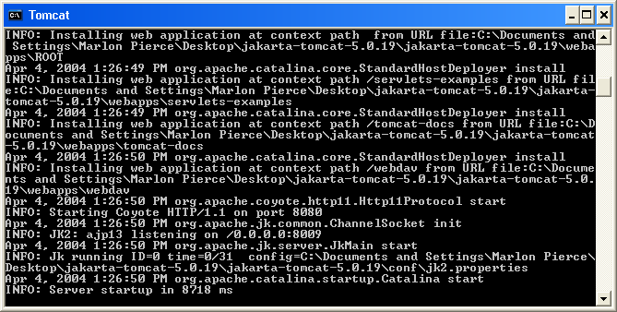
Running Tomcat
In the Tomcat folder, open the bin folder.
Click the startup.bat icon.
You should see a black and white Java command window.
  You should not see any obvious java error messages.
Open your browser and point to http://localhost:8080.
  You should see the Tomcat welcome page.
Note startup.bat actually calls other scripts in the same directory (catalina.bat, particularly).
The .sh files are for running Tomcat on Linux/Unix
  Maybe Mac also.

Slide 13
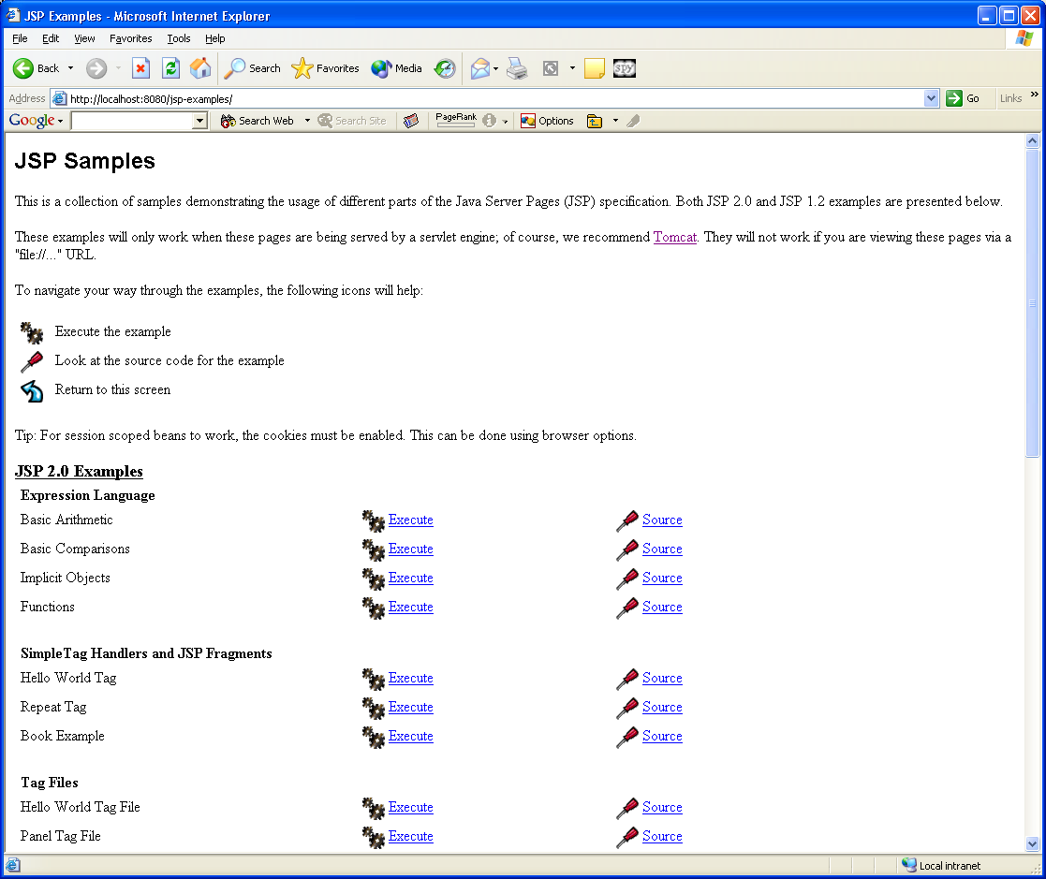
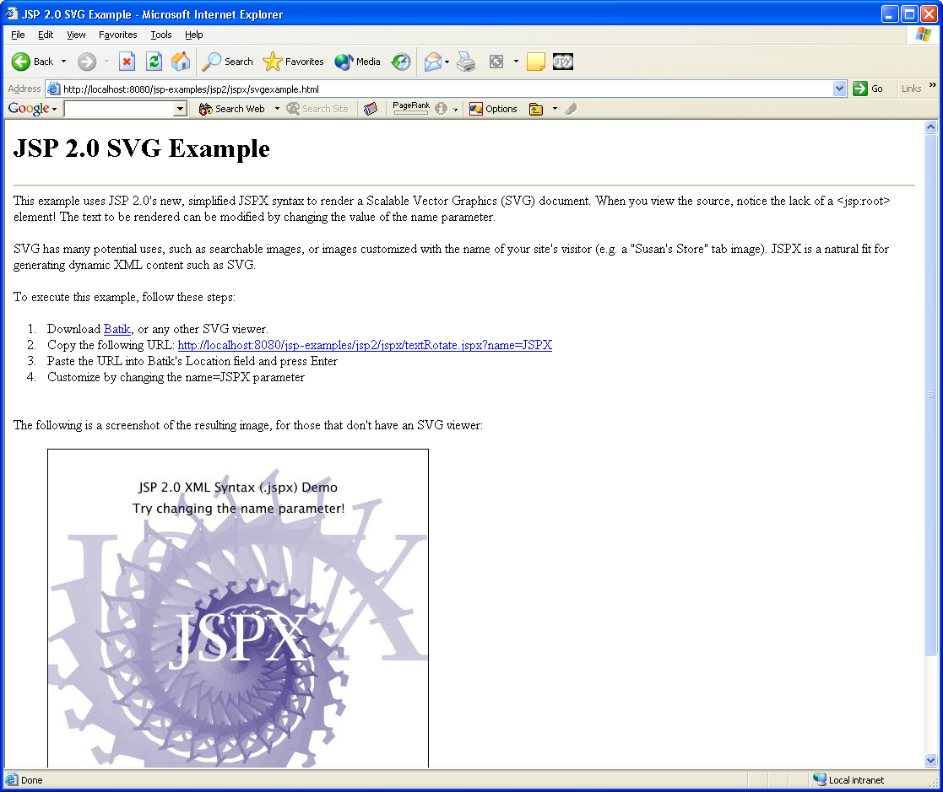
Run Some Examples
From Tomcat’s welcome page, click the examples link and run some examples to make sure everything is OK.

Slide 14
Problems
Tomcat failures to start correctly if
  you either do not have the Java SDK installed on, or
  your JAVA_HOME environment variable is set incorrectly.
You must have the Java SDK installed, since you need javac.

Slide 15
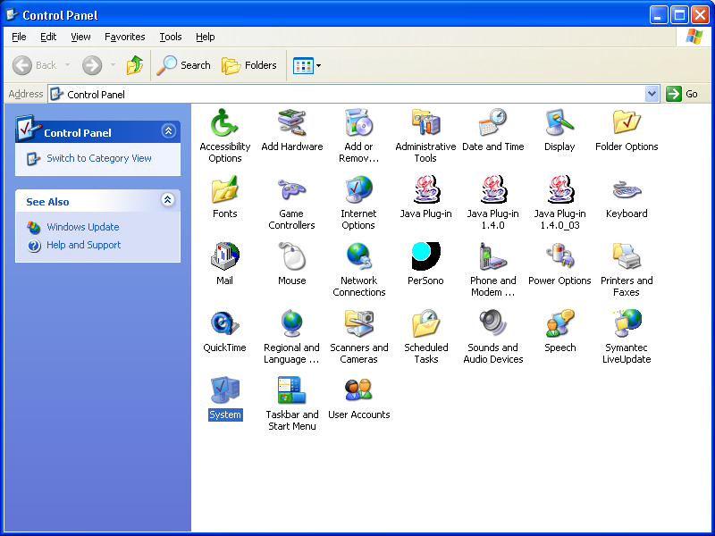
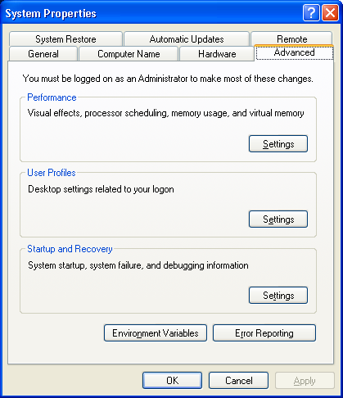
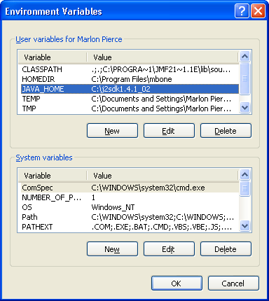
Setting JAVA_HOME on Windows XP
From “Start” at the bottom left of your screen, open the control panel.
Select “System” to edit System properties and choose the “Advanced” tab.
Click the “Environment Variables” Button.
Edit or add the JAVA_HOME variable
  It should point to the top folder of your Java installation.
  C:\j2sdk1.4.1_02, for example.
  Check “My Computer” to get the actual name.

Slide 16
Shutting Down Tomcat
You can do this in at least two ways:
  By closing the black and white java command window.
  By executing shutdown.bat in Tomcat’s bin directory
    Same place as startup.bat.
Running shutdown.sh is probably best.

Slide 17
Running Two Tomcat Servers
Web services often are applied to allow two Tomcat (or other) servers communicate
  One does display, the other runs commands.
So to really test things out and to understand what is going on, you should set up and run two web servers.
  Preferably on two different machines.
Installing a second server on the same host follows all of the same steps as before, with one additional step.
  You must modify server.xml

Slide 18
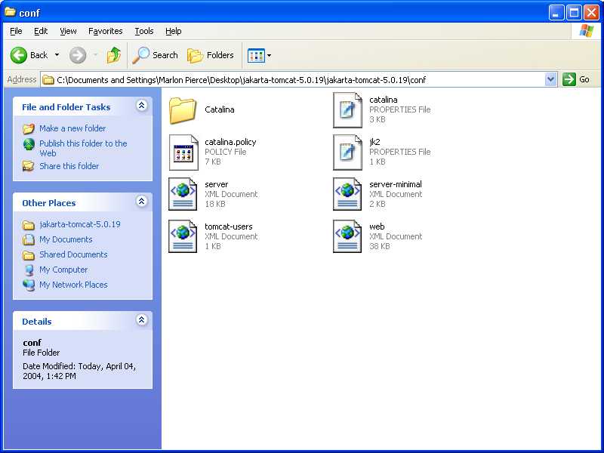
Finding server.xml
The file server.xml has all of the server configuration information.
This is located in the folder jakarta-tomcat-5.0.19/conf.
You only need to edit it in two places.
  See next slide
Double click it to open it with your favorite text editor.
Make a backup copy of server.xml before you change things.

Slide 19
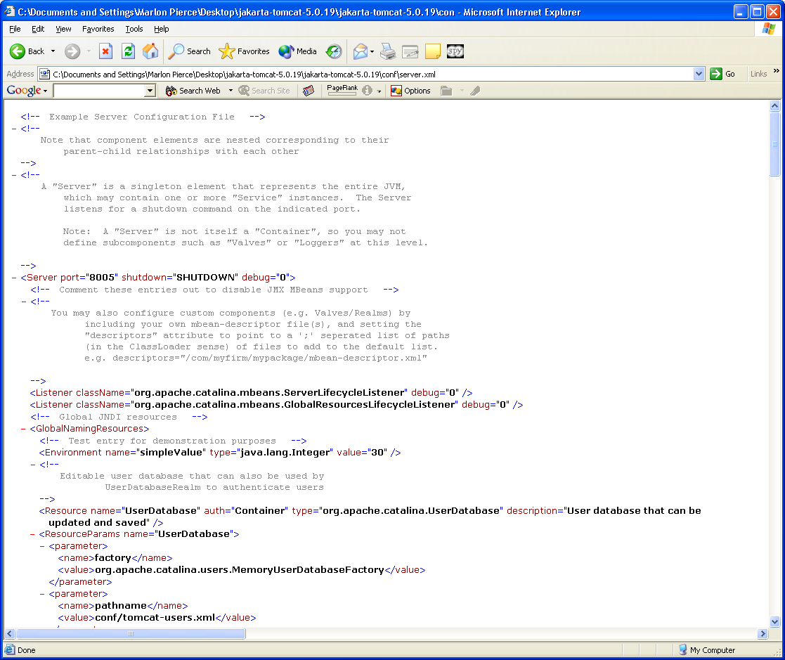
Tomcat Ports
Tomcat 5’s default settings listen to three ports: 8080, 8005, 8009.
  8080 is the http port number.
  8005 is the shutdown port.
    You can contact this to shutdown Tomcat from another process.
  8009 is the AJP port for running Tomcat behind an Apache server.
    Not needed here, but port opened
Tomcat can use other ports
  8443 for SSL connections
    Commented out by default.
    Requires some additional configuration
  8082 is for proxy connections
    Redirecting HTTP to other servers.
    Commented out by default.
  You don’t have to edit these.
For reference, use 9090, 9005, and 9009.

Slide 20
Changing Ports
Only one server at a time can accept connections on ports 8080, 8005, and 8009.
If you want run a second Tomcat server, you must change the values of these ports for the second server.
Just edit server.xml to change these ports.
  Shutdown the server first.
  Values don’t matter
  For Linux/Unix, values <1024 are owned by root processes so you normally can’t use these values.
Now restart the server. Point your browser at the new port number to check.
  http://localhost:9090 for example.

Slide 21
Editing server.xml
The following slides show the config settings that you need to change the shutdown, http, and ajp ports.
You can freely change other parameters if you want.
Note of course you are taking advantage of your basic XML knowledge.

Slide 22
Shutdown port
<!-- A "Server" is a singleton element that represents the entire JVM,
which may contain one or more "Service" instances. The Server
listens for a shutdown command on the indicated port.
Note: A "Server" is not itself a "Container", so you may not
define subcomponents such as "Valves" or "Loggers" at this level.
-->
<Server port="9005" shutdown="SHUTDOWN" debug="0">

Slide 23
HTTP Connector
<!-- Define a non-SSL Coyote HTTP/1.1 Connector on port 8080 -->
<Connector port="9090"
maxThreads="150" minSpareThreads="25" maxSpareThreads="75"
enableLookups="false" redirectPort="8443" acceptCount="100"
debug="0" connectionTimeout="20000"
disableUploadTimeout="true" />
<!-- Note : To disable connection timeouts, set connectionTimeout value to 0 -->

Slide 24
AJP Port
<!-- Define a Coyote/JK2 AJP 1.3 Connector on port 8009 -->
<Connector port="9009"
enableLookups="false"
redirectPort="8443" debug="0"
protocol="AJP/1.3" />

Slide 25
Tomcat Directory Structure (5.5)
Tomcat-Base
conf
logs
webapps
bin
work
common
server.xml
Tomcat-users.xml
ROOT
myApp1
myApp2
lib
WEB-INF
JAR files
web.xml
lib
classes
JAR Files

Slide 26
Creating Web Applications
A Web application usually contains
several different types of Web resources like HTML files, Servlets, JSP files, and other resources like Database tables
Each Web application has its own subdirectory under the directory $CATALINA_BASE/webapps/
  $CATALINA_BASE is an environment variable set to your tomcat-base directory (The directory that contains the Web-site content, Web applications and configuration data

Slide 27
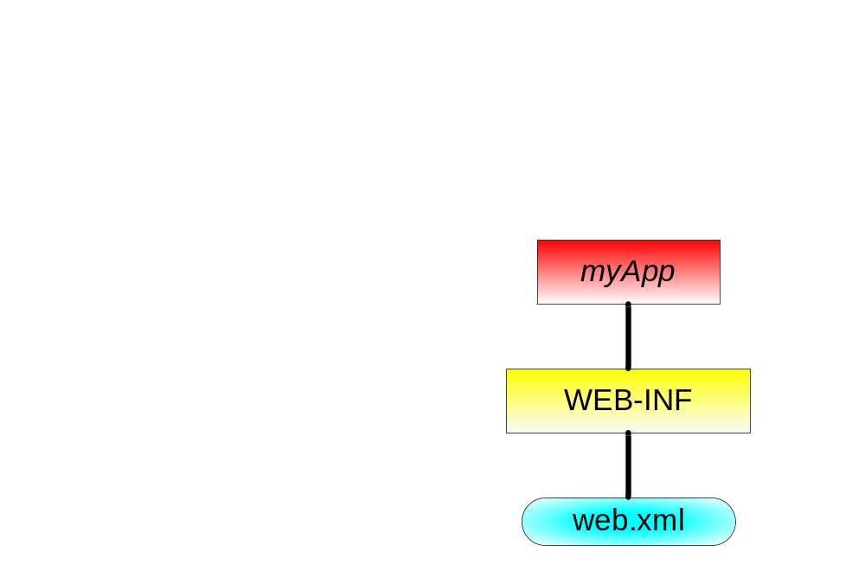
The Directory Structure of a Web Application – Cont.
An application's directory should contain the following:
  The directory WEB-INF/
  A legal web.xml file under WEB-INF/
Minimal content of web.xml
<web-app>
</web-app>

Slide 28
Configuring a Web Application
Application-specific configuration and declarations are written in the file myApp/WEB-INF/web.xml
This file contains:
  Servlet declarations, mappings and parameters
  Default files for directory requests (e.g index.html)
  Error pages (sent in cases of HTTP errors)
  Security constraints
  Session time-out specification
  Context (application) parameters
  And more…

Slide 29
Error Pages
Use the error-page element to define the page sent in case of an HTTP error that occurs within the application context
An error page element has two sub elements:
  error-code - the HTTP error status code
  location - the page that should be sent

Slide 30
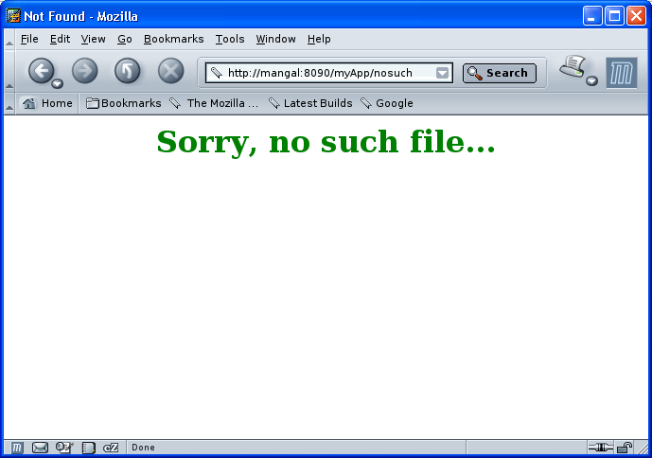
A non-existing resource

