Slide 1
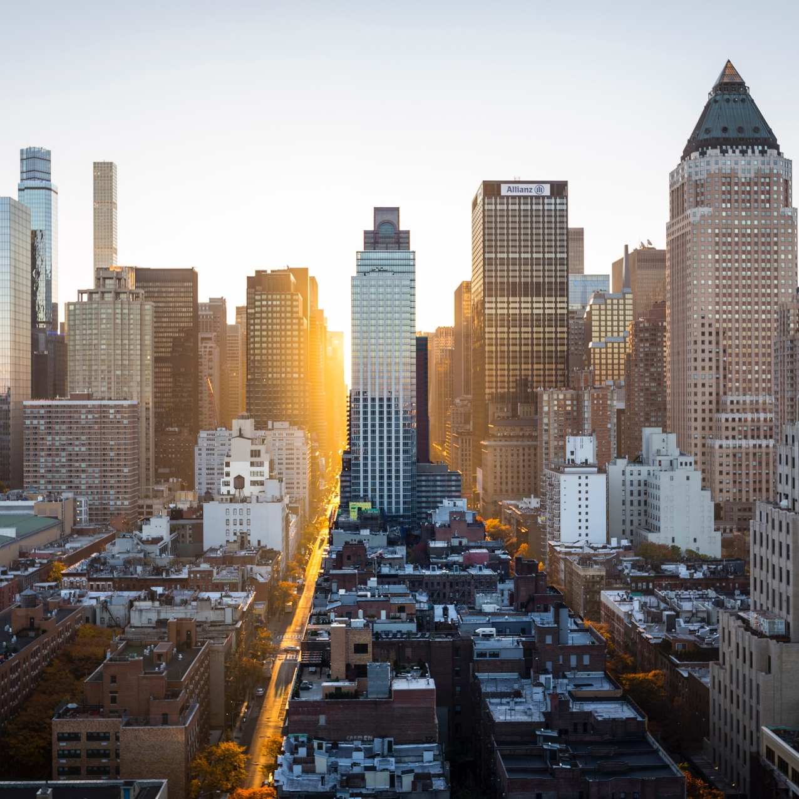
Optimizing work/life balance
Josette bitanga,
Crystina dang,
Henrietta danso,
Isobel tsang
Notes:
Hello everyone, my name is Josette. I worked with Crystina, Henrietta, and Isobel on this projet that looked into optimizing work/life balance.

Slide 2

Agenda
Data Exploration
Notes:
Today we’ll look at the dataset we found, discuss our problem statement and the machine learning models we tested, and finally go over our key takeaways.

Slide 3
Agenda
Data Exploration
Problem Statement
Notes:
Today we’ll look at the dataset we found, discuss our problem statement and the machine learning models we tested, and finally go over our key takeaways.

Slide 4
Agenda
Data Exploration
Problem Statement
Machine Learning Models
Notes:
Today we’ll look at the dataset we found, discuss our problem statement and the machine learning models we tested, and finally go over our key takeaways.

Slide 5
Agenda
Data Exploration
Problem Statement
Machine Learning Models
Final Takeaways
Notes:
Today we’ll look at the dataset we found, discuss our problem statement and the machine learning models we tested, and finally go over our key takeaways.

Slide 6
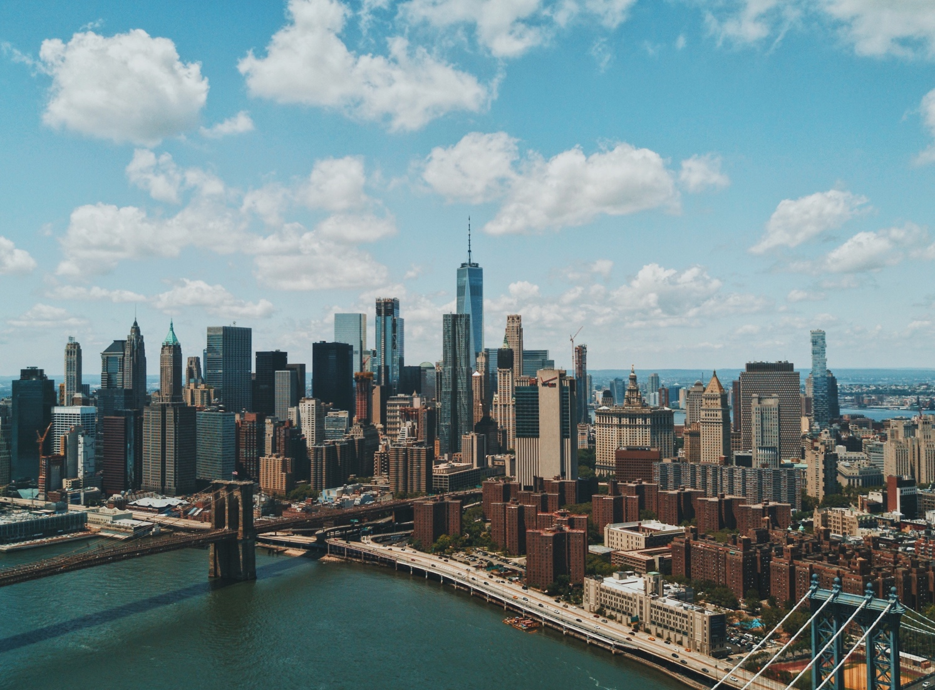
Data exploration
The pandemic has heightened our awareness to the importance of human wellbeing, most notably at work. We were interested in exploring the relationship between work/life balance and various external factors, such as social interactions and physical wellness.
Notes:
I’m sure you’ve all heard about work/life balance. At the start of the pandemic, when the barrier between work life and home life collapsed, many people were concerned about human wellbeing. It’s now clear that work/life balance plays a role in company culture and employee retention. We are interested in exploring the influence of the various social, mental, work, and spiritual factors on work/life balance. We wanted to create a tool that could potentially help a company's Human Resources efforts, to help strengthen employee wellbeing, staff retention, and improve company culture, as a whole.

Slide 7
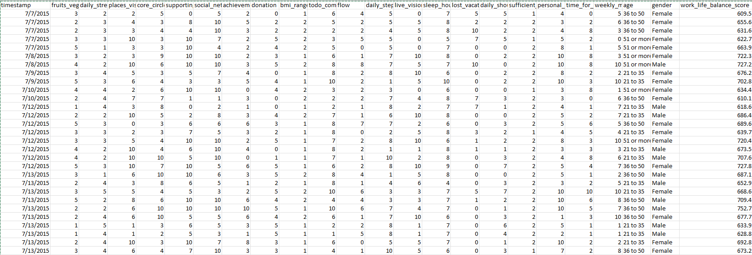
Lifestyle & wellbeing data
Notes:
We found this dataset called lifestyle and wellbeing on Kaggle. These are actually survey results from a site called authentic-happiness.com. I’ll link the survey at the end of the presentation so you can find out your own work/life balance score! The raw dataset contained 15977 responses with 24 columns or features, or how we live our lives, from your fitness level and mental health to your social connections and perceived life achievements. It’s quite comprehensive!
https://www.authentic-happiness.com/your-authentic-happiness-score

Slide 8
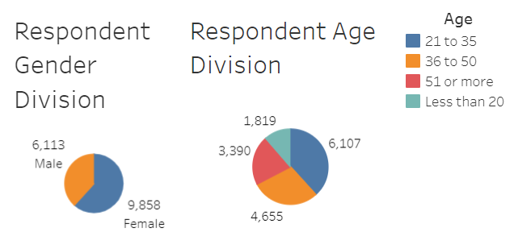
Lifestyle & wellbeing data
Notes:
More women than men took the survey. Most respondents were over 20 years old.

Slide 9
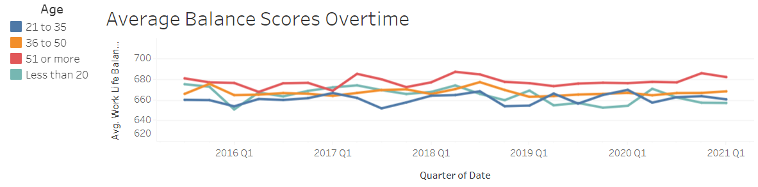
Lifestyle & wellbeing data
Notes:
The responses date as far back as 2016. The last update was in March 2021. Interesting observation, when we look at the evolution of work/life balance over time, we see that it has stayed relatively stable, even through the pandemic.
For the analysis, we dropped gender, timestamp, and age as these were non-beneficial to the purpose of our analysis. Other than this, the dataset was relatively clean, there wasn’t much manipulation performed. Some incorrect data was removed here and there, but nothing major. Once cleaned, we were left with 15971 responses.

Slide 10
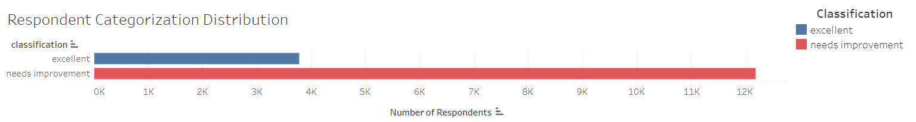
Lifestyle & wellbeing data
Notes:
Our output is the work/life balance score. The survey uses 3 classifications for the score: bad, good, and excellent. There were only 74 respondents who scored bad, we decided to merge these with the good category to create a new category called needs improvement. In the end, we had 2 classifications: needs improvement and excellent.

Slide 11
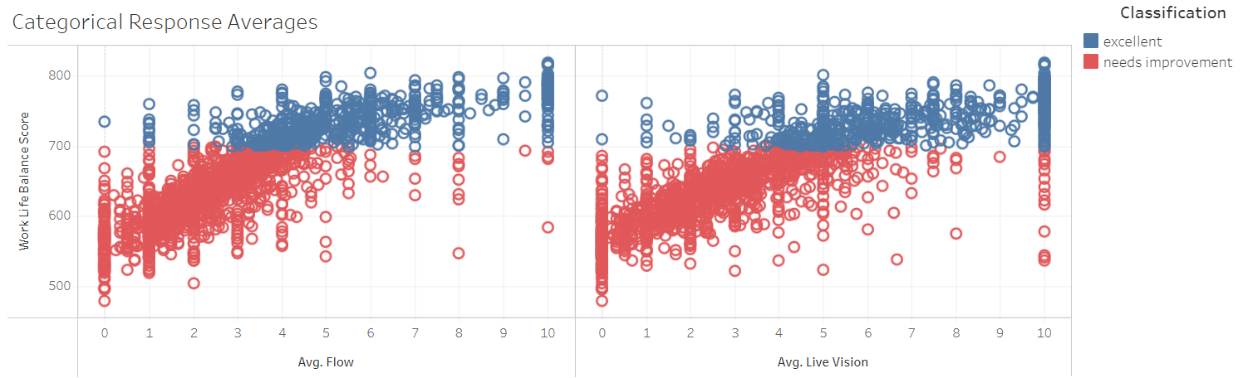
Lifestyle & wellbeing data
Notes:
There were many features, but from a cursory glance, Live_Vision and Flow seemed to be very closely related to the Work/Life balance score. In the survey, we define Flow as the amount of hours you experience focusing on what you’re supposed to be doing. Live_Vision is how clearly you see the life you have ahead of you.

Slide 12
Problem statement
Live_Vision and Flow have a strong influence on the Work/Life balance score and will enable us to predict which employees need support
Notes:
Going back to our problem statement, the hypothesis is that a high work/life balance score means you are happier and less likely to leave your current employment. So those who score lower, are assumed to need some type of support. We wanted to deduce which features had the strongest influence on the work/life balance score to reduce the survey to its minimum inputs. From there, the machine learning model should be able to predict which employees may need more support.

Slide 13
Confusion matrix
Employees with predicted low work/life balance and actually need support | Employees with predicted low work/life balance but are supported
Employees with predicted high work/life balance but actually need support | Employees with predicted high work/life balance and are actually supported
Notes:
If we look at the confusion matrix, we wanted to maximize the precision of our model in order to catch folks that may have a predicted high work/life balance but, actually do need more support. This would ensure that all employees who may require any support can receive the help they need.

Slide 14
Machine learning models
Classifying the outcomes
Notes:
As we are classifying the responses into 2 possible outputs (needs improvement or excellent), we selected classification models: Logistic Regression, Balanced Random Forest Classifier, Decision Tree, and XGBoost

Slide 15


Machine Learning models
Full set: 91% accuracy, 94% precision
Reducing the features based on rankings did not yield a better accuracy or precision
Ranked supporting_others and sufficient_income as top features: 70% accuracy, 79% precision
Flow and live_vision: 62% accuracy,77% precision
Balanced random forest classifier
Full set: 94% accuracy, 94% precision
Reducing the features based on rankings did not yield a better accuracy or precision
Ranked supporting_others and achievements as top features: 76% accuracy and 82% precision
Using flow and live_vision: 73% accuracy, 79% precision
Xg boost
Notes:
So, what we did for all our models: we started by running the model with the full set of features. Then, reduced the inputs and compared their accuracy and precision.
For random forest classifier, the full set of features yielded a high accuracy and precision. What’s interesting is that reducing the inputs based on their rankings did not make the model better. For example, using supporting_others and achievements only, which were ranked as the top features, yielded only 76% accuracy and 82% precision. If we use the inputs we thought correlated most with work/life balance score, we have a 73% accuracy and 79% precision. Similarly for XG Boost, we see high accuracy and precision for the full set of features, but these lower once we reduce the inputs.

Slide 16
Machine Learning models
Not compatible with feature importance
Full set: 95% accuracy, 93% precision
Flow and live_vision: 80% accuracy, 74% precision
Decision tree
Not compatible with feature importance
Full set: 86% accuracy, 87% precision
Using flow and live_vision: 80% accuracy, 78% precision
Logistic regression
Notes:
We then used the decision tree and logistic regression models. These were not compatible with feature importance. We used all inputs first. This gave us decent accuracy and precision. We then reduced the inputs to only flow and live_vision and found the accuracy and precision decrease, but still a decent percentage.

Slide 17
Final takeaways
Logistic regression is our chosen model
Notes:
Top Machine Learning Model found, with the limited testing we performed, is Logistic Regression with Live_Vision and Flow as inputs
If there was more time,
we could continue to explore the influences of each feature or more feature pairings to work/life balance score.
we could search for other types of lifestyle and wellbeing surveys and somehow join them with the dataset we used to explore whether other features influence the work/life balance score as well.

Slide 18

Questions?

