Slide 1
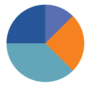
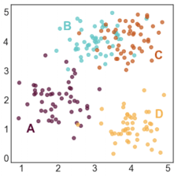
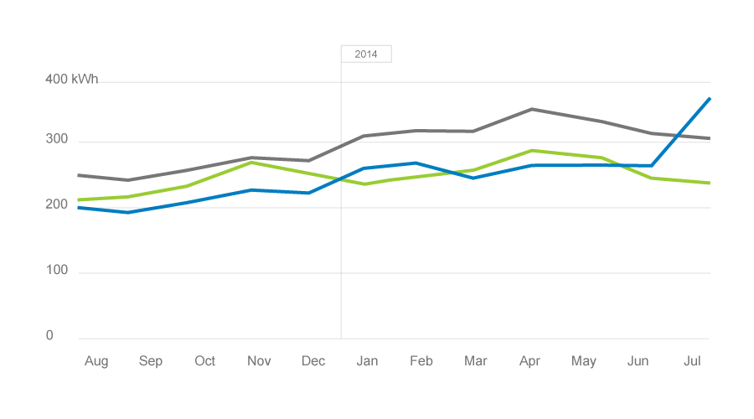
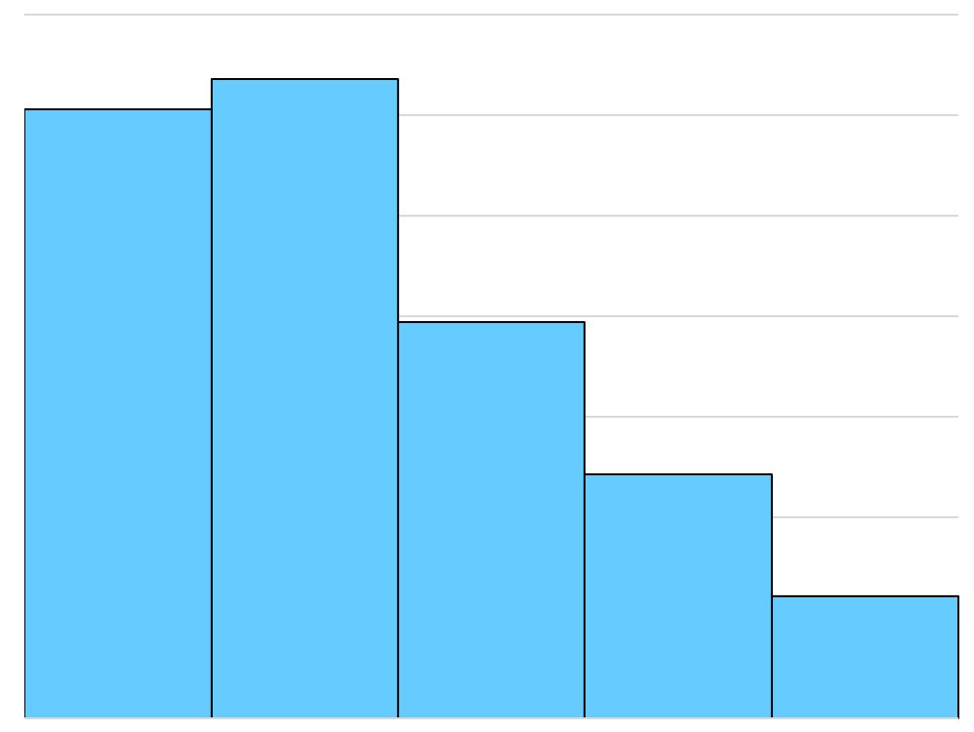
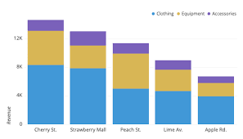
TOTAL # OF SURVEY RESPONSES (TEXT)
Division of respondents by age group
Average of balance scores overtime
Distribution of respondents in the 3 balance score ranges
* Opportunity to make interactive: can allow users to select between ‘good’ and ‘bad’ category from dropdown to see stats for selection.
* Opportunity to make interactive: can allow users to select between ‘good’ and ‘bad’ category from dropdown to see stats for selection.
Frequency of categorical responses based on balance score range
Average rating for each category for each of the balance score ranges (each ‘stack’ within each bar = 1 balance score range)

