Slide 1
Intelligent Admissions: The Future of University Decision Making with Machine Learning
Submitted By:
Team ID:NM2023TMID22881
D.RAMYA(20326ER060)
J.RAMYA(20326ER061)
S.SANDHIYA(20326ER062)
S.SANGEETHA(20326ER063)

Slide 2
CONTENT
INTRODUCTION
PROBLEM DEFINITION & DESIGN THINKING
RESULT
ADVANTAGES
APPLICATIONS
CONCLUSION
FUTURE SCOPE
APPENDIX

Slide 3
ABSTRACT
The Future of University Decision Making with Machine Learning is a concept that involves the use of advanced algorithms and data analysis techniques to automate and optimize the university admission process.
With the help of machine learning, universities can accurately predict a student's likelihood of success and fit within the institution.
This approach can lead to more efficient and objective decision-making, ultimately resulting in a more diverse and talented student body.
The integration of machine learning in university admissions can also help to reduce bias and increase transparency, creating a fairer and more accessible system for all applicants.

Slide 4
1.INTRODUCTION 1.1 Overview
University admission is the process by which students are selected to attend a college or university. The process typically involves several steps, including submitting an application, taking entrance exams, and participating in interviews or other evaluations.
Students are often worried about their chances of admission in University.
The university admission process for students can be demanding, but by being well-informed, prepared, and organized, students can increase their chances of being admitted to the university of their choice. ccccccc
The aim of this project is to help students in short listing universities with their profiles.

Slide 5
1.2 Purpose
The purpose of admission prediction is to develop models that can accurately predict whether a student will be admitted to a particular college or university based on a set of input features. This task is important because it can help both students and universities make better-informed decisions about the college admissions process.
For students, admission prediction models can help them identify which schools they are most likely to be accepted to based on their academic and personal characteristics. This can help students make more informed decisions about where to apply, and can also help them focus their efforts on schools where they are more likely to be admitted.
For universities, admission prediction models can assist with the admissions process by providing a more efficient and objective way of evaluating applicants. By using data-driven models to predict admission decisions, universities can potentially reduce bias and ensure that all applicants are evaluated fairly and consistently.

Slide 6
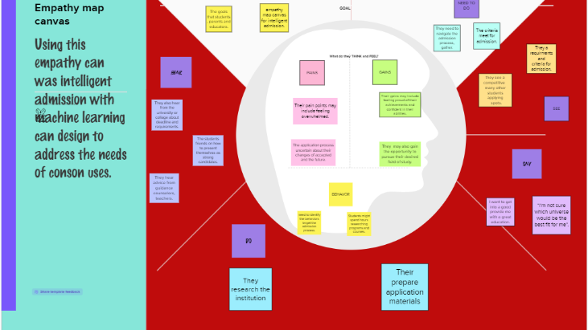
2. PROBLEM DEFINITION & DESIGN THINKING 2.1 Empathy Map
An empathy is Design Thinking map is a collaborative tool teams can use to gain a deeper insight into their customers.

Slide 7
2.2 Ideation & Brainstorming Map
A mind map is a highly effective tool used by creatives,
marketers, a need project manager to inspire their teams.

Slide 8
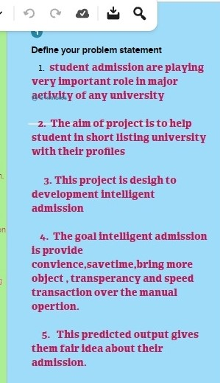

Slide 9
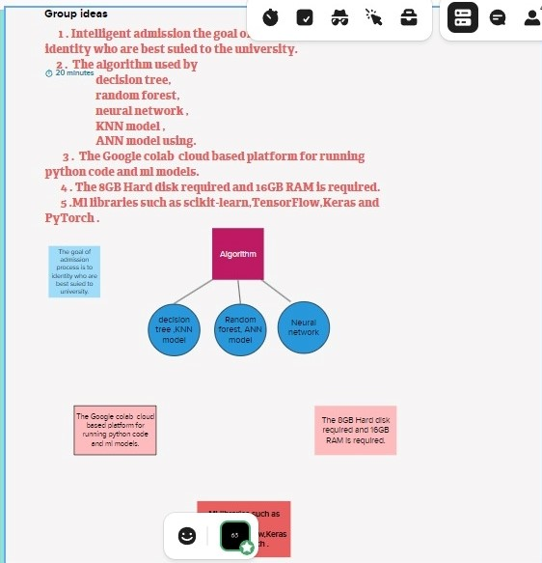

Slide 10

3. RESULT

Slide 11
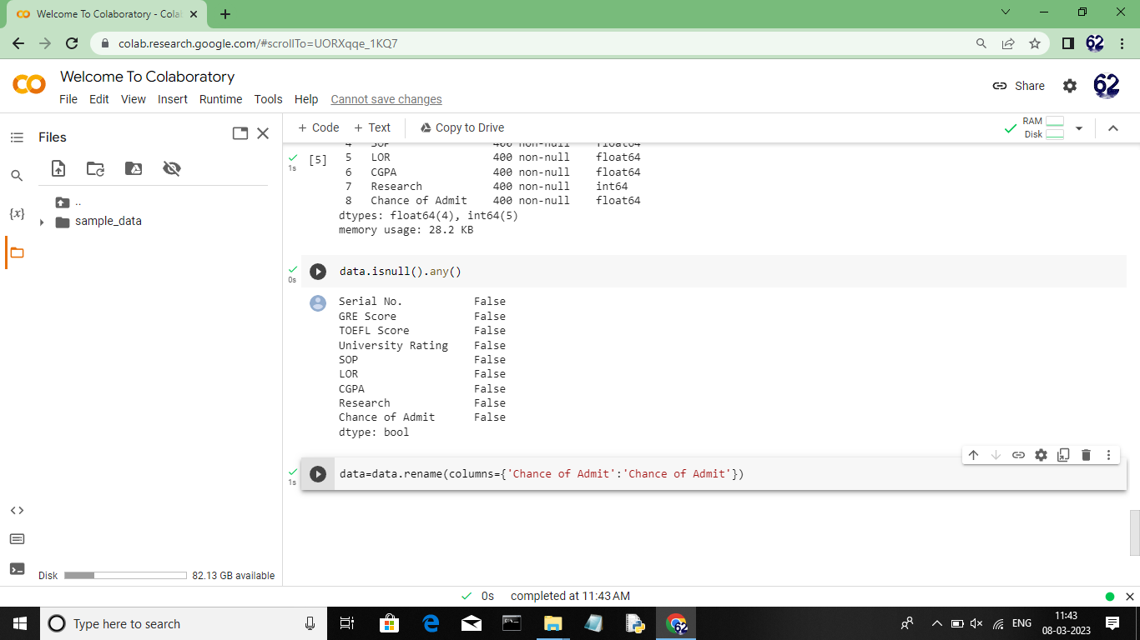
SOURCE CODE

Slide 12
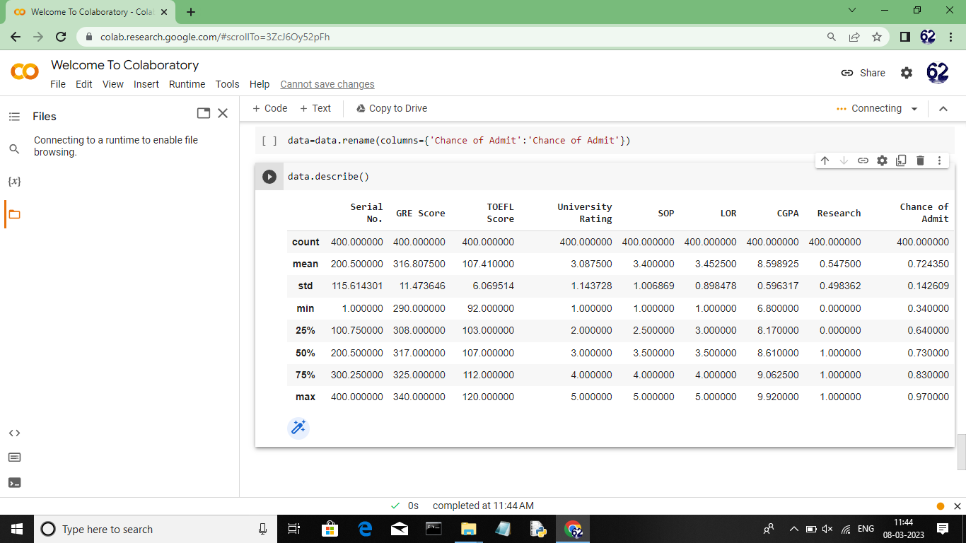

Slide 13
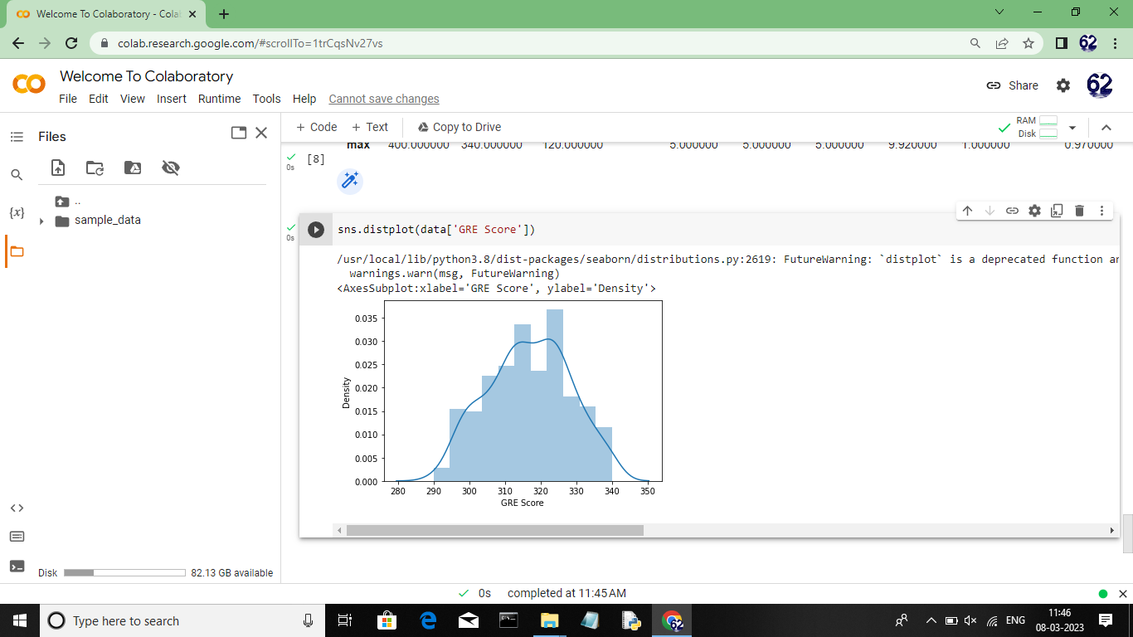

Slide 14
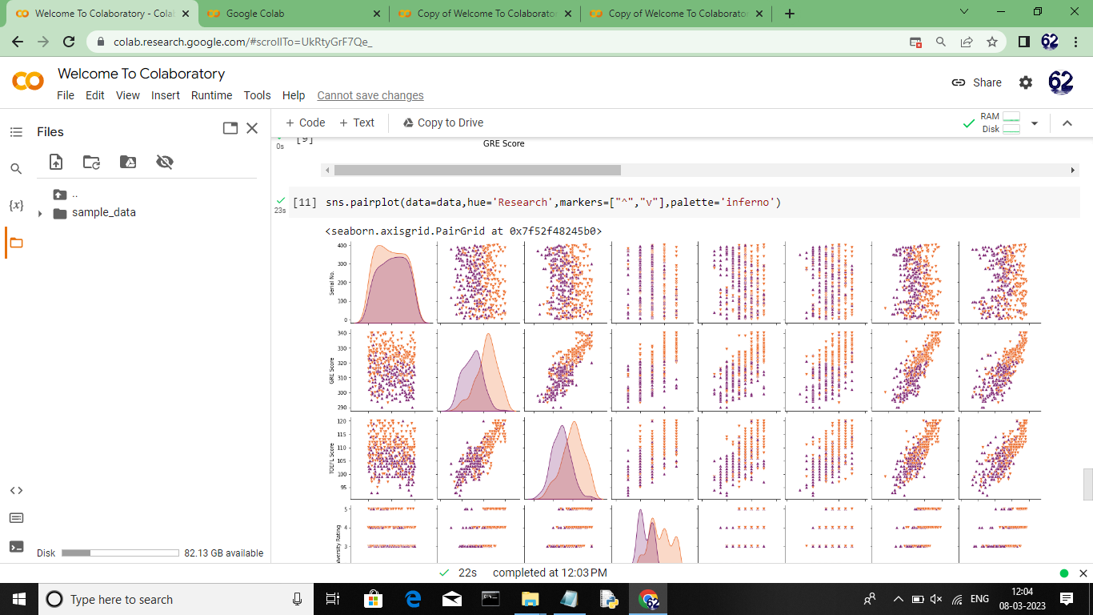

Slide 15
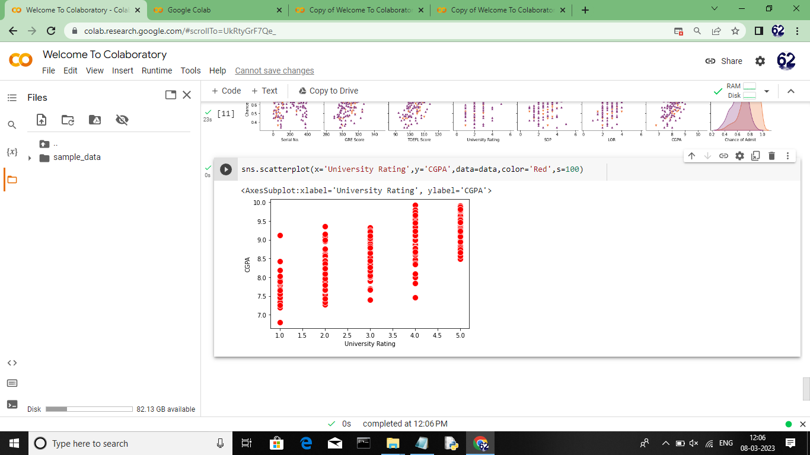

Slide 16
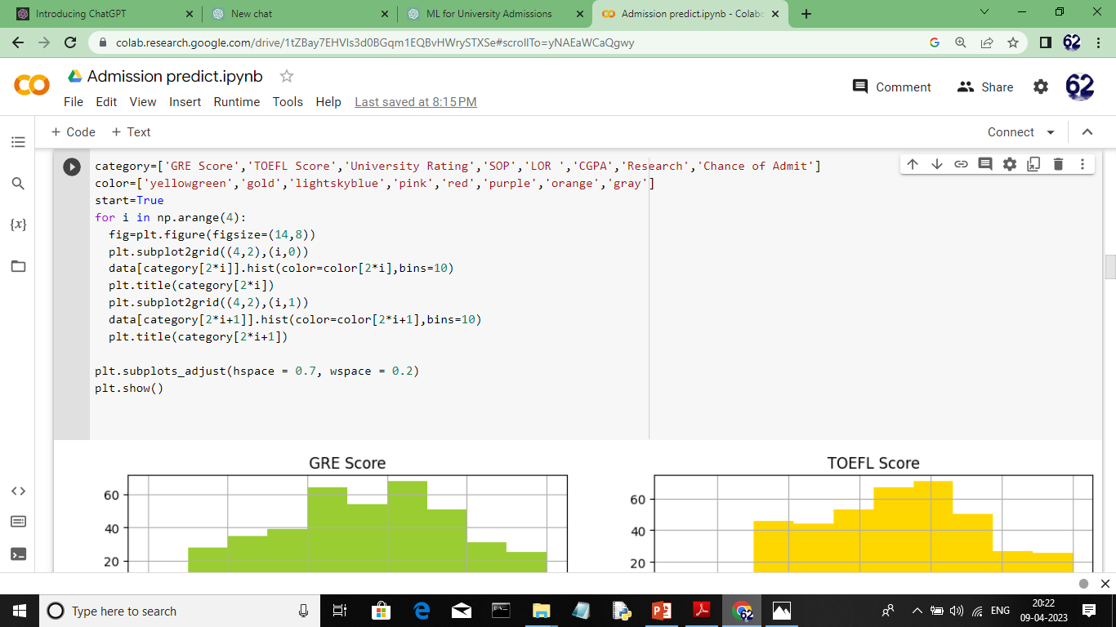

Slide 17
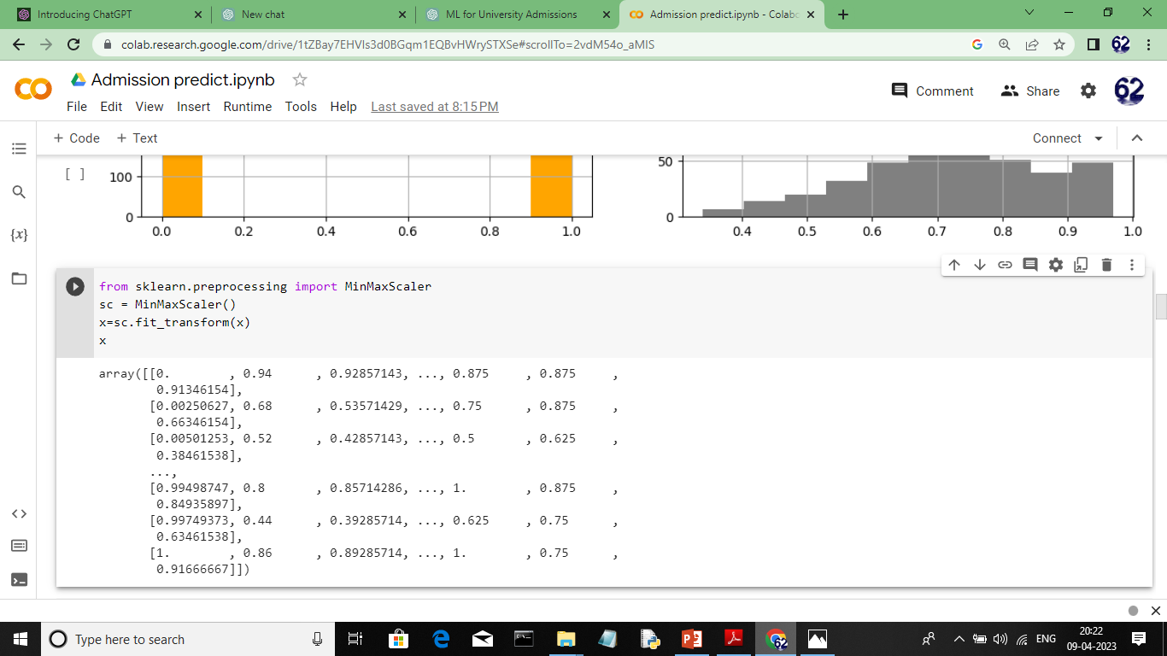

Slide 18
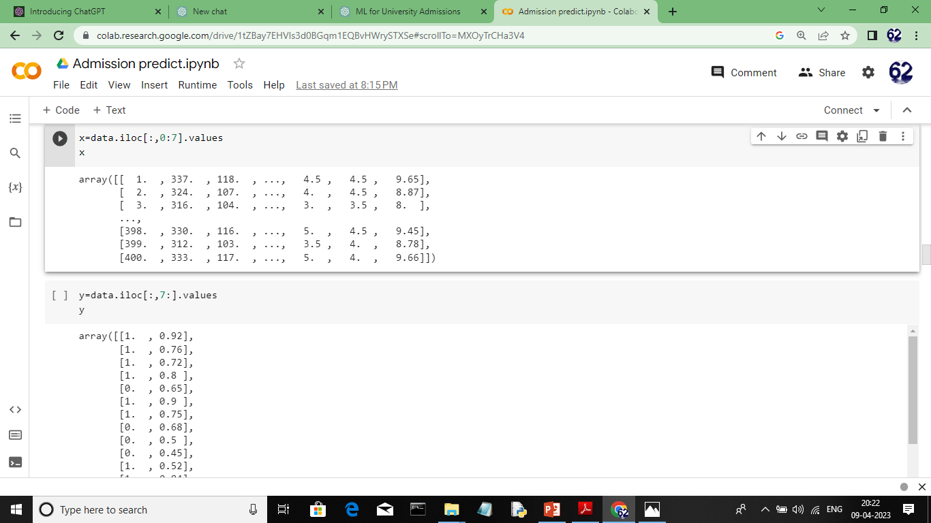

Slide 19


Slide 20
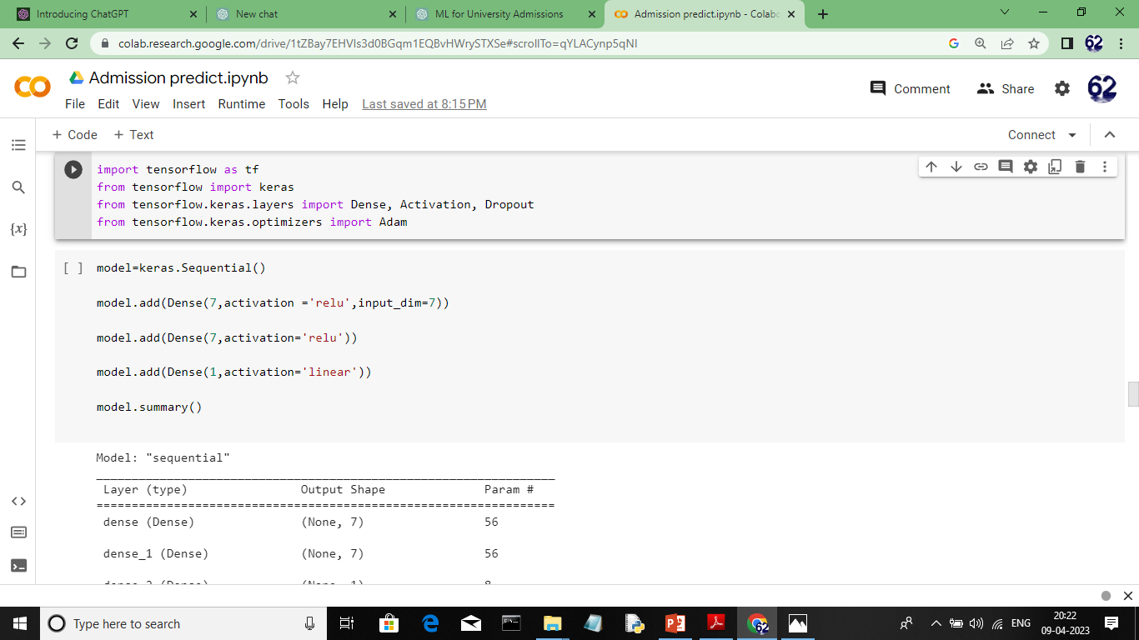

Slide 21


Slide 22
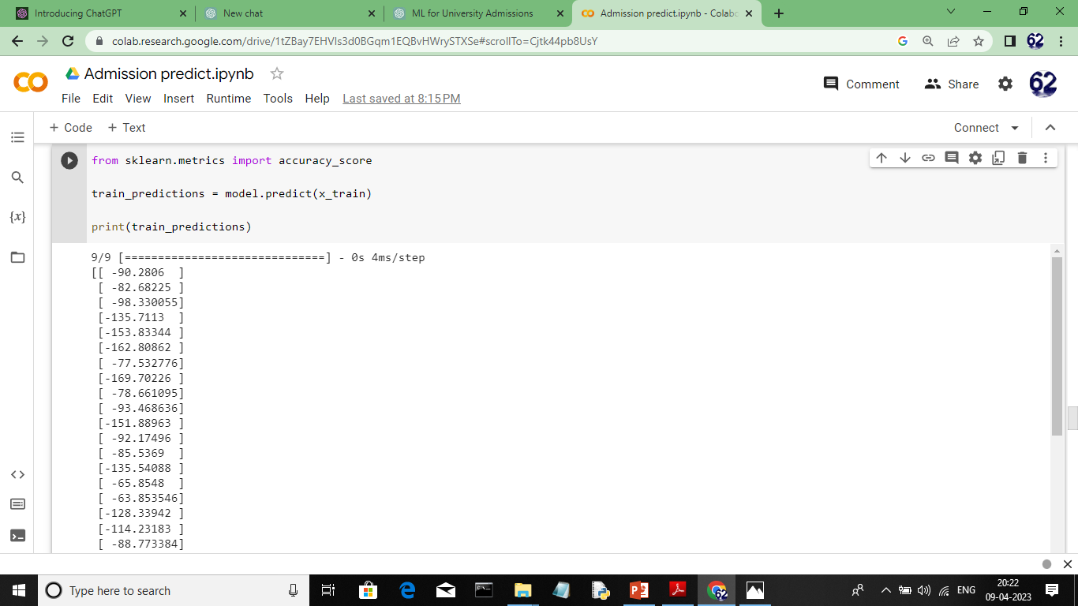

Slide 23


Slide 24
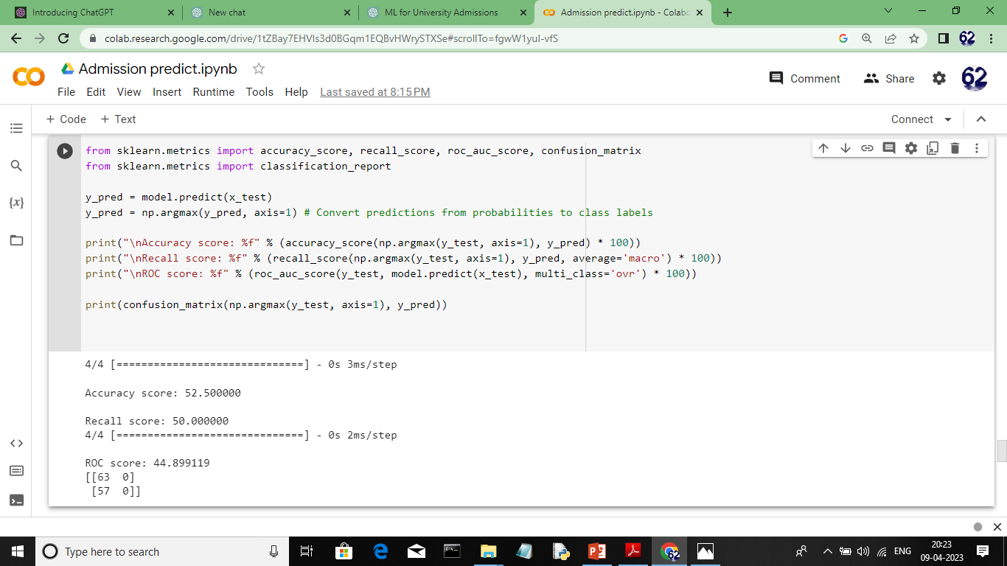

Slide 25
4. ADVANTAGES
1. Easily identifies trends and patterns
2.no human intervention needed
3.handling multi-dimensional and multi-variety data
4.wide application

Slide 26
5. APPLICATIONS
Though this might seem obvious, ensure you take care over this. You don’t want to miss out simply because you forgot to submit the required evidence or applied too late.
“Students should check entry requirements and deadlines before applying to make sure that they have the best possible chance of gaining a place on their chosen course,” Berry confirms.
“If they are unsure whether their qualifications are acceptable, they might like to contact the admissions office or international office in their chosen institution to check before submitting a full application.”

Slide 27
6. CONCLUSION
The study of intelligence is important because findings can give a better understanding of human creativity, psychological development, and emotion. The existence of intelligence has been attributed to both nature and nurture, but the truth behind it may be something of a mix of both.
Overall, admission prediction has the potential to improve the fairness and efficiency of the college admissions process, and can provide valuable insights into the factors that contribute to admission decisions. By continuing to develop and refine admission prediction models, we can help ensure that the college admissions process is as transparent and equal as possible.

Slide 28
7. FUTURE SCOPE
There are several future enhancements that can be made to admission prediction models to improve their accuracy and usefulness:
Incorporating more data: Admission prediction models can be improved by incorporating additional data sources, such as social media activity, personal essays, and letters of recommendation. This can provide a more comprehensive view of the applicant and improve the accuracy of the model.
Using more advanced machine learning algorithms: While logistic regression and decision trees are commonly used for admission prediction, more advanced machine learning algorithms such as random forests, gradient boosting, and deep learning can be applied to improve model accuracy.

