Slide 1
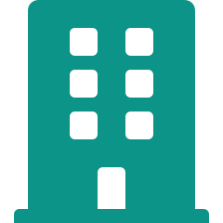

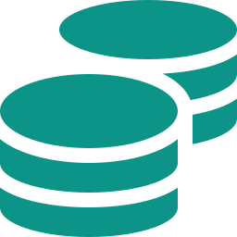
Deciphering Tokenization of Real World Assets
Three foundational concepts underpinning the tokenized asset ecosystem
Real World Assets
Blockchain
Tokenization
Tangible & intangible assets
existing outside blockchain:
real estate, equities, bonds,
commodities, art, IP, private
credit, fund interests
Distributed, immutable ledger
enabling programmable,
transparent, and auditable
record-keeping without
centralized intermediaries
Converting ownership rights
in an asset into a digital token
on blockchain — enabling 24/7
trading, fractional ownership,
and instant settlement
Together: tokenization bridges traditional finance with blockchain infrastructure

Slide 2

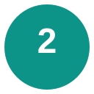
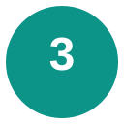

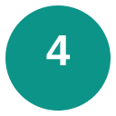
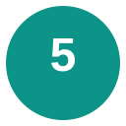
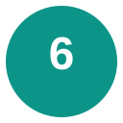
The Tokenization Process
Tokenization converts ownership rights in an asset into a digital token on a distributed ledger, creating a programmable, transferable, and fractionable representation of value. The process spans six stages — from asset identification through ongoing lifecycle management — each involving distinct legal, technical, and commercial design choices.
Asset Selection
Token Design
Blockchain
Choice
Identify the underlying asset — either an RWA (equities, bonds, real estate, funds) or a blockchain-native asset (DeFi protocol tokens, NFTs)
Define token type (fungible ERC-20 vs. non-fungible ERC-721), economic rights (dividends, voting), supply, and compliance features (whitelisting, transfer restrictions)
Select public (Ethereum, Solana, Avalanche) vs. private/permissioned (Hyperledger, Canton Network), weighing transparency, throughput, and regulatory preferences
↴
Smart
Contracts
Trading
Management
Deploy programmable logic encoding compliance rules, dividend distributions, corporate actions, transfer restrictions, and KYC/AML hooks on-chain
Enable primary issuance and secondary market trading via CEX/DEX listings, ATS platforms, or OTC desks with liquidity provision and price discovery
Ongoing lifecycle operations: NAV updates, coupon/dividend processing, corporate actions, regulatory reporting, and investor communications
Worked Example: BlackRock’s BUIDL Fund
BlackRock selects US Treasuries as the underlying RWA (Step 1). Securitize designs an ERC-20 token granting pro-rata NAV rights with $5M minimum and accredited-only transfer restrictions (Step 2). The token deploys on Ethereum (Step 3) via smart contracts encoding KYC whitelists and daily NAV accrual (Step 4). Secondary trading occurs on Securitize Markets ATS (Step 5). Ongoing management includes daily NAV strikes, USDC dividend distributions, and monthly compliance reporting (Step 6).

Slide 3






Regulatory Tailwinds Across Key Markets
Accelerating global policy momentum toward tokenized asset frameworks
United States
European Union
United Kingdom
CLARITY Act: stablecoin regulatory framework
SEC crypto task force formed; SAB 121 repealed
OCC permits banks to custody digital assets
MiCA fully effective Jan 2025; first comprehensive crypto regulation
DLT Pilot Regime live for tokenized securities trading
ECB digital euro in preparation phase
FCA digital securities sandbox operational
HM Treasury digital gilts pilot announced
Property (Digital Assets) Bill in progress
Singapore
UAE
Japan
MAS Project Guardian: institutional DeFi pilots
Global Layer One interoperability initiative
Variable Capital Company tokenized fund regime
VARA comprehensive virtual asset framework
ADGM RegLab for tokenized securities
DIFC Innovation Hub licensing regime
Revised FIEA enabling security token offerings
JPX/SBI digital securities exchange live
Stablecoin regulation under revised PSA

Slide 4
Tokenization Landscape: Key Players Across Asset Classes
Representative firms spanning asset managers, platforms, infrastructure, and exchanges
Asset Managers
& Issuers
BlackRock (BUIDL)
Franklin Templeton
Hamilton Lane
KKR
Apollo
WisdomTree
Tokenization
Platforms
Securitize
Figure (FIGR)
Ondo Finance
Centrifuge
Maple Finance
Backed Finance
Blockchain
Infrastructure
Ethereum
Solana
Avalanche
Polygon
Canton Network
Provenance
Exchanges &
Marketplaces
NASDAQ
NYSE
Coinbase
Bullish (BLSH)
INX Digital
tZERO
Custody &
Settlement
DTCC
Fireblocks
Anchorage Digital
Komainu
Copper
BitGo
Source: Bernstein Research. For illustrative purposes; not exhaustive.

