Slide 1
MARKET MAP
Who is building tokenized equities
The full stack, layer by layer: transfer agents, exchanges, broker-dealers,
settlement, custody and DeFi, with every name verified against a public source.
Positions reflect publicly announced activity in tokenized equities and ETFs as of 10 September 2026. Sources are listed for every entry in the appendix.

Slide 2











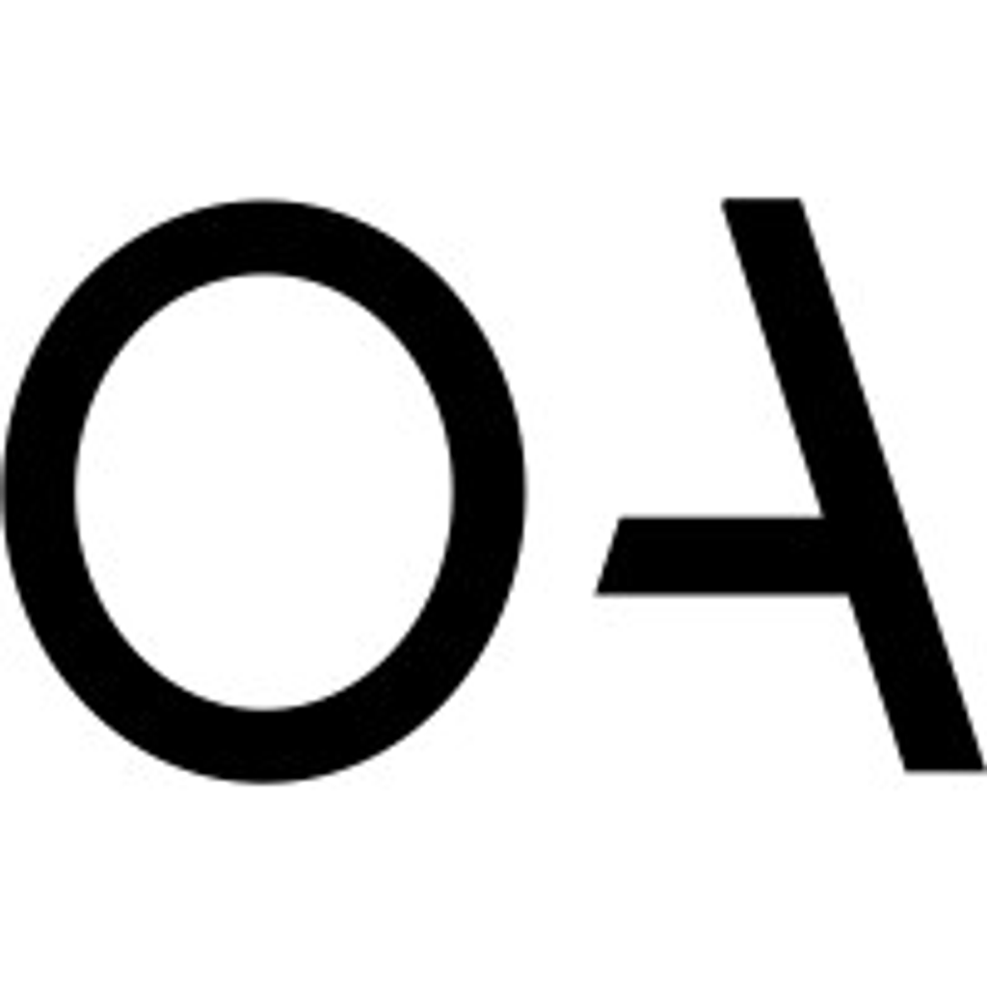








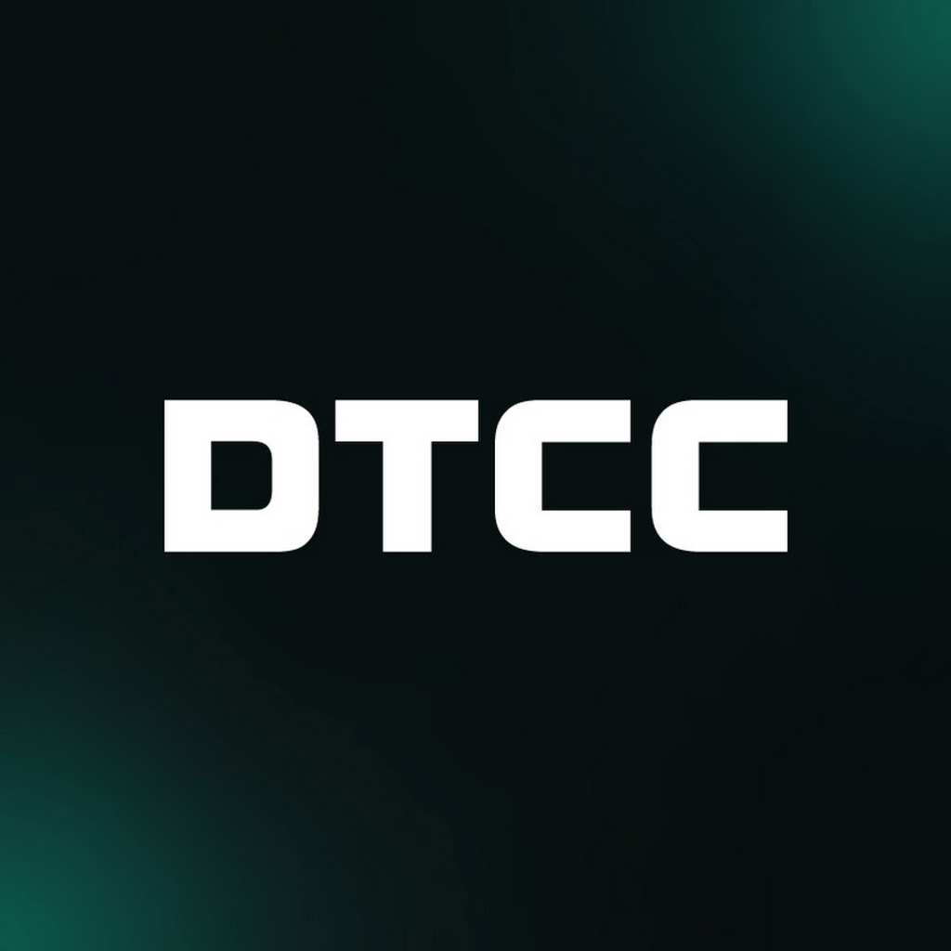


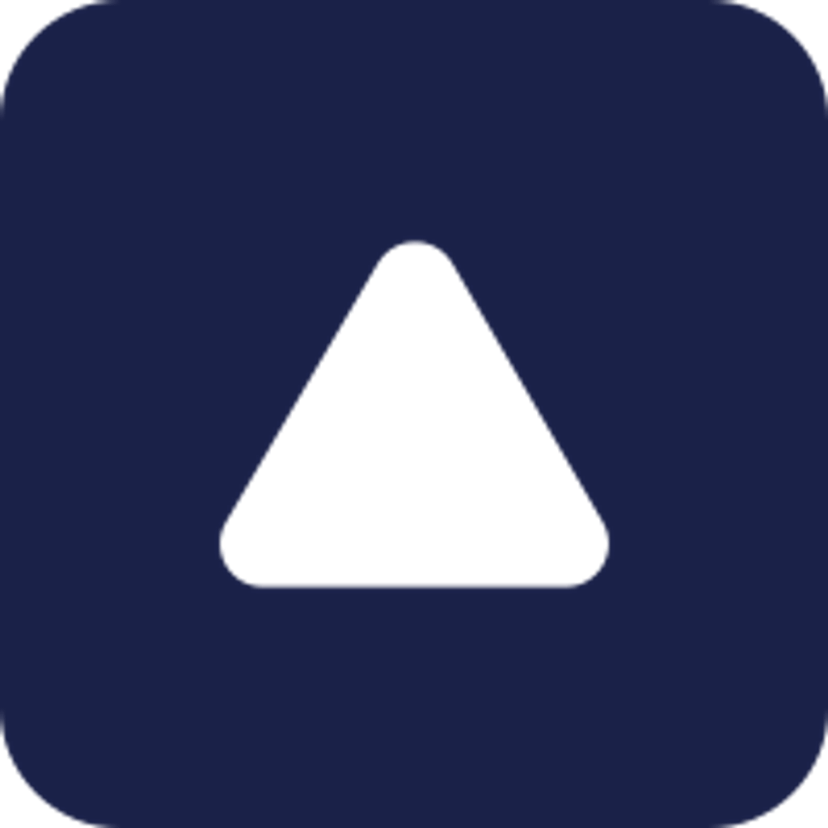

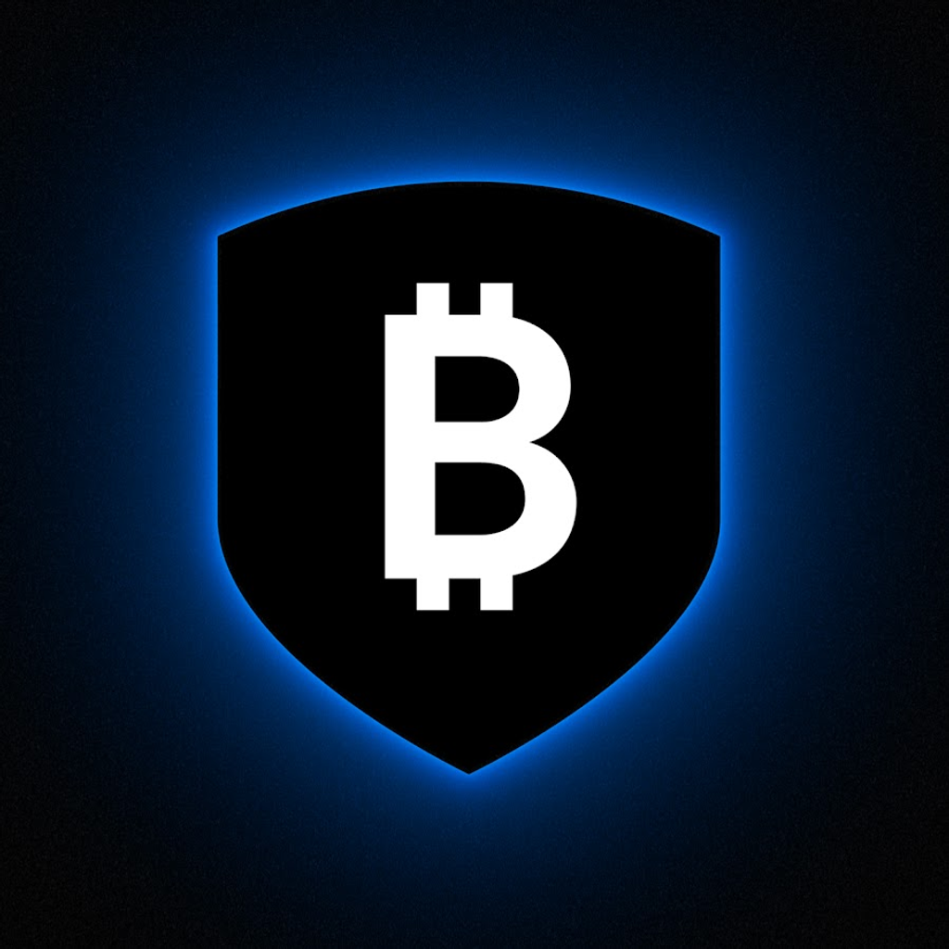



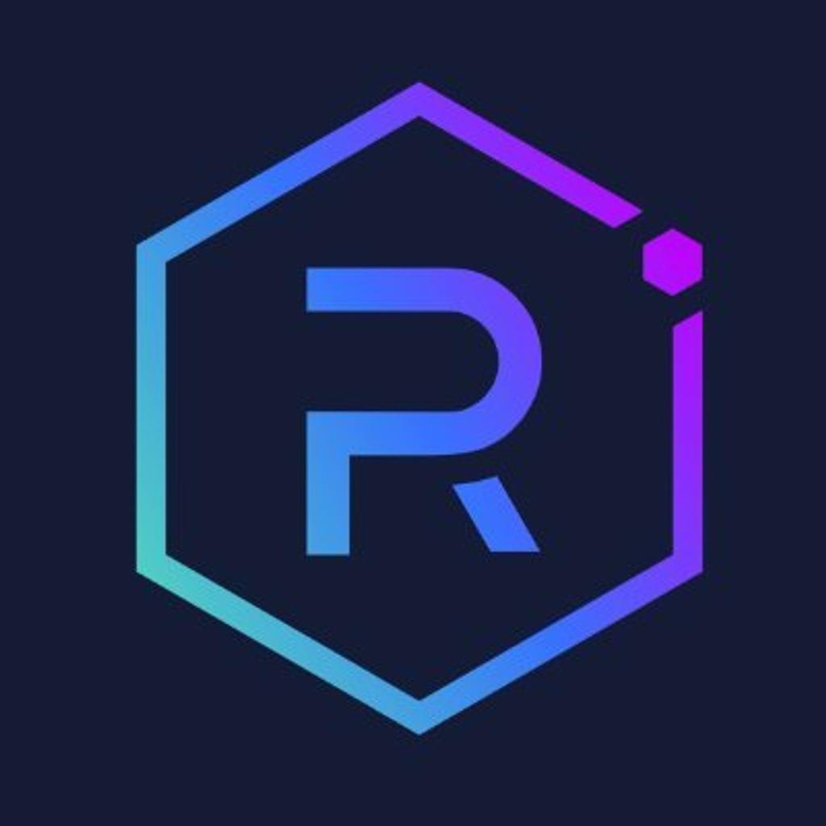
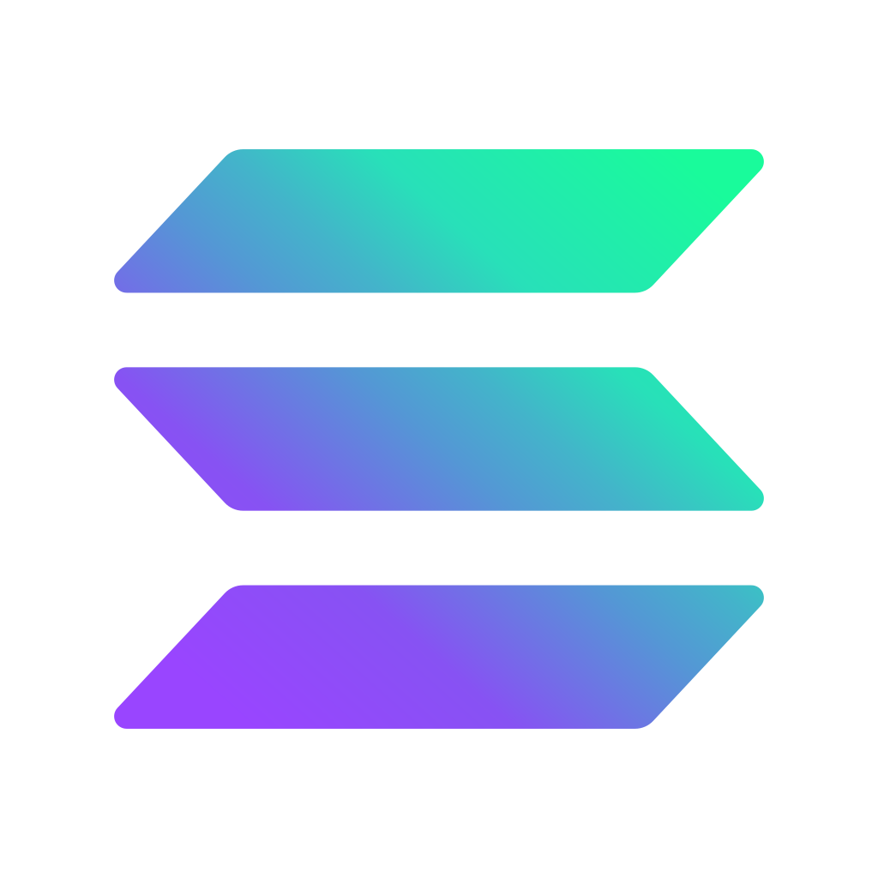
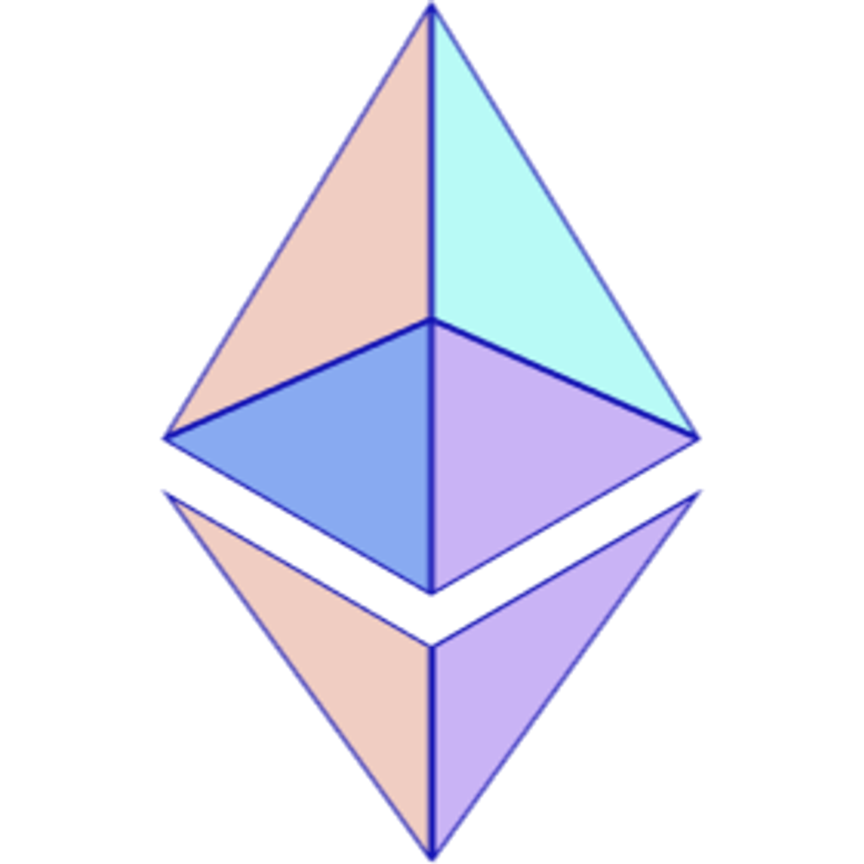









The tokenized equities value chain
AS OF 10 SEPTEMBER 2026
Firms with live products, regulatory registrations or announced launches in tokenized equities and ETFs
TRANSFER AGENTS
7
EXCHANGES & TRADING VENUES
8
BROKER-DEALERS & ATSs
7
Own the official share register; mint and burn the token
Listing and order books where tokenized stock changes hands
Regulated intermediation, order routing and secondary venues
Securitize
Computershare
Superstate
Dinari
Nasdaq
NYSE
Kraken
Coinbase
Dinari Securities
Securitize Markets
tZERO
Texture Capital
Injective
Oasis Pro
Broadridge
Robinhood
Bybit
Gemini
Backpack
North Capital
Ondo
Alpaca Securities
SETTLEMENT & INFRASTRUCTURE
8
CUSTODY
10
DeFi
6
Depository, chains, oracles and the cash leg
Hold the underlying shares, and hold the keys
Lending, liquidity and wallets that make the token useful
DTCC / DTC
Chainlink
Circle
Fireblocks
Anchorage Digital
BitGo
Coinbase Custody
Fireblocks
BNY
Kamino
Jupiter
Raydium
Solana
Ethereum
Arbitrum
Base
State Street
InCore Bank
Maerki Baumann
Clearstream
Alpaca Securities
Morpho
Aave
MetaMask
Several firms deliberately appear in more than one layer: Dinari, Securitize and Superstate each combine a transfer agent with a broker-dealer or venue.
Sources for every entry in the appendix

Slide 3
Three competing models, not one market
The layers above are assembled differently depending on who holds the share and what the token actually is
ISSUER-SPONSORED / NATIVE
DEPOSITORY-TOKENIZED
CUSTODIAL / 1:1 BACKED
The token is the registered share.
DTC tokenizes the existing entitlement.
A regulated custodian holds the real share.
A registered transfer agent records the holder on-chain, so token holders keep voting, dividend and corporate-action rights.
Trades execute and settle conventionally on Nasdaq or NYSE, then DTC mints a token to the buyer's wallet as a post-trade step.
A broker-dealer or SPV holds shares one-for-one and issues a token that tracks them; rights pass through by contract, not by register.
WHO IS DOING IT
WHO IS DOING IT
WHO IS DOING IT
Superstate Opening Bell
DTCC / DTC
Backed xStocks / Kraken
Securitize + Computershare
Nasdaq
Coinbase (Alpaca custody)
Injective
NYSE
Dinari dShares
Backpack (venue)
Chainlink (collateral)
Ondo + Oasis Pro
Strongest legal claim; requires issuer consent and a registered TA.
Preserves the whole existing rulebook; settlement stays T+1 for now.
Fastest to scale and the bulk of live volume; weakest direct claim.
Where the money is today: tokenized equities were roughly $300m of on-chain AUM in Q1 2026 and the spot market reached about $487m by the end of Q1, against a $524.8bn quarter
in RWA perpetuals. The custodial model carries most of that volume; the issuer-sponsored and depository models carry most of the regulatory weight.

Slide 4
Appendix: sources (1 of 4)
Every entry on the market map, the specific claim it rests on, and where that claim was verified.
Company | Layer | Verified claim | Source
Securitize | Transfer agent | SEC-registered transfer agent; named the first digital TA eligible to mint blockchain-native corporate stock and ETF securities for NYSE's affiliated Digital Trading Platform (Mar 2026). | Ledger Insights, Mar 2026
Computershare | Transfer agent | Transfer agent to a majority of the S&P 500; partnered with Securitize so US-listed clients can issue blockchain versions of their shares as Issuer-Sponsored Tokens. | Forbes, 29 Apr 2026
Superstate | Transfer agent | Superstate Services LLC is an SEC-registered transfer agent; its Opening Bell platform issues SEC-registered public equity shares natively on Solana and Ethereum. | Superstate docs / CoinDesk
Dinari | Transfer agent | Dinari Inc. is registered with the SEC as a transfer agent and maintains the shareholder register behind its dShares tokenized equities. | GlobeNewswire, 4 Aug 2026
Injective | Transfer agent | Injective Institutional Services became an SEC-registered transfer agent on 19 Aug 2026, the first layer-1 blockchain affiliate to hold the registration. | The Block, 19 Aug 2026
Oasis Pro | Transfer agent | Transfer agent minting Ondo's 1:1 tokenized entitlements to BlackRock's IVV ETF and Micron shares on Ethereum under the SEC's third-party custodial model. | Broadridge / CoinDesk, Jul 2026
Broadridge | Transfer agent | Extends shareholder communications, proxy materials and voting rights to holders of Ondo's tokenized securities through its investor services infrastructure. | Broadridge press release, 2026
Nasdaq | Exchange / venue | SEC approved Nasdaq's rule change (SR-NASDAQ-2025-072) in Mar 2026 to trade tokenized Russell 1000 stocks and index ETFs on the same order book as ordinary shares. | SEC Rel. 34-105047, Mar 2026
NYSE | Exchange / venue | SEC approved SR-NYSE-2026-17 with immediate effectiveness on 17 Apr 2026, allowing tokenized securities to be listed and traded; NYSE also stood up an affiliated Digital Trading Platform. | SEC Rel. 34-105260, Apr 2026
Kraken | Exchange / venue | Distributes xStocks (100+ listings, >$25bn cumulative volume); agreed in Dec 2025 to acquire issuer Backed, and parent Payward signed a tokenization pact with Nasdaq. | Kraken blog, Dec 2025
Coinbase | Exchange / venue | Launched 1:1-backed tokenized US stocks natively on Base on 24 Aug 2026 (NVDAc, METAc, AAPLc, GOOGLc first) for eligible non-US users; not yet available to US customers. | CoinDesk, 24 Aug 2026
Robinhood | Exchange / venue | Switched on 200+ EU stock and ETF tokens on Arbitrum from Jun 2025, since expanded past 2,000; Robinhood Chain L2 mainnet went live 1 Jul 2026. EU/EEA only, not US. | Robinhood newsroom, 2025-26
Source links are live hyperlinks. Where a claim rests on secondary coverage rather than a filing or company release, the outlet is named explicitly.

Slide 5
Appendix: sources (2 of 4)
Every entry on the market map, the specific claim it rests on, and where that claim was verified.
Company | Layer | Verified claim | Source
Bybit | Exchange / venue | Listed xStocks from the 30 Jun 2025 launch and accepts a set of xStocks as margin collateral. | PR Newswire, 30 Jun 2025
Gemini | Exchange / venue | Offers tokenized US stocks and ETFs to EU users under a Malta MiFID II licence, with tokens issued via Dinari; began Jun 2025 with MicroStrategy shares. | CoinDesk, 27 Jun 2025
Backpack | Exchange / venue | Lists Superstate Opening Bell SEC-registered tokenized stocks, giving holders actual shareholder status rather than synthetic exposure. | CoinDesk, 15 Oct 2025
Dinari Securities | Broker-dealer / ATS | SEC-registered broker-dealer and FINRA/SIPC member; first US platform cleared to offer tokenized US equities domestically. Listed 724 tokenized stocks including the full S&P 500 on 4 Aug 2026. | CoinDesk, 4 Aug 2026
Securitize Markets | Broker-dealer / ATS | SEC-registered broker-dealer and operator of an SEC-regulated ATS; will act as a trading participant on NYSE's Digital Trading Platform. | Ledger Insights, Mar 2026
tZERO | Broker-dealer / ATS | Broker-dealer and ATS; in Jul 2026 partnered with Dinari on a turnkey tokenized US equities platform for broker-dealers spanning issuance, trading, custody, settlement and shareholder servicing. | CoinDesk, 8 Jul 2026
Texture Capital | Broker-dealer / ATS | SEC-registered broker-dealer operating an ATS for private placements, retail offerings and secondary trading of digital securities. | Texture Capital
North Capital | Broker-dealer / ATS | With tZERO launched Agora (Jan 2026), described as the first technology network connecting ATSs to broaden market access for tokenized securities. | tZERO, 15 Jan 2026
Ondo | Broker-dealer / ATS | Ondo Global Markets / Ondo Stocks tokenizes US equities and ETFs backed by shares held with US broker-dealers; passed $1bn TVL within eight months of its Sep 2025 launch. | CoinDesk, 1 Jul 2026
Alpaca Securities | Broker-dealer / ATS | US broker-dealer acting as custodian of the shares backing Coinbase's tokenized stocks (ADGM framework) and part of Backed's segregated custody chain. | Genfinity, 25 Aug 2026
DTCC / DTC | Settlement | Tokenized securities service: SEC no-action letter Dec 2025 for a three-year pilot, limited production trades from Jul 2026, full launch scheduled Oct 2026. Covers Russell 1000 equities, ETFs and Treasuries with 50+ participating firms. | CoinDesk, 4 May 2026
Chainlink | Settlement | Selected to power DTCC's Collateral AppChain (Q4 2026 launch) for pricing, valuation, margining and settlement; also provides Proof of Reserve for Backed's xStocks. | CoinDesk, 12 May 2026
Source links are live hyperlinks. Where a claim rests on secondary coverage rather than a filing or company release, the outlet is named explicitly.

Slide 6
Appendix: sources (3 of 4)
Every entry on the market map, the specific claim it rests on, and where that claim was verified.
Company | Layer | Verified claim | Source
Circle | Settlement | USDC is the cash and settlement leg for on-chain equity trading, including Dinari's US S&P 500 launch; Circle is also a DTCC tokenization working group participant. | Crypto Briefing, Aug 2026
Fireblocks | Settlement | Custody and transfer infrastructure; named participant in DTCC's tokenized securities working group alongside BlackRock, Goldman Sachs and JPMorgan. | Decrypt, 2026
Solana | Settlement | Primary settlement chain for Backed's xStocks (c.86% of tokenized-stock issuance on Solana) and for Superstate Opening Bell shares. | The Block, 2026
Ethereum | Settlement | Issuance chain for Ondo's Oasis Pro-minted tokenized IVV and Micron entitlements, and for Securitize-issued securities. | CoinDesk, 1 Jul 2026
Arbitrum | Settlement | Hosts Robinhood's EU stock tokens; Robinhood Chain is built on the Arbitrum Orbit stack. | Robinhood newsroom, Feb 2026
Base | Settlement | Settlement layer for Coinbase's tokenized US stocks, issued as B20 tokens and integrated into Base DeFi from day one. | CoinDesk, 24 Aug 2026
Anchorage Digital | Custody | OCC-chartered digital asset bank and qualified custodian under Advisers Act Rule 206(4)-2; favoured by banks and regulated issuers. Early participant in BNY's tokenized deposit platform. | BNY / Eco custody survey, 2026
BitGo | Custody | BitGo Trust is an NYDFS-regulated qualified custodian widely used by exchanges and asset managers for tokenized assets. | Eco custody survey, 2026
Coinbase Custody | Custody | Qualified custodian arm of Coinbase providing institutional custody for tokenized real-world assets. | Eco custody survey, 2026
Fireblocks | Custody | MPC-based custody and wallet infrastructure that frequently sits behind qualified custodians, issuers and exchanges. | Eco custody survey, 2026
BNY | Custody | First G-SIB to offer regulated digital asset custody; platform live in the US with USDC supported, and has launched global digital transfer agency capabilities integrating tokenization, distribution and custody. | BNY press releases, 2026
State Street | Custody | State Street Investment Management is a named participant in DTCC's tokenized securities pilot working group. | Decrypt, 2026
Source links are live hyperlinks. Where a claim rests on secondary coverage rather than a filing or company release, the outlet is named explicitly.

Slide 7
Appendix: sources (4 of 4)
Every entry on the market map, the specific claim it rests on, and where that claim was verified.
Company | Layer | Verified claim | Source
InCore Bank | Custody | FINMA-supervised Swiss B2B bank holding segregated sub-accounts of the shares backing Backed's xStocks. | Backed structure review, 2025
Maerki Baumann | Custody | Zurich private bank holding dedicated segregated sub-accounts backing xStocks, with no commingling between products. | Backed structure review, 2025
Clearstream | Custody | Deutsche Boerse CSD named as part of the custody chain for Backed's underlying securities. | Backed structure review, 2025
Alpaca Securities | Custody | Regulated custodian of the 1:1 shares backing Coinbase's B20 tokenized stocks under the ADGM framework. | Genfinity, 25 Aug 2026
Kamino | DeFi | First major DeFi lender to accept tokenized stocks as collateral (xStocks, Jul 2025); Kamino Lend now runs roughly 83% of tokenized-stock lending on Solana. | The Defiant / KuCoin, 2026
Jupiter | DeFi | Jupiter Lend accepts xStocks as collateral on Solana, alongside Kamino. | Eco / market data, 2026
Raydium | DeFi | AMM liquidity pools for xStocks on Solana, letting holders earn trading fees on tokenized equity pairs. | PR Newswire, 30 Jun 2025
Morpho | DeFi | Ondo's SPYon and QQQon are live as collateral in Morpho markets curated by Gauntlet; RWA collateral on Morpho reached roughly $330-400m by mid-2026. | Morpho, 2026
Aave | DeFi | Aave V4 is the first credit market to support Coinbase's tokenized stocks on Base; Aave is explicitly targeting the securities lending market with tokenized equity collateral. | Coinfomania / Blockonomi, 2026
MetaMask | DeFi | Ondo integration puts 200+ tokenized US stocks and ETFs directly inside the MetaMask mobile wallet for eligible users. | Ondo, 2026
Source links are live hyperlinks. Where a claim rests on secondary coverage rather than a filing or company release, the outlet is named explicitly.

