Slide 1
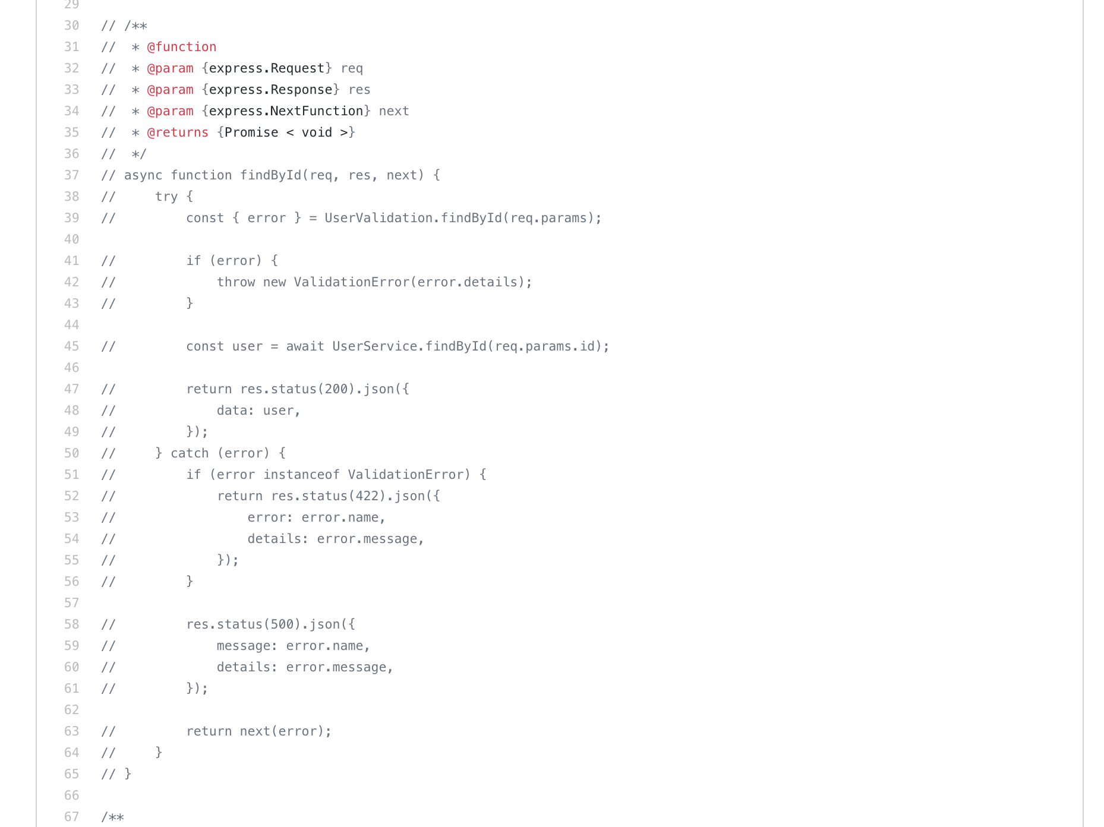

Slide 2
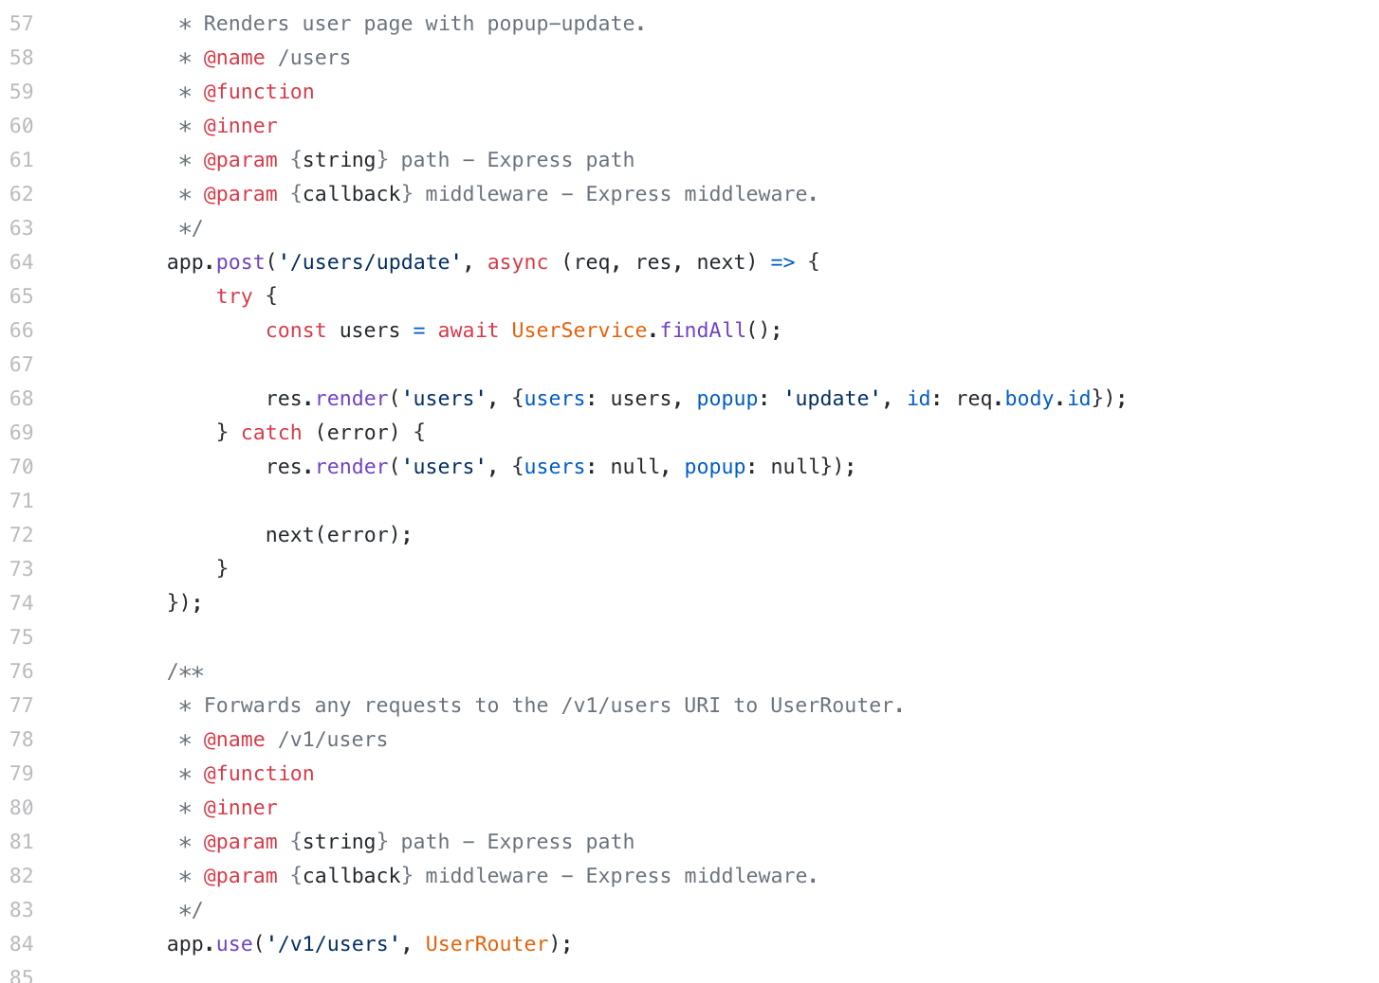

Slide 3
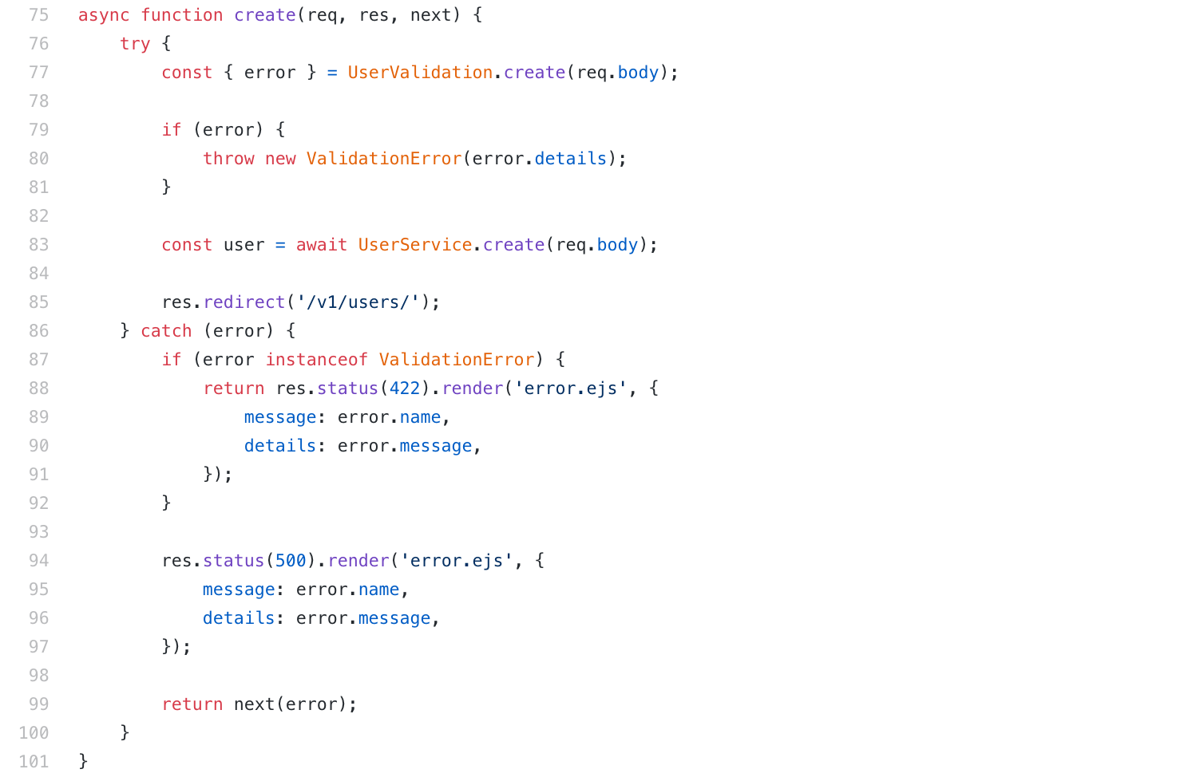

Slide 4
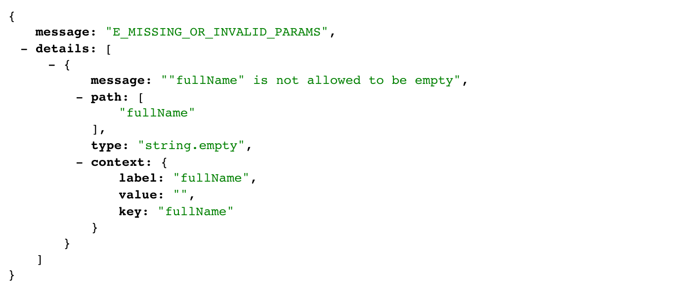

Slide 5
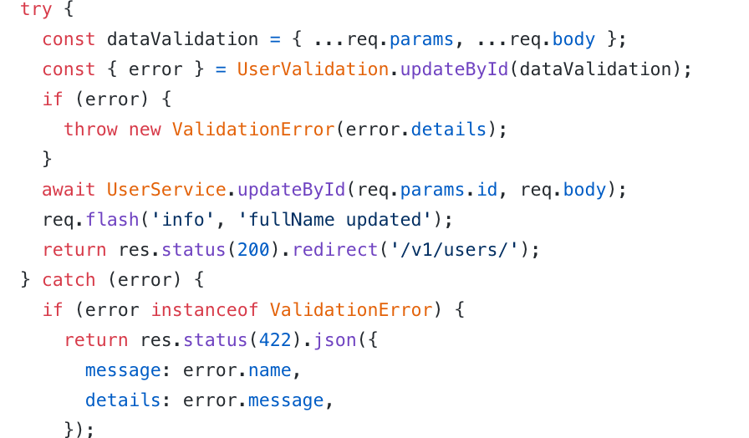

Slide 6
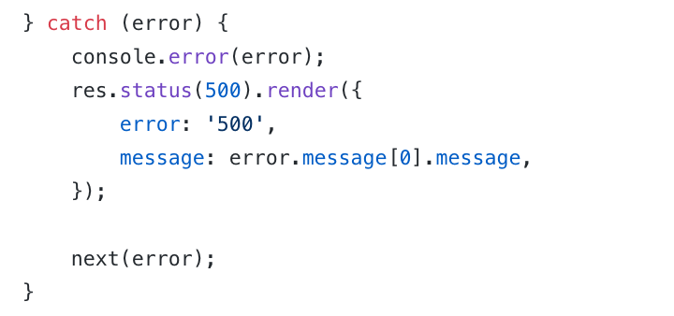
eslint no-console

Slide 7
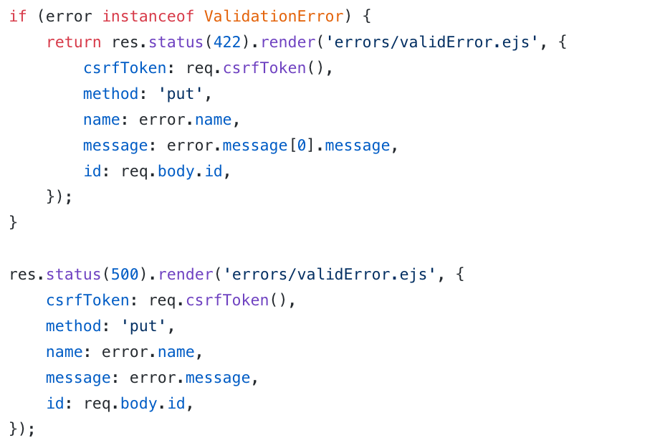

Slide 8
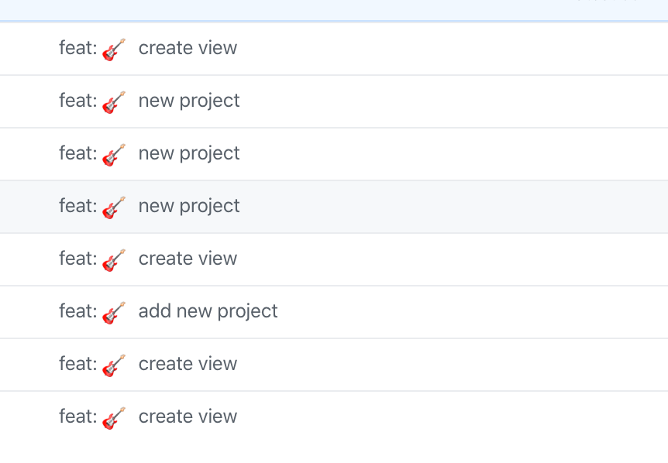
Я заметил :)

Slide 9
FOREACH

Slide 10
headless browser

Slide 13
Chrome
Firefox
PhantomJS
Splash
TrifleJS

Slide 14
Test automation
Screenshot of web pages
Scraping

Slide 15
const puppeteer = require('puppeteer');
(async () => {
const browser = await puppeteer.launch();
const page = await browser.newPage();
await page.goto('https://example.com');
await page.screenshot({path: 'example.png'});
await browser.close();
})();

Slide 16
Save List of emails to MondoDB collection ‘GrabbingEmails’
Create screenshot from users table and upload to google drive Save public link to file in collection ‘Screenshots’

