Slide 1
Introduction to Artificial Intelligence and Machine Learning
Fundamentals and applications transforming modern technology
CS131 Spring 2026 Semester Project - Pierce Benjamin Hales
Notes:
AI-generated content may be incorrect. ---

Slide 2
Foundations, Methods, and Future of AI
---[:AI is Everywhere:]--- ...but how does it actually work?
Notes:
Introduction to Artificial Intelligence and Machine Learning, Historical Evolution from Rule-Based Logic to Learning Systems, Understanding the Hierarchy: AI, Machine Learning, and Deep Learning, Traditional Programming Versus Machine Learning Paradigms, Data as the Fundamental Fuel of Intelligent Systems, Supervised Learning and the Role of Labeled Examples, Unsupervised Learning and Discovery of Hidden Structure, Reinforcement Learning and Reward-Based Optimization, Feature Engineering and the Model Training Process, Deep Learning and Neural Network Architectures, Generative AI and Large Language Models, Infrastructure, GPUs, and Cloud Scalability, Edge Computing and Distributed Intelligence, Conclusion: Preparing for an Intelligent Future

Slide 3
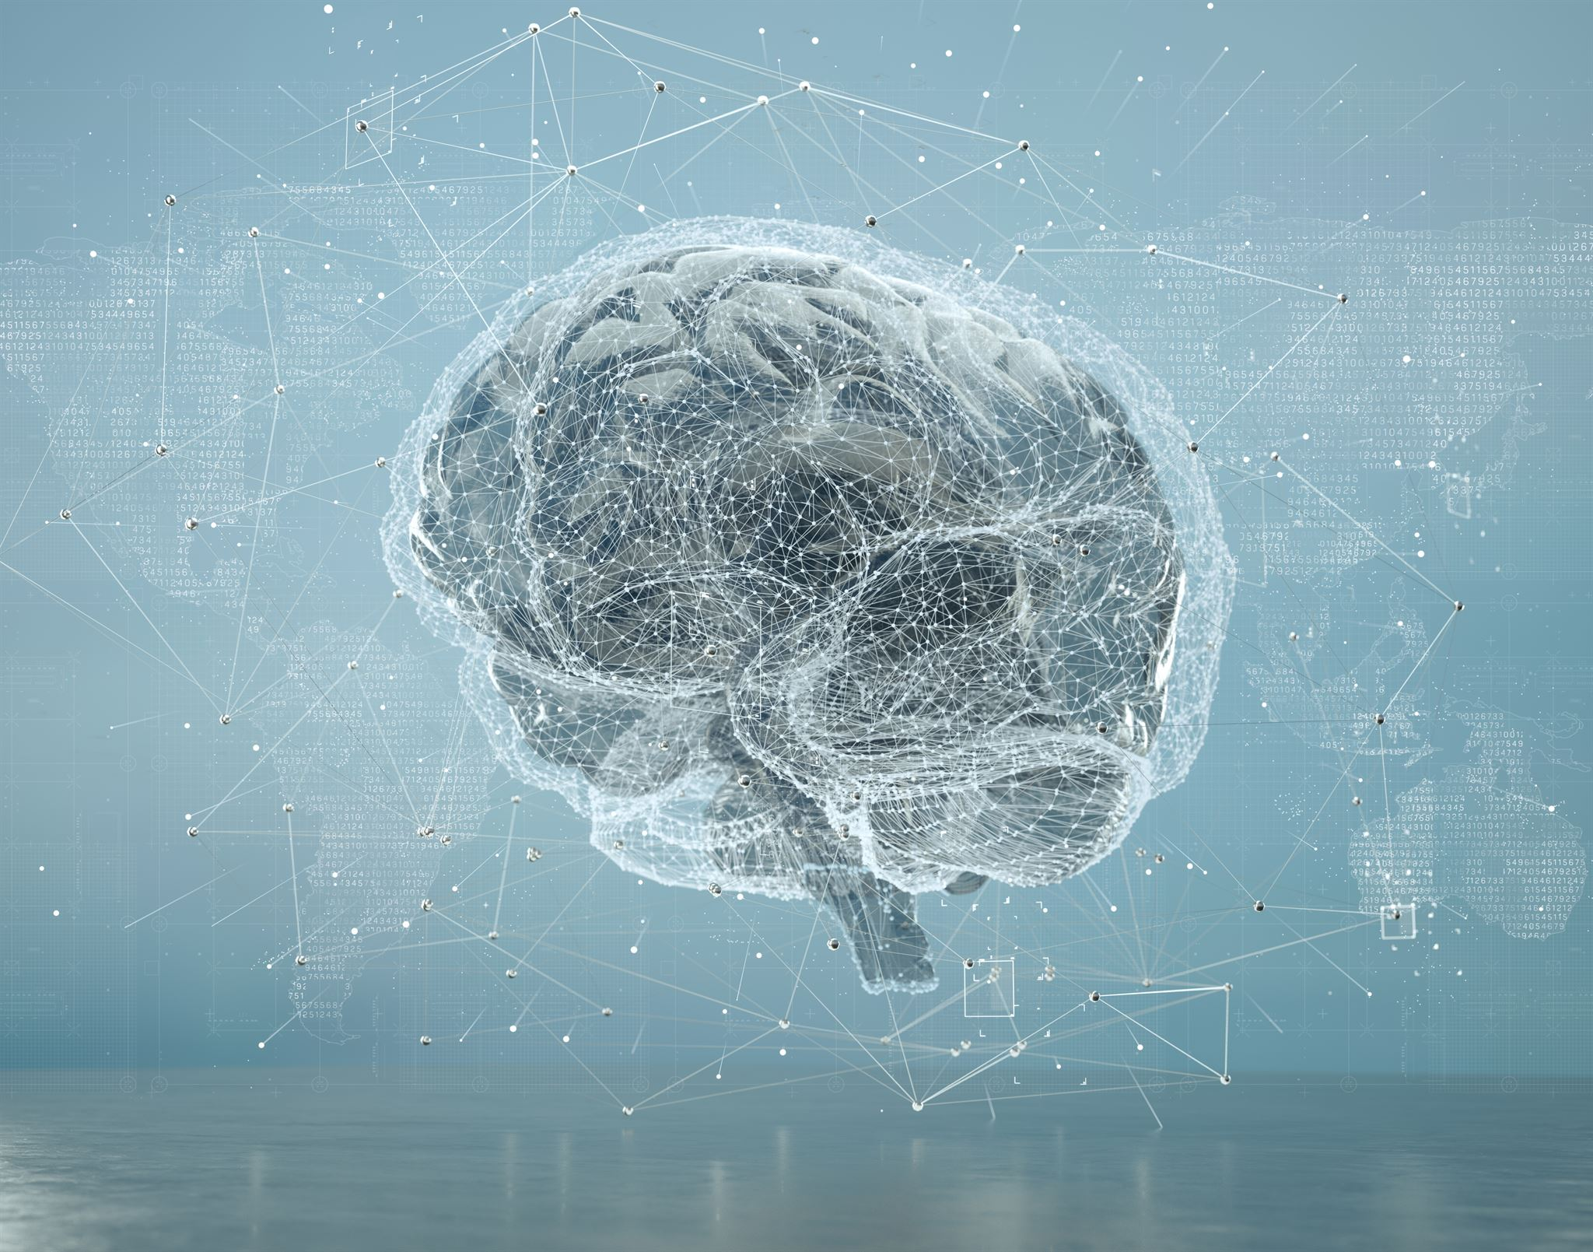
Introduction to Artificial Intelligence and Machine Learning
Artificial Intelligence Defined
AI refers to computer systems performing tasks requiring human intelligence like reasoning and perception.
Machine Learning Explained
ML enables systems to learn from data and improve performance without explicit programming.
Real-world Applications
AI and ML power recommendation engines, voice assistants, and fraud detection in daily life.
Importance and Impact
These technologies scale decision-making across massive datasets faster than humans, transforming industries.
Notes:
Artificial Intelligence and Machine Learning represent two of the most influential technological developments shaping the modern digital world. Artificial Intelligence, often abbreviated as AI, refers broadly to the goal of building computer systems capable of performing tasks that normally require human intelligence, such as reasoning, perception, language understanding, and decision-making. Machine Learning, or ML, is a key approach used to achieve this goal, enabling systems to improve their performance by learning from data rather than relying solely on explicitly programmed instructions. These technologies now power everyday experiences, from recommendation engines on Netflix and YouTube to voice assistants like Siri and Alexa, and fraud detection systems used by banks. Despite their widespread use, many people conflate AI and Machine Learning or treat them as mysterious black boxes. A clear understanding begins by recognizing that AI is the overarching ambition, while Machine Learning is the primary engine driving recent progress. The importance of these technologies lies not only in automation, but in their ability to scale decision-making across massive datasets at speeds no human could match. As data volumes explode due to smartphones, sensors, and the internet, traditional software approaches struggle to keep up. AI-driven systems thrive in this environment, extracting patterns and insights from complexity. This presentation establishes a structured foundation for understanding how AI systems are built, how they learn, and why they are redefining industries ranging from healthcare and finance to transportation and creative work. By grounding the discussion in technical principles rather than hype, this introduction prepares the audience to engage more critically and confidently with intelligent systems.

Slide 4
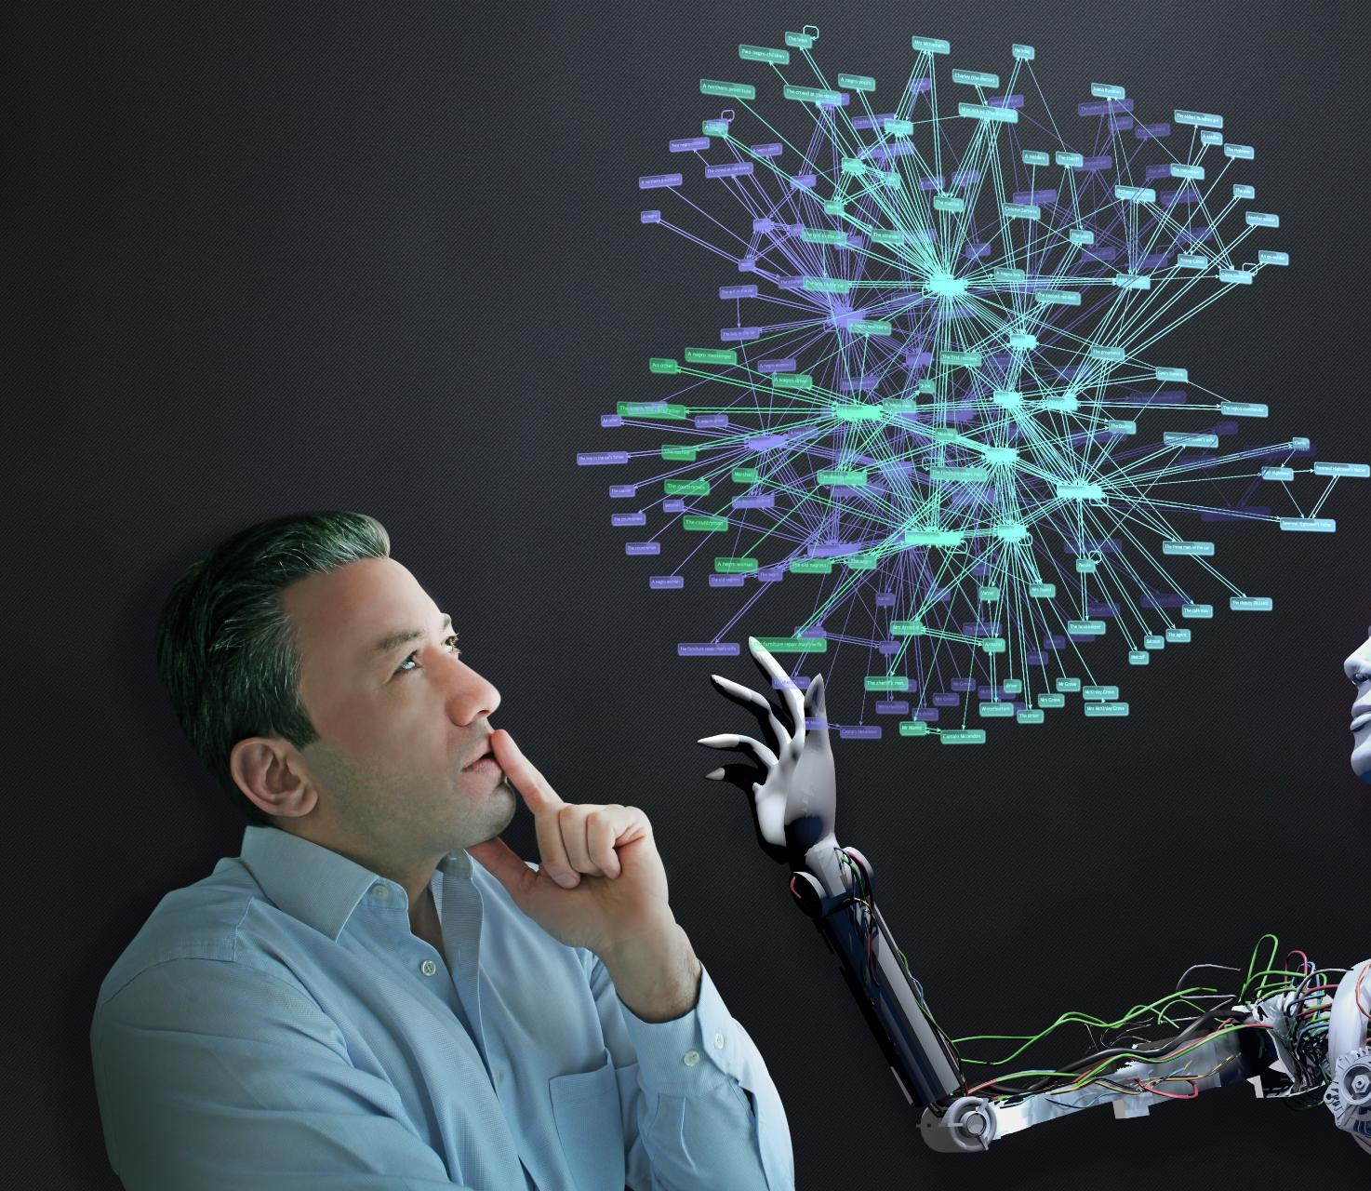
Historical Evolution from Rule-Based Logic to Learning Systems
Early AI and Symbolic Logic
Early AI used rule-based systems relying on handcrafted if-then logic to simulate expertise in narrow domains.
Limitations of Rule-Based AI
Rule-based AI struggled with brittleness, maintenance costs, and inability to adapt to new conditions or data.
Shift to Machine Learning
Rising computing power and data abundance enabled AI to learn patterns from data rather than explicit programming.
Modern AI Capabilities
Learning-based AI excels at perception, pattern recognition, and prediction but still faces challenges in general reasoning.
Notes:
The origins of Artificial Intelligence trace back to the mid-20th century, when early computer scientists began asking whether machines could emulate human thinking. Alan Turing’s famous question, “Can machines think?”, laid philosophical and technical groundwork that shaped decades of research. Early AI systems, particularly from the 1950s through the 1980s, were dominated by symbolic logic and expert systems. These systems relied on extensive sets of human-crafted rules, often written as if-then statements, to simulate expertise in narrow domains such as medical diagnosis or chess. While impressive in controlled environments, these approaches struggled in the real world. They were brittle, expensive to maintain, and unable to adapt when conditions changed or when data fell outside predefined rules. As computing power increased and data became more abundant, researchers began exploring statistical approaches that allowed machines to learn patterns directly from examples. This shift marked a fundamental turning point, moving away from programming intelligence explicitly and toward training it implicitly. The rise of Machine Learning in the 1990s and 2000s reflected this new paradigm, supported by advances in probability theory, optimization, and hardware performance. This historical transition explains why modern AI systems excel at perception, pattern recognition, and prediction, yet still struggle with general reasoning. Understanding this evolution highlights why learning-based systems now dominate AI research and why data, rather than handcrafted logic, has become the most valuable resource in intelligent computing.

Slide 5
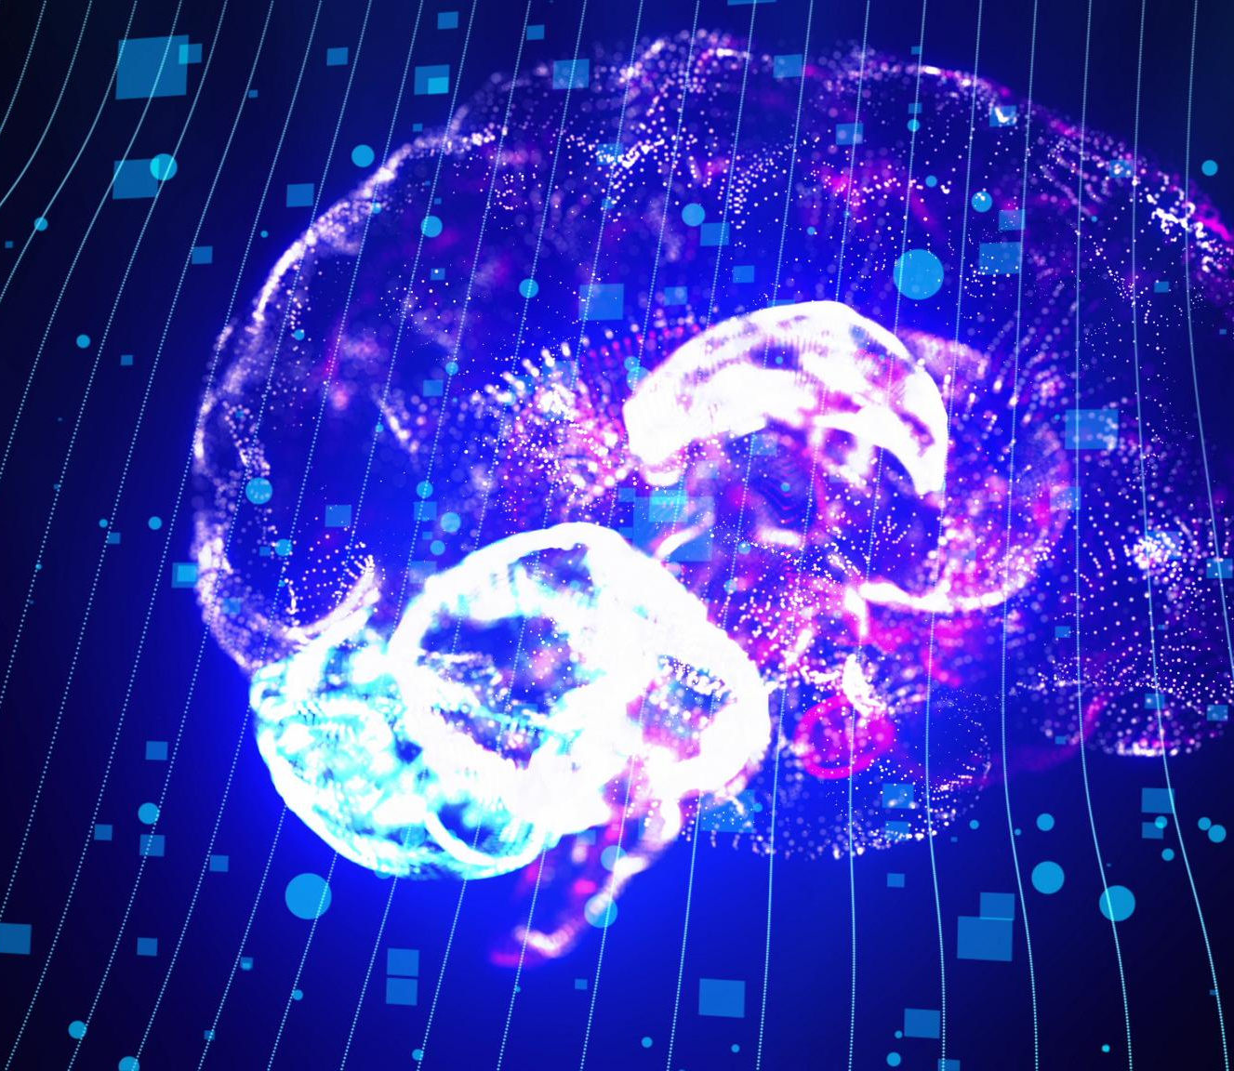
Understanding the Hierarchy: AI, Machine Learning, and Deep Learning
Artificial Intelligence Overview
AI is the broadest field enabling machines to perform human-like tasks including reasoning and perception.
Machine Learning Explained
Machine Learning uses statistical methods to improve systems through data experience and pattern recognition.
Deep Learning Specialization
Deep Learning uses multi-layered neural networks to handle complex unstructured data like images and language.
Hierarchy Importance
Understanding that AI, ML, and Deep Learning form a hierarchy clarifies capabilities and appropriate application areas.
Notes:
Artificial Intelligence, Machine Learning, and Deep Learning form a nested hierarchy that is often misunderstood. Artificial Intelligence is the broadest concept, encompassing any technique that enables machines to perform tasks associated with human intelligence, including reasoning, planning, and perception. Within AI, Machine Learning represents a specific methodology that uses statistical techniques to allow systems to improve through experience. Rather than following static rules, Machine Learning models identify patterns within data and use those patterns to make predictions or decisions. Deep Learning exists as a further subset within Machine Learning and refers to models built using multi-layered artificial neural networks. These deep architectures excel at handling unstructured data such as images, audio, and natural language. For example, while a traditional ML model might rely on manually selected features to classify emails as spam, a deep learning model can automatically learn relevant representations directly from raw text. This hierarchy clarifies that not all AI systems are based on Machine Learning, and not all Machine Learning systems use deep learning. However, the recent surge in AI capabilities is largely driven by deep learning due to its ability to scale with data and computational power. Recognizing these distinctions helps demystify terminology and allows for more precise discussions about capabilities, limitations, and appropriate use cases across different AI approaches.

Slide 6

Traditional Programming Versus Machine Learning Paradigms
Traditional Programming Logic
Developers explicitly define rules that computers follow deterministically for predictable outputs in defined problems.
Machine Learning Approach
Machine Learning uses large datasets and algorithms to infer logic, adapting to new and complex data automatically.
Strengths and Challenges
Machine Learning excels in perception and prediction but faces challenges in interpretability and data quality reliance.
Hybrid Software Systems
Modern systems combine traditional programming for control with Machine Learning for adaptability and prediction.
Notes:
Traditional software development and Machine Learning differ fundamentally in how logic is created and applied. In conventional programming, a developer explicitly defines the rules that govern how inputs are transformed into outputs. The computer executes these instructions deterministically, producing predictable results as long as conditions remain consistent. This approach works well for clearly defined problems, such as calculating taxes or managing inventory systems. Machine Learning inverts this workflow. Instead of supplying rules, engineers provide large datasets along with desired outcomes, allowing the algorithm to infer the underlying logic autonomously. For example, rather than coding explicit rules for identifying handwritten digits, developers train a model using thousands of labeled images. The model learns statistical relationships that generalize to new, unseen data. This paradigm shift enables systems to handle complexity and variability that would be impractical to encode manually. However, it also introduces challenges, including reduced interpretability and reliance on data quality. Understanding this contrast explains why Machine Learning excels in perception and prediction tasks, while traditional programming remains dominant in systems requiring strict control, transparency, and deterministic behavior. In practice, modern software systems often combine both approaches, leveraging Machine Learning where adaptability is required and classical logic where precision and control are paramount.

Slide 7

Data as the Fundamental Fuel of Intelligent Systems
Data Quality Impact
Algorithm performance depends heavily on the quantity, quality, and diversity of training data used.
Data Preprocessing Challenges
Preprocessing and cleaning real-world data is vital due to noise, missing values, and inconsistencies.
Bias and Ethical Concerns
Datasets may contain social and historical biases that can lead to unfair AI outcomes.
Data Governance Importance
Robust data pipelines, governance, and ethical oversight ensure responsible and reliable AI systems.
Notes:
Data is the foundational resource that powers Machine Learning and, by extension, modern Artificial Intelligence. An algorithm’s effectiveness is directly tied to the quantity, quality, and diversity of the data used during training. Real-world data is rarely clean or complete, often containing noise, missing values, and inconsistencies that can mislead models. As a result, data preprocessing and cleaning consume a significant portion of AI development time. Beyond technical issues, data also encodes social and historical biases. If a training dataset reflects biased hiring practices or unequal access to resources, the resulting model may perpetuate or amplify those inequities. This reality underscores the importance of careful dataset curation, auditing, and evaluation. The phrase “garbage in, garbage out” captures this dependency succinctly, emphasizing that even the most advanced algorithms cannot overcome fundamentally flawed data. Organizations that invest in robust data pipelines, governance, and ethical oversight gain a substantial advantage in building reliable and responsible AI systems. Recognizing data as both an asset and a liability is essential for anyone seeking to deploy Machine Learning at scale.

Slide 8
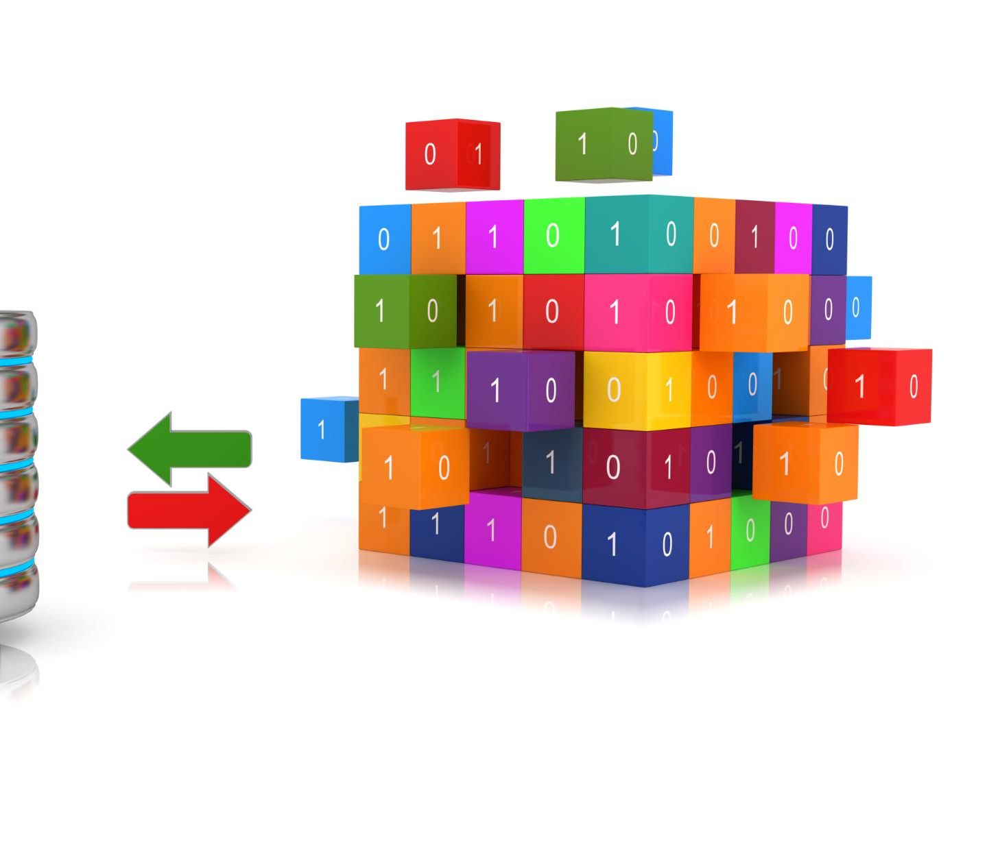
Supervised Learning and the Role of Labeled Examples
Definition of Supervised Learning
Supervised learning uses labeled data where each input is paired with a known output for training models.
Applications of Supervised Learning
Common uses include predicting prices, spam detection, and medical image diagnosis with measurable accuracy.
Challenges in Supervised Learning
Creating labeled datasets is costly and models may struggle with new, unseen data beyond training scope.
Importance in AI Systems
Despite challenges, supervised learning is central to AI systems for its effectiveness and clear evaluation metrics.
Notes:
Supervised Learning is the most widely used category of Machine Learning and is characterized by the presence of labeled training data. In this setting, each input example is paired with a known output, effectively providing the model with a teacher. The algorithm’s objective is to learn a function that maps inputs to outputs with minimal error. Common applications include predicting housing prices, classifying emails as spam or not spam, and diagnosing diseases based on medical images. The strength of supervised learning lies in its clarity and measurable performance, as accuracy can be directly evaluated against known answers. However, creating labeled datasets is often expensive and time-consuming, requiring human expertise or extensive data collection efforts. Additionally, supervised models are limited by the scope of their training data and may perform poorly when encountering novel situations. Despite these challenges, supervised learning remains the backbone of many commercial AI systems due to its effectiveness, interpretability, and alignment with well-defined business objectives.

Slide 9

Unsupervised Learning and Discovery of Hidden Structure
Unlabeled Data Challenges
Unsupervised learning handles raw data without labels, identifying patterns without explicit guidance.
Clustering Algorithms
Clustering methods like k-means group data based on similarities such as customer behavior or demographics.
Dimensionality Reduction
Techniques like principal component analysis simplify complex data to reveal underlying structure.
Insight Generation
Unsupervised learning provides exploratory insights but requires human interpretation for meaningful conclusions.
Notes:
Unsupervised Learning addresses scenarios where labeled data is unavailable or impractical to obtain. In this paradigm, the algorithm receives only raw input data and must identify patterns, groupings, or structures without explicit guidance. Clustering algorithms, such as k-means, are commonly used to segment customers based on purchasing behavior, browsing habits, or demographic similarities. Dimensionality reduction techniques, like principal component analysis, help uncover underlying structure by simplifying complex datasets. The value of unsupervised learning lies in its exploratory power, enabling organizations to generate insights that were not predefined. However, interpreting the results often requires human judgment, as the discovered patterns may not align neatly with existing categories. Unsupervised learning transforms unstructured data into actionable knowledge, making it especially valuable in early-stage analysis, anomaly detection, and knowledge discovery across large and complex datasets.

Slide 10

Reinforcement Learning and Reward-Based Optimization
Core Concept of Reinforcement Learning
An agent learns to maximize cumulative reward through interaction and feedback in an environment.
Learning Through Trial and Error
Reinforcement learning relies on trial and error without labeled examples, requiring many iterations.
Applications in Complex Domains
Used successfully in game playing, robotics, and autonomous driving for strategic decision-making.
Challenges and Research
Computational intensity and safety concerns make real-world deployment difficult but vital for adaptive systems.
Notes:
Reinforcement Learning represents a distinct approach to Machine Learning based on interaction, feedback, and long-term optimization. In this framework, an agent operates within an environment, taking actions and receiving rewards or penalties in response. The agent’s goal is to learn a policy that maximizes cumulative reward over time. Unlike supervised learning, reinforcement learning does not rely on labeled examples of correct behavior. Instead, it learns through trial and error, often requiring millions of iterations. This approach has achieved remarkable success in domains such as game playing, robotics, and autonomous driving. For example, reinforcement learning systems have defeated world champions in games like Go and StarCraft by discovering strategies beyond human intuition. Despite its power, reinforcement learning is computationally intensive and challenging to deploy safely in real-world environments. Nevertheless, it remains a critical area of research for building adaptive systems capable of sequential decision-making under uncertainty.

Slide 11
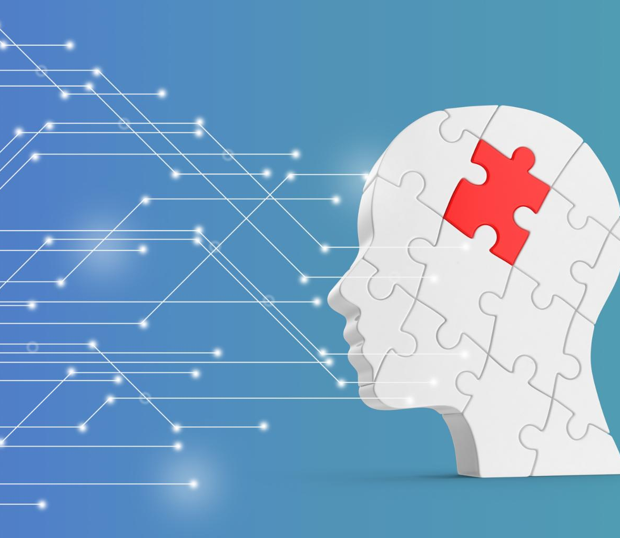
Feature Engineering and the Model Training Process
Role of Feature Engineering
Feature engineering transforms raw data into meaningful inputs that improve model learning effectiveness.
Model Parameter Optimization
Model training adjusts weights and biases to minimize prediction errors using optimization algorithms.
Loss Function and Feedback
Loss functions measure prediction errors and guide iterative improvements in model accuracy.
Balancing Underfitting and Overfitting
Effective training balances simplicity and complexity to ensure generalization beyond training data.
Notes:
The training of a Machine Learning model involves transforming raw data into a form that an algorithm can effectively learn from. Feature engineering plays a crucial role in this process, as it determines which variables are presented to the model and how they are represented. During training, the model adjusts internal parameters, commonly referred to as weights and biases, to minimize prediction error. A loss function quantifies the difference between predicted and actual outcomes, providing a signal for improvement. Optimization algorithms, such as gradient descent, iteratively update parameters to reduce this loss. This cycle may repeat thousands or millions of times, gradually improving model accuracy. The training process highlights the balance between underfitting, where a model is too simple, and overfitting, where it memorizes training data but fails to generalize. Mastery of these concepts is essential for building robust and reliable Machine Learning systems.

Slide 12

Deep Learning and Neural Network Architectures
Layered Neural Network Structure
Deep learning uses multiple layers of interconnected nodes to model complex relationships in data hierarchically.
Applications of Deep Learning
Deep learning excels in image recognition, speech transcription, and natural language understanding tasks.
Challenges in Deep Learning
Deep learning models require large datasets and computational power but often lack transparency and interpretability.
Notes:
Deep Learning leverages artificial neural networks composed of multiple layers to model complex, non-linear relationships within data. Inspired loosely by the human brain, these networks consist of interconnected nodes that process information hierarchically. An input layer receives raw data, hidden layers extract increasingly abstract features, and an output layer produces final predictions. This layered structure enables deep learning models to excel at tasks such as image recognition, speech transcription, and natural language understanding. For instance, in facial recognition, early layers detect edges and textures, while deeper layers identify facial features and ultimately recognize identities. The effectiveness of deep learning depends heavily on large datasets and powerful computational resources. While these models achieve state-of-the-art performance, they often lack interpretability, raising questions about transparency and trust. Despite these challenges, deep learning remains the driving force behind many of today’s most advanced AI applications.

Slide 13

Generative AI and Large Language Models
Generative AI Capabilities
Generative AI creates new content such as text, code, and conversation instead of just analyzing data.
Transformer Architecture
LLMs use transformer models with self-attention to understand context in large sequences of data.
Applications of LLMs
Applications include customer chatbots, creative writing tools, and software development assistants.
Ethical and Practical Concerns
Generative AI raises issues of misinformation, intellectual property, and ethics requiring responsible use.
Notes:
Generative AI marks a significant evolution in Artificial Intelligence by enabling systems to create new content rather than merely analyze existing data. Large Language Models, or LLMs, exemplify this shift by generating human-like text, writing code, and engaging in conversation. These models are typically built using transformer architectures that rely on self-attention mechanisms to capture contextual relationships across vast sequences of data. Trained on enormous corpora of text, LLMs develop statistical representations of language that allow them to produce coherent and contextually relevant responses. Applications range from customer support chatbots to creative writing tools and software development assistants. While powerful, generative models also raise concerns related to misinformation, intellectual property, and ethical use. Understanding their underlying mechanisms and limitations is essential for responsible deployment in real-world scenarios.

Slide 14

Infrastructure, GPUs, and Cloud Scalability
Computational Demand of AI
AI training requires processing massive datasets and trillions of operations, surpassing traditional CPU capabilities.
Role of GPUs and Accelerators
GPUs and specialized accelerators enable parallel computation, accelerating AI model training efficiently.
Cloud Computing Scalability
Cloud platforms provide on-demand resources, enabling scalable AI experimentation and global system deployment.
Transforming AI Accessibility
Combination of hardware and cloud services makes AI accessible and practical for organizations of all sizes.
Notes:
Modern AI systems depend on vast computational infrastructure to train and deploy models at scale. Training advanced Machine Learning and deep learning models involves processing massive datasets and performing trillions of mathematical operations. Traditional CPUs are insufficient for this workload, leading to widespread adoption of GPUs and specialized accelerators optimized for parallel computation. Cloud computing platforms provide on-demand access to these resources, allowing organizations to scale experimentation and deployment without building costly local infrastructure. The cloud also enables global distribution, monitoring, and continuous improvement of AI systems. This combination of specialized hardware and elastic cloud services has transformed AI from an academic pursuit into a practical, industrial technology accessible to organizations of all sizes.

Slide 15

Edge Computing and Distributed Intelligence
Decentralized AI Inference
Edge computing shifts AI inference from centralized clouds to local devices, reducing latency and improving privacy.
Model Optimization Techniques
Techniques like model compression and quantization enable running AI on resource-constrained edge hardware efficiently.
Real-time Edge Applications
Edge AI powers real-time applications such as autonomous driving, industrial automation, and healthcare monitoring.
Evolving Cloud-Edge Balance
Improved connectivity and hardware enable a dynamic balance between cloud and edge computing for resilient AI ecosystems.
Notes:
Edge computing represents a growing trend in AI deployment, shifting inference from centralized cloud servers to local devices such as smartphones, sensors, and vehicles. By running models directly on the edge, systems reduce latency, improve reliability, and enhance privacy by keeping sensitive data local. Techniques such as model compression and quantization make it possible to deploy sophisticated intelligence on resource-constrained hardware. Edge AI is particularly valuable in applications requiring real-time responsiveness, including autonomous driving, industrial automation, and healthcare monitoring. As connectivity and hardware capabilities improve, the balance between cloud and edge computing will continue to evolve, creating a more distributed and resilient AI ecosystem.

Slide 16

Conclusion: Preparing for an Intelligent Future
AI and ML Foundations
AI and ML have evolved into essential technologies that transform software development and decision-making processes.
Opportunities and Challenges
AI offers new ways to enhance human abilities and optimize processes but raises ethical and societal concerns.
Responsible Engagement
Understanding AI's principles enables responsible, effective use and guides informed decisions on design and governance.
Notes:
Artificial Intelligence and Machine Learning have transitioned from experimental concepts to foundational technologies reshaping how software is built and how decisions are made. Understanding their principles, from data and algorithms to infrastructure and deployment, is increasingly essential for professionals across industries. These systems offer unprecedented opportunities to augment human capabilities, optimize complex processes, and unlock new forms of creativity. At the same time, they introduce challenges related to ethics, transparency, and societal impact. By developing a grounded understanding of how machines learn and reason, individuals and organizations can engage with AI more responsibly and effectively. The intelligent future will be shaped not only by technological innovation, but by informed choices about how these powerful tools are designed, governed, and applied.

