Slide 1
CNN Journey
Summer 2020

Slide 2
Terminology used
API
Interface
Keras
Tensorflow
Anaconda
Python
Pip
CNN
Juypter notebook
Add here

Slide 3
Where do I start?
Start off getting an understanding of CNN from YouTube, different articles and books.
Get an understanding of Anaconda, TensorFlow, Keras, virtual environments, Jupyter notebook, python.
Install TensorFlow or Keras. Recommend using Anaconda and create an environment with the necessary installs.

Slide 4
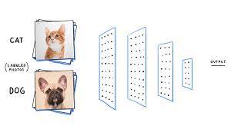
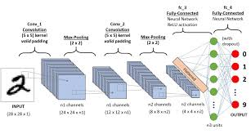
CNN
CNN (Convolutional Neural Networks) is a Deep learning algorithm that takes input image, assign importance by using weight and biases to various aspects/objects in the image and be able to differentiate one from the other.
Notes:
https://www.youtube.com/watch?v=kOFUQB7u5Ck
About MINST @ 12:40
https://machinelearningmastery.com/how-to-develop-a-convolutional-neural-network-from-scratch-for-mnist-handwritten-digit-classification/
https://docs.google.com/document/d/1dw2wuPO-zy2RBZEIXnOzSFxYb-Iwq3fZW4zR4NE8aPo/edit?ts=5ed6d379

Slide 5
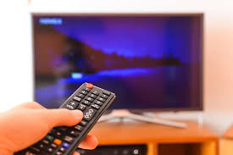
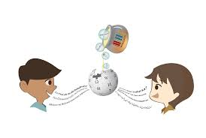
Interface
A device or a system that unrelated entities use to interact.
Examples:
A remote control is an interface between you and a television set.
A linguist translator is an interface between you (English speaker) and another person (ex. French speaker)

Slide 6
An API is …
API (Application programming interface )- a set of functions and procedures allowing the creation of applications that access the features or data of an operating system, application or other services.
Specifies how software components should interact.
APIs are used when programming graphical user interface (GUI) components.
An example of an API is … KERAS

Slide 7

Keras
Keras is an api designed for human beings. Keras follows the best practices for reducing cognitive load. Offering consistent and simple APIs. Also, Minimizes the # of users action required for common use cases. Keras also has an extensive documentation and developer guides.
You can export keras models to JavaScript to run directly in the browser.
Keras is used by companies like CERN, NASA and NIH

Slide 8
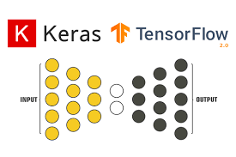

Slide 9
TensorFlow
Tensorflow is a python friendly open source library for numerical operations that make machine learning faster and easier.

Slide 10
pip
Pip (preferred installer program) starting with Python 3.4, it is included by default with the Python binary installers.

Slide 11
What language was used?
Python

Slide 12
Juypter notebook
https://github.com/Microsoft/vscode-python/blob/master/PYTHON_INTERACTIVE_TROUBLESHOOTING.md

Slide 13
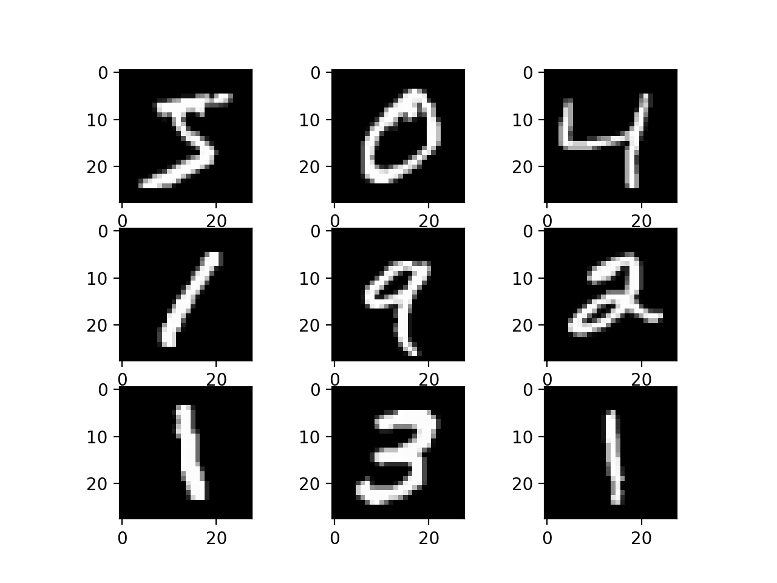
MNIST Handwritten Digit

Slide 14
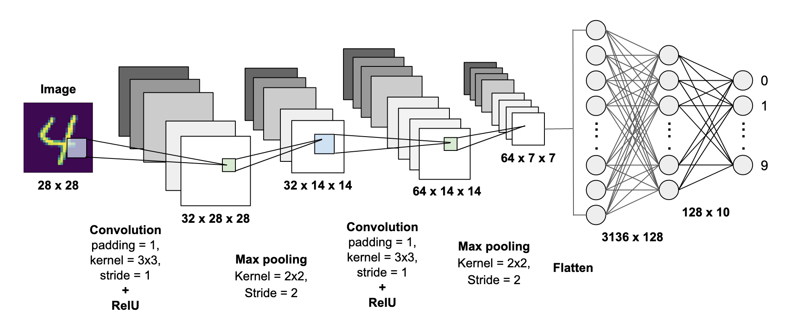
Using MNIST handwritten digit classification problem

Slide 15
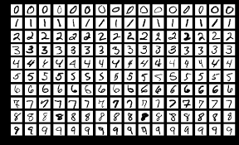
MNIST database
MNIST ( Modified National Institute of Standards and Technology database.
This is a large database of handwritten digits that are commonly used for training various image processing systems.
This database is also widely used for training and testing Machine Learning.
The dataset contains 60,000 training images and 10,000 testing images.

Slide 16
The Problem
60,000 small squares 28 x 28-pixel grayscale images of handwritten single digits between 0 and 9.
Task: Classify a given image of handwritten digit into 1 of 10 classes representing integer values from 0 to 9, inclusively.
Solvable: Top Performing models are deep learning CNN that achieve of above 99% with an error rate between 0.4% and 0.2%

Slide 17
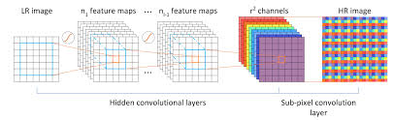
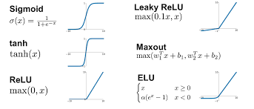
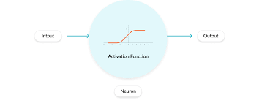
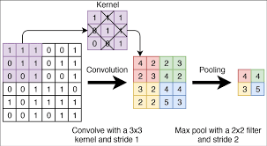
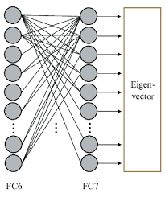
Layers in a CNN
Convolution layer
Activation layer
Pooling layer
Fully connected layer

Slide 18
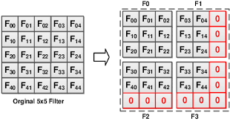
Filter
Small matrix for which we decide the # of columns and rows that this matrix has

Slide 19
Filtering**
The math behind matching pixels is called Filtering.
Line up the feature and the image patch.
The feature is lined up with a little patch of the image.
Then one by one the pixels are compared
Multiply each image pixel by the corresponding feature pixel.
The pixels are multiplied by each other.
Add them up
Divide by the total # of pixels.

Slide 20
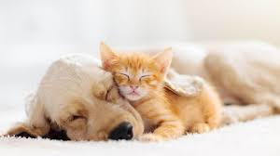
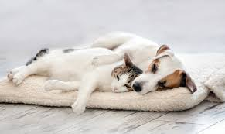
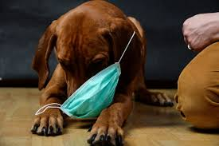
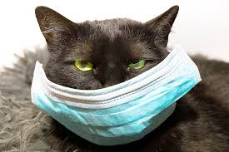
Cats and Dogs

Slide 21
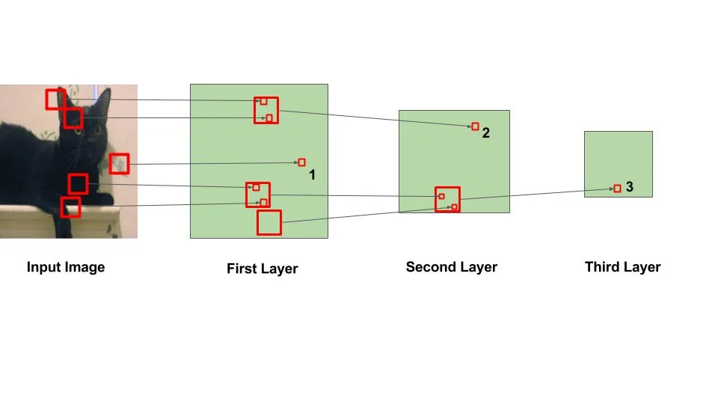
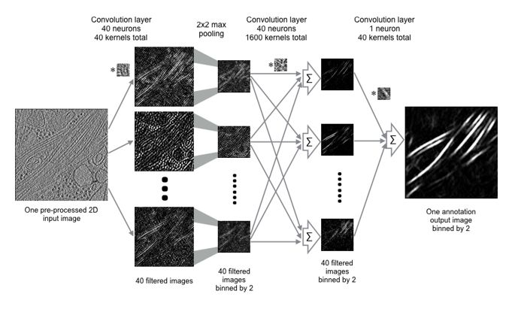
Multi-Layer- using example faces, cars or animals
First layer
Edges, dots, bright spots, dark spots
Edges, dots
Second layer (Things that are recognizable)
Eyes, noses, mouth
Tires, wheel, hoods
Third layer
Things that look like faces
Things that are clearly identifies by cars

Slide 22
Convolution layer – 1 trick
One image becomes a stack of filtered images
Notes:
9 by 9 after comparison will have a map of 7 by 7
9 -2 = 7
If 128 by 128 after comparison will be 126 by 126
Comparison can only be 2 at a time

Slide 23
Pooling (shrinking the image stack)
Pick a window size (usually 2 or 3)
Pick a stride( usually 2)
Walk your window across your filtered images.
From each window, take the maximum value
Shrinking will be half of original.
Notes:
9 by 9 after comparison will have a map of 7 by 7
9 -2 = 7
If 128 by 128 after comparison will be 126 by 126
Comparison can only be 2 at a time

Slide 24
Normalizing – ex.ReLU
Another type of layers with no negative values

Slide 25
Fully Connected Layer
Every value gets a vote/say.

Slide 26
Hyperparameters (not learned automatically)
Decisions the person writing gets to determine
Convolution
# of features
Sizes of features
Pooling
Window size
Window stride
Fully connected
# of neurons
Architecture
How many of each type of layer?
Can we create a new layer to access?

Slide 27
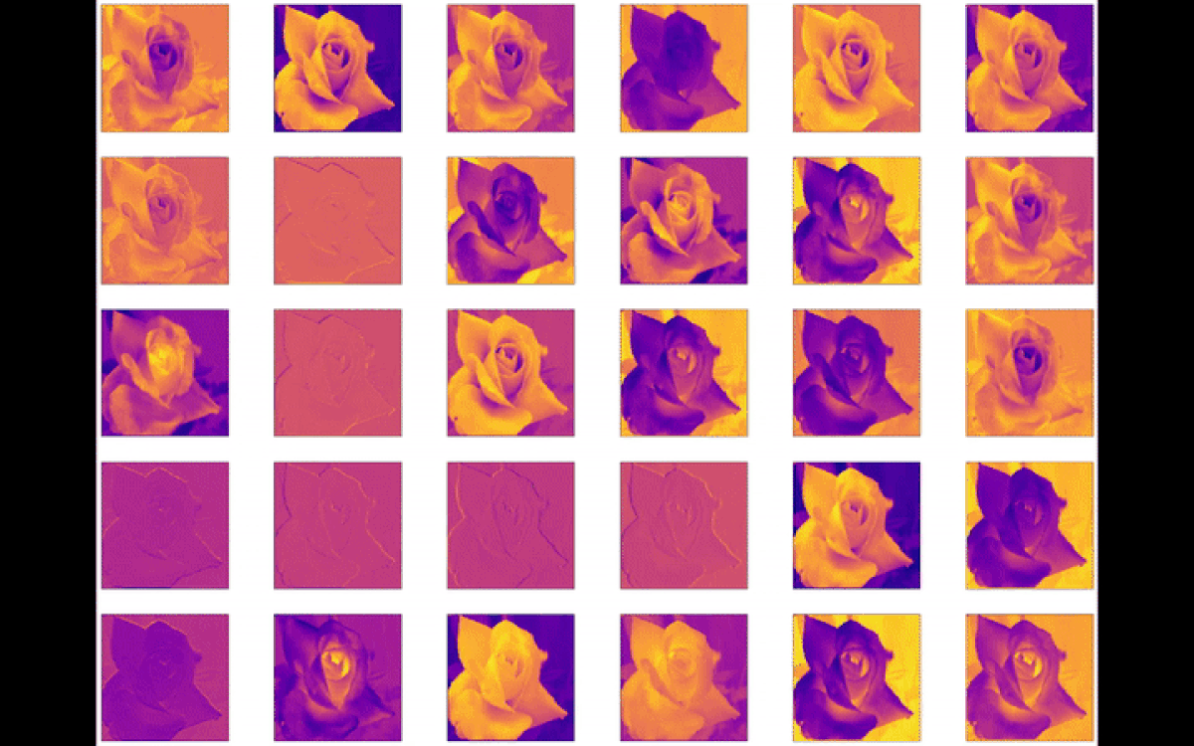
Visualization of layers in an image

Slide 28
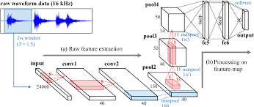
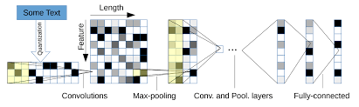
Other problems CNNs can be used for
Sound:
Time steps(column) vs Intensity in each(rows) , frequency band.(rows)
Text:
Position in sentence vs words in dictionary

Slide 29
Limitation of CNN
Spatial data

Slide 30
Source
Rosebrock, A., Pierce, G., Bonn, D., Girish, K., Viguerie, J., Rolbiecki, P., … Niko. (2020, April 18). Keras vs. tf.keras: What's the difference in TensorFlow 2.0? Retrieved from https://www.pyimagesearch.com/2019/10/21/keras-vs-tf-keras-whats-the-difference-in-tensorflow-2-0/
Saha, S. (2018, December 17). A Comprehensive Guide to Convolutional Neural Networks - the ELI5 way. Retrieved from https://towardsdatascience.com/a-comprehensive-guide-to-convolutional-neural-networks-the-eli5-way-3bd2b1164a53
https://www.medpagetoday.com/infectiousdisease/covid19/85860

