Slide 1




Yuxi Chen, Shu Wang, Shan Lu, and Karthikeyan Sankaralingam*
*

Slide 2






2
Synchronization mistakes in multithreaded programs
Thread 1
Thread 2
If(ptr){
ptr = NULL;
tmp = *ptr;
}
Segfault

Slide 3


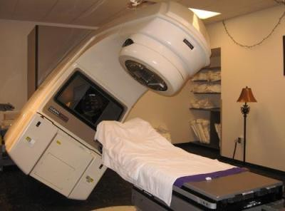
3
Common
Hard to diagnose and fix correctly
Disasters in production runs

Slide 4

4
Semantic correctness
Performance
Low recovery latency
Low overhead
So what’s the solution?

Slide 5

5
Thread 1
Execution
Thread 2
Failure site
Thread 3

Slide 6




Traditional Roll-back Recovery
6
Execution
Whole-program memory-state checkpoint
Thread 1
Thread 2
Thread 3
Failure site

Slide 7

7
Recovery capability
Rx
good capability poor performance
0.5
10
Overhead (%)
[1]Rx:Treating bugs as allergies – a safe method to survive software failure, SOSP’05

Slide 8

ConAir Roll-back Recovery
8
Thread 1
Thread 2
Execution
longjmp
Failure site
Thread 3
setjmp

Slide 9

9
Recovery capability
Rx
good capability poor performance
poor capability good performance
ConAir
0.5
10
Overhead (%)

Slide 10





10
ConAir cannot reexecute shared-variable writes
Thread 1
Thread 2
Heap
ptr = NULL;
*buf = 0x122334
If(ptr){
*buf_{old} = 0x123
*buf_{new} = 0x234
*buf = newBuf();
tmp = *ptr;
}
Segfault

Slide 11



11
Recovery capability
Rx
better capability worse performance
worse capability better performance
ConAir
0.5
10
Overhead (%)

Slide 12



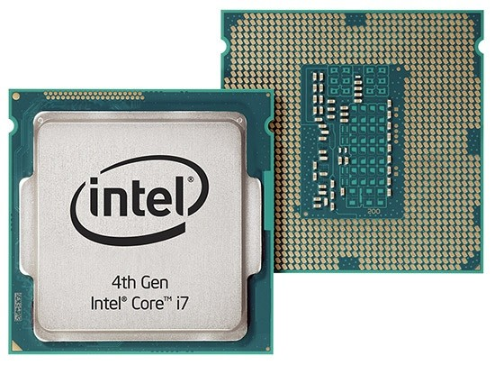



BugTM static analysis code transformation
12
Xbegin Xabort
Xend
Leveraging HTM
Recovery capability
Rx
BugTM_{H}
ConAir
0.5
3
Overhead (%)
10

Slide 13









BugTM static analysis code transformation
13
Xbegin/Setjmp Xabort/Longjmp
Xend
Recovery capability
Rx
BugTM_{H}
BugTM_{HS}
ConAir
0.5 1.5
3
Overhead (%)
10

Slide 14
Outline:
14
BugTM_{H}
BugTM_{HS}
Evaluation Methodology
Experiment Results
Conclusion

Slide 15

15
Implicit checkpoint
Rollback-reexecution
OPPORTUNITY
CHALLENGE

Slide 16

16
Performance challenges
High frequency of transaction uses
Unsuitable content of transactions (eg. trapping instructions)
Nesting && Loops

Slide 17
17
Performance challenges
Correctness challenges
Unpaired transaction-start and transaction-commit
Deterministic aborts (eg. trapping instruction aborts)

Slide 18

18
Performance challenges
Correctness challenges
Failure recovery challenges
Surround the buggy codes when failures happen
HTM-abort handlers
Carefully design HTM start, commit, and abort routines
Selectively insert HTM start, commit, and abort routines

Slide 19
19
Xbegin
Xend
Xtest
Xabort
Thread 1
+Xbegin();
+
Xabort(); assertion();
+Xtest()
+ Xend();

Slide 20









20
mXbegin(){
if(!Xtest())
Xbegin();
}
No nested TM!
mXend(){
if(Xtest())
Xend();
}
No unpaired Xbegin and Xend during run time!

Slide 21
Principle: put mXabort before where failures might happen
21
If(ptr){
*buf = newBuf(); if(ptr == NULL){
+mXabort();
__assert_fail;
}
else{
tmp = *ptr;
}
}

Slide 22
Principle:
22
Avoid trapping instructions abort
Minimize capacity abort
time();
+ mXbegin(); If(ptr){
*buf = newBuf(); if(Ptr==NULL){
+ mXabort();
assert_fail;
}
else{
tmp = *ptr;
}
}

Slide 23














CFG node
23
mXbegin()
Potential failure
Trapping/Call/loop-exit Instruction or function entrance
mXbegin()

Slide 24
Principles:
24
Avoid trapping instructions abort
Minimize capacity abort
End TM before loop entry
End TM before function exit
time ();
+ mXbegin(); If(ptr){
*buf = newBuf(); if(Ptr==NULL){
+ mXabort();
assert_fail;
}else{
tmp = *ptr;
}
}
+ mXend();

Slide 25



















25
mXend()
CFG node
Potential failure
mXend()
Trapping/Call/loop-header instruction
Function exit
mXend()

Slide 26
Design fallback and retry
26
Principle: Reexecution only when aborts might be caused by concurrency bugs
Concurrency bug relevant aborts (reexecute in Tx mode)
Data conflict abort && Xabort abort
Concurrency bug irrelevant aborts (reexecute in non-Tx mode)
Capacity abort && Trapping instruction abort

Slide 27
Outline:
27
BugTM_{H}
BugTM_{HS}
Evaluation Methodology
Experiment Results
Conclusion

Slide 28
: locations where ConAir inserts setjmp
28
^{Loc}setjmp
Loc_{mXbegin}: locations where BugTM_{H} inserts mXbegin
Insert setjmp at every Loc_{setjmp}
Insert mXbegin only when Loc_{mXbegin} is farther than
^{Loc}setjmp
Not insert mXbegin if Loc_{setjmp} and Loc_{mXbegin} are same

Slide 29





















29
mXbegin()
setjmp
CFG node
mXbegin()
Potential failure
Trapping instruction Shared-variable writes
setjmp
Function entrance

Slide 30

30
HTM rollback first (under an active transaction)
longer reexecution region
Longjmp rollback (not under an active transaction)
If HTM rollback fails, longjmp rollback can still have a chance

Slide 31
Outline:
31
BugTM_{H}
BugTM_{HS}
Evaluation Methodology
Experiment Results
Conclusion

Slide 32
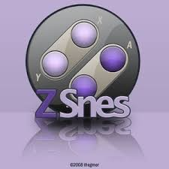





Evaluation methodology
32
Benchmarks (29 bugs^{[1,2,3,4,5,6]})
…….
micro architecture
Broadwell (4-core Intel Core i7-5775C)
LLVM
Guoliang Jin, et al,Automated atomicity-violation fixing, PLDI’11
Horatiu Jula, et al, Deadlock immunity: Enabling systems to defend against deadlocks, OSDI’08
Yao Shi, et al, Do I use the wrong definition? DefUse: Definition-use invariants for detecting concurrency and sequential bugs, OOPSLA’10
Wei Zhang, et al, ConAir: Featherweight concurrency bug recovery via single-threaded idempotent execution,ASPLOS’13
Wei Zhang, et al, ConSeq: Detecting concurrency bugs through sequential errors,ASPLOS’11
Wei Zhang, et al, ConMem: Detecting Crash-Triggering Concurrency Bugs through an Effect-Oriented Approach,ACM TOSEM, 2012.

Slide 33

Recovery capability
33
Recovery capability comparison
Benchmarks(ID) | Root Cause | ConAir | BugTM_{H} |  |  | BugTM_{HS}
Mysql2011 Mysql38883 | RAR Atomicity Violation RAR Atomicity Violation | - - | V V |  |  | V V
Apache21287 | RAW Atomicity Violation | - | V |  |  | V
Moz-JS18025 | RAW Atomicity Violation | - | V |  |  | V
Moz-JS142651 | RAW Atomicity Violation | - | V |  |  | V
Bank | WAR Atomicity Violation | - | V |  |  | V
Transmission | Order Violation | V | - |  |  | V
Total |  | 1 |  | 6 |  | 7
ConAir < BugTM_{H} < BugTM_{HS}

Slide 34
Performance Overhead
34
ConAir > BugTM_{HS} > BugTM_{H}
overhead comparing with baseline: %
14
12
10
8
ConAir BugTMH BugTMHS
6
4
2
0
Bank
Click
FFT
zsnes
HawkNL
Mysql2011
Mysql3596
Mysql791
HTTrack
SQLite1672
Mysql38883
Moz-JS18025
Mysql16582
Transmission
Moz-JS79054
Apache21287
Moz-JS142651
Moz-ex52111
Moz-ex209188
Moz-xpcom61369
Benchmark

Slide 35
Outline:
35
BugTM_{H}
BugTM_{HS}
Evaluation Methodology
Experiment Results
Conclusion

Slide 36
Conclusions
36
BugTM can help recover all major types of concurrency-bug failures in production run
Low run-time overhead
Outperform the state of art approach (ConAir)
Present novel ways of using HTM techniques (failure recovery)
Come and eat this free lunch!

Slide 37



