Slide 1
AutoSSD: an Autonomic SSD Architecture
张翔
10/30/2018

Slide 2
Outline
Background and Motivation
Overview of AutoSSD
AutoSSD Architecture
Evaluation Methodology and Modeling
Experiment Results
Conclusion

Slide 3
Background and Motivation
Flash translation layer (FTL)--internal management schemes
Mandating a mapping table between the logical and the physical address space.
Garbage collection (GC)
The uncoordinated use of resources by competing tasks in FTL makes it difficult to guarantee predictable performance.
AutoSSD, an autonomic SSD architecture that self-manages FTL tasks to maintain a high-level of QoS performance.

Slide 4
Overview of AutoSSD
Each FTL task is given a virtualized view of the flash memory subsystem
Each task is allocated a share that represents the amount of progress it can make,and a simple yet effective scheduling scheme enforces resource arbitration according to the allotted shares.
The shares are dynamically and automatically adjusted through feedback control by monitoring key system states and reacting to their changes.

Slide 5
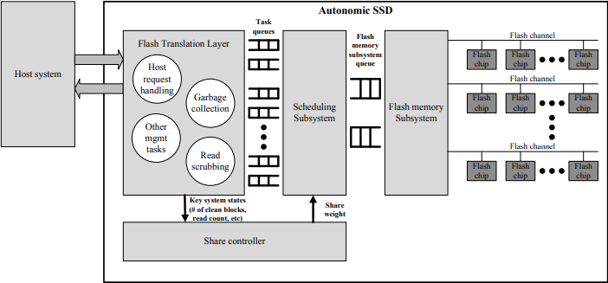
AutoSSD Architecture
Share controller
Monitor key system states and determines the appropriate share for each FTL task

Slide 6
AutoSSD Architecture
Virtualization of the Flash Memory Subsystem
Each task to be independent of others
Each FTL task is given a pair of request and response queues
This virtualization not only effectively frees each task from having to worry about others, but also makes it easy to add a new FTL task to address any future flash memory quirks.

Slide 7
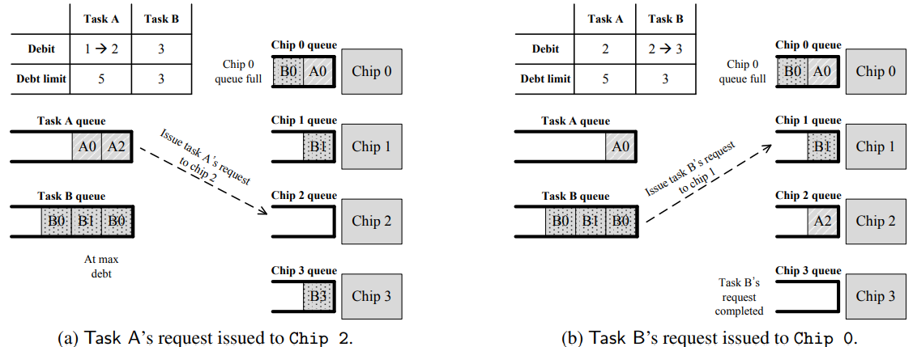
AutoSSD Architecture
Scheduling subsystem
Interface with each FTL task and arbitrates the resources of the flash memory subsystem
Needs to be efficient with low overhead
Debit(the number of outstanding requests for a task) scheduling
Tracks and limits(proportional to the share) the number of outstanding requests per task across all resources
Skewed randomness favoring a task with a smaller debit

Slide 8


AutoSSD Architecture
The share controller
Determine the appropriate share for the scheduling subsystem by observing key system states:
number of free blocks -- response time
maximum read count for a block -- data loss
S_{A}[t] is the share for task A at time t,S_{A}[t−1] is the previous share for task A,P_{A} and I_{A} are two nonnegative coefficients,e_{A}[t] is the error value for task A at time t； target_{freeblk}[t] is the number of target free blocks,num_{freeblk}[t] is the number of free blocks.

Slide 9
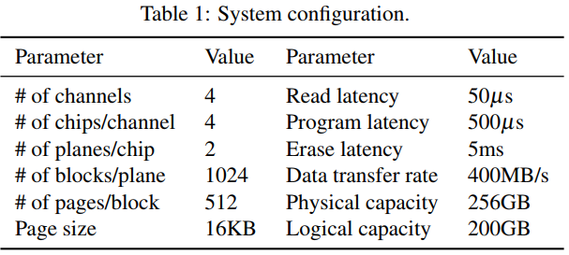
Evaluation Methodology and Modeling
Mapping: 4KB granularity，LRU（Least Recently Used），128MB mapping table
Host request handling：Mapping table lookup delay 0.5µs~1µs,flash memory request generation delay for the host task 1µs~2µs
Garbage collection：threshold values for GC activation and deactivation are set to 128 and 256 free blocks，request generation delay 1µs~3µs

Slide 10
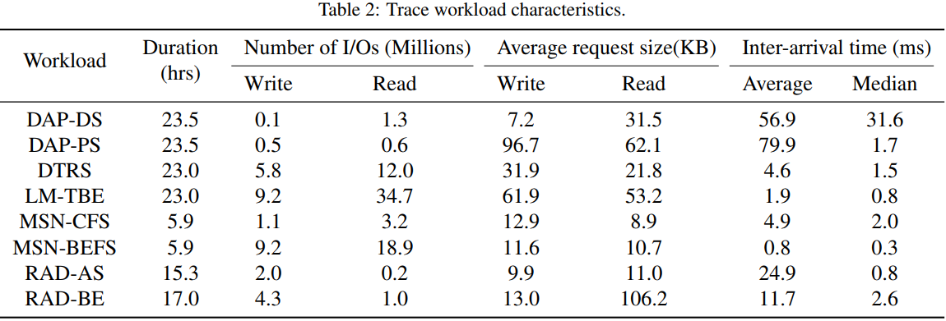
Evaluation Methodology and Modeling
Workload
synthetic workloads and real-world I/O traces from Microsoft production servers

Slide 11
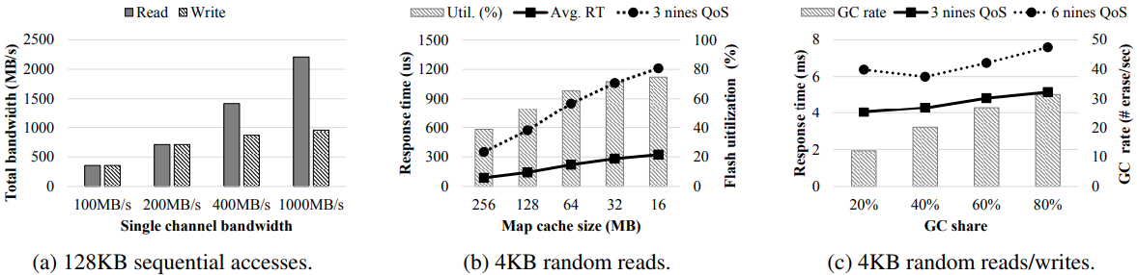
Experiment Results
Micro-benchmark Results
b:100K I/Os per second (IOPS)
c:20K IOPS with a 1-to-9 read/write ratio

Slide 12
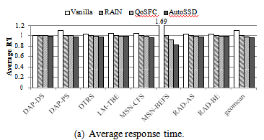
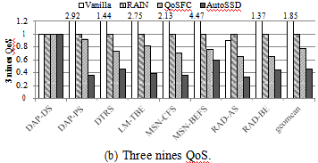
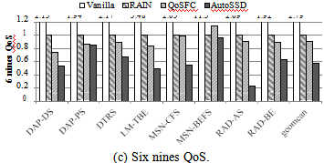
Experiment Results
I/O Trace Results
Vanilla:without virtualization and coordination,a single pair of request/response queue
RAIN:use parity to reconstruct data when chip is blocked by background tasks,fixed priority scheduling,host requests having the highest priority
QoSFC:weighted fair queueing (WFQ)

Slide 13
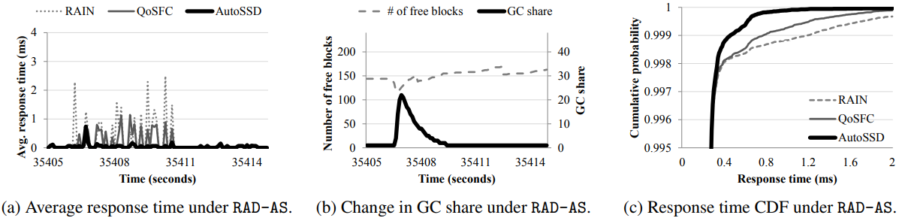
Experiment Results
I/O Trace Results

Slide 14
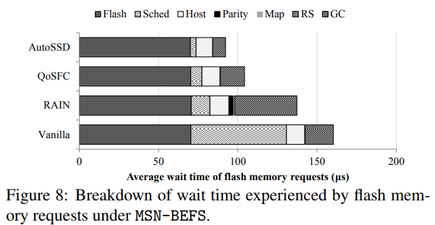
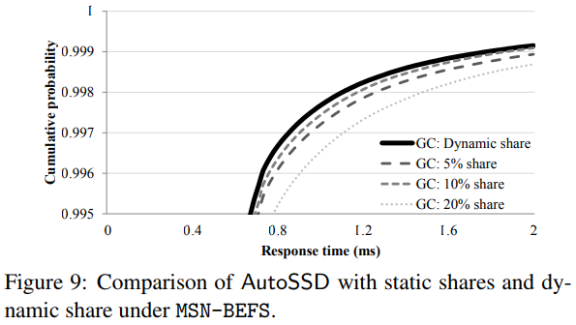
Experiment Results
I/O Trace Results

Slide 15
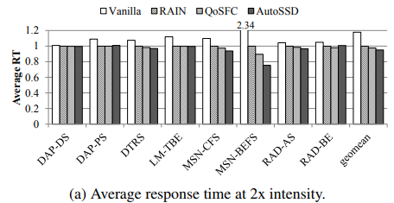
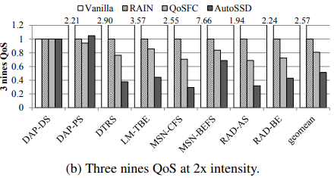
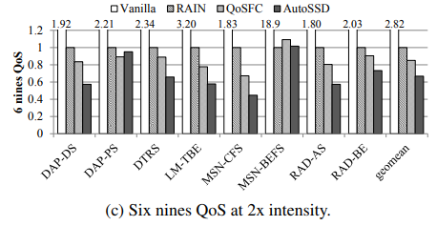
Experiment Results
I/O Trace Results at Higher Request Intensity -- request dispatch times are reduced in half
AutoSSD reduces the average response time by up to 24.6% under MSN-BEFS (by 4.9% on average),the 3 nines QoS by up to 70.6% under MSN-CFS (by 48.6% on average).and the 6 nines QoS by up to 55.3% under MSN-CFS (by 33.2% on average).

Slide 16
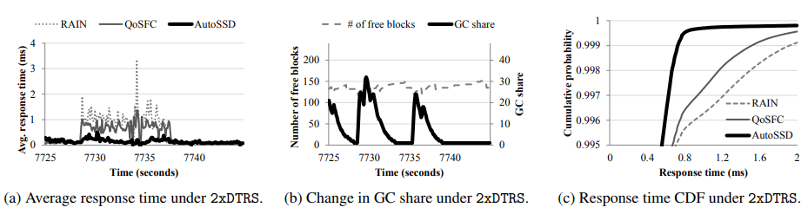
Experiment Results
I/O Trace Results at Higher Request Intensity -- request dispatch times are reduced in half

Slide 17
Conclusion
An autonomic SSD architecture that self-manages concurrent FTL tasks in the flash storage
In effect, AutoSSD reduces the average response time by up to 18.0%, the 3 nines (99.9%) QoS by up to 67.2%, and the 6 nines (99.9999%) QoS by up to 76.6% for QoS-sensitive small reads

Slide 18
Thanks！

