Slide 1
Stable and Consistent Membership at Scale with Rapid
Lalith Suresh, Dahlia Malkhi, Parikshit Gopalan
Ivan Porto Carreiro¹, Zeeshan Lokhandwala²
Key words: membership management,failure detection

Slide 2
01
Comparison of Existing Solutions
02
The Rapid Service
CONTENTS
03
Designs
04
Implementation and Evaluation
05
Conclusions

Slide 3
Comparison of Existing Solutions
01

Slide 4

Logically centralized configuration service
ZooKeeper, etcd, Chubby
provide different degrees of resiliency and consistency
Gossip-based membership
adopted in Akka, Cassandra, Serf etc.
Group membership
state machine replication(SMR)

Slide 5
The Rapid Service
02
A membership service based on techniques that apply equally well to both decentralized as well as logically centralized designs

Slide 6
API
Processes use the membership service by using the Rapid library and invoking a call JOIN
(HOST:PORT, SEEDS, VIEW-CHANGE-CALLBACK)
process’ TCP/IP listen address
initial set of process addresses
to notify applications about membership change events

Slide 7
Configuration
A conﬁguration in Rapid comprises a conﬁguration identiﬁer and a membership-set (a list of processes)
Each process has a local view of the conﬁguration
All processes use the initial seed-list as a bootstrap conﬁguration C₀
VIEW-CHANGE-CALLBACK
C₀
C
urrent

Slide 8
Failure model
Assume that every pair of correct processes can communicate with each other within a known transmission delay bound
Assuming:
Every pair of correct processes can communicate with each other
Communication within a known transmission delay bound
p₁
...
K
...
p
p_{k}
observer
subject

Slide 9
Cut Detection Guarantees
Assumption: at time t
current configuration C;
subset of processes F; F ⊂C |F|/|C| < 1/2
all processes in C\F remain non-faulty
Multi-process cut detection:
joins: every process in C∪J is notiﬁed of J joining
joins and removals: (C\F)∪J is eventually notiﬁed of the changes
View-Change:
consensus
Agreement & Liveness

Slide 10
Designs
03

Slide 11
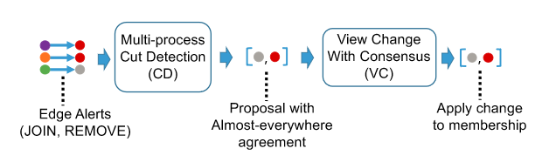
Decentrailized Design
Brief overview of the algorithm：
a monitoring overlay;
an almost-everywhere multi-process cut detection(CD)
a fast, leaderless view-change(VC) consensus protocol

Slide 12
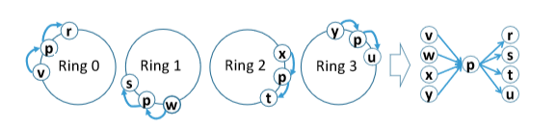
Expander-based Monitoring
edge
expander graph of process p
To every process, observer num. = subject num. =K
Two types of alerts: JOIN and REMOVE
Mode of dissemination: broadcast

Slide 13
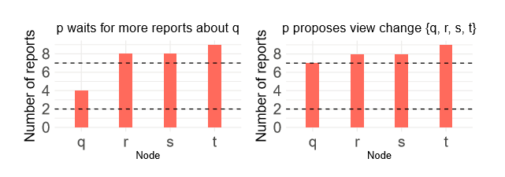
Multi-process Cut Detection
Collecting evidence to support a single, stable multi-process conﬁguration change proposal
K = 10, H = 7, L = 2
Left: stable ={r,s,t}; unstable ={q}
Right: p proposes a view change{r,s,t}.
Providing stable multi-process cut detection with almost-everywhere agreement
Setting two thresholds: L and H, 1 ≤ L ≤ H ≤ K
Three situations:
1) ≥ H, stable report mode;
2) between L and H, unstable report mode;
3) fewer than L, noise

Slide 14
View-change Agreement
Input: the result of each process' CD proposal
Consensus protocol: has a fast, leaderless path in the commom case
Fast Paxos quorum (three quarters) of the membership
If fail, Fast Paxos falls back to a recovery path, where we use classical Paxos to make progress

Slide 15
Logically Centrailized Design
A set of auxiliary nodes S records the membership changes for a cluster C
Steps:
1) Nodes in the current configuration C report alerts only to all nodes in S instead;
2) Nodes in S execute the VC protocol only among themselves;
3) Nodes in C learn about changes in the membership through notiﬁcations from S(or by probing nodes in S periodically).
For progress, members of C need to be connected to a majority partition of S.

Slide 16
Implementation and Evaluation
04
Rapid source code. https://github.com/lalithsuresh/ rapid

Slide 17
Implementation
in Java with 2362 lines of code and 2034 lines of code for tests
100 VMs
2 cores and 8GB of RAM per VM
vary the number of processes(N) in the cluster from 1000 to 2000
For Rapid, we use the decentralized variant unless speciﬁed otherwise (Rapid-C, where a 3-node ensemble manages the membership of N processes)
Rapid uses {K, H, L} = {10, 9, 3} for all experiments

Slide 18
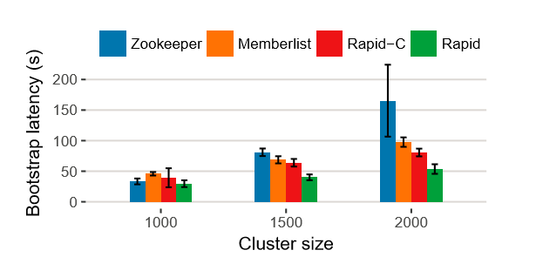
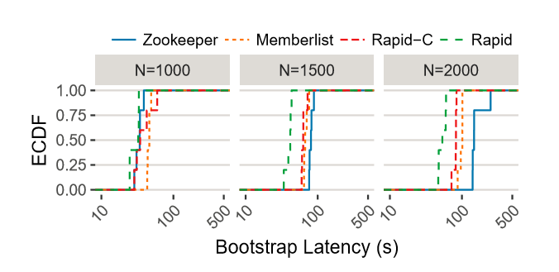
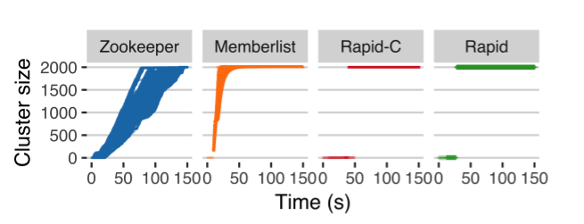
Evaluation
Bootstrap experiments

Slide 19
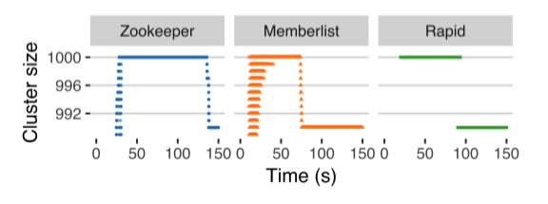
Evaluation
Crash faults
Experiment with 10 concurrent crash failures

Slide 20
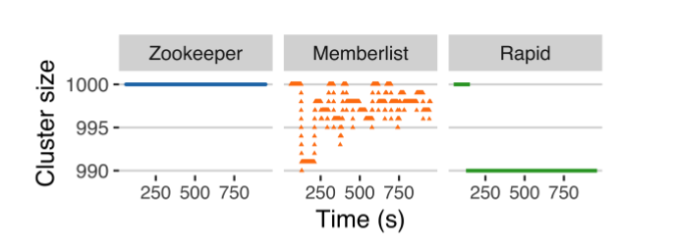
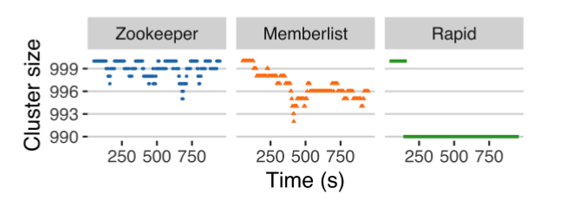
Evaluation
Asymmetric network failures
Flip-ﬂops in one-way connectivity
High packet loss scenario
on the network interface of 1% of processes
(ingress path)
Experiment with 80% ingress packet loss
on the network interface of 1% of processes.

Slide 21
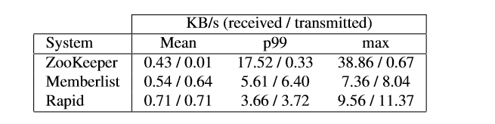
Evaluation
Memory utilization
Type | Min heap utilization | Max heap utilization
Zookeeper | 3.5MB | 16MB
Memberlist | average of 12MB
Rapid | 10MB | 25MB
(per process)
Network utilization

Slide 22
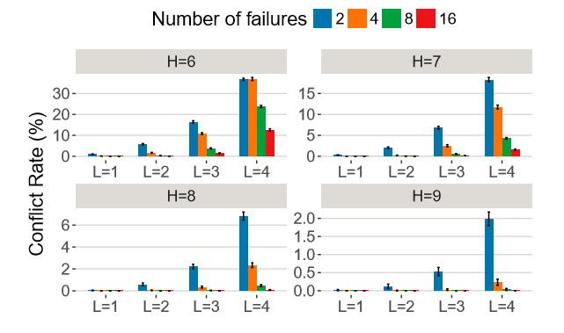
Evaluation
F, H, L sensitivity study

Slide 23
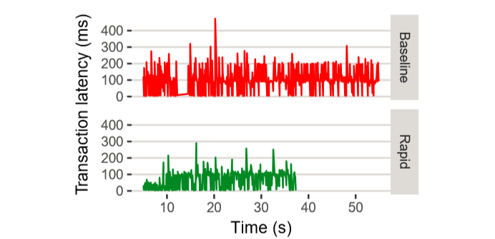
Evaluation
Experience with end-to-end workloads
The baseline failure detector triggers repeated failovers that reduce throughput by 32%
Notes:
事务：指访问并可能更新数据库中各种数据项的一个程序执行单元。

Slide 24
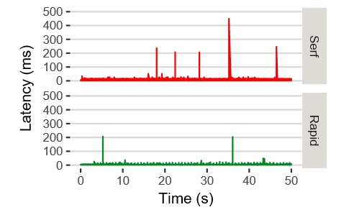
Evaluation
Service discovery
Rapid’s batching reduces the number of conﬁguration reloads during a set of failures, thereby reducing tail latency.

Slide 25
Conclusions
05

Slide 26
Conclusions
Demonstrated the effectiveness of detecting cluster-wide multi-process cut conditions
Our implementation successfully bootstraps clusters at scale faster than existing solutions, while being stable against complex network failures.
The high ﬁdelity of the CD output prevents frequent oscillations or incremental changes when faced with multiple failure.
It achieves unanimous detection almost-everywhere, enabling a fast, leaderless consensus protocol to drive membership changes.
Rapid easy to integrate end-to-end within a distributed transactional data platform and a service discovery use case.

Slide 27
Q & A

