Slide 1
Accurate Timeout Detection Despite Arbitrary Processing Delays
Sixiang Ma , Yang Wang
The Ohio State University
M201877285 张蕾

Slide 2
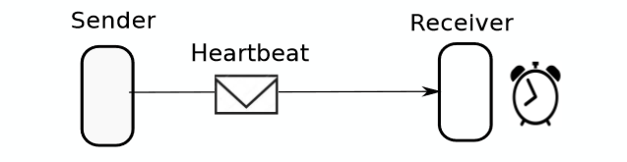
Timeout is Widely Used in Failure Detection

Slide 3
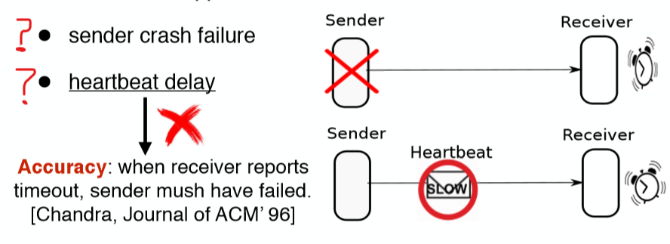
Timeout Detection Can be Inaccurate
When timeout happens, it is hard to tell between:

Slide 4

How to Ensure System Correctness
方法1：基于Paxos的共识
ensure correctness despite false failure reports
allow short timeout for better availability
high cost and complexity
examples: Zookeeper, Chubby, Spanner, etc.

Slide 5



How to Ensure System Correctness
方法2：设置一个长超时间隔
system correctness relies on timeout accuracy
estimate the maximum delay of the communication channel
examples: HDFS, Ceph, Yarn, etc
Our work aims to improve this approach

Slide 6

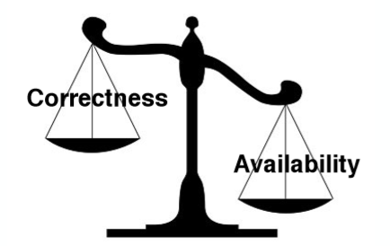
The Dilemma: Availability v.s. Correctness
Correctness: require long timeout to tolerate maximum delays
Availability: prefer short timeout for fast failure detection

Slide 7
Motivations
Long delays in OS and application
Their whitebox nature creates opportunities for better solutions

Slide 8
Heartbeat Delay in Our Experiment
Disk I/O: 10 seconds
Packet processing: 2 seconds
JVM garbage collection: 26 seconds
Application speciﬁc delays: several minutes
- HDFS: directories deletion before heartbeat sending
- ZooKeeper: session close/expire ﬂooding

Slide 9
Delays in OS and Application Are Significant
Compared to default timeout, delays in OS and App are significant
HDFS: 30 seconds
Ceph: 20 seconds
ZooKeeper: 5 seconds

Slide 10
Motivations
Long delays in OS and application
Their whitebox nature creates opportunities for better solutions

Slide 11
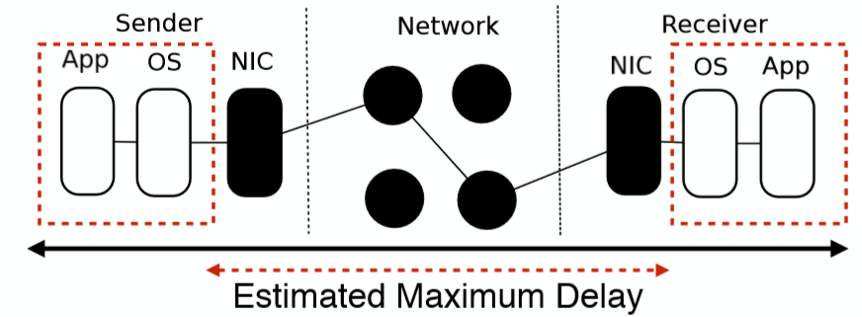
Existing Timeout Views Channel as a Blackbox and the OS and Application as a Whitebox
Blackbox: only provides information when receiving a packet
Whitebox: can provide information such as packet pending/drop

Slide 12
Overview of SafeTimer
Goal: if the receiver reports timeout, the sender must have failed
Assumptions of SafeTimer
- Delays in whitebox can be arbitrarily long
- SafeTimer relies on existing protocol for blackbox
• Solutions
- Receiver: check pending/dropped heartbeats when timeout
occurs
- Sender: blocks sender when heartbeat sending is slow

Slide 13
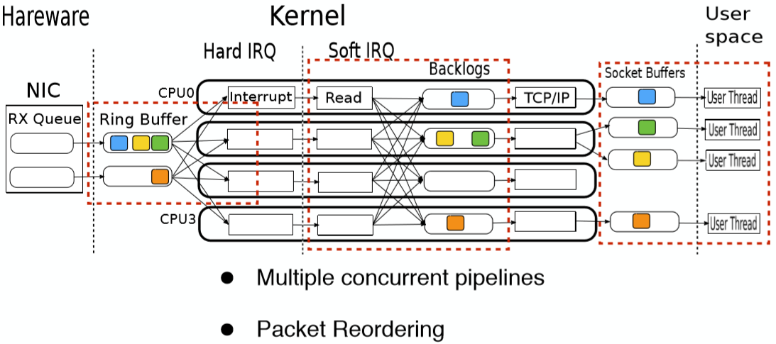
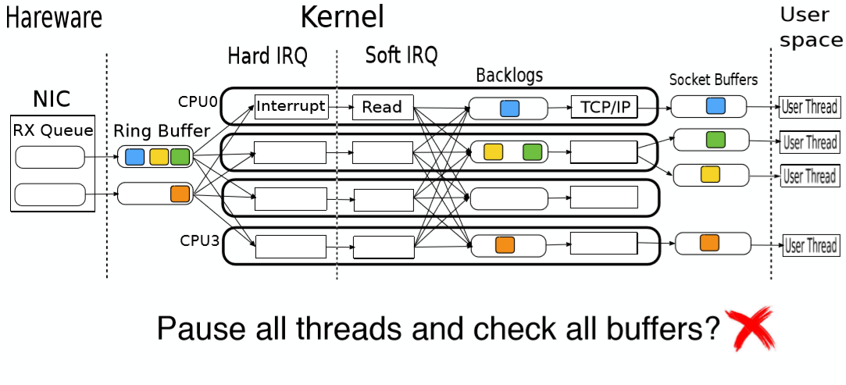
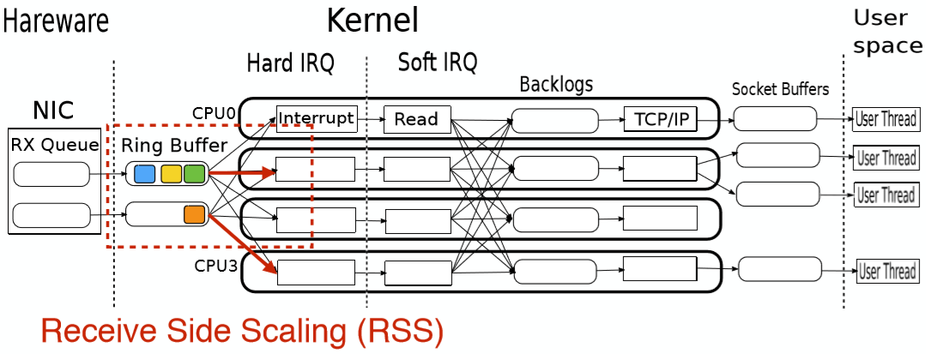
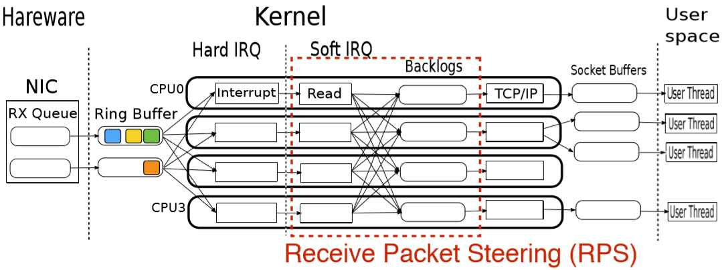
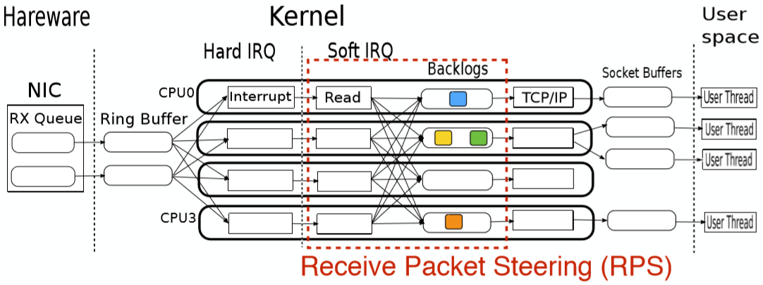
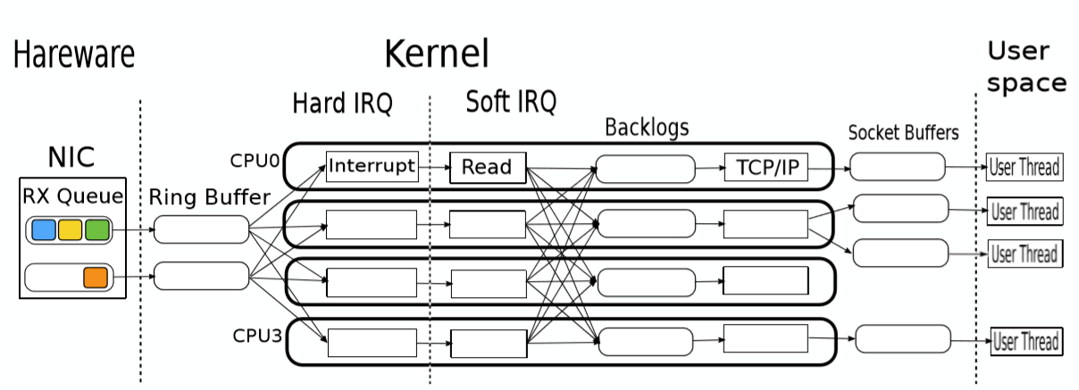
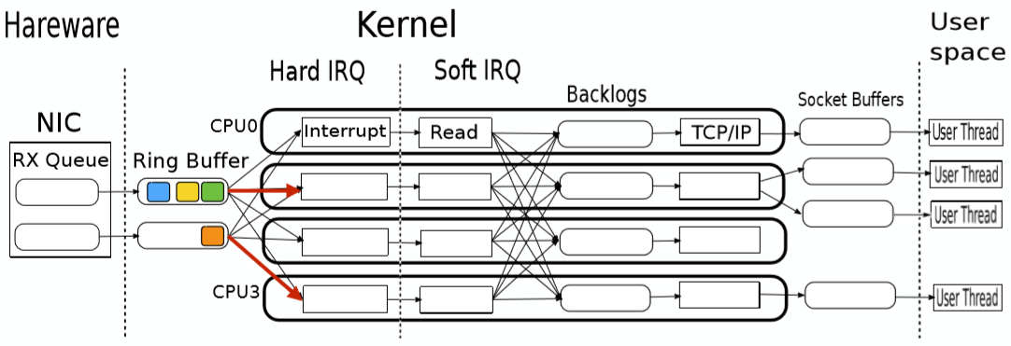
Background: Concurrent Packet Processing

Slide 14
SafeTimer’s Solution: Barrier Mechanism
Receiver sends barrier packets to itself when timeout
Force heartbeats and barriers to be executed in FIFO order
When barriers are processed =>
Heartbeats arrived before timeout must have been processed

Slide 15
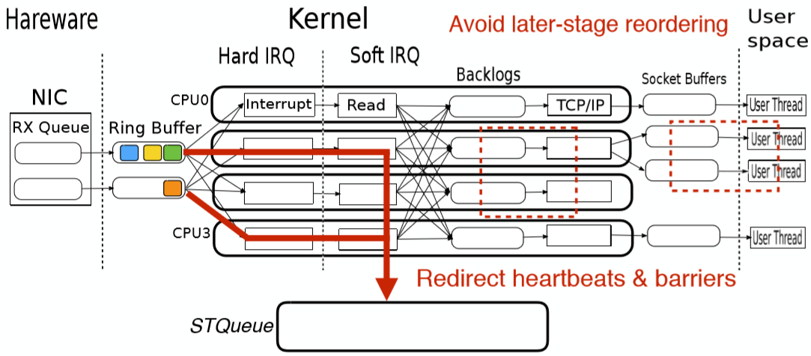
Preserve Per-Ring FIFO Order

Slide 16
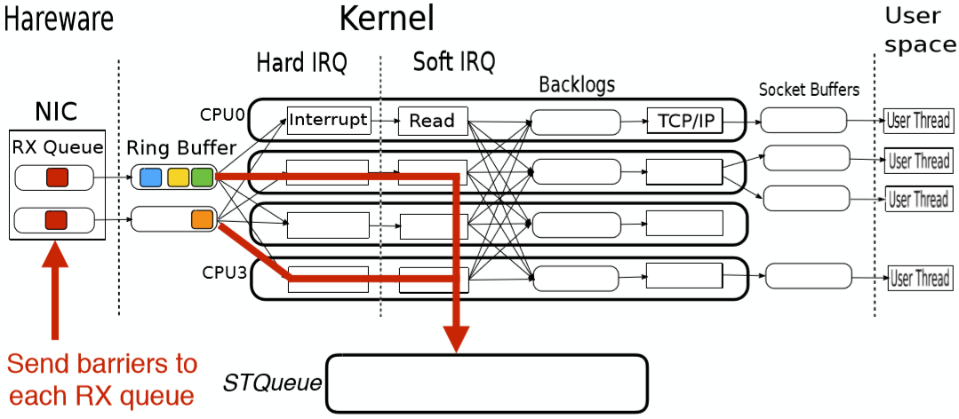
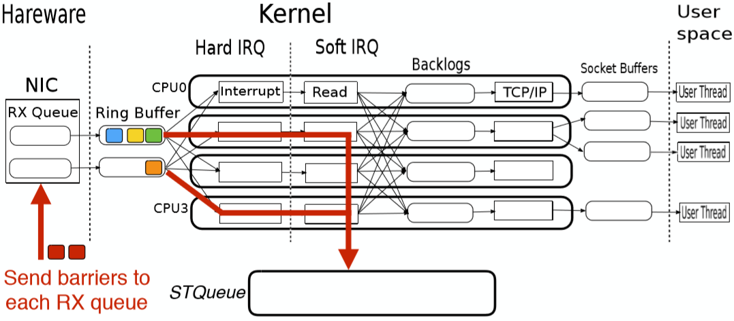
Send Barriers to Flush Heartbeats

Slide 17
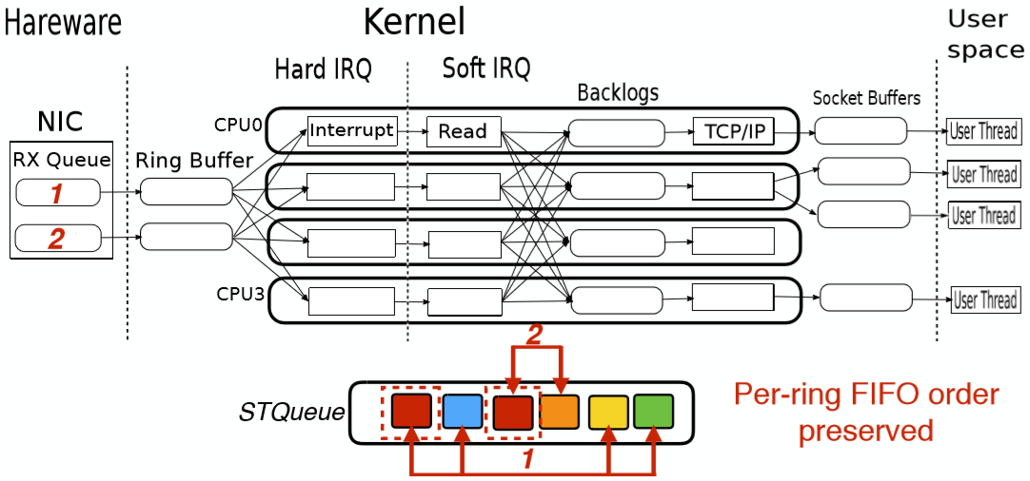
When Barriers Processed, Heartbeat Processed

Slide 18
Overview of SafeTimer
Goal: if the receiver reports timeout, the sender must have failed
Assumptions of SafeTimer
- Delays in whitebox can be arbitrarily long
- SafeTimer relies on existing protocol for blackbox
• Solutions
- Receiver: check pending/dropped heartbeats when timeout
occurs
- Sender: blocks sender when heartbeat sending is slow

Slide 19
Problems in Existing Killing Mechanism
Killing a slow sender is not a new idea, but
Killing operation itself can be delayed
Sender alive for arbitrarily long after receiver reports failure =>
Accuracy will be violated

Slide 20
Utilizing the Idea of Output Commit
A slow sender may continue processing
As long as other nodes do not observe the effects, the slow
sender is indistinguishable from a failed sender

Slide 21

Block Sender When It Is Slow
Maintain a timestamp before which sending is valid
Extend when sender sends heartbeats successfully
- The deﬁnition of “success” depends on the blackbox protocol
• SafeTimer blocks sending if current time >

Slide 22
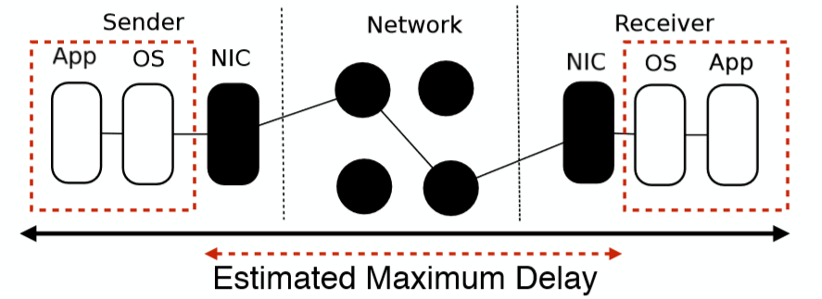
No Need to Include Maximal Delay For Whitebox
Receiver doesn’t report failure if heartbeats arrived before timeout
• Sender is blocked when sender is slow

Slide 23
Implementation Overview
Re-direct heartbeats and barriers to STQueue
Send barriers to a speciﬁc RX Queue
Force barriers to go through NIC
Fetch real-time drop count
Detect heartbeat sending completion
Block slow sender

Slide 24
Evaluation Overview
Can SafeTimer achieve accuracy despite long delays in whitebox?
What is the overhead of SafeTimer?

Slide 25
Evaluation: Accuracy
Methodology:
- inject delay/drop at different layers
- compare with vanilla timeout implementation
• Result:
-SafeTimer can correctly prevent false timeout report
- vanilla implementation violates accuracy

Slide 26
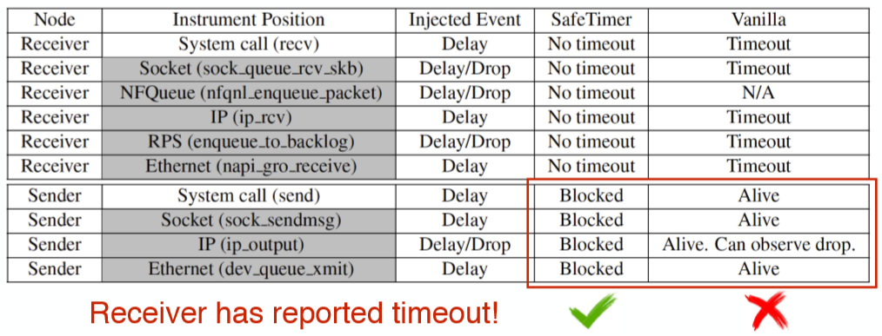
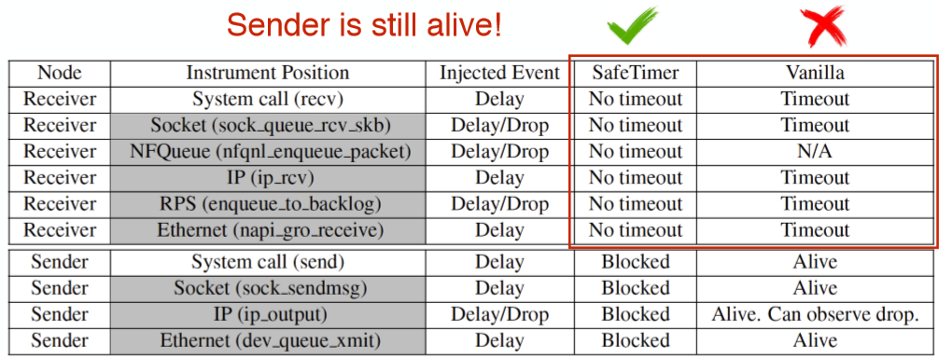
Accuracy: Heartbeats Delayed/Dropped on Receiver/sender

Slide 27
Evaluation: Performance Overhead
Ping-Pong micro benchmark
- small overhead (up to 2.7%) for small packets
- negligible overhead for large packets
• Benchmarks for HDFS and Ceph
- DFSIO and RADOS Bench
- negligible overhead

Slide 28
Related Work
Synchronous systems: HDFS, Ceph, etc.
Asynchronous systems: Spanner, ZooKeeper, etc.
Failure detection without timeout:
- Falcon and its following works
- Work if whole channel is a whitebox
- Use timeout as a backup

Slide 29
Summary
SafeTimer achieves accurate timeout detection despite arbitrary
processing delays
Users can set shorter timeout intervals without sacriﬁcing
accuracy
The overhead of SafeTimer is small

Slide 30

Question

