Slide 1



Selecta：Heterogeneous Cloud Storage Configuration for Data analysis
Ana Klimovic Stanford University，Heiner Litz UC Santa Cruz，Christos Kozyrakis Stanford University
M201873224
许佳豪

Slide 2






Contests
Background&
Contributions
Theory
Experiment
Evaluation Methodology
Conclusion

Slide 3
Background>>Configuring storage for analytics
Block, file, object, key-value storage
Cluster Size
Storage Media：
HDD,FLASH,SSD
CPU Cores，
GB of DRAM
Bandwidth
Local /remote
Cloud cluster configuration is difficult yet critical for performance & cost.

Slide 4
Background>>Configuring storage for analytics
Storage
local：SSD,HDD,NVMe
Block Storage
remote
File Storage：FTP,NFS Service
Object Storage
Data Stream
Input/Output Data: Permanent ;Sequential
Intermediate data:Temporarily;Random

Slide 5
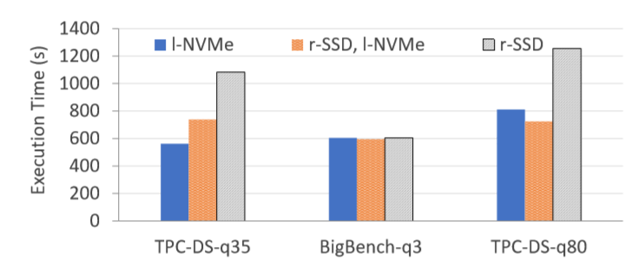
Background>>Configuring storage for analytics
Example: selecting between 3 storage options ― all other parameters constant
Choosing the right storage is non-trivial
Input/output data
Intermediate data
Notes:
TPC-DS-q35性能测试（）query
Bigbench是对TPC-DS的扩展
Intermediate data(中间数据) 存储在不同的磁盘组合比存储在单一磁盘上性能更好，因为隔绝了数据流，减少他们之间的干扰

Slide 6
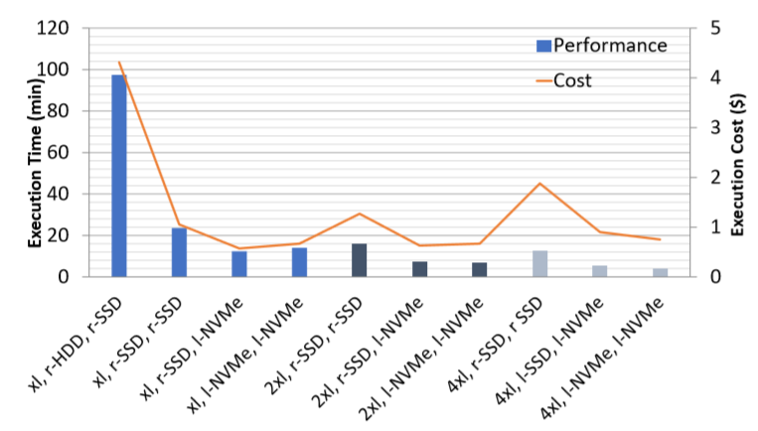
Background>>TPC-DS query 64 on 10 configurations
Compare the performance and cost of TPC-DS query 64 on 10 configurations
Intermediate
Storage
VM size

Slide 7
Background>>TPC-DS query 64 on 10 configurations
Performance
Lowest performance
24x
Highest performance

Slide 8
Background>>TPC-DS query 64 on 10 configurations
Cost
Highest Cost
7.5x
Lowest Cost

Slide 9

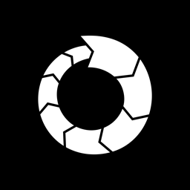

Contributions
Selecta： a tool that recommends near-optimal cloud VM and storage configurations for target applications based on sparse training data
Analysis of data analytics performance with different storage options:
Which storage options are good fit and for different data streams?
What lessons do we learn for the design of future cloud storage systems?

Slide 10
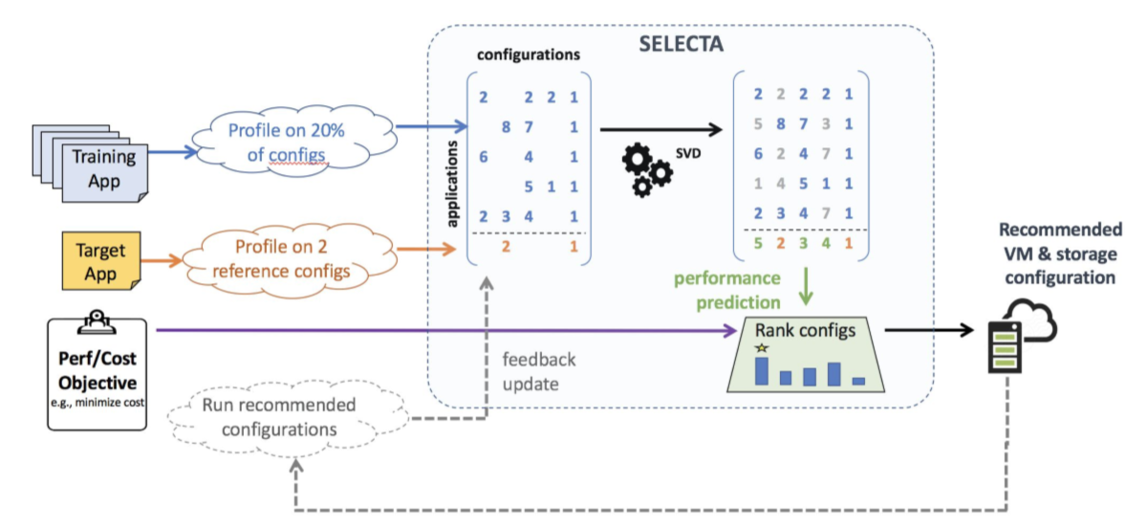
Models & Theory>>Selecta
Selecta
A system that predicts the performance of a target application on candidate configurations using sparse training data across jobs → recommend the right config
Notes:
使用跨作业的稀疏训练数据预测候选配置上目标应用程序性能的系统→推荐正确的配置

Slide 11
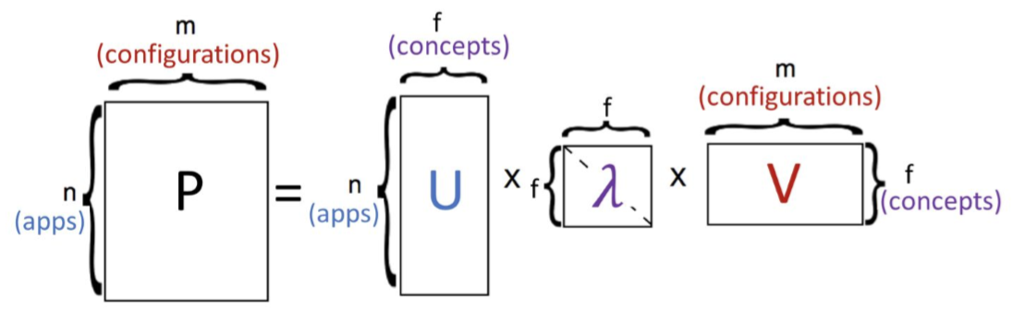
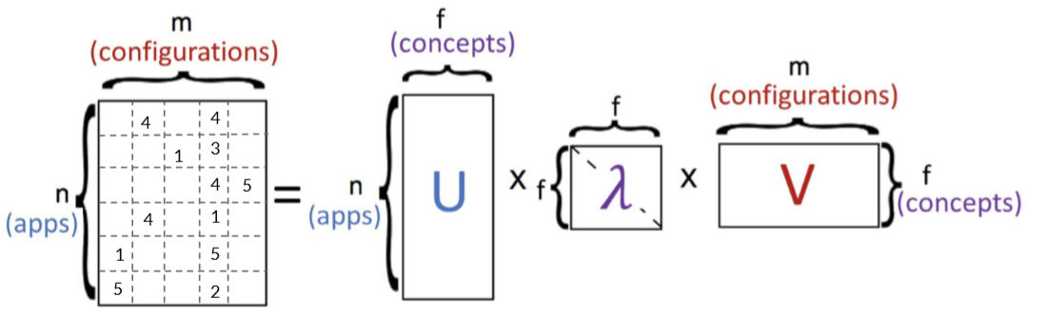
Models & Theory>>Collaborative Filtering
Collaborative Filtering
Collaborative filtering approach: use singular value decomposition (SVD) to decompose app-config matrix P to uncover latent (“hidden”) similarity concepts
P is sparse and SVD requires dense matrix → use stochastic gradient descent to update unknown entries; objective function minimizes error on known entries
✔ Automatically infers (latent) features
✔ Works well with sparse training set
✔ Agnostic to the applications and configurations used
Notes:
使用跨作业的稀疏训练数据预测候选配置上目标应用程序性能的系统→推荐正确的配置

Slide 12
Evaluation Methodology
● Run >100 different Spark SQL/ML applications on 17 different configurations
● Two dataset sizes for each application
● Our candidate configuration space (in Amazon EC2):
○ 8-node clusters of 3 different VM sizes (vary CPU cores & DRAM per node)
○ Storage options:
■ Remote block storage (EBS) HDD
■ Remote block storage (EBS) SSD
■ Local block storage NVMe
■ S3 object storage

Slide 13
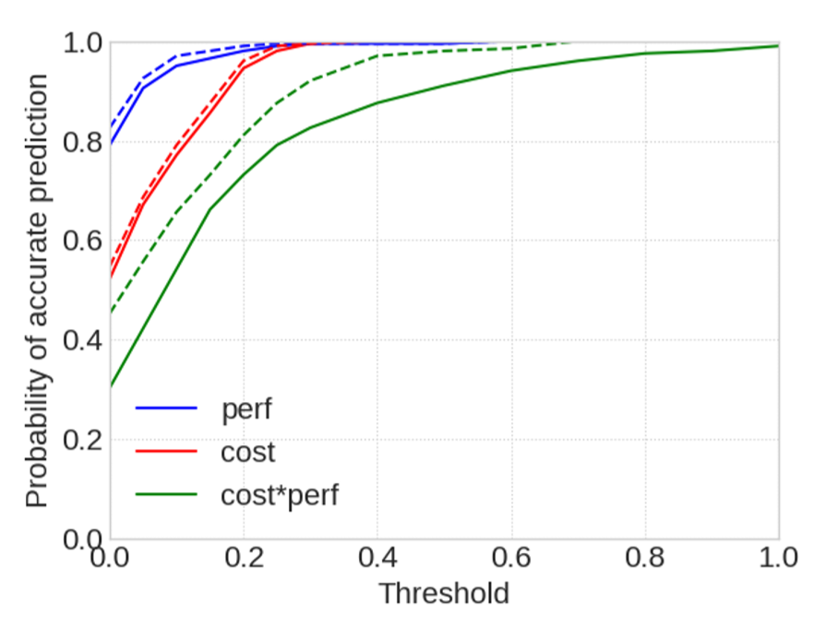
Evaluation Methodology >>Selecta’s Accuracy
Selecta’s Accuracy
0.94
Recommend near-optimal (T = 0.1) config for best perf with 94% probability
Recommend near-optimal (T= 0.1) config for best cost with 80% probability
0.8
Dotted line shows improvement with one feedback round
T=0.1

Slide 14
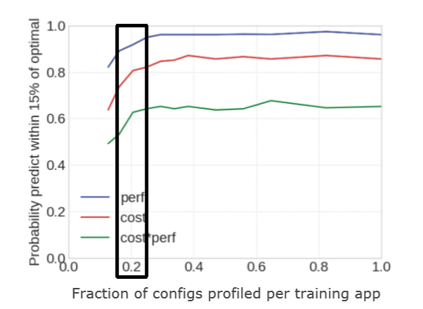
Evaluation Methodology >>Sensitivity analysis
Sensitivity analysis
Training matrix should be ~20% dense in steady state for good accuracy

Slide 15
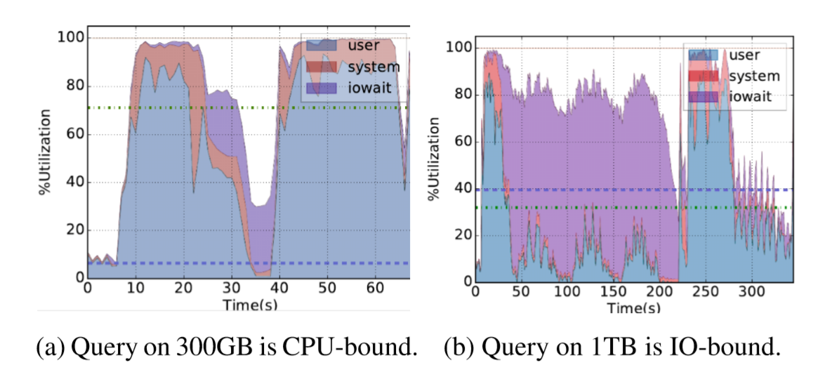
Evaluation Methodology >>Dealing with application changes
Dealing with application changes
Changes in the input dataset can alter the CPU vs. I/O intensity of the job and influence the choice of optimal configuration
When CPU utilization varies beyond a threshold, treat the job as a new application

Slide 16
  Conclusions
Cloud cluster configuration is difficult yet critical for performance and cost
Selecta is a tool that uses collaborative filtering to make near-optimal configuration recommendations for a user’s performance-cost objective
  94% probability of predicting configuration with near-optimal performance
  80% probability of predicting configuration with near-optimal cost
We use Selecta to explore the cloud storage landscape in the context of data analytics to guide the design of future storage systems

