Slide 1
On the diversity of cluster workloads and its impact on research results
M201873217 阚航

Slide 2
研究目标：
use historical data to improve cluster efficiency
Produce generalizable models of cluster workloads
the evaluation of new research

Slide 3
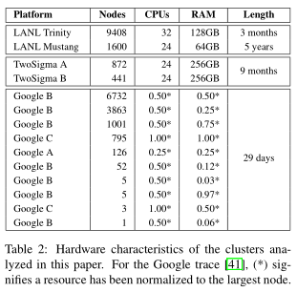
hardware configuration
LANL: HPC cluster(high performence computing)
Two Sigma clusters:buiness analytics
a Spark installation
home-grown data analytics

Slide 4
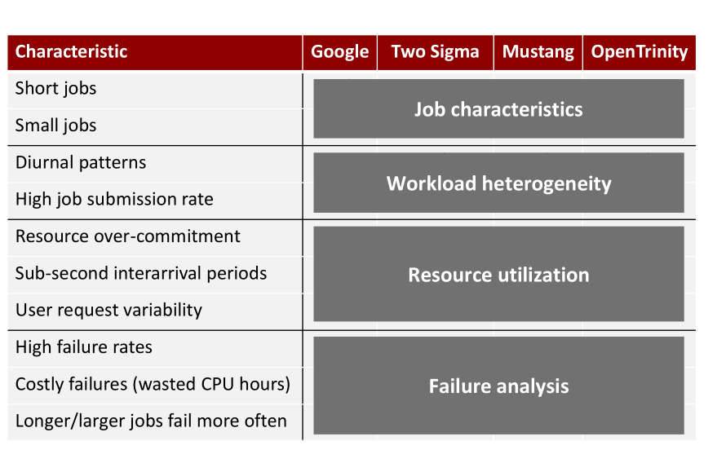

Slide 5
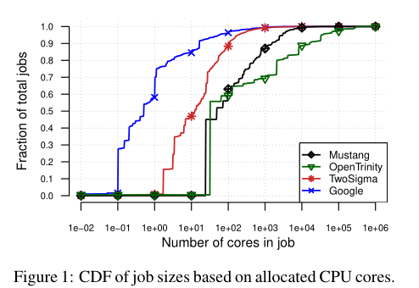
Job characteristics
job size:
Google jobs request 3 - 406x fewer CPU cores
LANL request sizes more uniformly distributed

Slide 6
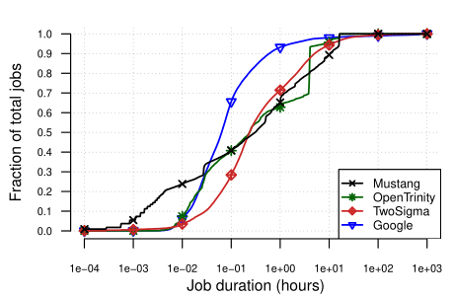
job duration:
Google jobs:
80% of jobs last less than 12 minutes each
is 4 - 5x shorter than Two Sigma and LANL

Slide 7
作业调度程序的效率依赖于绝大多数作业持续时间约为几分钟到十几分钟
分布式调度调度程序来提高短期作业的效率

Slide 8
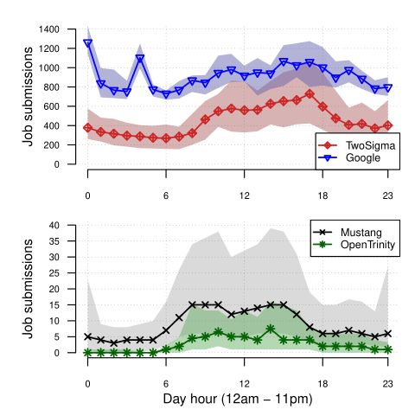
Workload heterogeneous
Diurnal patterns are universal. Clusters received more scheduling requests and smaller jobs at daytime
Google：most active from midnight to 4 AM , presumably due to batch jobs
Scheduling request rates differ by up to 3 orders of magnitude across clusters

Slide 9
Resource utilization
对于CPU和内存的分配，Google过度配置10%，其它工作集群未分配范围在2%-10%
资源分配的不平衡与资源利用目的有关。

Slide 10
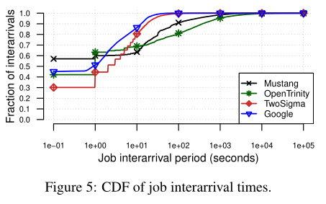
大部分工作的到达时间都是亚秒级- > 被测系统的负载

Slide 11
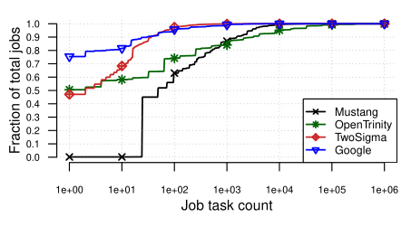
Google单任务多（77%），其它集群多任务多

Slide 12
User resource requests are more variable in the LANL and TwoSigma traces than in the Google trace.
改进：通过工作负载的整合来缓解资源不足的问题（Google）
实现：在提交作业时分析并将其归类，进行整合。

Slide 13
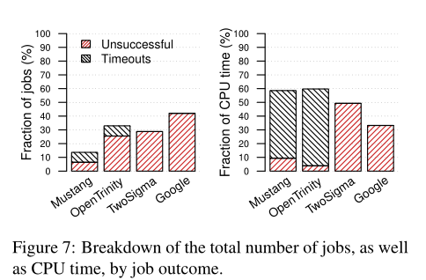
Failure analysis
unsuccessful jobs:异常终止（被用户强行关掉）
Unsuccessful job rates at Google is 1.4-6.8x higher than other traces

Slide 14
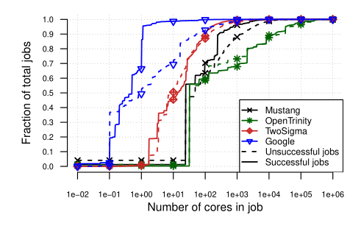
Google：不成功的作业比成功作业消耗更多的资源

Slide 15
A case study for dateset pluralism
JvmPredict:集群调度程序的作业运行预测模块，提高集群资源利用率。
根据作业运行时间信息作出更好的调度决策->优先安排延迟敏感作业，延迟高优先级批处理作业但不可超出批处理作业最后出来期限。
大前提：所提供的作业运行信息是准确的。

Slide 16
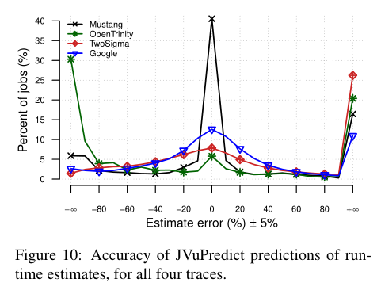
依据：user ID, number of cores, job name (if present)

Slide 17
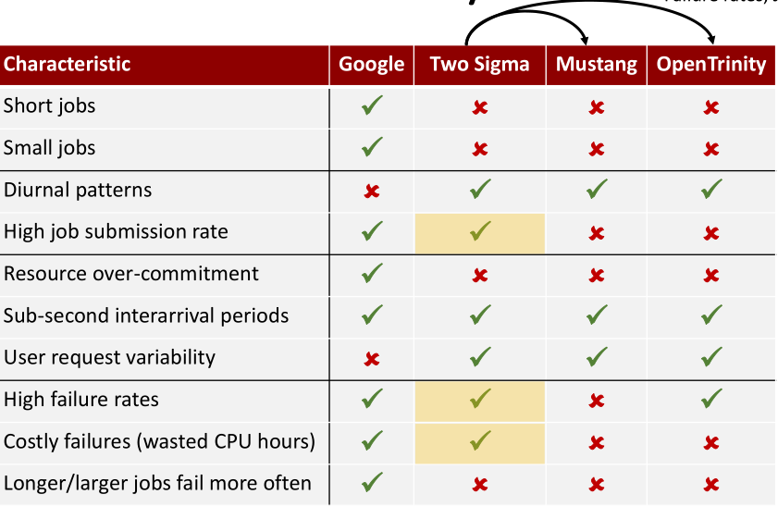
summary
Private more similar to HPC, except:Failure rates, Job submission rate

Slide 18
conclusion:
the plurality and diversity of dataset in the evaluation of new research is important.using mutiple traces allowed us to reliably rank data features by predictive power.

