Slide 1
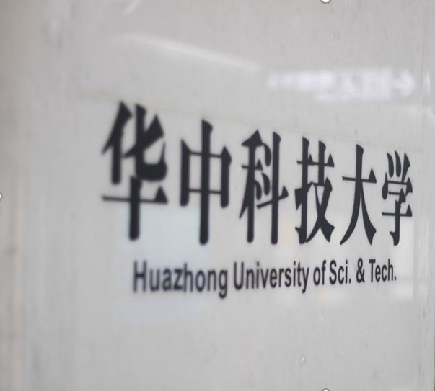

Boosting Full-Node Repair
in Erasure-Coded Storage
HUAZHONG UNIVERSITY OF SCIENCE AND TECHNOLOGY
报告人：余祺
明德厚学 求是创新

Slide 2

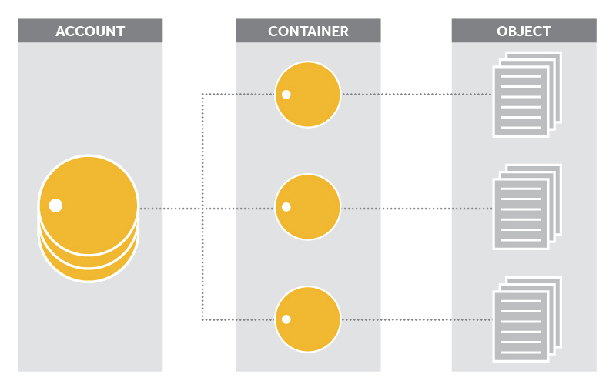
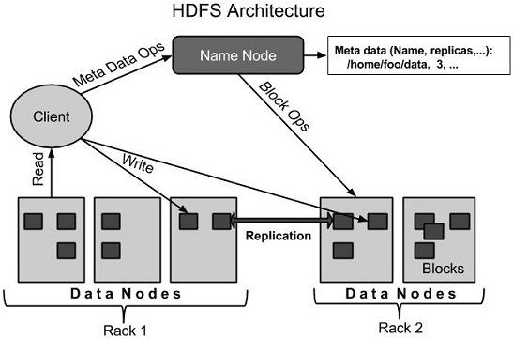
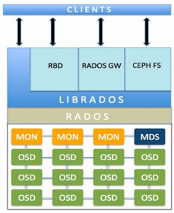
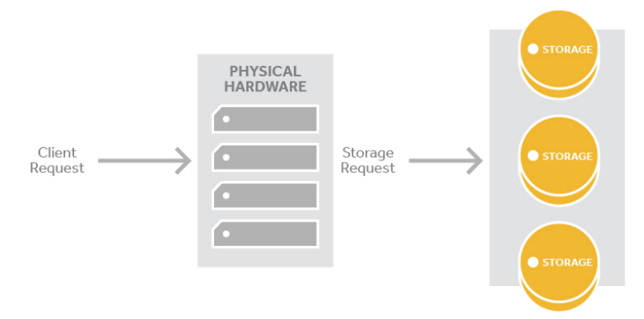
Introduction
Architecture
HDFS
Ceph
OpenStack Swift
Notes:
目前，随着数据的爆炸性增长，存储系统往往部署在大量的存储节点上，这也导致了故障的普遍发生。如何容错以提升系统的可靠性成为了关键问题。

Slide 3
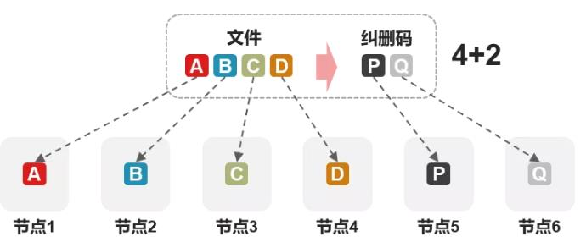
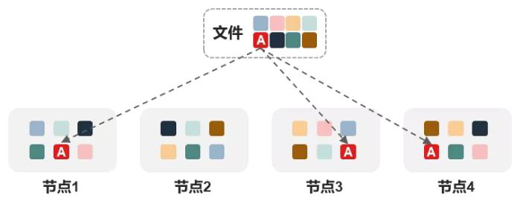
Introduction
Redundancy techniques
Replication
Erasure coding
Notes:
目前有两种主流的容错技术：副本和纠删码。副本技术通过简单的复制来达到容错的目的，显然，副本技术会带来较大的存储开销。
纠删码技术引入轻量的计算，实现达到副本技术相同的容错的同时，拥有更低的存储开销。但是，纠删码技术会放大修复时的网络I/O。如何更快地修复就成为了主要问题。

Slide 4
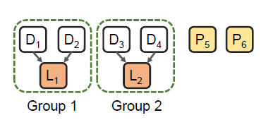
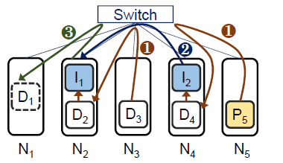

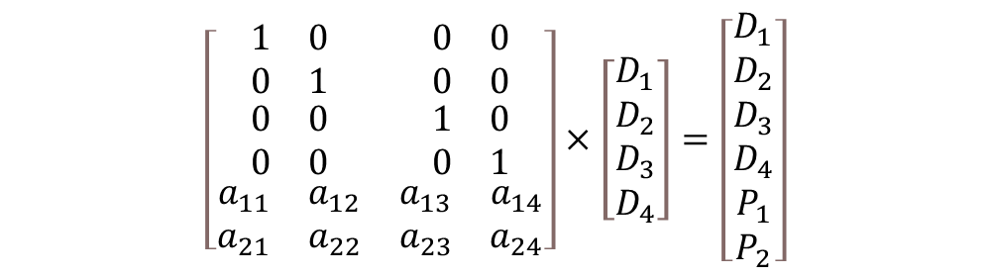
Erasure Coding
Repair
Existing studies
encoding
1. constructing new theoretical erasure codes with provably reduced repair traffic (e.g., Locally Repairable Codes ,Rotated RS codes, and regenerating codes);
$$\left[\begin{matrix}\begin{matrix}\begin{matrix}1 \\ 0\end{matrix} & \begin{matrix}0 \\ 1\end{matrix} \\ \begin{matrix}0 \\ 0\end{matrix} & \begin{matrix}0 \\ 0\end{matrix}\end{matrix} & \begin{matrix}\begin{matrix}0 \\ 0\end{matrix} & \begin{matrix}0 \\ 0\end{matrix} \\ \begin{matrix}1 \\ 0\end{matrix} & \begin{matrix}0 \\ 1\end{matrix}\end{matrix} \\ \begin{matrix}a_{11} & a_{12} \\ a_{21} & a_{22}\end{matrix} & \begin{matrix}a_{13} & a_{14} \\ a_{23} & a_{24}\end{matrix}\end{matrix}\right]×\left[\begin{matrix}\begin{matrix}D_{1} \\ D_{2}\end{matrix} \\ \begin{matrix}D_{3} \\ D_{4}\end{matrix}\end{matrix}\right]=\left[\begin{matrix}\begin{matrix}D_{1} \\ D_{2} \\ D_{3}\end{matrix} \\ \begin{matrix}D_{4} \\ P_{1} \\ P_{2}\end{matrix}\end{matrix}\right]$$
2. designing efficient repair algorithms to parallelize the repair;
decoding, D₃ and P₂ failed
$$\left[\begin{matrix}\begin{matrix}D_{1} \\ D_{2}\end{matrix} \\ \begin{matrix}D_{3} \\ D_{4}\end{matrix}\end{matrix}\right]={\left[\begin{matrix}\begin{matrix}1 & 0 \\ 0 & 1 \\ 0 & 0\end{matrix} & \begin{matrix}0 & 0 \\ 0 & 0 \\ 0 & 1\end{matrix} \\ \begin{matrix}a_{11} & a_{12}\end{matrix} & \begin{matrix}a_{13} & a_{14}\end{matrix}\end{matrix}\right]}^{−1}×\left[\begin{matrix}\begin{matrix}D_{1} \\ D_{2}\end{matrix} \\ \begin{matrix}D_{4} \\ P_{1}\end{matrix}\end{matrix}\right]$$
3. utilizing machine-learning based prediction techniques to proactively restore the data with the repair algorithms before failure occurrence.
Notes:
当前，学术界主要从以下3个方向研究纠删码的修复问题。

Slide 5
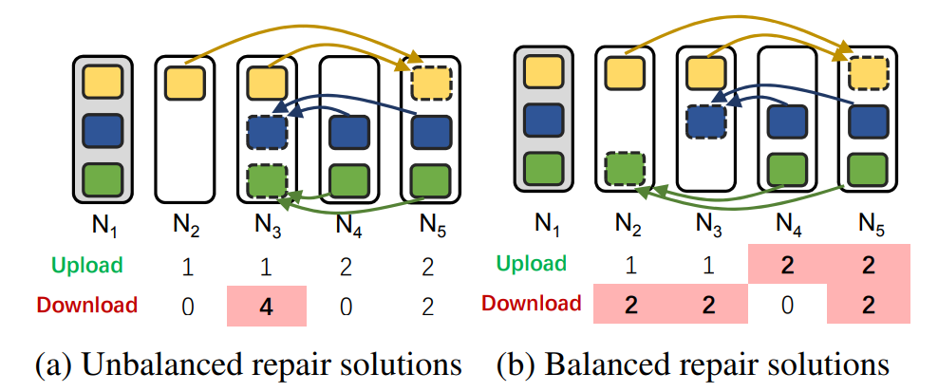
Limitations
Failing to utilize the full duplex transmission.
Notes:
经过分析，发现直接将现有的修复算法应用在全节点修复会有以下限制。

Slide 6
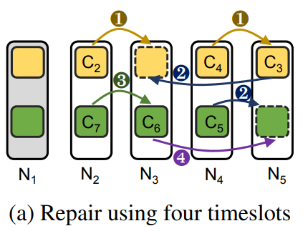
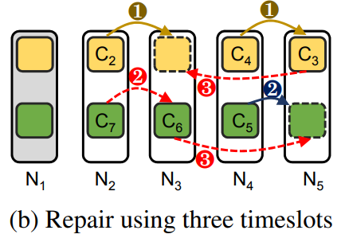
Limitations
Failing to fully utilize the bandwidth at each timeslot.
Notes:
因为现有的修复算法应用在全节点修复上只是单块修复的简单累加。

Slide 7

Contributions
RepairBoost：a framework to speed up the full-node repair
Tech 1: Repair abstraction (for generality and flexibility)
Tech 2: Repair traffic balancing (for load balancing)
Tech 3: Transmission scheduling(for saturating bandwidth utilization)
A prototype RepairBoost integrated with HDFS
Tackle multiple node failures and facilitate the repair in heterogeneous environments
Experiments on Amazon EC2
Increase the repair throughout by 35.0-97.1%

Slide 8
Repair Abstraction
Advantages
Abstraction
1.General and Flexible
Formalize a single-chunk repair solution through a directed acyclic graph(RDAG).
2.Parallel
3.Intuitive
Update
Update
Update
Notes:
修复抽象指将单块修复抽象成一个修复有向无环图，称为RDAG。RDAG可以指示数据在顶点中的路由方向以及顶点之间的依赖关系；RDAG还可以指导修复的进行。

Slide 9
Repair Traffic Balancing
Mapping of Intermediate Vertices
1.Set of vertices is sorted by the number of chunks required to be downloaded in descending order.
2.N* has the least download traffic in the set of nodes
3.The algorithm is executed until all the intermediate vertices have been assigned to the corresponding nodes.
Notes:
将顶点的修复任务（主要是下载）映射到某个节点，基本思想是平衡修复过程的下载流量，将待下载量大的任务分配到实际下载量较小的节点处。

Slide 10
Transmission Scheduling
Formulate the transmission scheduling as a maximum flow problem
To further saturate the bandwidth utilization, Repairboost try to make the most chunks that can be transmitted simultaneously at a timeslot.
Notes:
为了进一步利用系统中的带宽资源，每一个时间片中节点的传输任务需要被妥善安排。这里将传输调度形式化为最大流问题。在某个时间片，假设系统中有n个节点，
构造2n+2个顶点的流网络，根据RDAG来建立连边，最终得到的最大流表示在该时间片能同时进行的传输块数量。

Slide 11
Implementation
System Architecture
The architecture of RepairBoost comprises a coordinator sitting on the metadata server and multiple agents running on the nodes(with one agent per node).

Slide 12

实验环境
亚马逊云
数量：17个虚拟实例
类型：m5.large
操作系统：Ubuntu 16.04.7 LTS
处理器：2x CPU 2.5GHz Intel Xeon Platinum
内存：8G
硬盘：40GB
网络带宽：1Gb/s
磁盘带宽：130MB/s

Slide 13
纠删码和修复算法选择
纠删码策略选择
修复算法选择
01
传统RS码
01
传统修复
02
LRC
02
PPR
03
Butterfly Code
03
ECPipe

Slide 14
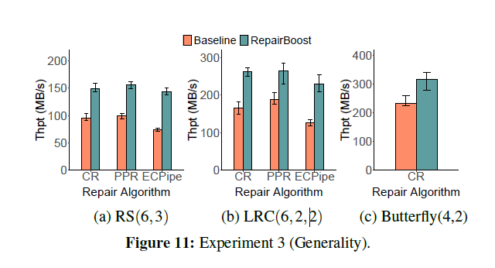
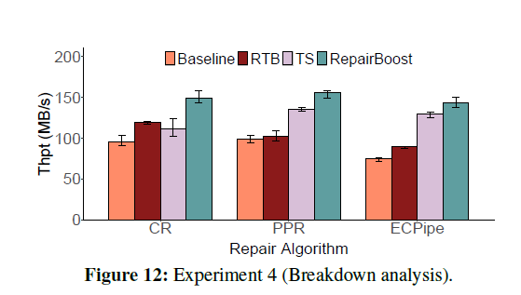
实验结果
观察#1：Butterfly Code达到了最高的修复吞吐量
观察#1：对于不同的修复算法，RTB（Repair Traffic Balancing）和TS（Transmission Scheduling）的表现不一样
观察#2：对于不同纠删码，RepairBoost平均可以提升60.4%的修复吞吐量
观察#2：相比于RTB和TS，RepairBoost分别提升了45.7%和19.8%的修复吞吐量
Notes:
第一幅图是RepairBoost应用在不同纠删码系统中的结果：..
第二幅图是Breakdown分析的结果：

Slide 15
THANKS
华中科技大学2021级 计算机学院
明德厚学 求是创新

