Slide 1
Hybrid Edge Partitioner:
Partitioning Large Power-Law Graphs under Memory Constraints
SIGMOD 2021
程健

Slide 2
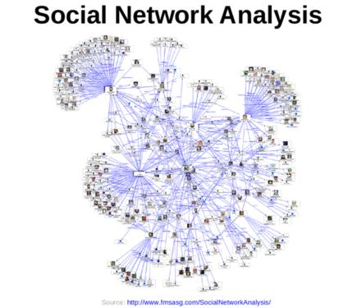
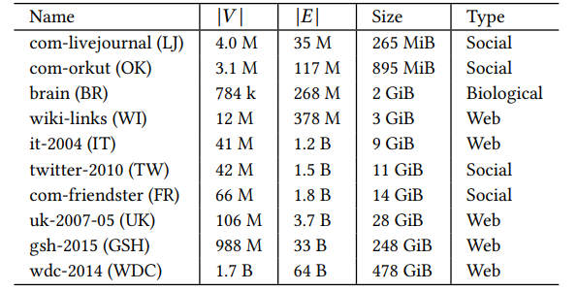
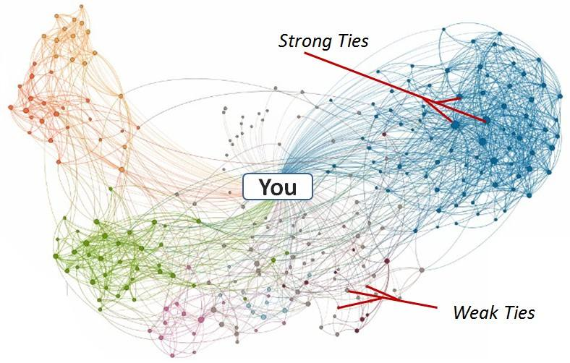
Graph processing
Graph-structured data is everywhere
( social network, web graphs, biological network … )
Graphs capture relationships between entities
( friendship between social network, link of a website )
Real-world graphs can be huge
Hybrid Edge Partitioner: Partitioning Large Power-Law Graphs under Memory Constraints

Slide 3
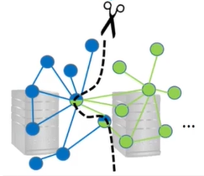



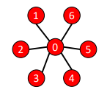

Distributed Graph Processing
Stand-alone operation is not feasible ( expensive! )
Distributed graph processing system scale across many compute nodes
Split and distributed graph : graph partitioning
Edge partitioning induces a new problem
( synchronization overhead or communication overhead )
Goal : Minimize vertex replication factor
P1
Send state
return new state
① Graph partitioning
P2
Input graph
Partition P1
Partition P2
② Graph processing
Hybrid Edge Partitioner: Partitioning Large Power-Law Graphs under Memory Constraints

Slide 4
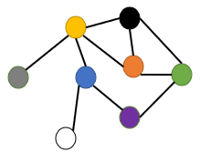
Shortcomings of Existing Partitioners
P1
In-Memory partitioning
High partitioning quality ( exploits view of the entire graph )
High memory overhead ( entire graph should load into memory ---expensive! )
Entire graph
In-Memory partitioner
P2
… ...
Pk
Streaming partitioning
Low partitioning quality ( limited view of the graph )
Low memory overhead ( accesses graph only one edge at a time )
P1
Edge streaming
Streaming Partitioner
P2
…
… …
Pk
Hybrid Edge Partitioner: Partitioning Large Power-Law Graphs under Memory Constraints

Slide 5
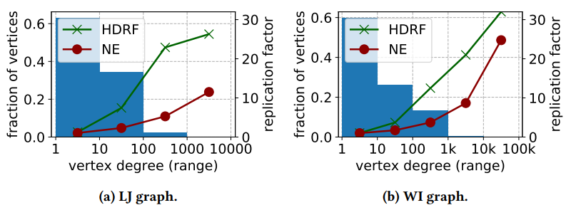
Hybrid Edge Partitioner : Overview
Divide graph into two sub-graphs A and B
Partition sub-graph A with In-Memory algorithm
Partition sub-graph B with Streaming algorithm
Only sub-graph A must be loaded into memory !
Input graph
In many natural graphs, the degree distribution of the vertices follows a power-law
Low-degree vertices constitute the majority
Goal : focus on reducing the replication of low-degree vertices
B
A
In-Memory
partitioning
Streaming
partitioning
…
P1
P2
P3
Pk
Hybrid Edge Partitioner: Partitioning Large Power-Law Graphs under Memory Constraints

Slide 6
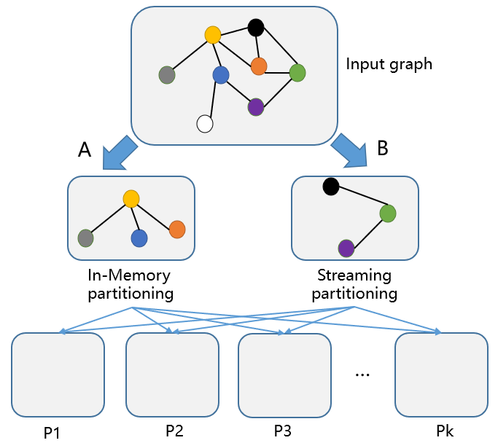
Hybrid Edge Partitioner : Overview
Divide graph into two sub-graphs A and B
Partition sub-graph A with In-Memory algorithm
Partition sub-graph B with Streaming algorithm
Only sub-graph A must be loaded into memory !
In many natural graphs, the degree distribution of the vertices follows a power-law
Low-degree vertices constitute the majority
Goal : focus on reducing the replication of low-degree vertices
H
L
H
L
L
H
Edges that are incident to at least one low-degree vertex are partitioned with in-memory partitioning
Edges that are incident to two high-degree vertices (𝐸ℎ2ℎ) are partitioned with streaming partitioning
Hybrid Edge Partitioner: Partitioning Large Power-Law Graphs under Memory Constraints

Slide 7
In-Memory Partitioning via NE++
NE++ extend NE( Neighborhood Expansion ) with the following optimizations:
Graph pruning ➔ Save Memory, Save Time
Lazy edge Invalidation ➔ Save Memory
Efficient seed vertex search ➔ Save Time
Adapted Partition Capacity Bound ➔ Save Time
Building the Last Partition ➔ Save Time
Hybrid Edge Partitioner: Partitioning Large Power-Law Graphs under Memory Constraints

Slide 8
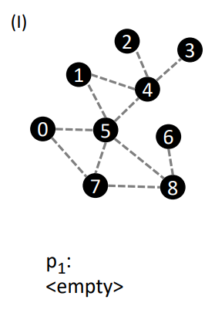
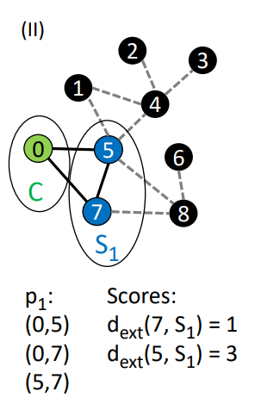
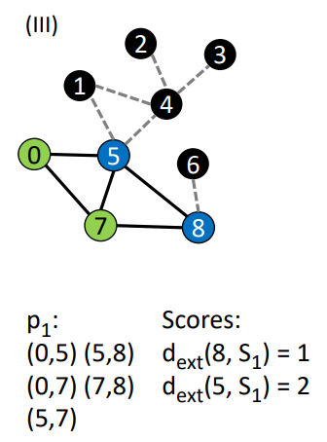
Background : NE algorithm
Grows partitions subsequently by expansion
Start with a random seed v, place it in the core set C
Move v neighbors to the secondary set S
Add edges between vertices in C and S to current partition
Expand : move the vertex with the lowest external degree from S to C, and move its external neighbors to S
Add edges between vertices in C and S to current partition
Proceed with expansion ( step 4 ) until partition has enough edges
Hybrid Edge Partitioner: Partitioning Large Power-Law Graphs under Memory Constraints

Slide 9
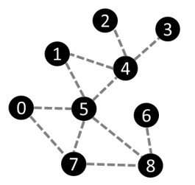
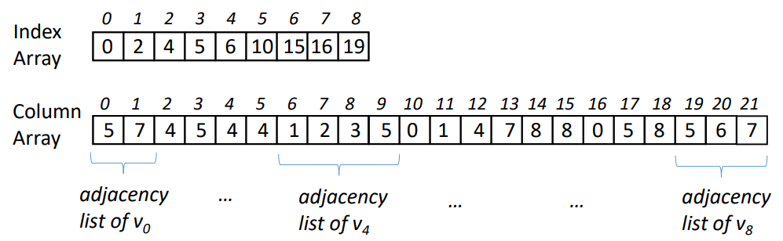
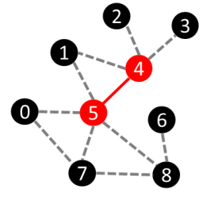
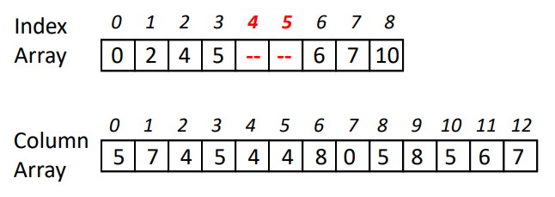
Graph Pruning
NE loads the entire graph into memory
NE++ prunes high-degree vertices when loading the graph
Skip adjacency lists of high-degree vertices
Write out edges between high-degree vertices to an external file
original graph
pruned graph
➔ Save Memory, Save Time
Hybrid Edge Partitioner: Partitioning Large Power-Law Graphs under Memory Constraints

Slide 10
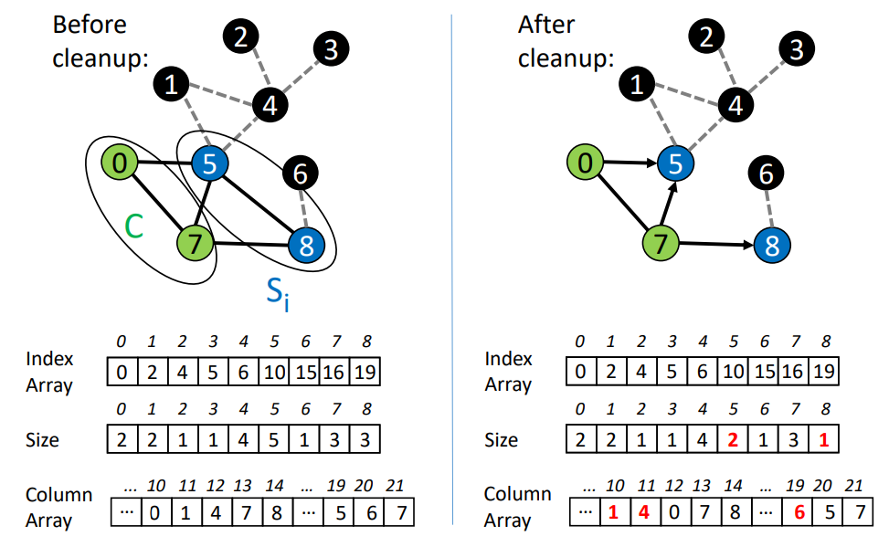
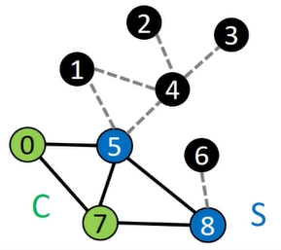
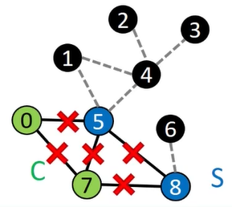
Lazy Edge Invalidation
NE eagerly keeps book about all assigned edges to avoid assignments
This is not necessary !
Vertices in C will not be visited again ➔ edge between vertices in C are not critical
Vertices in S may be visited again ➔ critical edges are those incident to vertices in S
➔ Save Memory
Hybrid Edge Partitioner: Partitioning Large Power-Law Graphs under Memory Constraints

Slide 11
Efficient Seed Vertex Search
3 scenarios when initialization is need
when a partition expansion is started
when one of disconnected components has assigned all edges
when there are only high-degree vertices in 𝑆_{𝑖}
when initialization start we need to find a seed vertex
NE : random selection of seed vertex
Hard to find suitable vertices
Many random “jumps” until a suitable vertex is found
NE++ : Sequential scan by vertex ID
Every vertex is visited at most once in overall seed vertex search
➔ Save Time
Hybrid Edge Partitioner: Partitioning Large Power-Law Graphs under Memory Constraints

Slide 12
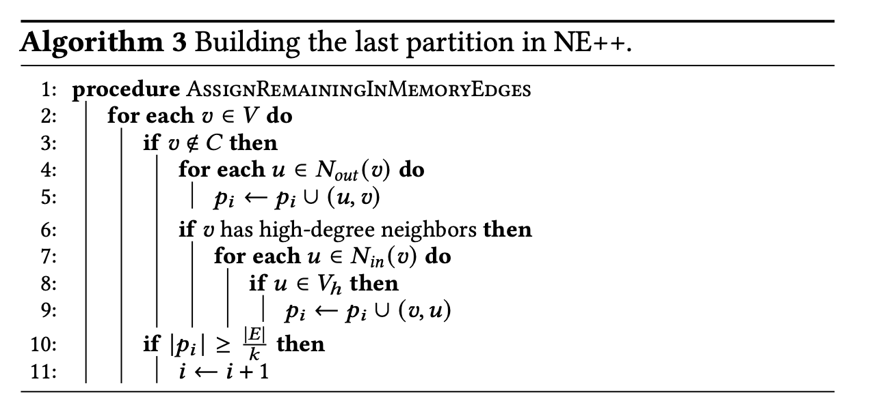
Further Optimizations for NE++
Adapted Partition Capacity Bound
new capacity bound is |E-E_{h2h}|/k instead of |E|/k
Building the Last Partition
simply assign all remaining in-memory edges to the last partition
➔ Save Time
Hybrid Edge Partitioner: Partitioning Large Power-Law Graphs under Memory Constraints

Slide 13
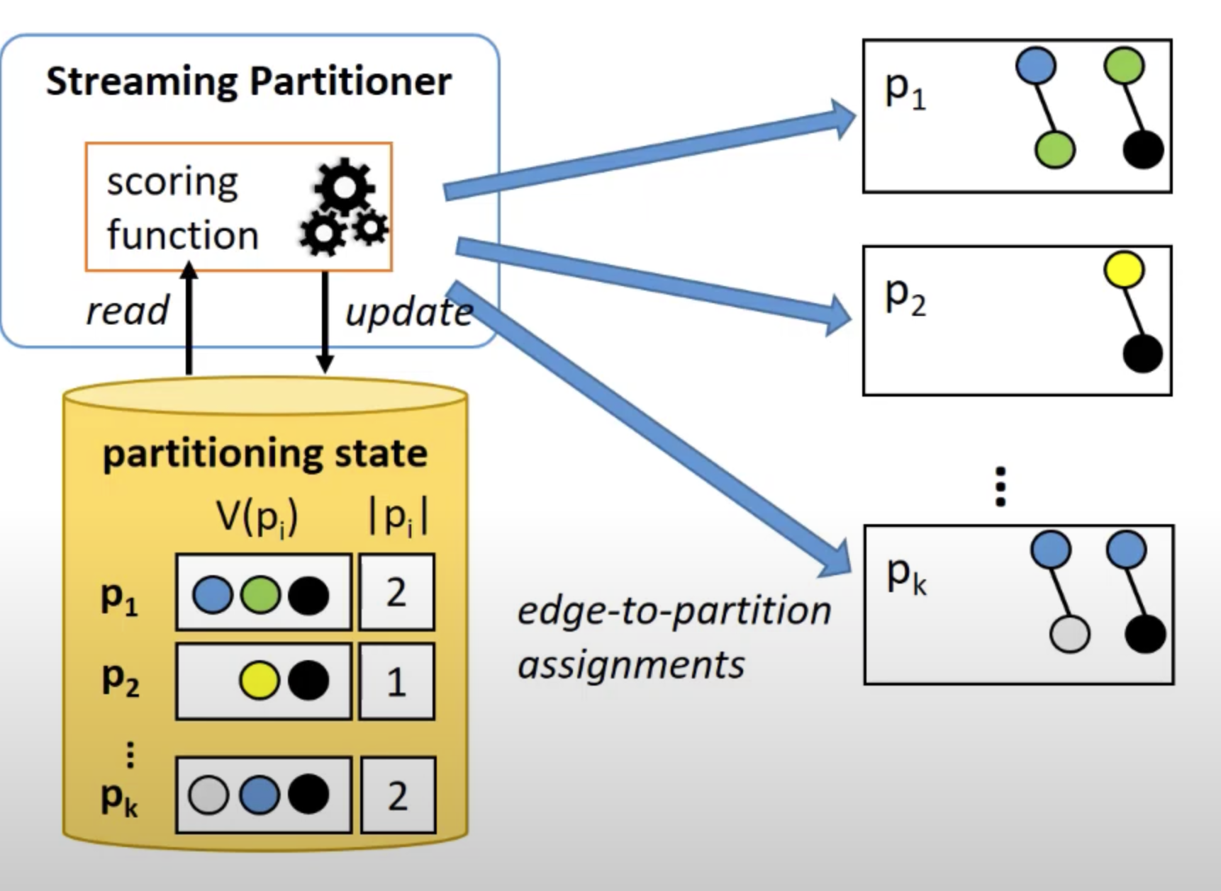
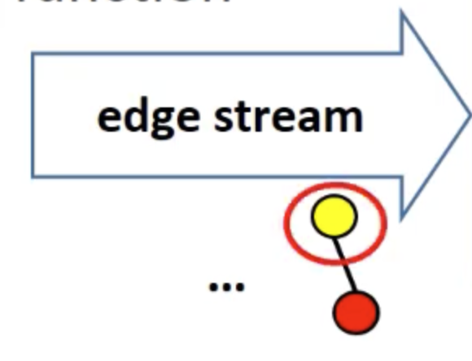
Streaming Partitioning via Informed HDRF
HEP uses HDRF scoring function
HEP optimization:
Initialize partitioning
state from NE++ ( to avoid cold start or uninformed assignment problem)
➔ Save Time
Give higher score if vertex
is already replicated on partition
Update partitioning state after
assigning an edge
Hybrid Edge Partitioner: Partitioning Large Power-Law Graphs under Memory Constraints

Slide 14
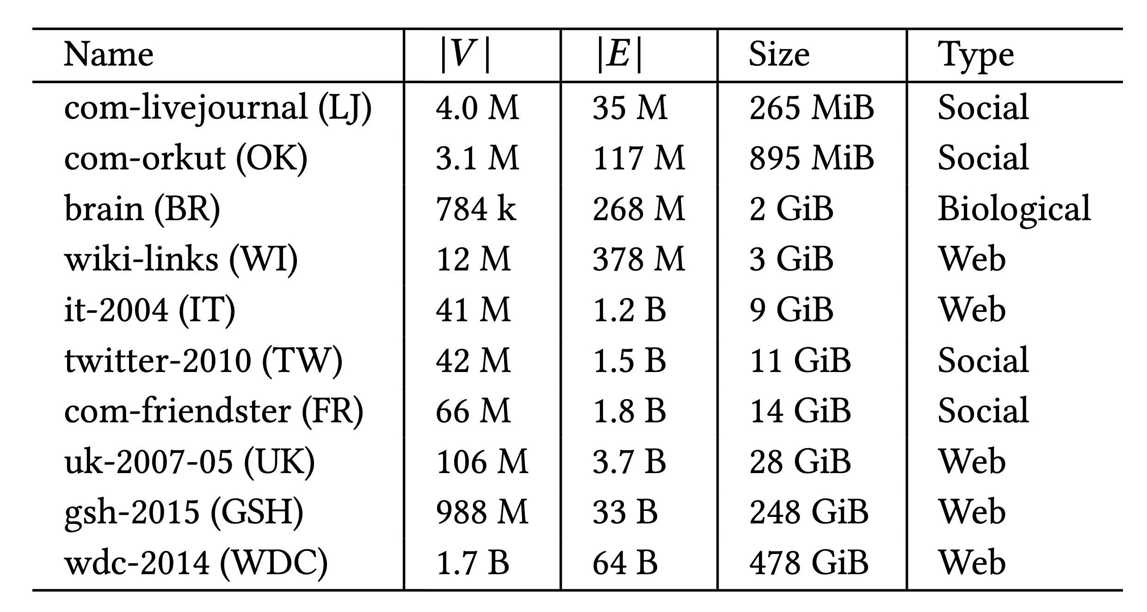
Evaluations
Partitioning metrics
Replication factor
Partitioning run-time
Memory overhead
Real-world graphs:
Hybrid Edge Partitioner: Partitioning Large Power-Law Graphs under Memory Constraints

Slide 15
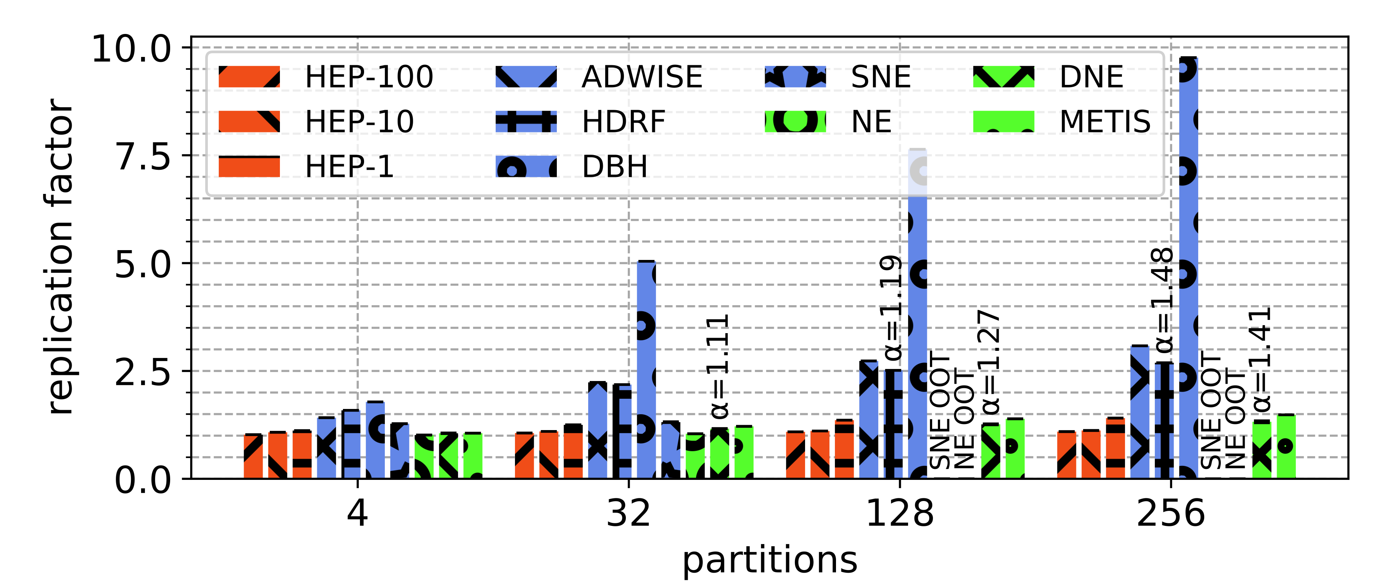
Evaluations
Replication Factor
Better replication factor than streaming partitioners, competitive to in-memory partitioners
Better replication factor for higher setting of 𝜏
Hybrid Edge Partitioner: Partitioning Large Power-Law Graphs under Memory Constraints

Slide 16
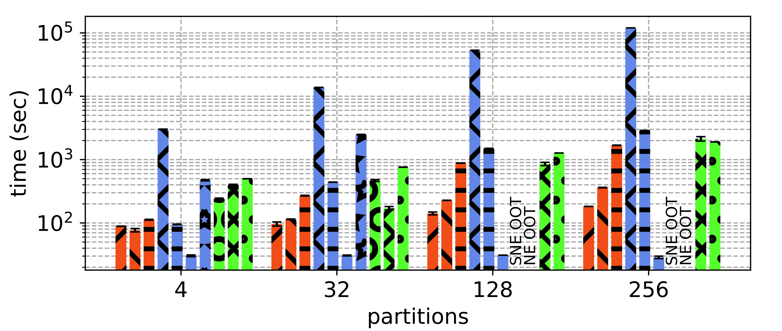
Evaluations
Partitioning run-time
Competitive run-time to other partitioners, only hash-based partitioning (DBH) is faster
Run-time increases with decreasing 𝜏
Hybrid Edge Partitioner: Partitioning Large Power-Law Graphs under Memory Constraints

Slide 17
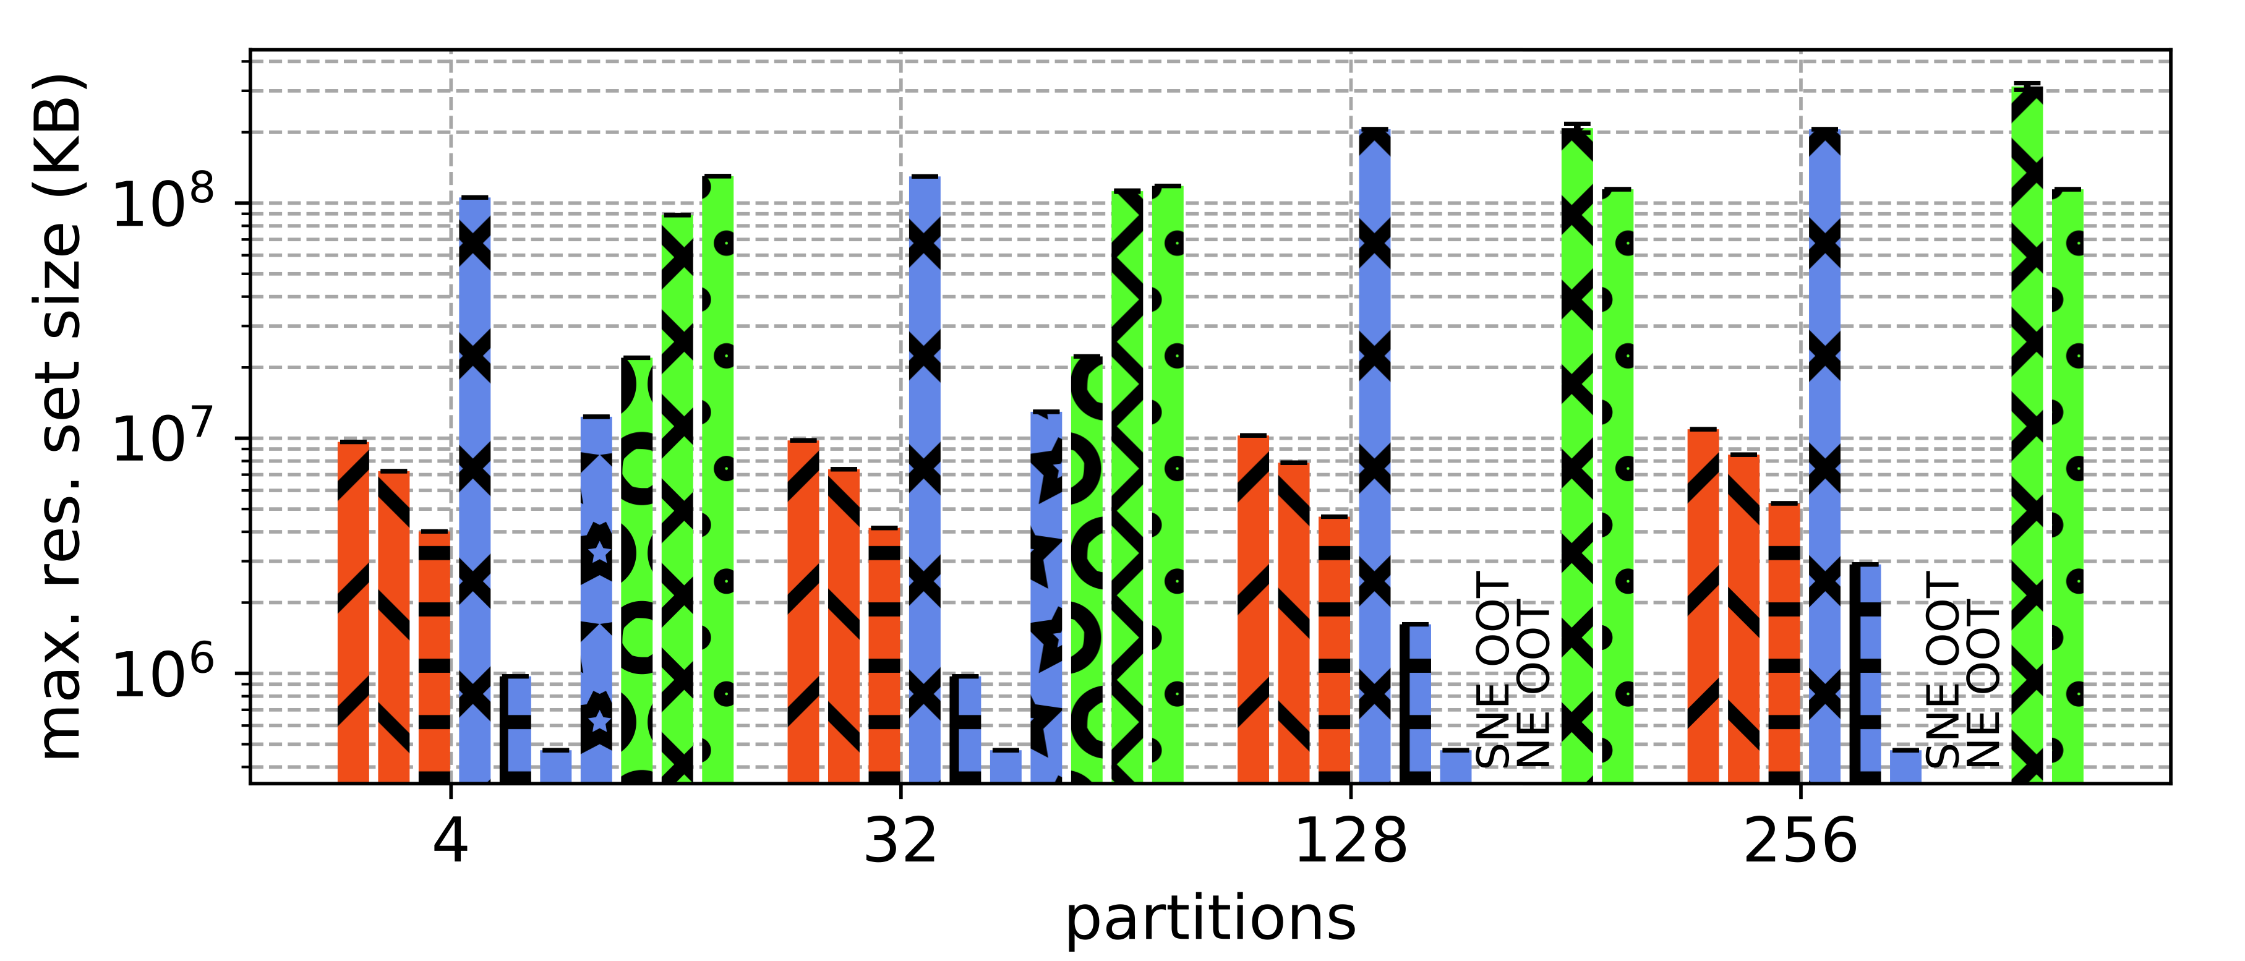
Evaluations
Memory overhead
Lower memory overhead than in-memory partitioners
Tunable with 𝜏 (lower 𝜏 - lower memory overhead)
Hybrid Edge Partitioner: Partitioning Large Power-Law Graphs under Memory Constraints

Slide 18
Thank you
程健

