Slide 1

Reducing Load Latency with Cache Level Prediction
——IEEE HPCA. 2022
汇报人：杨洁
Notes:
XXXXXX
XXX

Slide 2
01
Motivation
CONTENTS
02
Design and Implementation
03
Evaluation
04
Conclusion

Slide 3
1
Motivation

Slide 4
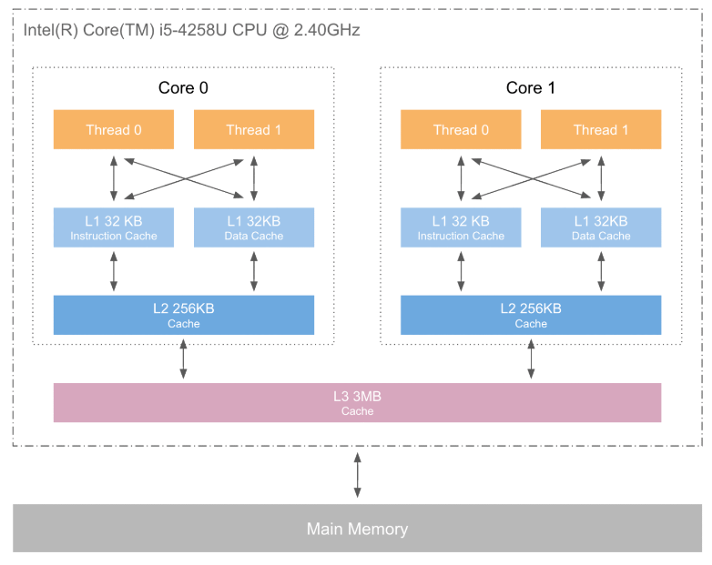
1.1 Background
Motivation
Design and Implementation
Evaluation
Conclusion
Three-level Cache Architecture
Good locality:
The number of demand load misses decreases
Bad locality:
Unnecessary lookup delays
Higher load latencies

Slide 5
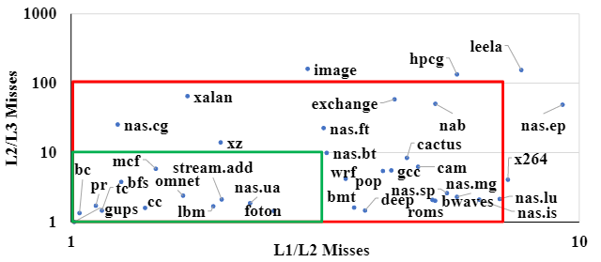
1.1 Background
Motivation
Design and Implementation
Evaluation
Conclusion
The Effectiveness of Lookup Strategy
Outside the red box
A good fit for sequential level lookup
Not benefit from level prediction
Inside the green box
Significant latency reductions from non-sequential lookup
Between the boxes
Modest performance gains from level prediction

Slide 6
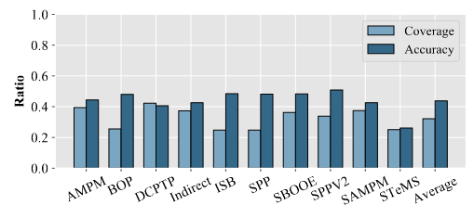
1.2 Prior Searches
Motivation
Design and Implementation
Evaluation
Conclusion
01
Prefetcher
Advantages
Moving data between levels prior to the execution of load instructions
Mitigating the latency impact
Disadvantages
Access slow main memory frequently
Low average accuracy

Slide 7
2
Design and Implementation

Slide 8
2.1 Predictor Design
Motivation
Design and Implementation
Evaluation
Conclusion
Levels to predict
Resource and power
Excluding L1 as a prediction target
Including L2 as a prediction target
Being area-efficient to provide benefits
Small and lower power for predictor structures
Level Prediction Approach
Impact of Prefecthers
PC + Miss history
Address + Miss history
Miss-Map approach
Prefetchers add "noise" to the hit/miss history
Coordinating the prefetcher and level predictor

Slide 9
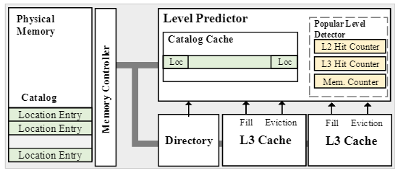
2.2 Cache Level Predictor
Motivation
Design and Implementation
Evaluation
Conclusion
Extending the Miss-Map
Miss-Map >> Location-Map
Providing the location of each block
2 bits of metadata per block (64B)
In-cache table >> In-memory table
A small & consistent table
Caching in a small meta-data cache
Adding Popular Levels Detector
Solving metadata cache miss
Three counters

Slide 10
2.3 LocMap & Tracking
Motivation
Design and Implementation
Evaluation
Conclusion
LocMap Access
Time: L1 cache miss or updated
Address: LocMap Address = Base Address + Physical Address >>14
LocMap Update
Updating Events:
Demand cache fills, dirty evictions, and prefetch fills that are metadata cache hits.
Other Events:
Prefetch fills with metadata cache missing
Frequent clean evictions
Coherence-induced level change

Slide 11
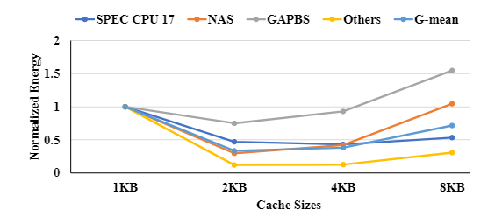
2.3 LocMap & Tracking
Motivation
Design and Implementation
Evaluation
Conclusion
Metadata Cache Size
Too small
High miss ratio
Updating LocMap frequently
Degrading prediction
Too high
Can't maintain low access latency&energy
2KB metadata cache provides a reasonable tradeoff

Slide 12
2.3 Popular Levels Detector
Motivation
Design and Implementation
Evaluation
Conclusion
Time of Prediction
Metadata cache missing
Strategy of Updating
Hitting level counter + 1 and others -1
Strategy of Prediction
Single-way prediction:
Topmost is picked only (counter > threshold).
Multi-way prediction:
Topmost and second highest counter are picked (sum pf two counter > threshold).
Three counters are all included (sum pf two counter < threshold).

Slide 13
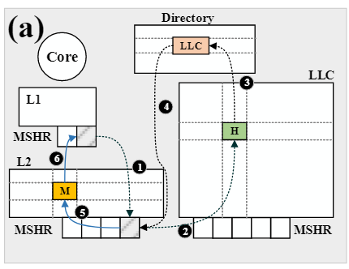
2.4 Misprediction Detection
Motivation
Design and Implementation
Evaluation
Conclusion
01
One-way correct prediction
Allocate MSHR (L1) & Send request to L2
Allocate MSHR (L2) & Forward request to the LLC
Check tag-store
Respond to the request (LLC)
Deallocate MSHR (L2) & Fill the block into L2
Forward the block to L1

Slide 14
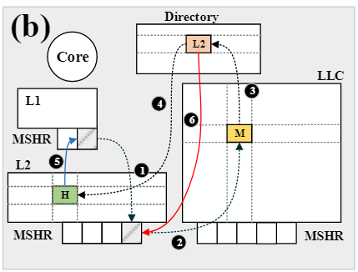
2.4 Misprediction Detection
Motivation
Design and Implementation
Evaluation
Conclusion
01
One-way correct prediction
Allocate MSHR (L1) & Send request to L2
Allocate MSHR (L1) & Forward request to the LLC
Check tag-store
Indicate block is present in L2 & Send a new request to L2
Forward the block to L1
Deallocate MSHR (L2)

Slide 15
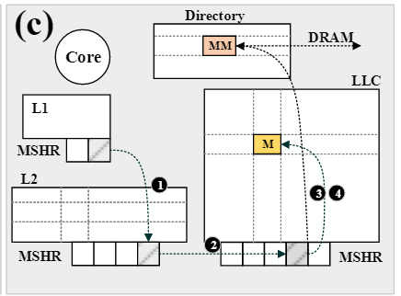
2.4 Misprediction Detection
Motivation
Design and Implementation
Evaluation
Conclusion
01
One-way correct prediction
Allocate MSHR (L1) & Send request to L2
Allocate MSHR (L2) & Forward request to the LLC & directory
Check tag-store
Indicate block is present in DRAM & Send request to DRAM

Slide 16
3
Evaluation

Slide 17
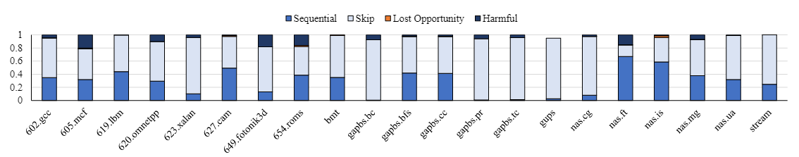
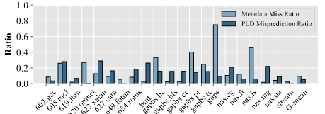
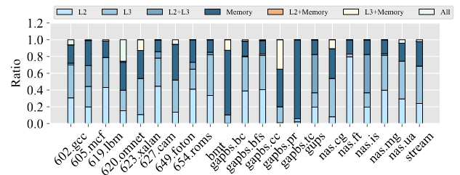
3.1 Prediction Accuracy
Motivation
Design and Implementation
Evaluation
Conclusion
High LocMap metadata cache miss rate >> Lower accuracies
Stale LocMap information >> Mispredictions
Aggressive prefetchers: More clean evictions without updating.
Poor locality: Large cache fills missed in metadata cache.
High accuracy of the PLD
Clear cache-level usage pattern.
Multi-way access to multiple levels in parallel

Slide 18
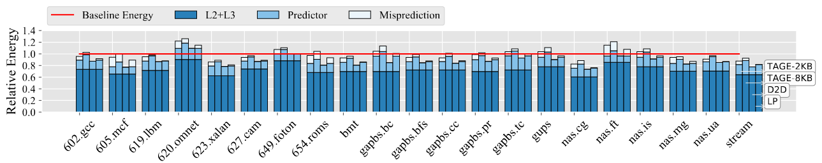
3.2 Cache Energy
Motivation
Design and Implementation
Evaluation
Conclusion
1
LocMap + PLD predictor is substantially better than either TAGE variant.
2
The LP results in an average energy saving of 16%.
3
D2D also exhibits overheads and can only improve on the LP by 3% on average.

Slide 19
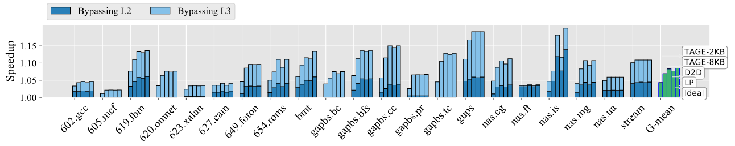
3.2 Cache Energy
Motivation
Design and Implementation
Evaluation
Conclusion
1
Speedup correlates well with the level-prediction potential
2
LP nearly matches the speedup of Ideal and D2D.
3
Just skipping L2 offers > 5% speedup for many applications.

Slide 20
4
Conclusion

Slide 21
4. Conclusion
Motivation
Design and Implementation
Evaluation
Conclusion
1
Many graph analytics and scientific applications benchmarks can benefit from non-sequential lookup
2
An effective, yet low-cost level predictor that operates in each core on the L1 cache miss path substantially outperforms cache miss predictors
3
Level prediction eliminates many unnecessary miss lookups.

Slide 22
Thanks for watching!!
Notes:
XXXXXX
XXX

