Slide 1



Don’t Be a Blockhead: Zoned Namespaces Make Work on Conventional SSDs Obsolete
汇报人：洪子骁 汇报时间：2022年12月8日

Slide 2
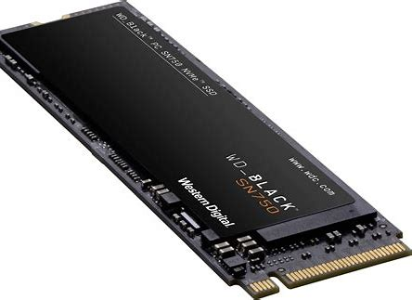
ABSTRACT
Research on flash devices almost exclusively focuses on conventional SSDs, which expose a block interface. Industry, however, has standardized and is adopting Zoned Namespaces (ZNS) SSDs, which offer a new storage interface that dominates conventional SSDs. Continued research on conventional SSDs is thus a missed opportunity to unlock a step-change improvement in system performance by building on ZNS SSDs. We argue for an immediate and complete shift in research to ZNS SSDs and discuss research directions.

Slide 3
1
ZNS的优势
目 录
2
ZNS研究分析
CONTENTS
3
研究议程

Slide 4
A Quick Flash Primer
Flash architecture.
Reading and writing flash.
Conventional SSDs.
Zoned Namespaces SSDs.

Slide 5
优势1：ZNS Costs Less per Gigabyte
Less on-board DRAM.
Less overprovisioning.

Slide 6
优势2：ZNS Is a More Useful Abstraction
The interface exposed by ZNS SSDs hits a sweet spot that balances being easy to use and faithfully representing how the device handles data.
Building an abstraction over the device’s interface shifts some computational and DRAM burden to the host.

Slide 7
优势3：ZNS May Get Better Performance
The key performance strategies used by FTLs in conventional SSDs are equally available to a ZNS device.
The host can also leverage application knowledge to make better scheduling decisions.
Early ZNS SSD experiments highlight their performance.

Slide 8
优势4：ZNS SSD Adoption
ZNS devices are already on the market from some vendors.
ZoneFS,F2FS, BtrfsXFS, ext4,Ceph, RocksDB, SPDK…

Slide 9
REEVALUATING THE FOCUS OF SSD R&D
论文调查了过去五年在FAST，OSDI，SOSP和MSST发表的论文。总共收集了465篇论文，并将其缩小到104篇论文，其中基于闪存的SSD是研究或系统实施的重要组成部分。
具体来说，这样做的目的是，在ZNS设备占主导地位的未来，我们是否还会进行闪存和SSD相关的研究。

Slide 10
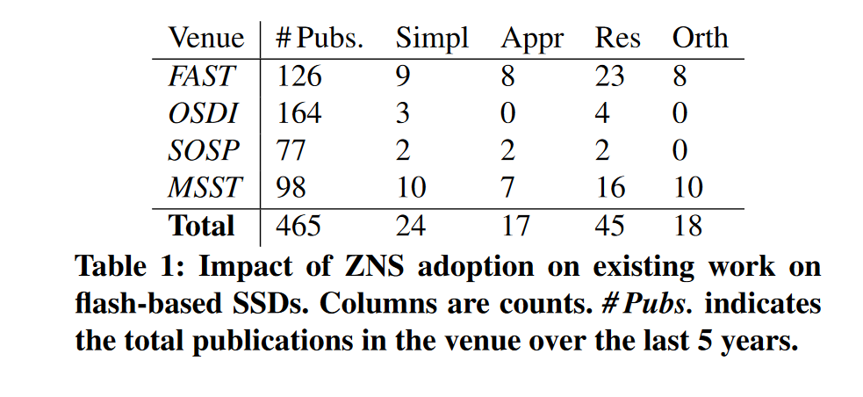
分类结果

Slide 11
RESEARCH AGENDA
Improving Performance
Managing Limitations

Slide 12
Improving Performance
How can application-level information improve zone management?
How should applications interact with zones?
What is the best approach to I/O scheduling with hostdriven device management?
How can we best exploit transparent data placement?

Slide 13
Managing Limitations
How should hosts manage active zone limits?
Are there workloads that perform worse on ZNS SSDs than on conventional SSDs?
How do ZNS SSDs fit with recent trends to offload I/O tasks from the host to dedicated hardware?

Slide 14
CONCLUSION
虽然许多SSD研究都集中在传统SSD的问题上，但行业已经取得了进步——标准化并开始采用ZNS。这个拐点为如何充分利用这些新兴设备开辟了令人兴奋和有影响力的研究方向。它还指出了系统社区面临的一个问题：许多研究都是针对大型云提供商等环境进行的，但通常只有那些在工业界或与行业有密切联系的人才能优先访问新兴技术和问题。这对没有这种联系的研究人员不利，但也损害了整个领域。如果接触相关问题的机会受到限制，当解决最紧迫问题的思想家的多样性受到限制时，进展就会受到阻碍。我们希望能够鼓励来自世界各地一系列机构的研究人员参与研究，并组织行业小组，作为讨论新趋势和挑战的渠道。

Slide 15

THANKS

