Slide 1
FarReach: Write-back Caching in Programmable Switches
USENIX ATC‘23
汇报人：孙纪涛

Slide 2
Writes in Key-value Stores
Writes dominate in production key-value storage workloads
20% of Twitter’s Twemcache clusters are write-intensive
Facebook’s RocksDB for AI services has 92.5% of read-modify-writes
Challenges for high write performance
High round-trip latencies in transmission, queuing, and processing
Skewness introduces imbalanced server loads

Slide 3
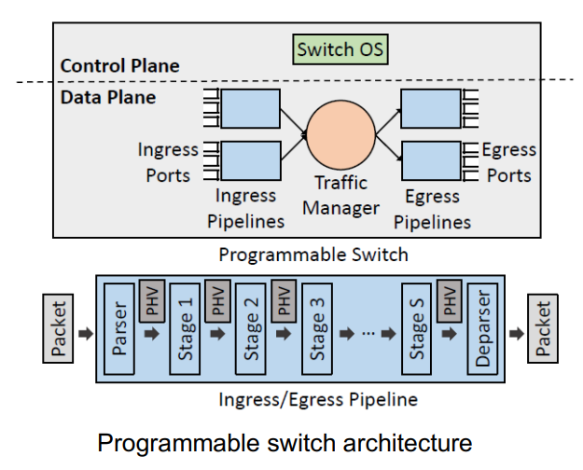
In-switch Write-back Cache
Programmable switches can help improve write performance
Switch OS controls multi-pipeline data plane
Each pipeline has multiple stages with stateful memory
Write-back policy: caches popular write records in switch without immediately updating servers

Slide 4
Challenges
Performance challenge
Scarce switch resources require offloading cache management to controller → high controller-to-switch latency
Availability challenge
Synchronization between switch and servers is required to keep latest records available
Reliability challenge
Latest records may be lost in switch failures under write-back caching

Slide 5
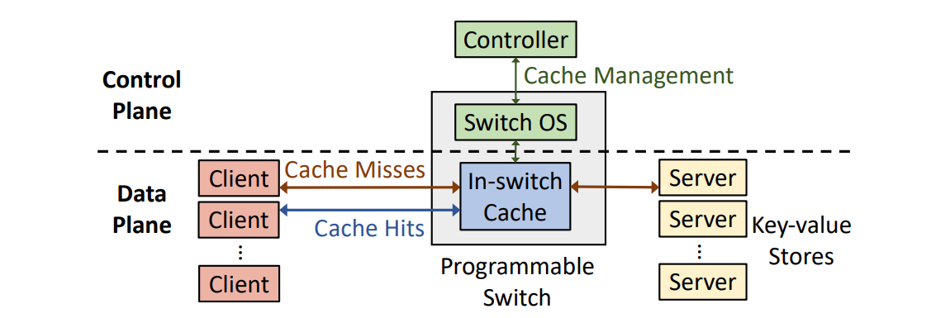
Design overview
FarReach architecture
In-switch cache absorbs writes with cache hits
Controller performs cache management through switch OS
Carefully co-design control and data planes

Slide 6
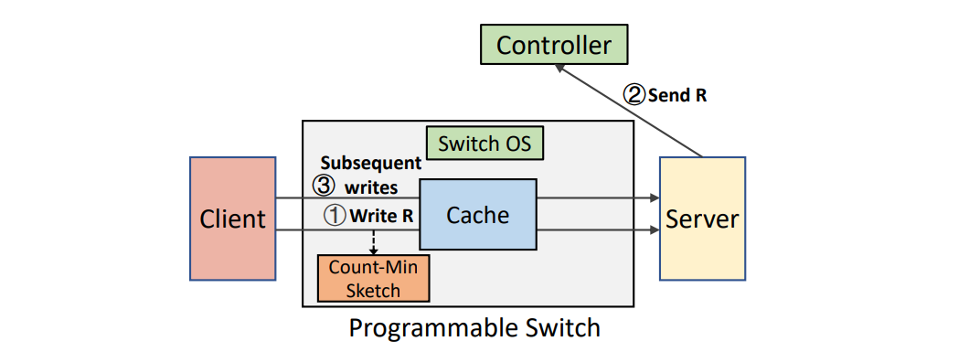
Problem of Cache Admission
Suppose that a request triggers cache admission
Subsequent writes arrive at switch before admission
Blocking subsequent writes undermines I/O performance
Absorbing subsequent writes in switch undermines availability

Slide 7
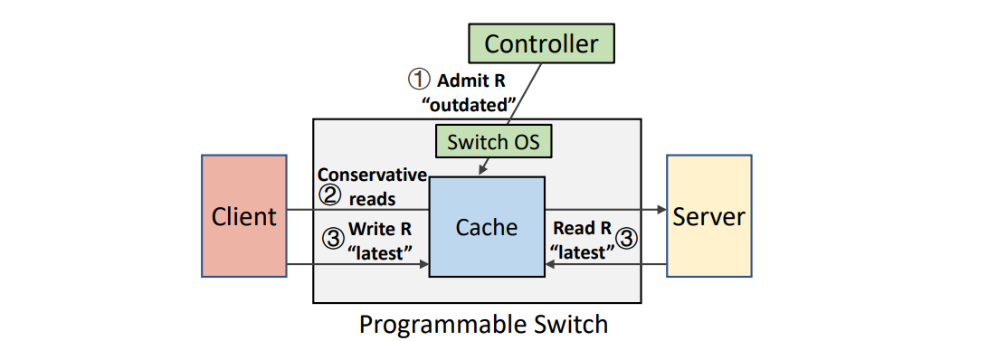
Non-blocking Cache Admission
Process subsequent writes in server without blocking
Mark admitted record as “outdated” as server is latest
Conservatively forward subsequent reads to server for availability
Mark admitted record as “latest” as early as possible

Slide 8
Problem of Cache Eviction
Under write-back policy
Evicted record is latest yet not updated to server
Controller loads evicted record to server for persistent storage
Subsequent writes arrive at switch during cache eviction
Processing without synchronization undermines availability
Synchronization by controller incurs large overhead

Slide 9
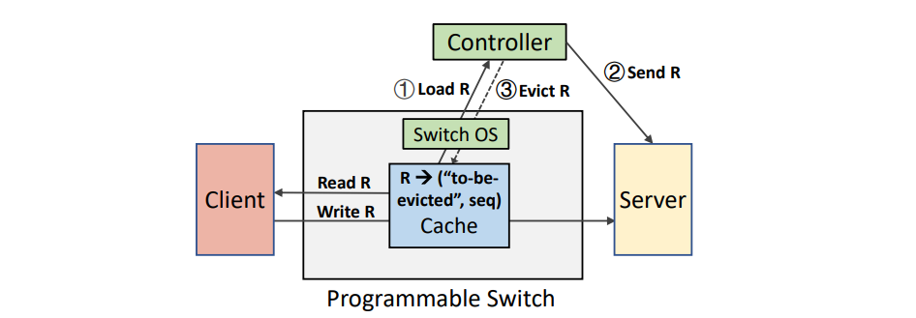
Available Cache Eviction
Associate additional in-switch metadata to evicted record
Mark evicted record as “to-be-evicted”
Load evicted record to server before removing it from switch
Mark “to-be-evicted” record as “outdated” and forward writes to server
Process reads by switch if “latest” or server if “outdated”

Slide 10
Problem of Reliability
Under write-back policy
• Cached records are latest yet not updated to servers
• Latest in-switch records are lost after switch failures
Controller loads cached records for snapshots
• Subsequent writes arrive at switch during snapshot generation
• Updating cache records incurs inconsistent snapshots

Slide 11
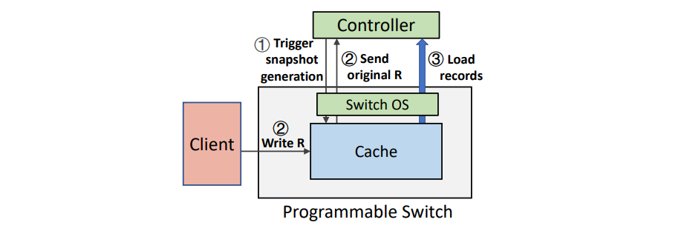
Crash-consistent Snapshot Generation
Send original cached record for each first write
• Controller replaces overwritten records for consistency
Two-phase algorithm
• Controller triggers snapshot generation
• Controller loads cached records and switch sends original ones

Slide 12
Zero-loss Recovery
Limitation of snapshot generation
• Snapshot generation avoids data loss before the latest snapshot
• Cached records after the latest snapshot are not protected
Client-side record preservation
• Clients preserve copies of cached records after the latest snapshot
• Controller notifies clients to release the snapshotted records
Replay-based recovery
• Replay writes of the latest records to update servers
• Replay admission decisions to recover in-switch cache

Slide 13
Evaluation
Methodology
• Simulate tens of servers by server rotation for server-side storage
• Compile P4 in a Tofino switch for in-switch cache
• Baselines: NoCache and NetCache [Jin et al., SOSP’17]
Experiments
• YCSB core workloads to evaluate throughput, latency, and scalability
• Synthetic workloads to evaluate impact of different parameters
• Performance of snapshot generation and crash recovery time
• Hardware resource usage

Slide 14
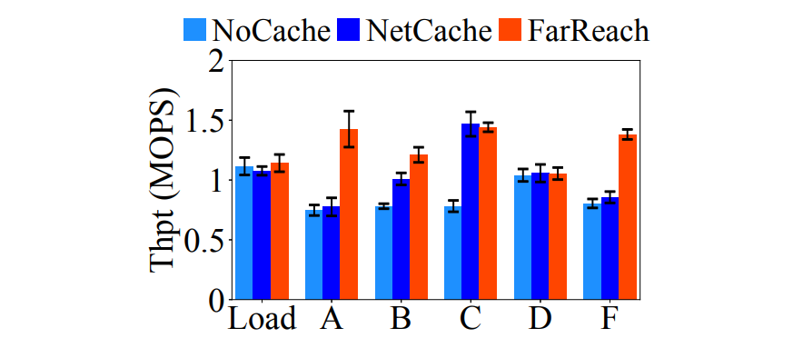
Throughput Analysis
Simulate 16 servers by server rotation
Larger throughput especially for workload A
• In-switch write-back cache reduces server-side load
Notes:
Load (inserting records),
A (50% reads, 50% writes),
B (95% reads, 5% writes),
C (100% reads),
D (95% reads, 5% writes),
and F (50% reads, 50% read-modify-writes);

Slide 15
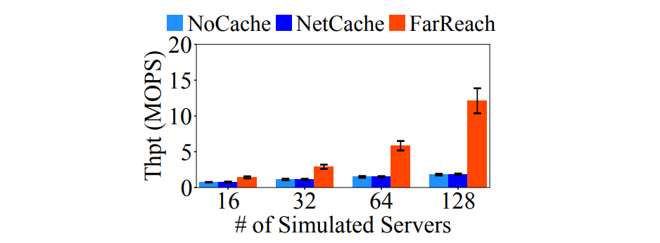
Scalability
Use workload A (skewed and write-intensive)
• Simulate 16 to 128 servers by server rotation
Throughput gain is up to 6.6× under 128 simulated servers
• In-switch write-back cache balances server-side load

Slide 16
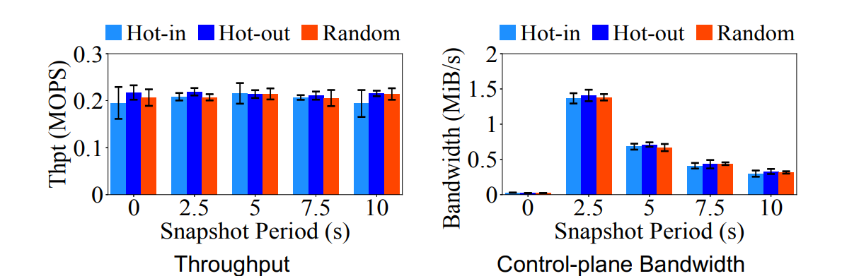
Performance of Snapshot Generation
Dynamic workload patterns
• Bandwidth includes snapshot generation and cache management
Similar throughput and limited control-plane bandwidth

Slide 17
Conclusion
FarReach, a fast, available, and reliable in-switch write-back cache
• Non-blocking cache admission
• Available cache eviction
• Crash-consistent snapshot generation with zero-loss recovery
Tofino switch evaluation on YCSB and synthetic workloads

