Slide 1
数据中心技术
施展
武汉光电国家实验室
2017-09-14, 09-15, 09-21

Slide 2
基本信息
施展 副研究员，武汉光电国家实验室，存储部，F309
课程公务 每周五上午08:30-10:00
课程主页 https://github.com/cs210-566
联系方式 zshi@hust.edu.cn 13971459597
参考书
云计算与分布式系统——从并行处理到物联网，机械工业出版社，2012
云计算——概念、技术与架构，机械工业出版社，2014
Barroso, Clidaras, and Holzle, “The Datacenter as a Computer: An Introduction to the Design of Warehouse-Scale Machines, Second Edition.”

Slide 3
课程计划
1 | 课程总体介绍 | 09-07
2 | 背景技术与基础环境概述 | 09-08
3 | 虚拟化、容器技术 | 09-14
4 |  | 09-15
5 | 虚拟化、容器编排技术 | 09-21
6 | 论文、实验讲解 | 09-22
7 | 分布式对象存储技术 | 09-28
8 | 论文、实验讲解 | 09-29
9 | 监控与管理技术 | 10-12
10 | 论文、实验讲解 | 10-13
11 | 分组讨论论文、汇报实验 | 10-19
12 |  | 10-26
13 |  | 10-27
14 |  | 11-02
15 | 完成实验，课程总结，编写报告 | 11-03
16 |  | 11-10

Slide 4
讲座内容
虚拟化技术
基础概念、关键技术
KVM/QEMU, XEN
VirtualBox
容器技术
基础概念、关键技术
Docker, LXC/LXD, RKT
虚拟机与容器编排
Vagrant
docker-compose

Slide 5
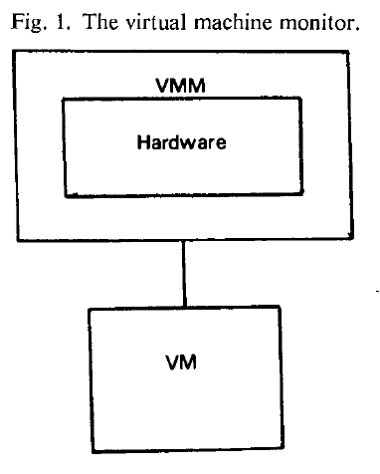
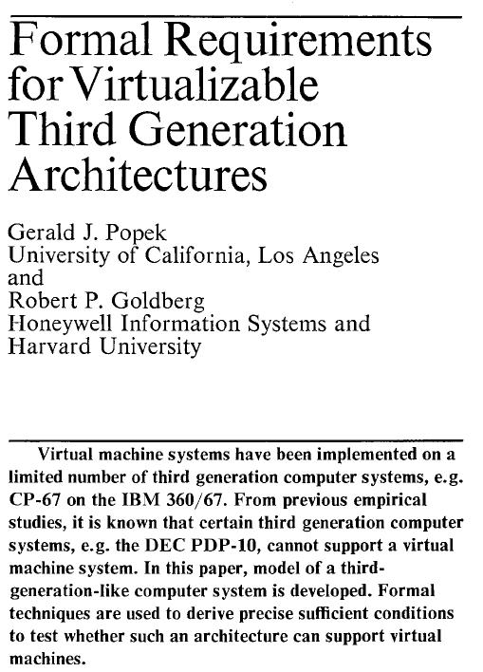
虚拟化简史
“an efficient, isolated duplicate of the real machine”
Efficiency
Innocuous instructions should execute directly on the hardware
Resource control
Executed programs may not affect the system resources
Equivalence
The behavior of a program executing under the VMM should be the same as if the program were executed directly on the hardware (except possibly for timing and resource availability)
Communications of the ACM, vol 17, no 7, 1974, pp.412-421

Slide 6
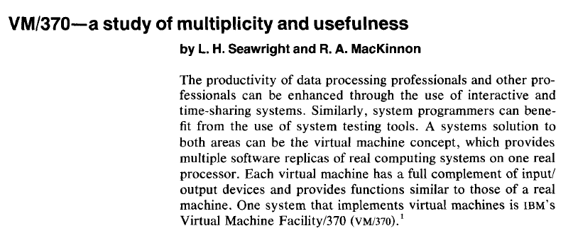
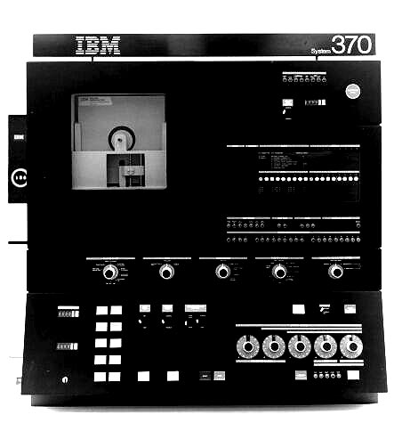
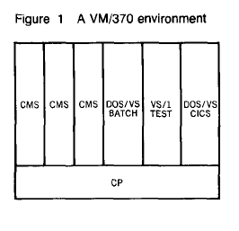
虚拟化简史
IBM Systems Journal, vol. 18, no. 1, 1979, pp. 4-17.
Concurrent execution of multiple production operating systems
Testing and development of experimental systems
Adoption of new systems with continued use of legacy systems
Ability to accommodate applications requiring special-purpose OS
Introduced notions of “handshake” and “virtual-equals-real mode” to allow sharing of resource control information with CP
Leveraged ability to co-design hardware, VMM, and guestOS

Slide 7
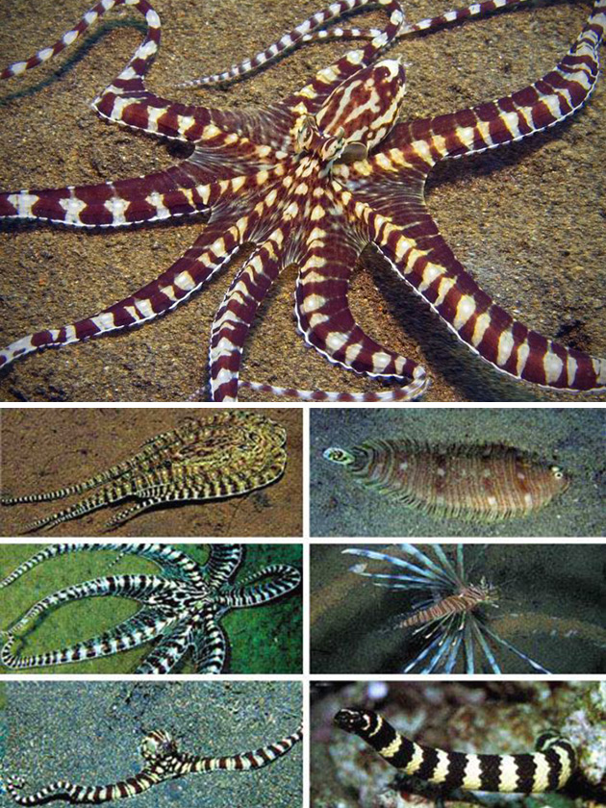

虚拟化 Virtualization
Virtualization deals with
“extending or replacing an existing interface so as to mimic the behavior of another system”
Virtual system examples
Virtual Private Network
Virtual Memory
Virtual Machine

Slide 8
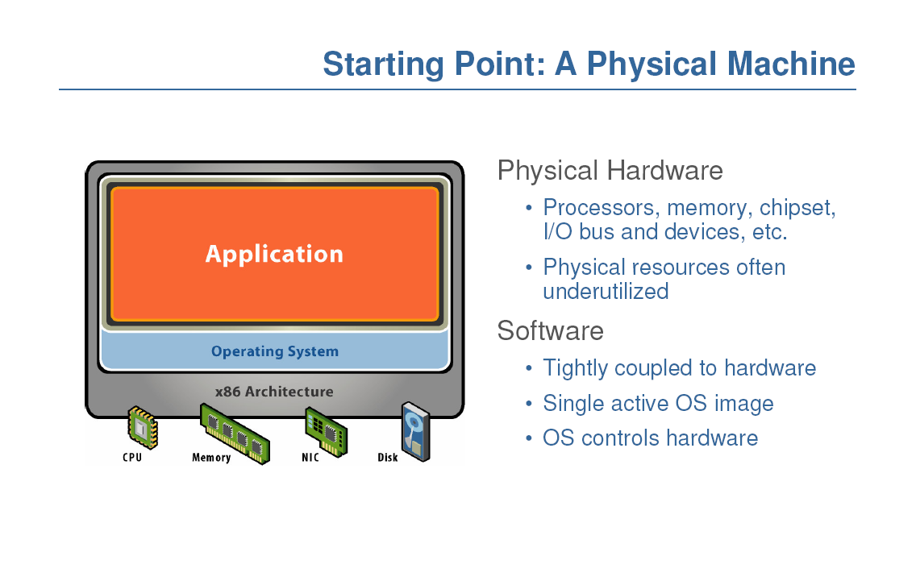
从物理机开始

Slide 9
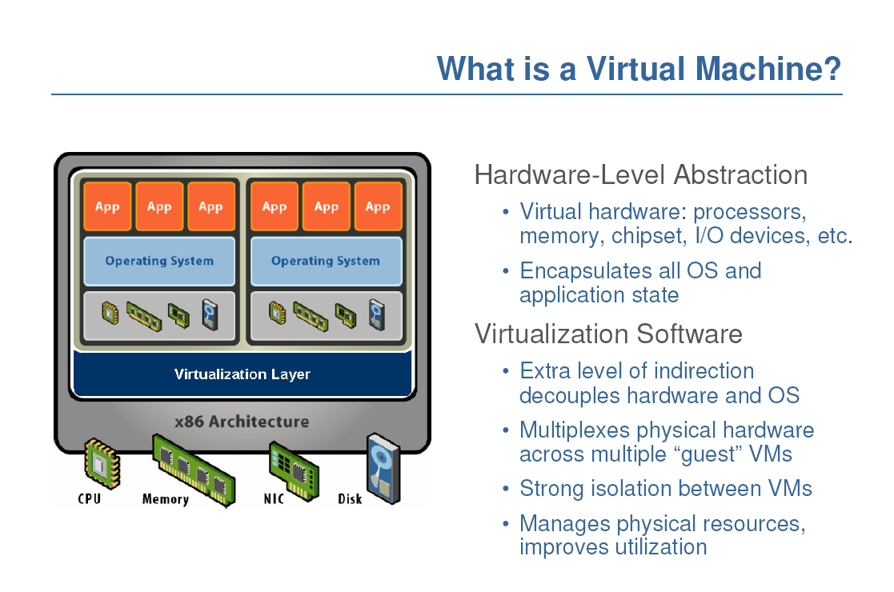
什么是虚拟机？

Slide 10
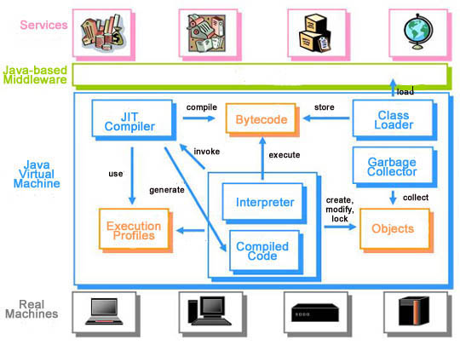
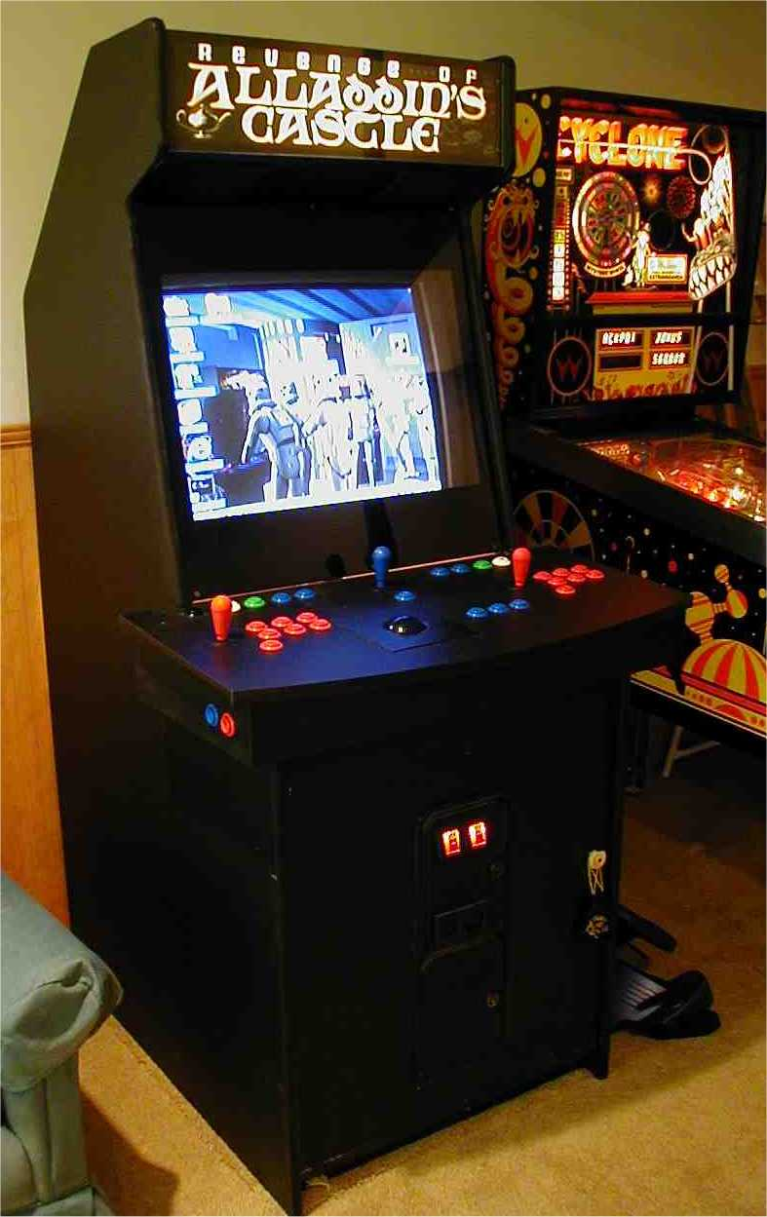
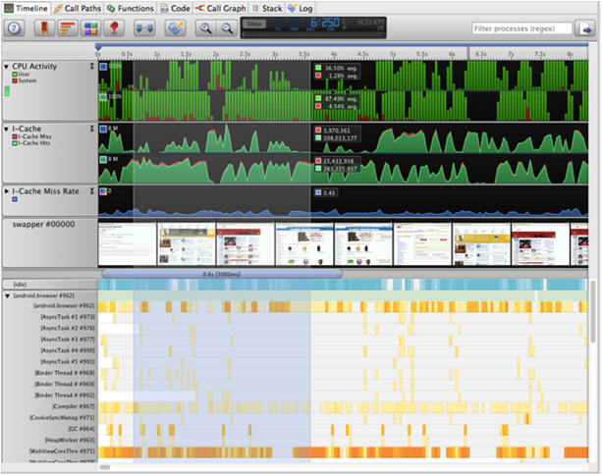
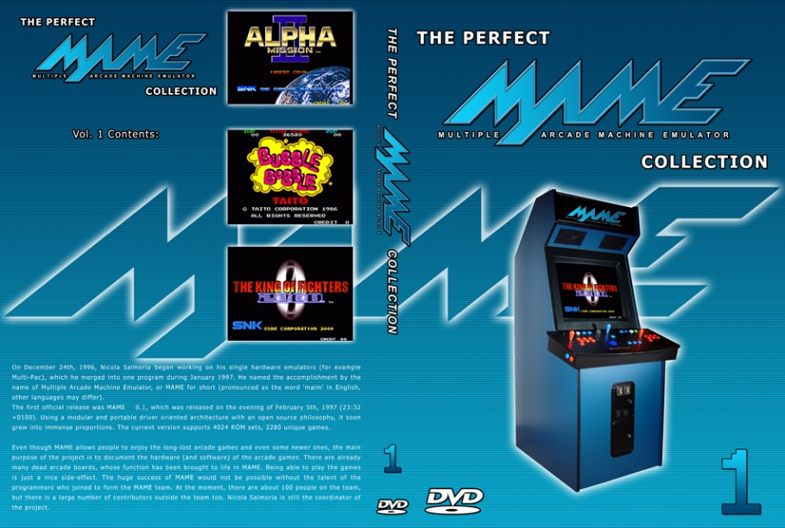
什么是虚拟机？
Java
GEM5
MAME

Slide 11
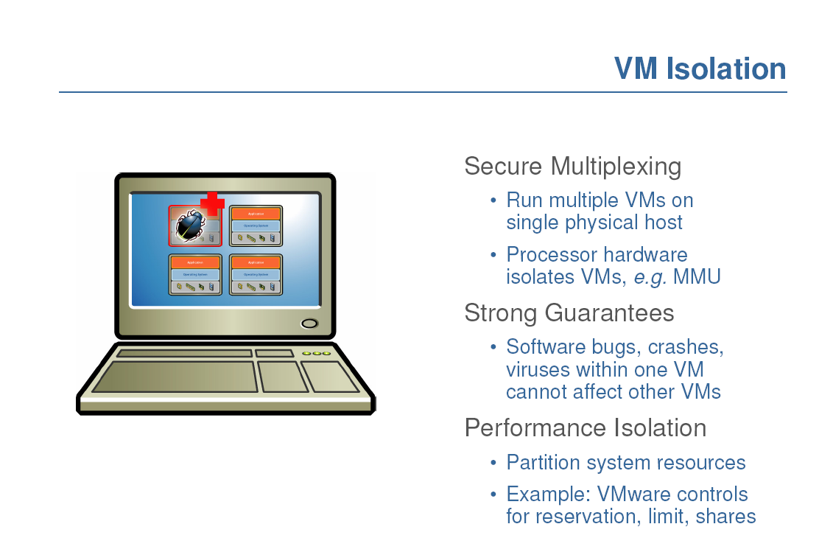
实现隔离

Slide 12
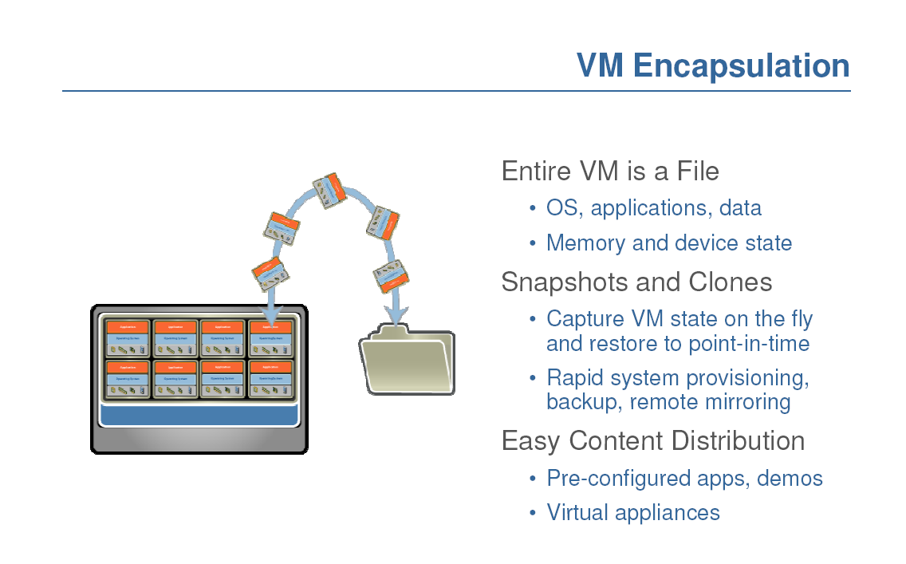
实现封装

Slide 13
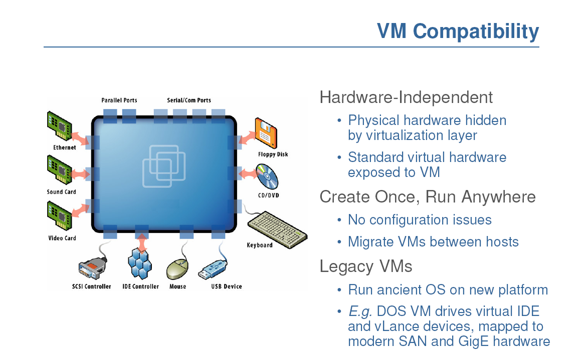
实现兼容
Notes:
Hardware and low-level systems software change quickly
High-level software (middleware, applications) changes more slowly

Slide 14
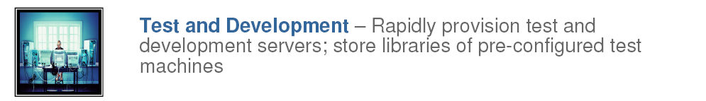
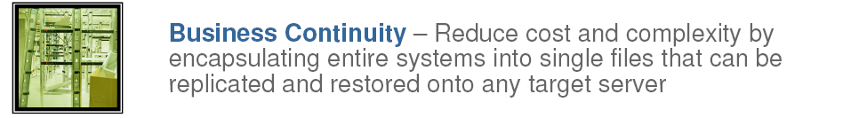
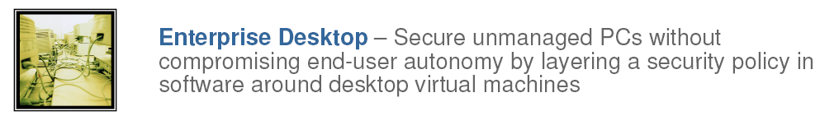
用途

Slide 15
用途
Run legacy software on non-legacy hardware
Run multiple operating systems on the same hardware
Create a manageable upgrade path
Manage outages (expected and unexpected) dynamically

Slide 16
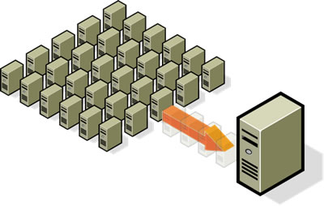
用途
Reduce costs by consolidating 整合 services onto the fewest number of physical machines
http://www.vmware.com/img/serverconsolidation.jpg

Slide 17
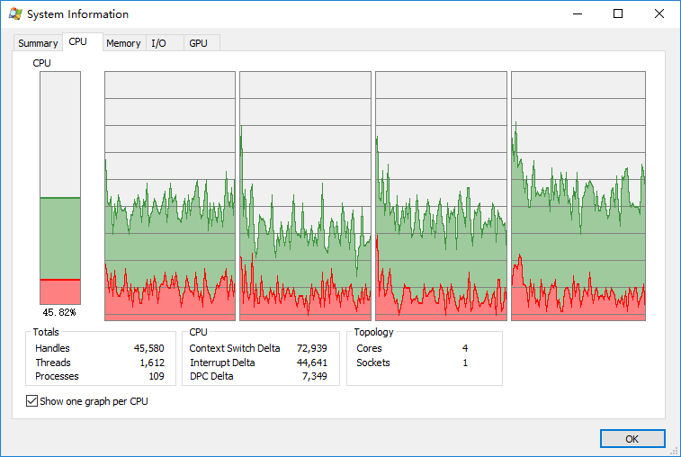
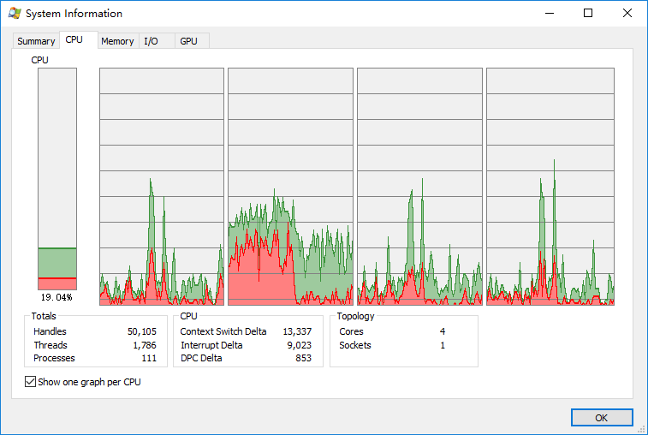
Non-Virtualized Data Centers
Too many servers/cores for too little work
High costs and infrastructure needs
维护 Maintenance
网络 Networking
空间 Floor space
冷却 Cooling
能耗 Power
容灾 Disaster Recovery

Slide 18
Dynamic Data Center
Virtualization helps us break the “one service per server” model
Consolidate many services into a fewer number of machines when workload is low, reducing costs
Conversely, as demand for a particular service increases, we can shift more virtual machines to run that service
We can build a data center with fewer total resources, since resources are used as needed instead of being dedicated to single services
Notes:
Or sitting and waiting until the next spike in demand

Slide 19
VM workload multiplexing
Separate VM sizing
VM multiplexing
s₃
s₂
s₁
We expect s₃ < s₁ + s_{2.} Benefit of multiplexing !
工作负载复用
Multiplex VMs’ workload on same physical server
Aggregate multiple workload. Estimate total capacity need based on aggregated workload
Performance level of each VM be preserved

Slide 20
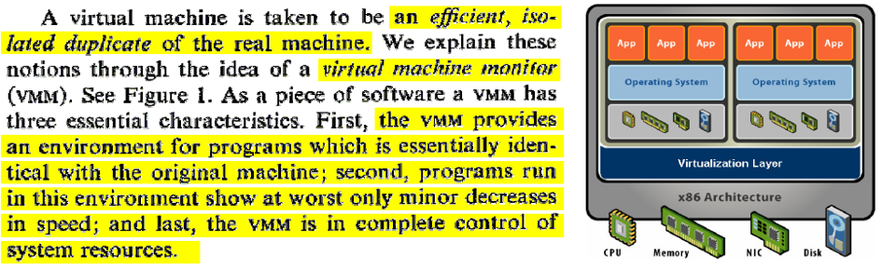
虚拟机管理器
Java 虚拟机？
显然不是，Java 虚拟机以及各类高级语言虚拟机目标不在于模拟各类机器部件设备
虚拟机管理器需要从 CPU 指令层面准确模拟各种硬件

Slide 21
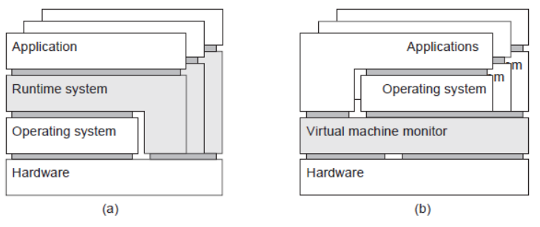
两种 “虚拟机” 虚拟机管理器与进程虚拟机
Process VM 进程虚拟机
程序编译为 Intermediate Code 中间代码交由“Runtime运行时”执行
为编程语言提供“跨平台/平台无关”特性
Java VM, Python VM
VM Monitor 虚拟机管理器
用于模拟另外一套硬件指令集的特殊软件层
足以支持一整套操作系统及其应用软件运行
VMWare, VirtualBox, Hyper-V

Slide 22
Three Virtualization Approaches
全虚拟化 Full Virtualization
半虚拟化 Paravirtualization
硬件辅助虚拟化 Hardware-Assisted Virtualization

Slide 23
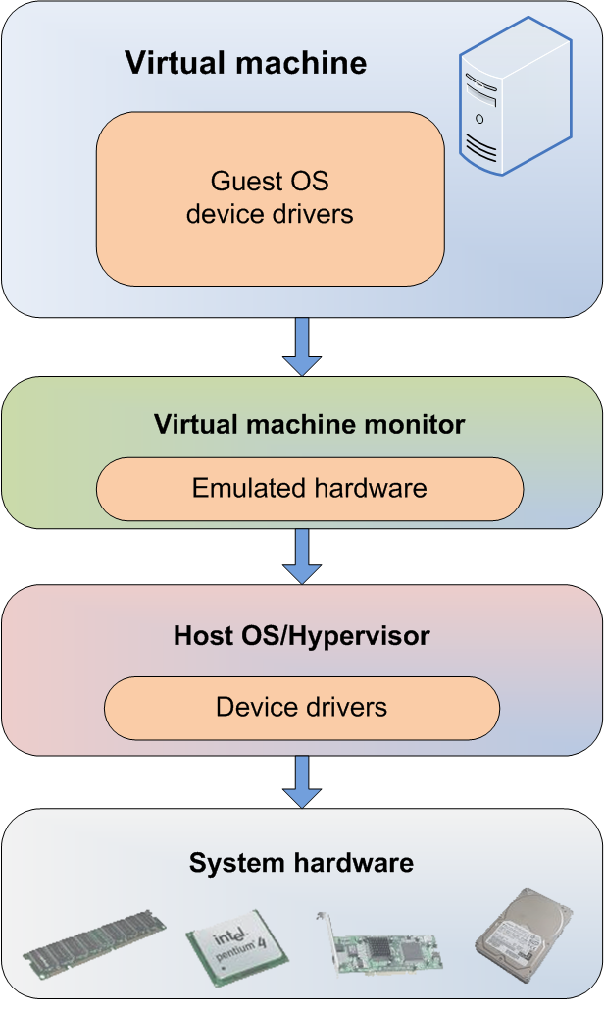
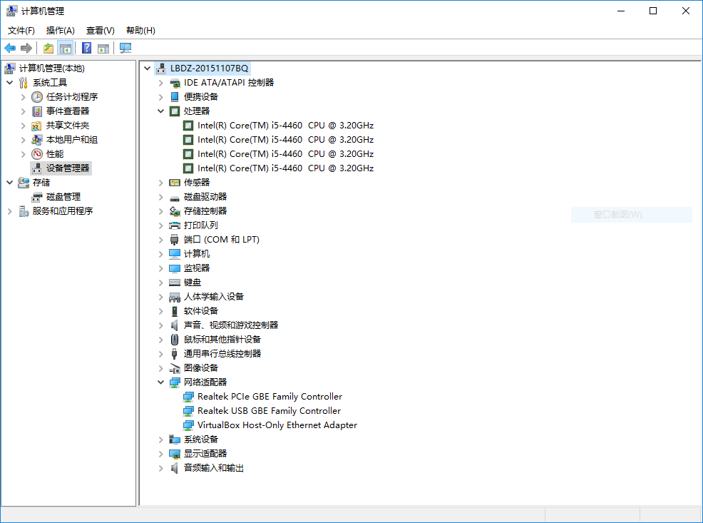
Full Virtualization
Everything is virtualized
Full hardware emulation
Emulation = latency

Slide 24
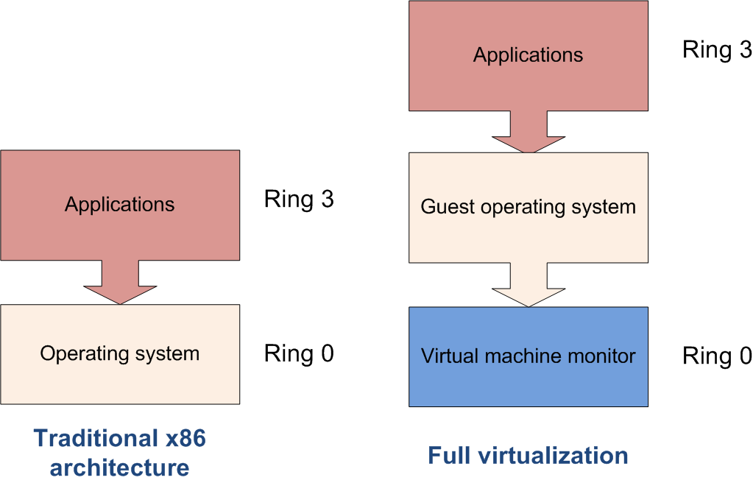
Privileged Instructions
Privileged instructions:
OS kernel and device driver access to system hardware
Trapped and emulated by VMM

Slide 25
Full Virtualization Pros and Cons
Pros
Disaster recovery, failover
Virtual appliance deployment
Legacy code on non-legacy hardware
Cons – LATENCY of core four resources
RAM performance reduced 25% to 75%
Disk I/O degraded from 5% to 20%
Network performance decreased up to 10%
CPU privileged instruction dings nearing 1% to 7%

Slide 26

Paravirtualization
OS or system devices are virtualization aware
Requirements:
OS level -- recompiled kernel
Device level – paravirtualized or “enlightened” device drivers

Slide 27
Paravirtualization Pros and Cons
Pros: fast!
Cons: requires a specially modified guest OS, thus precludes the ability to run off-the-shelf and legacy OS in para-virtual environments.

Slide 28
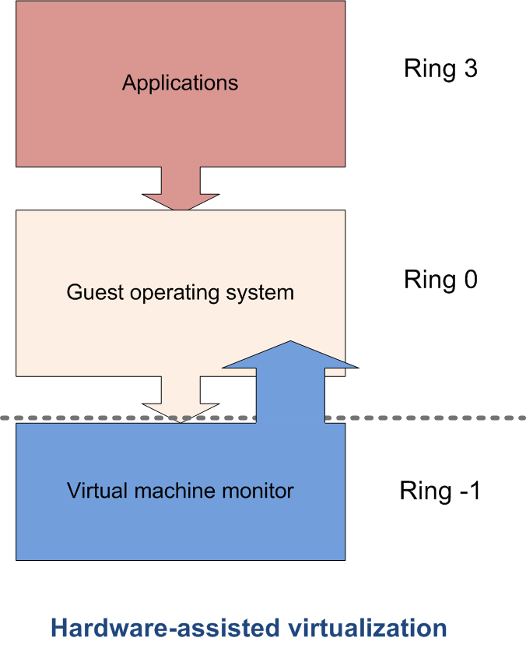
Hardware-assisted Virtualization
Server hardware is virtualization aware
Hypervisor and VMM load at privilege Ring-1 (firmware)
Removes CPU emulation bottleneck
Memory virtualization coming in quad core AMD and Intel CPUs

Slide 29







Evolution of Software solutions*
1st Generation: Full virtualization (Binary rewriting)
Software Based
VMware and Microsoft
2nd Generation: Para virtualization
Cooperative virtualization
Modified guest
VMware, Xen
3rd Generation: Silicon-based (Hardware-assisted) virtualization
Unmodified guest
VMware and Xen on virtualization-aware hardware platforms
Virtual
Machine
Virtual
Machine
…
Dynamic Translation
VM
…
VM
Virtual
Machine
Virtual
Machine
Hypervisor
…
Operating System
Hypervisor
Hardware
Hardware
Hardware
Time
Virtualization Logic
*This slide is from Intel® Corporation

Slide 30
实践
所需材料
VirtualBox(All)/HyperV(Windows10)/Parallels(MacOS)
Vagrant
https://github.com/ShiZhan/ubuntu-xenial-amd64-docker-cluster

Slide 31
实践
NIC1
NIC1
GBE
NIC1
NIC1
NIC2
NIC2
NIC2
NIC2
10GBE
NIC1
NIC2
NIC1
NIC2
NIC1
NIC2
NIC1
NIC2
Host 1
Host 2
Host 3
Host 4
VM1
VM2
…
VM30
VM31
VM32
…
VM60
VM61
VM62
…
VM90
VM91
VM92
…
VM120

Slide 32
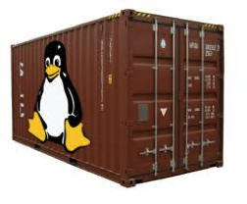
什么是容器？
A container (Linux Container) at its core is
an allocation, portioning, and assignment of host (compute) resources
such as CPU Shares, Network I/O, Bandwidth, Block I/O, and Memory (RAM)
so that kernel level constructs may jail-off, isolate or “contain” these protected resources
so that specific running services (processes) and namespaces may solely utilize them without interfering with the rest of the system.
These processes could be
lightweight Linux hosts based on a Linux image
multiple web severs and applications
a single subsystem like a database backend
a single process such as echo “Hello” with little to no overhead.

Slide 33
什么是容器？
Containers have been around for over 15 years, so why is there an influx of attention for containers?
As compute hardware architectures become more elastic, potent, and dense, it becomes possible to run many applications at scale while lowering TCO, eliminating the redundant Kernel and Guest OS code typically used in a hypervisor-based deployment.
This is attractive enough but also has benefits such as eliminating performance penalties, increase visibility and decrease difficulty of debug and management.

Slide 34
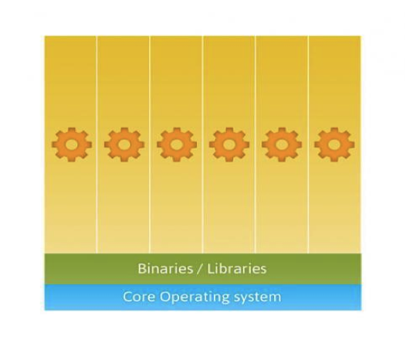
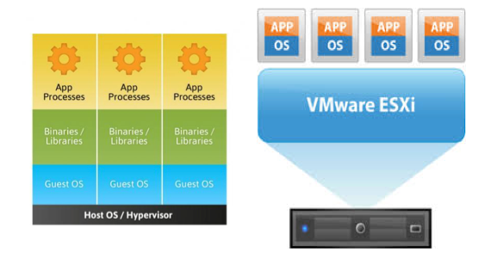
之于虚拟机
两种技术主要目标有所不同
虚拟化为基础设施服务与应用程序的结合提供抽象
容器允许在轻量化软件环境中干净隔离，是主要的服务提供方法。

Slide 35
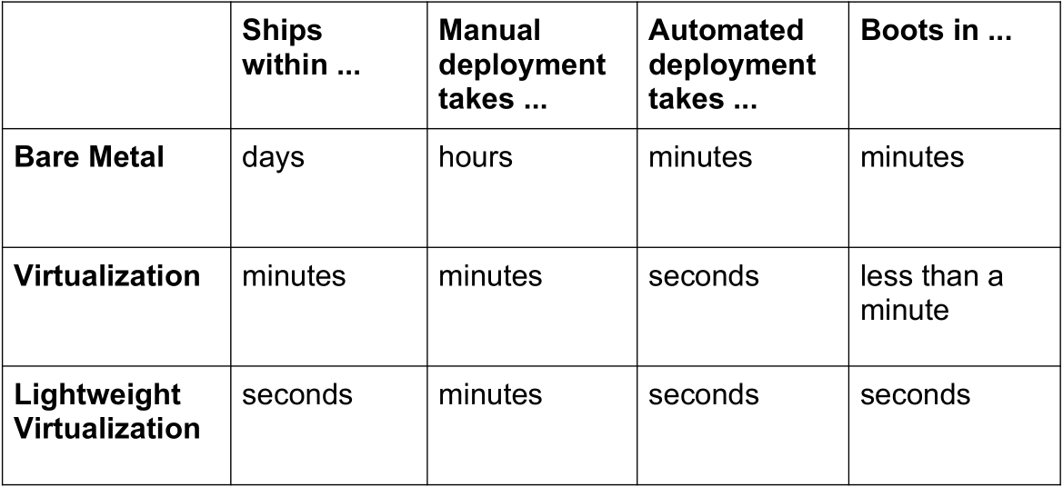
为什么？
够快！
参考 http://www.socallinuxexpo.org/sites/default/files/presentations/Jerome-Scale11x LXC Talk.pdf

Slide 36
为什么？
够轻！
On a typical physical server, with average compute resources, you can easily run:
10-100 virtual machines
100-1000 containers
On disk, containers can be very light.
A few MB — even without fancy storage.
参考 http://www.socallinuxexpo.org/sites/default/files/presentations/Jerome-Scale11x LXC Talk.pdf

Slide 37
为什么？
够“虚”！
Each container has:
its own network interface (and IP address)
can be bridged, routed... just like $your_favorite_vm
its own filesystem
Debian host can run Fedora container (&vice-versa)
isolation (security)
container A & B can't harm (or even see) each other
isolation (resource usage)
soft & hard quotas for RAM, CPU, I/O...
参考 http://www.socallinuxexpo.org/sites/default/files/presentations/Jerome-Scale11x LXC Talk.pdf

Slide 38
能干啥？
Some of the main business drivers and strategic reasons to use containers are:
Ability to easily run and accommodate legacy applications
Performance benefits of running on bare-metal, no overhead of hypervisor
Higher density and utilization for resources in the datacenter
Adoption for new technologies is accelerated, put in isolated secure containers
Reduce “shipping” pains; code is easily streamlined to customers, fast.
参考 https://aucouranton.com/2014/06/13/linux­-containers-­parallels­lxc-­openvz­-docker-­and­-more/

Slide 39
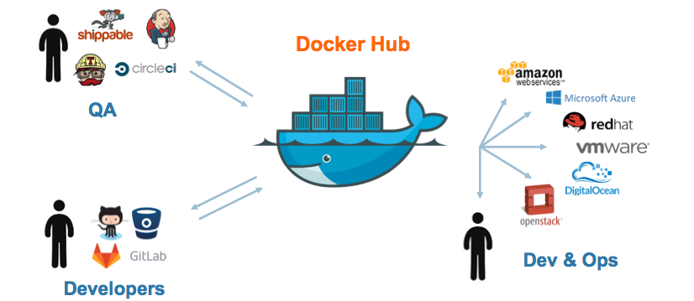
能干啥？

Slide 40
有哪些？
LxC ( Linux Containers )
0.1.0 releases in 2008
Works with general vanilla Linux kernels off the shelf.
GNU GPLv2 License
Used as a “container engine” in Docker
Google App Engine utilizes an LXC-like technology
Borg 与谷歌早期架构
Parellels Virtouzzo utilizes LXC
Rackspace Cloud Databases utilize LXC
Heroku (Application Deployment Platform) utilize LXC

Slide 41
有哪些？
Warden
Developed by Cloud Foundry as an orchestration layer to create application containers. Initially said working with LxC was “too troublesome”.
(Comparison) Warden and Docker both orchestrate containers controlling the subsystems like linux cgroups, namespaces and security.
Solaris Containers
A “non-linux” containerization mechanism. Differ from “true” linux systems of the mainline kernel
Utilizes “Zones” as a construct for partitioning system resources. Zones are an enhanced chroot mechanism that adds additional features like ones included in ZFS that allow snapshotting and cloning.
Zones are commonly compared to FreeBSD Jails

Slide 42
有哪些？
(Free) BSD Jails
Also “Non-Linux” containerization mechanism. Differ from “true” Linux systems of the mainline kernel
Also an “enhanced chroot”-like mechanism where not only does it use chroot to segregate the file system but it also does the same for users, processes and networks.
Linux V-Server
GNU GPL v2
Patched kernel to enable OS-level virtualization
Partitions of CPU, Memory, Network, Filesystem are called “Security Contexts” which uses a chroot-like mechanism
Utilizes CoW (Copy on Write) file systems to save storage space.

Slide 43
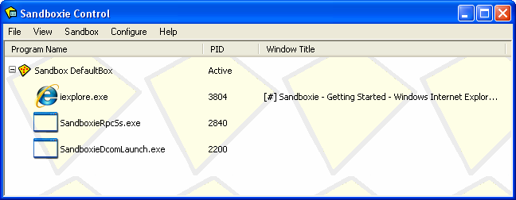
有哪些？
iCore Virtual Accounts
A Free Windows XP container solution.
Provides OS-level isolated computing environments for XP
https://icoresoftware.com/index.html (obsolete!)
Sandboxie
Developed by Invincea for Windows XP
“Sandboxes”, like a container, are created for isolated environments.
http://www.sandboxie.com/

Slide 44

主流实现
开源的应用容器引擎
让开发者打包应用以及依赖包到一个可移植的容器中
然后发布到任何流行的 Linux 机器上
完全使用沙箱机制
相互之间不会有任何接口 类似 iPhone/Android 的 app
几乎没有性能开销，可以很容易地在机器和数据中心中运行。

Slide 45
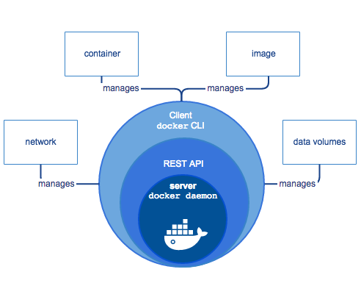
主流实现
3部分组成
A server which is a type of long-running program called a daemon process.
A REST API which specifies interfaces that programs can use to talk to the daemon and instruct it what to do.
A command line interface (CLI) client.

Slide 46
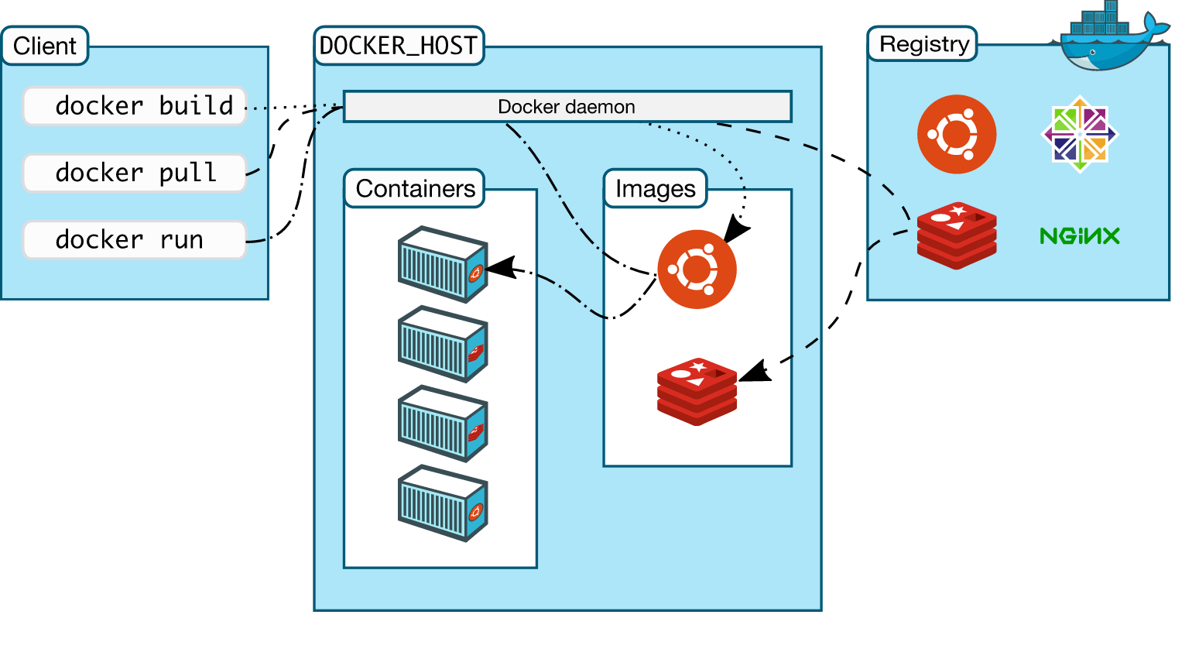
主流实现
架构

Slide 47
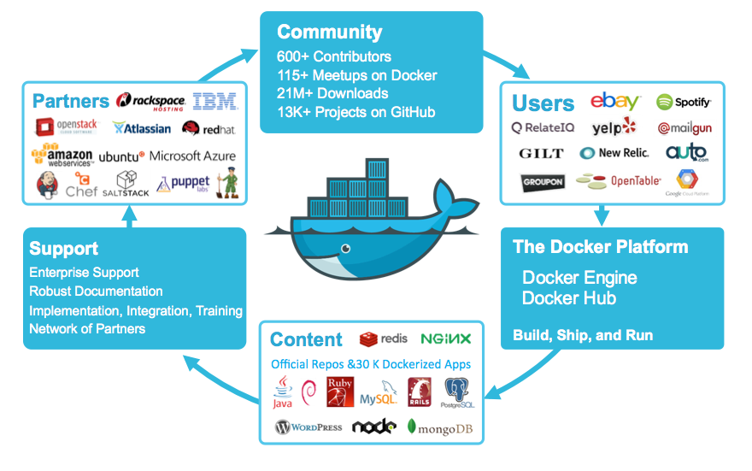
丰富生态

Slide 48
技术基础
Sysjail
A userspace virtualization tool developed for Open BSD systems. Much like the FreeBSS “jail”
Chroot
Kernel level function that allows a program to run in a host system in its own root filesytem.
Cgroups
Developed in 2006, used initially by Google Search
Unified in linux kernel by 2013.
Namespaces
Construct that allows partitioning and isolation of different resources so that they are only available to
the processes in the container. Namespaces are Network (NET), UTS(hostname), PROC(process id), MNT
(mount), IPC and User (Security Seperation)
Libcontainer
Written in Go programming language and developed by dotCloud/Docker it is a native Go
implementation of “lxc-like” control over cgroups and namespaces.

Slide 49
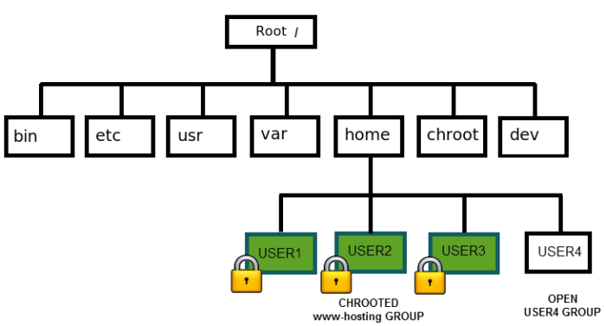
技术基础
Notes:
chroot 在 Linux 系统中发挥了根目录的切换工作，同时带来了系统的安全性等好处。
chroot，即 change root directory (更改 root 目录)。在 linux 系统中，系统默认的目录结构都是以 `/`，即是以根 (root) 开始的。而在使用 chroot 之后，系统的目录结构将以指定的位置作为 `/` 位置。
http://www.ibm.com/developerworks/cn/linux/l-cn-chroot/index.html

Slide 50
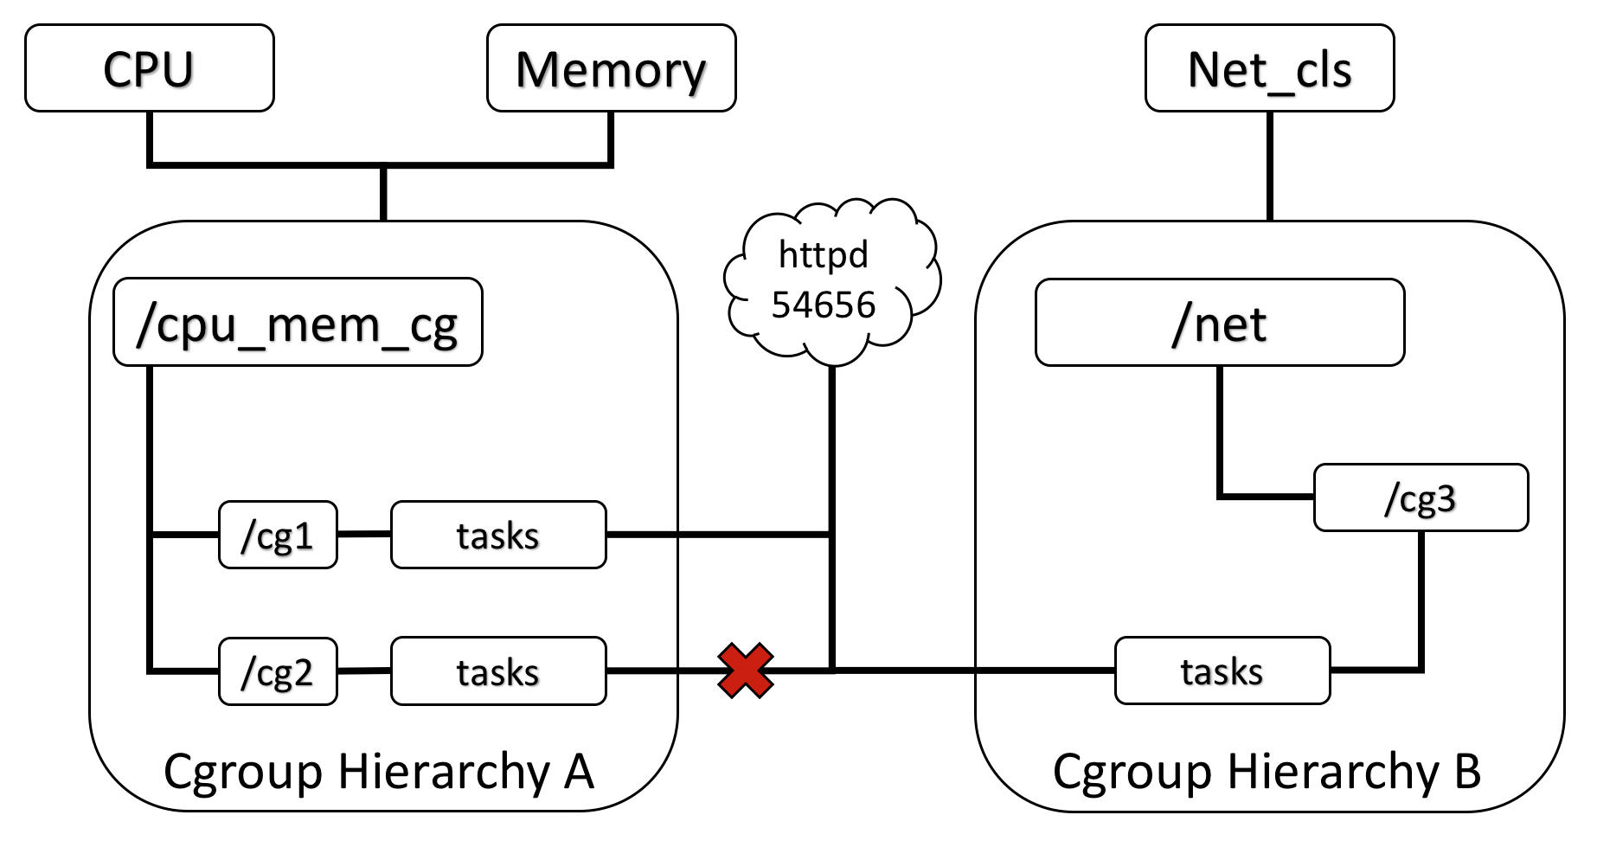
技术基础
Notes:
Cgroups是control groups的缩写，是Linux内核提供的一种可以限制、记录、隔离进程组（process groups）所使用的物理资源（如：cpu,memory,IO等等）的机制。最初由google的工程师提出，后来被整合进Linux内核。Cgroups也是LXC为实现虚拟化所使用的资源管理手段，可以说没有cgroups就没有LXC。

Slide 51
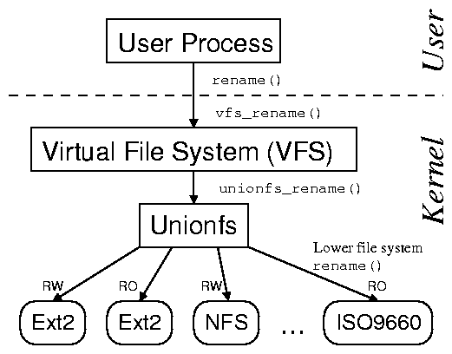
技术基础
参考 http://www.am-utils.org/docs/unionfs-tr/figures/stacking_fanout.png
Notes:
Stony brook fsl & Erez Zadok
http://www.fsl.cs.stonybrook.edu/

Slide 52
干货 (干活) 时间
检查内核 > 3.10
$ uname -r
3.11.0-15-generic
更新系统源
$ sudo apt-get update
确保支持 https 源，有根证书
$ sudo apt-get install apt-transport-https ca-certificates
收 docker 安装源证书
$ sudo apt-key adv --keyserver hkp://ha.pool.sks-keyservers.net:80 --recv-keys 58118E89F3A912897C070ADBF76221572C52609D
参考 https://docs.docker.com/engine/installation/linux/ubuntulinux/

Slide 53
实践
添加docker安装源
$ echo "<REPO>" | sudo tee /etc/apt/sources.list.d/docker.list
更新、确认
$ sudo apt-get update & $ apt-cache policy docker-engine
$ sudo apt-get install linux-image-extra-$(uname -r) linux-image-extra-virtual (AUFS 相关辅助软件)
Ubuntu version | Repository
Precise 12.04 (LTS) | deb https://apt.dockerproject.org/repo ubuntu-precise main
Trusty 14.04 (LTS) | deb https://apt.dockerproject.org/repo ubuntu-trusty main
Wily 15.10 | deb https://apt.dockerproject.org/repo ubuntu-wily main
Xenial 16.04 (LTS) | deb https://apt.dockerproject.org/repo ubuntu-xenial main
参考 https://docs.docker.com/engine/installation/linux/ubuntulinux/

Slide 54
实践
安装
$ sudo apt-get install docker-engine
$ sudo apt-get upgrade docker-engine (升级)
开服务 (守护进程)
$ sudo service docker start
$ sudo systemctl enable docker (开机运行)
走起
$ sudo docker run hello-world
免 sudo
$ sudo groupadd docker
$ sudo usermod -aG docker $USER
Log out and log back in.
参考 https://docs.docker.com/engine/installation/linux/ubuntulinux/

Slide 55
实践
卸载
$ sudo apt-get purge docker-engine
或者随依赖一起清除
$ sudo apt-get autoremove --purge docker-engine
然后删除所有用户数据：所创建容器、卷、配置
$ rm -rf /var/lib/docker
参考 https://docs.docker.com/engine/installation/linux/ubuntulinux/

Slide 56

实践
发掘一下
https://hub.docker.com/
https://store.docker.com/
比较虚拟机与容器
让虚拟机与容器合作

Slide 57
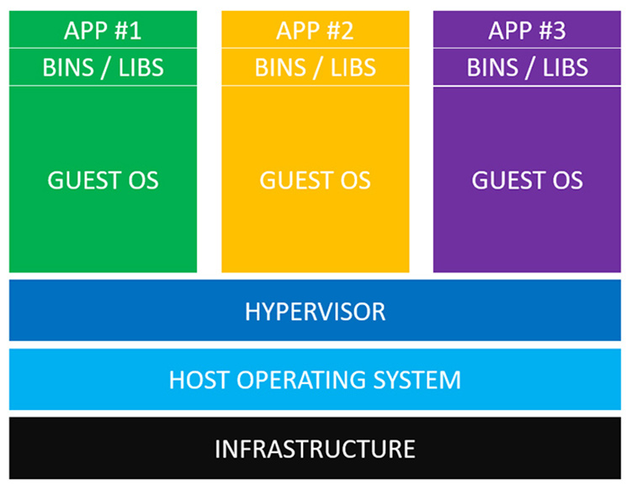
实践
https://nickjanetakis.com/blog/comparing-virtual-machines-vs-docker-containers

Slide 58
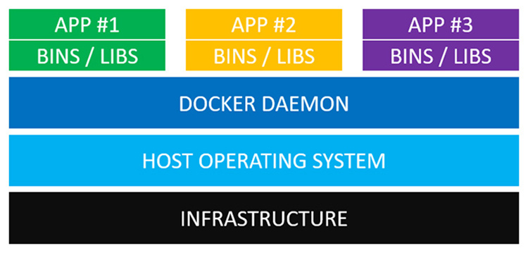
实践
https://nickjanetakis.com/blog/comparing-virtual-machines-vs-docker-containers

Slide 59
后续内容
泛读相关论文 选篇精读
勤练实验技术 Linux, Git, SSH, Python, OpenStack, Docker …
范文
Customizable SLO and Its Near-Precise Enforcement for Storage Bandwidth[J]. ACM Transactions on Storage (TOS), 2017, 13(1): 6:1–6:25.
PSLO: enforcing the Xth percentile latency and throughput SLOs for consolidated VM storage[C]//Proceedings of the Eleventh European Conference on Computer Systems. London, United Kingdom: ACM, 2016: 1–14.

Slide 60
阅读列表
WANG J, BALAZINSKA M. Elastic Memory Management for Cloud Data Analytics[C]//2017 USENIX Annual Technical Conference (USENIX ATC 17). Santa Clara, CA: USENIX Association, 2017: 745–758.
TAK B等. Understanding Security Implications of Using Containers in the Cloud[C]//2017 USENIX Annual Technical Conference (USENIX ATC 17). Santa Clara, CA: USENIX Association, 2017: 313–319.
SUN Y等. SmartCuckoo: A Fast and Cost-Efficient Hashing Index Scheme for Cloud Storage Systems[C]//2017 USENIX Annual Technical Conference (USENIX ATC 17). Santa Clara, CA: USENIX Association, 2017: 553–565.
SON J等. Protego: Cloud-Scale Multitenant IPsec Gateway[C]//2017 USENIX Annual Technical Conference (USENIX ATC 17). Santa Clara, CA: USENIX Association, 2017: 473–485.
PRASAD A等. The RCU-Reader Preemption Problem in VMs[C]//2017 USENIX Annual Technical Conference (USENIX ATC 17). Santa Clara, CA: USENIX Association, 2017: 265–270.
PENG Y等. deTector: a Topology-aware Monitoring System for Data Center Networks[C]//2017 USENIX Annual Technical Conference (USENIX ATC 17). Santa Clara, CA: USENIX Association, 2017: 55–68.
MISRA P A等. Scaling Distributed File Systems in Resource-Harvesting Datacenters[C]//2017 USENIX Annual Technical Conference (USENIX ATC 17). Santa Clara, CA: USENIX Association, 2017: 799–811.

Slide 61
阅读列表
LI H等. PARIX: Speculative Partial Writes in Erasure-Coded Systems[C]//2017 USENIX Annual Technical Conference (USENIX ATC 17). Santa Clara, CA: USENIX Association, 2017: 581–587.
KUPPUSAMY T K等. Mercury: Bandwidth-Effective Prevention of Rollback Attacks Against Community Repositories[C]//2017 USENIX Annual Technical Conference (USENIX ATC 17). Santa Clara, CA: USENIX Association, 2017: 673–688.
IORGULESCU C等. Don’t cry over spilled records: Memory elasticity of data-parallel applications and its application to cluster scheduling[C]//2017 USENIX Annual Technical Conference (USENIX ATC 17). Santa Clara, CA: USENIX Association, 2017: 97–109.
GUO J等. Pricing Intra-Datacenter Networks with Over-Committed Bandwidth Guarantee[C]//2017 USENIX Annual Technical Conference (USENIX ATC 17). Santa Clara, CA: USENIX Association, 2017: 69–81.
CIDON A等. Memshare: a Dynamic Multi-tenant Key-value Cache[C]//2017 USENIX Annual Technical Conference (USENIX ATC 17). Santa Clara, CA: USENIX Association, 2017: 321–334.
CHEN Y L等. Giza: Erasure Coding Objects across Global Data Centers[C]//2017 USENIX Annual Technical Conference (USENIX ATC 17). Santa Clara, CA: USENIX Association, 2017: 539–551.
CHEN W等. Preemptive, Low Latency Datacenter Scheduling via Lightweight Virtualization[C]//2017 USENIX Annual Technical Conference (USENIX ATC 17). Santa Clara, CA: USENIX Association, 2017: 251–263.

