Slide 1
数据中心技术
施展
武汉光电国家实验室
2016-11-18

Slide 2
基本信息
施展 副研究员，武汉光电国家实验室，存储部，F309
课程办公时间 每周五下午14:00-15:00
课程主页 https://github.com/cs210-566
联系方式 zshi@hust.edu.cn，13971459597
参考书
云计算与分布式系统——从并行处理到物联网，机械工业出版社，2012
云计算——概念、技术与架构，机械工业出版社，2014
Barroso, Clidaras, and Holzle, “The Datacenter as a Computer: An Introduction to the Design of Warehouse-Scale Machines, Second Edition.”
实验平台
X-Shell Proxy: HTTP1.1, 115.156.209.252:9001
192.168.3.85

Slide 3
课程计划
1 | 课程总体介绍 | 11-09
2 | 基础环境与技术讲解 | 11-11
3 | 虚拟化、容器技术 | 11-16
4 |  | 11-18
5 | 分布式对象存储技术 | 11-23
6 | 软件定义网络技术 | 11-25
7 | 论文讨论 | 11-30
8 |  | 12-02
9 |  | 12-07
10 |  | 12-09
11 | 实验讲解、操作、问题分析、课后实践 | 12-14
12 |  | 12-16
13 |  | 12-21
14 |  | 12-23
15 | 完成实验，课程总结，编写报告 | 12-28
16 |  | 12-30

Slide 4
讲座内容
虚拟化技术
基础概念、关键技术
KVM/QEMU, XEN, VirtualBox
容器技术
基础概念、关键技术
Docker, LXC/LXD, RKT

Slide 5
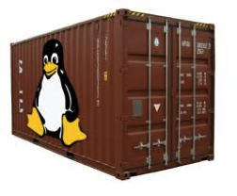
什么是容器？
A container (Linux Container) at its core is
an allocation, portioning, and assignment of host (compute) resources
such as CPU Shares, Network I/O, Bandwidth, Block I/O, and Memory (RAM)
so that kernel level constructs may jail-off, isolate or “contain” these protected resources
so that specific running services (processes) and namespaces may solely utilize them without interfering with the rest of the system.
These processes could be
lightweight Linux hosts based on a Linux image
multiple web severs and applications
a single subsystem like a database backend
a single process such as echo “Hello” with little to no overhead.

Slide 6
什么是容器？
Containers have been around for over 15 years, so why is there an influx of attention for containers?
As compute hardware architectures become more elastic, potent, and dense, it becomes possible to run many applications at scale while lowering TCO, eliminating the redundant Kernel and Guest OS code typically used in a hypervisor-based deployment.
This is attractive enough but also has benefits such as eliminating performance penalties, increase visibility and decrease difficulty of debug and management.

Slide 7
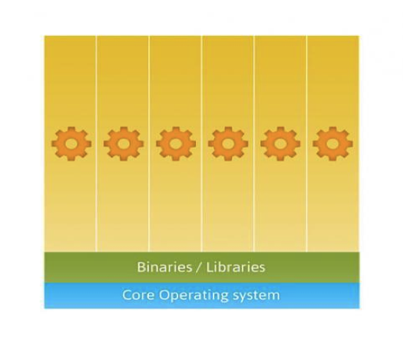
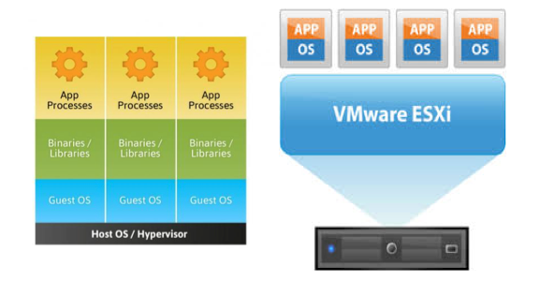
之于虚拟机
两种技术主要目标有所不同
虚拟化为基础设施服务与应用程序的结合提供抽象
容器允许在轻量化软件环境中干净隔离，是主要的服务提供方法。

Slide 8
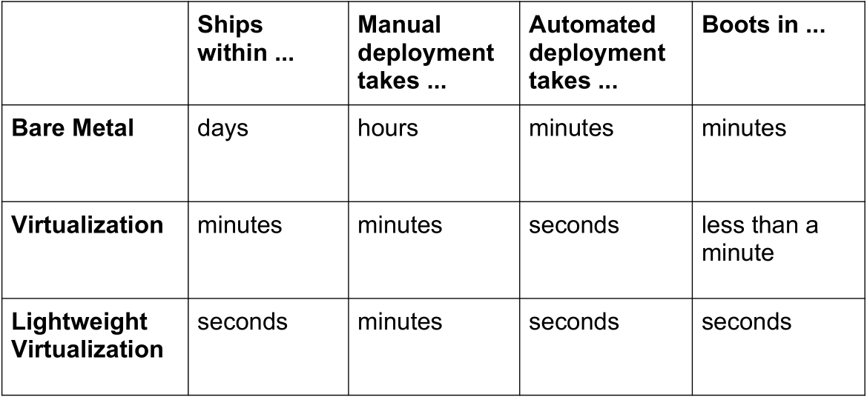
为什么？
够快！
参考 http://www.socallinuxexpo.org/sites/default/files/presentations/Jerome-Scale11x LXC Talk.pdf

Slide 9
为什么？
够轻！
On a typical physical server, with average compute resources, you can easily run:
10-100 virtual machines
100-1000 containers
On disk, containers can be very light.
A few MB — even without fancy storage.
参考 http://www.socallinuxexpo.org/sites/default/files/presentations/Jerome-Scale11x LXC Talk.pdf

Slide 10
为什么？
够“虚”！
Each container has:
its own network interface (and IP address)
can be bridged, routed... just like $your_favorite_vm
its own filesystem
Debian host can run Fedora container (&vice-versa)
isolation (security)
container A & B can't harm (or even see) each other
isolation (resource usage)
soft & hard quotas for RAM, CPU, I/O...
参考 http://www.socallinuxexpo.org/sites/default/files/presentations/Jerome-Scale11x LXC Talk.pdf

Slide 11
能干啥？
Some of the main business drivers and strategic reasons to use containers are:
Ability to easily run and accommodate legacy applications
Performance benefits of running on bare-metal, no overhead of hypervisor
Higher density and utilization for resources in the datacenter
Adoption for new technologies is accelerated, put in isolated secure containers
Reduce “shipping” pains; code is easily streamlined to customers, fast.
参考 https://aucouranton.com/2014/06/13/linux­-containers-­parallels­lxc-­openvz­-docker-­and­-more/

Slide 12
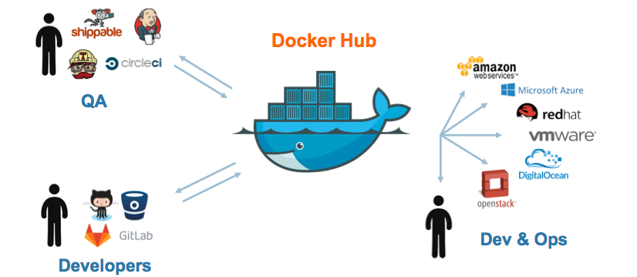
能干啥？

Slide 13
有哪些？
LxC ( Linux Containers )
0.1.0 releases in 2008
Works with general vanilla Linux kernels off the shelf.
GNU GPLv2 License
Used as a “container engine” in Docker
Google App Engine utilizes an LXC-like technology
Borg 与谷歌早期架构
Parellels Virtouzzo utilizes LXC
Rackspace Cloud Databases utilize LXC
Heroku (Application Deployment Platform) utilize LXC

Slide 14
有哪些？
Warden
Developed by Cloud Foundry as an orchestration layer to create application containers. Initially said working with LxC was “too troublesome”.
(Comparison) Warden and Docker both orchestrate containers controlling the subsystems like linux cgroups, namespaces and security.
Solaris Containers
A “non-linux” containerization mechanism. Differ from “true” linux systems of the mainline kernel
Utilizes “Zones” as a construct for partitioning system resources. Zones are an enhanced chroot mechanism that adds additional features like ones included in ZFS that allow snapshotting and cloning.
Zones are commonly compared to FreeBSD Jails

Slide 15
有哪些？
(Free) BSD Jails
Also “Non-Linux” containerization mechanism. Differ from “true” Linux systems of the mainline kernel
Also an “enhanced chroot”-like mechanism where not only does it use chroot to segregate the file system but it also does the same for users, processes and networks.
Linux V-Server
GNU GPL v2
Patched kernel to enable OS-level virtualization
Partitions of CPU, Memory, Network, Filesystem are called “Security Contexts” which uses a chroot-like mechanism
Utilizes CoW (Copy on Write) file systems to save storage space.

Slide 16
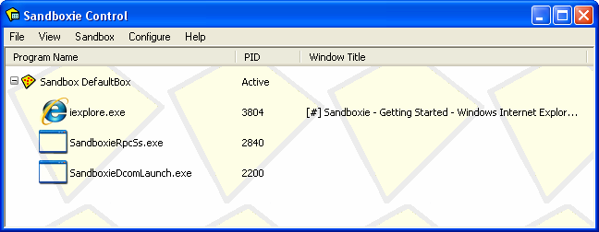
有哪些？
iCore Virtual Accounts
A Free Windows XP container solution.
Provides OS-level isolated computing environments for XP
https://icoresoftware.com/index.html (obsolete!)
Sandboxie
Developed by Invincea for Windows XP
“Sandboxes”, like a container, are created for isolated environments.
http://www.sandboxie.com/

Slide 17

主流实现
开源的应用容器引擎
让开发者打包应用以及依赖包到一个可移植的容器中
然后发布到任何流行的 Linux 机器上
完全使用沙箱机制
相互之间不会有任何接口 类似 iPhone/Android 的 app
几乎没有性能开销，可以很容易地在机器和数据中心中运行。

Slide 18
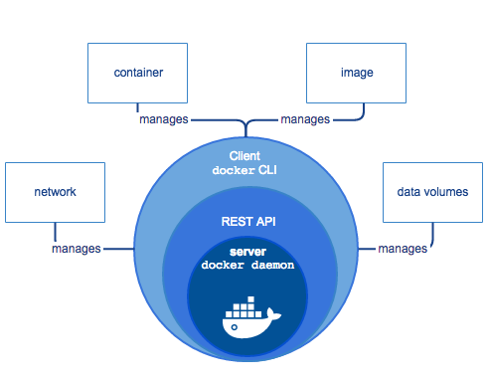
主流实现
3部分组成
A server which is a type of long-running program called a daemon process.
A REST API which specifies interfaces that programs can use to talk to the daemon and instruct it what to do.
A command line interface (CLI) client.

Slide 19
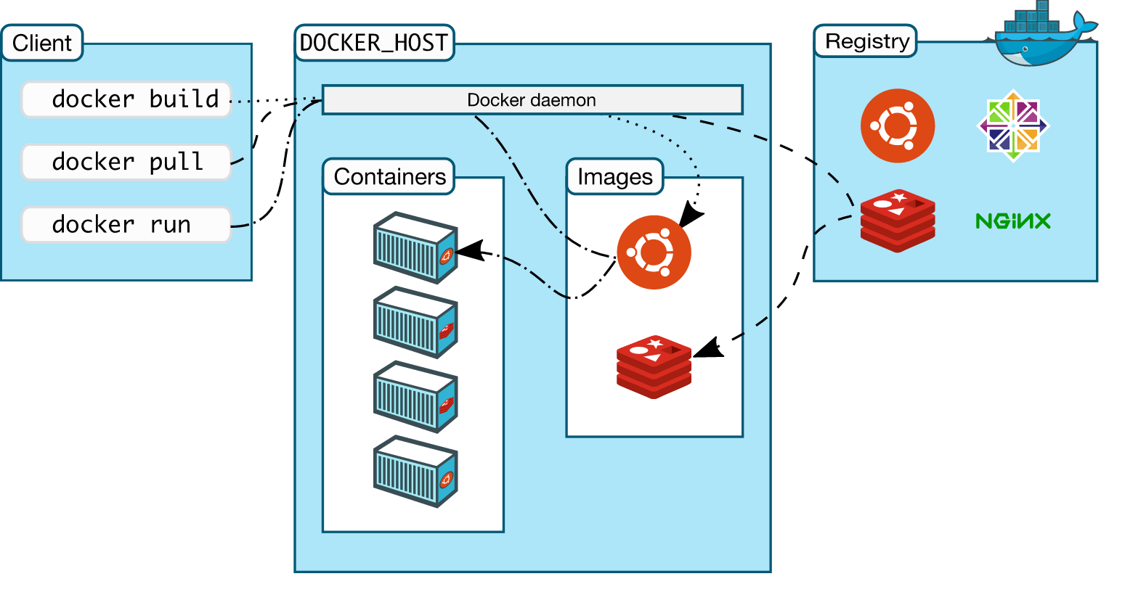
主流实现
架构

Slide 20
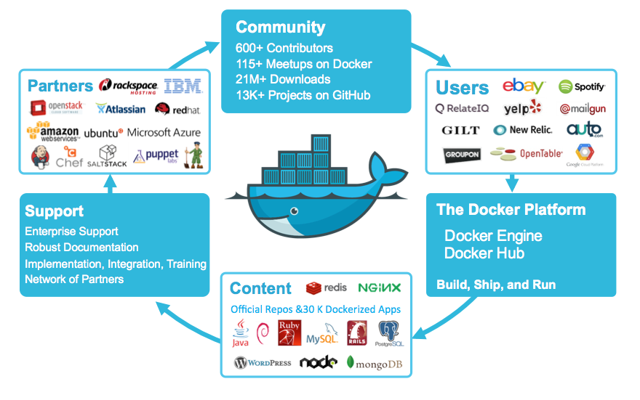
丰富生态

Slide 21
技术基础
Sysjail
A userspace virtualization tool developed for Open BSD systems. Much like the FreeBSS “jail”
Chroot
Kernel level function that allows a program to run in a host system in its own root filesytem.
Cgroups
Developed in 2006, used initially by Google Search
Unified in linux kernel by 2013.
Namespaces
Construct that allows partitioning and isolation of different resources so that they are only available to
the processes in the container. Namespaces are Network (NET), UTS(hostname), PROC(process id), MNT
(mount), IPC and User (Security Seperation)
Libcontainer
Written in Go programming language and developed by dotCloud/Docker it is a native Go
implementation of “lxc-like” control over cgroups and namespaces.

Slide 22
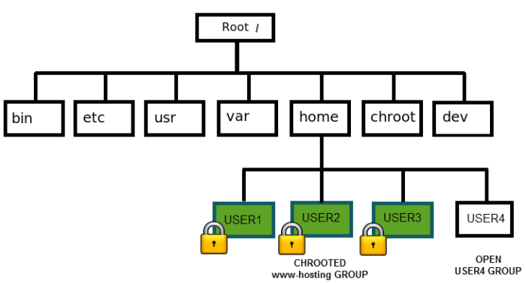
技术基础
Notes:
chroot 在 Linux 系统中发挥了根目录的切换工作，同时带来了系统的安全性等好处。
chroot，即 change root directory (更改 root 目录)。在 linux 系统中，系统默认的目录结构都是以 `/`，即是以根 (root) 开始的。而在使用 chroot 之后，系统的目录结构将以指定的位置作为 `/` 位置。
http://www.ibm.com/developerworks/cn/linux/l-cn-chroot/index.html

Slide 23
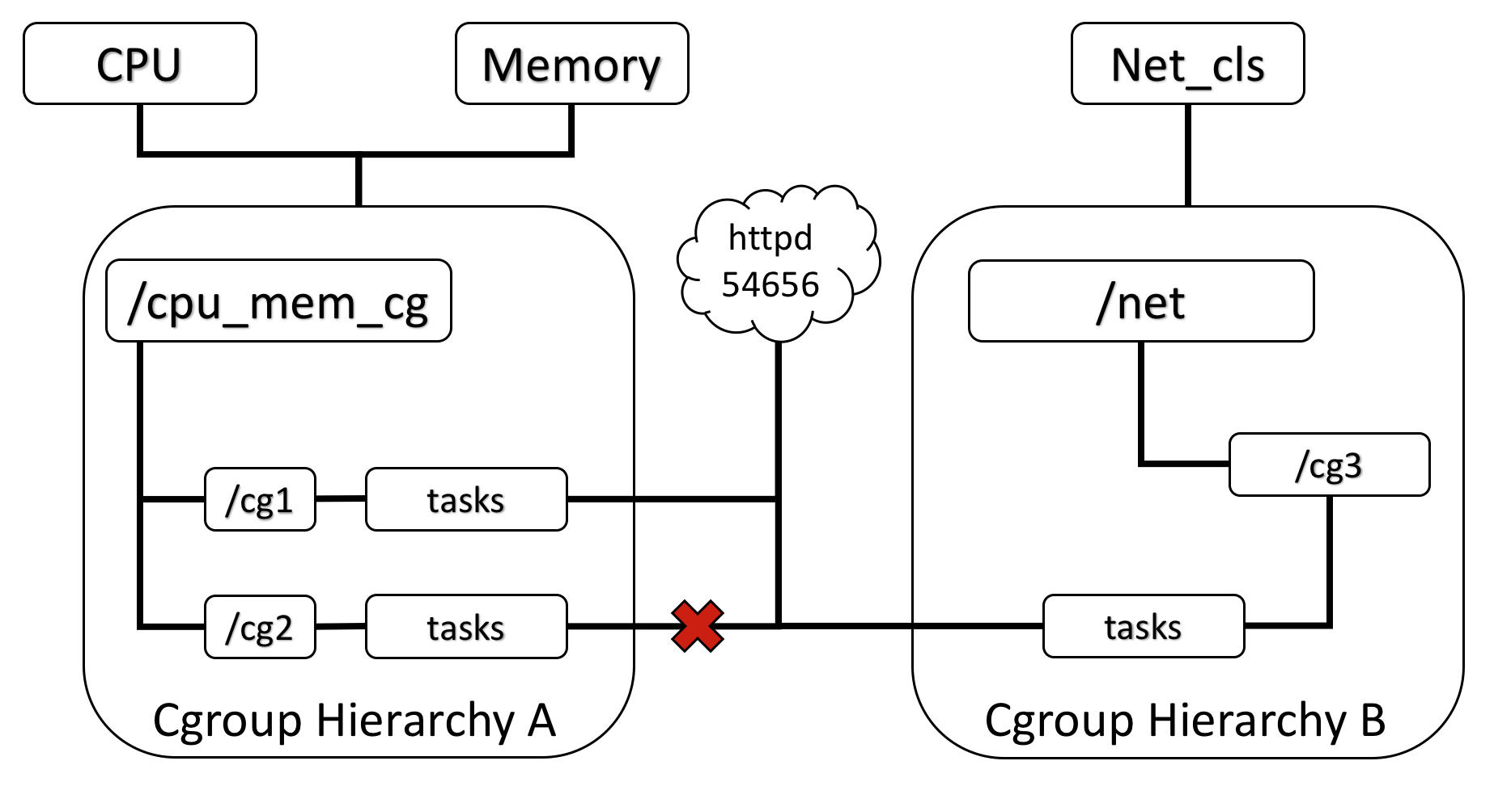
技术基础
Notes:
Cgroups是control groups的缩写，是Linux内核提供的一种可以限制、记录、隔离进程组（process groups）所使用的物理资源（如：cpu,memory,IO等等）的机制。最初由google的工程师提出，后来被整合进Linux内核。Cgroups也是LXC为实现虚拟化所使用的资源管理手段，可以说没有cgroups就没有LXC。

Slide 24
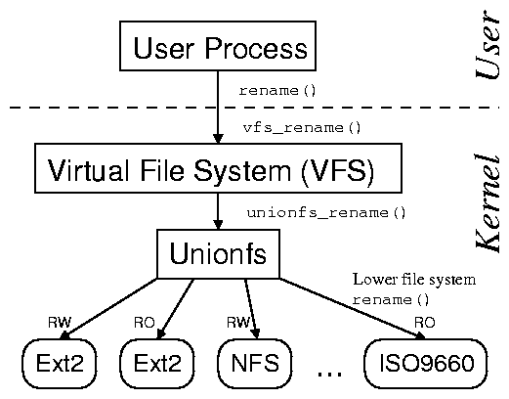
技术基础
参考 http://www.am-utils.org/docs/unionfs-tr/figures/stacking_fanout.png
Notes:
Stony brook fsl & Erez Zadok
http://www.fsl.cs.stonybrook.edu/

Slide 25
干货 (干活) 时间
检查内核 > 3.10
$ uname -r
3.11.0-15-generic
更新系统源
$ sudo apt-get update
确保支持 https 源，有根证书
$ sudo apt-get install apt-transport-https ca-certificates
收 docker 安装源证书
$ sudo apt-key adv --keyserver hkp://ha.pool.sks-keyservers.net:80 --recv-keys 58118E89F3A912897C070ADBF76221572C52609D
参考 https://docs.docker.com/engine/installation/linux/ubuntulinux/

Slide 26
实践
添加docker安装源
$ echo "<REPO>" | sudo tee /etc/apt/sources.list.d/docker.list
更新、确认
$ sudo apt-get update & $ apt-cache policy docker-engine
$ sudo apt-get install linux-image-extra-$(uname -r) linux-image-extra-virtual (AUFS 相关辅助软件)
Ubuntu version | Repository
Precise 12.04 (LTS) | deb https://apt.dockerproject.org/repo ubuntu-precise main
Trusty 14.04 (LTS) | deb https://apt.dockerproject.org/repo ubuntu-trusty main
Wily 15.10 | deb https://apt.dockerproject.org/repo ubuntu-wily main
Xenial 16.04 (LTS) | deb https://apt.dockerproject.org/repo ubuntu-xenial main
参考 https://docs.docker.com/engine/installation/linux/ubuntulinux/

Slide 27
实践
安装
$ sudo apt-get install docker-engine
$ sudo apt-get upgrade docker-engine (升级)
开服务 (守护进程)
$ sudo service docker start
$ sudo systemctl enable docker (开机运行)
走起
$ sudo docker run hello-world
免 sudo
$ sudo groupadd docker
$ sudo usermod -aG docker $USER
Log out and log back in.
参考 https://docs.docker.com/engine/installation/linux/ubuntulinux/

Slide 28
实践
卸载
$ sudo apt-get purge docker-engine
或者随依赖一起清除
$ sudo apt-get autoremove --purge docker-engine
然后删除所有用户数据：所创建容器、卷、配置
$ rm -rf /var/lib/docker
参考 https://docs.docker.com/engine/installation/linux/ubuntulinux/

Slide 29


实践
发掘一下
https://hub.docker.com/
https://store.docker.com/
试一试 Pandas，与直接部署比较
https://store.docker.com/community/images/tailordev/pandas
https://pypi.python.org/pypi/pandas

Slide 30
实践
Pandas Dependencies
setuptools
NumPy: 1.7.1 or higher
python-dateutil: 1.5 or higher
pytz: Needed for time zone support
Recommended Dependencies (for performance)
numexpr: for accelerating certain numerical operations. numexpr uses multiple cores as well as smart chunking and caching to achieve large speedups. If installed, must be Version 2.1 or higher (excluding a buggy 2.4.4). Version 2.4.6 or higher is highly recommended.
bottleneck: for accelerating certain types of nan evaluations. bottleneck uses specialized cython routines to achieve large speedups.
Optional Dependencies
Cython: Only necessary to build development version. Version 0.19.1 or higher.
SciPy: miscellaneous statistical functions
xarray: pandas like handling for > 2 dims, needed for converting Panels to xarray objects. Version 0.7.0 or higher is recommended.
PyTables: necessary for HDF5-based storage. Version 3.0.0 or higher required, Version 3.2.1 or higher highly recommended.
… …

Slide 31
后续内容
泛读相关论文 选篇精读
勤练实验技术 Linux, Git, SSH, Python, OpenStack, Docker …
讲解数据中心关键技术：数据中心存储
背景
背景

Slide 32
论文列表
II P T C, SCHEAR N. Spyglass: Demand-Provisioned Linux Containers for Private Network Access[C]//29th Large Installation System Administration Conference (LISA15). Washington, D.C.: USENIX Association, 2015: 37–48.
ZHAI Y, YIN L, CHASE J等. CQSTR: Securing Cross-Tenant Applications with Cloud Containers[C]//Proceedings of the Seventh ACM Symposium on Cloud Computing. New York, NY, USA: ACM, 2016: 223–236.

