Slide 1
数据中心技术
施展
武汉光电国家实验室
2016-11-16, 11-18

Slide 2
基本信息
施展 副研究员，武汉光电国家实验室，存储部，F309
课程办公时间 每周五下午14:00-15:00
课程主页 https://github.com/cs210-566
联系方式 zshi@hust.edu.cn，13971459597
参考书
云计算与分布式系统——从并行处理到物联网，机械工业出版社，2012
云计算——概念、技术与架构，机械工业出版社，2014
Barroso, Clidaras, and Holzle, “The Datacenter as a Computer: An Introduction to the Design of Warehouse-Scale Machines, Second Edition.”

Slide 3
课程计划
1 | 课程总体介绍 | 11-09
2 | 基础环境与技术讲解 | 11-11
3 | 虚拟化、容器技术 | 11-16
4 |  | 11-18
5 | 分布式对象存储技术 | 11-23
6 | 软件定义网络技术 | 11-25
7 | 论文讨论 | 11-30
8 |  | 12-02
9 |  | 12-07
10 |  | 12-09
11 | 实验讲解、操作、问题分析、课后实践 | 12-14
12 |  | 12-16
13 |  | 12-21
14 |  | 12-23
15 | 完成实验，课程总结，编写报告 | 12-28
16 |  | 12-30

Slide 4
讲座内容
虚拟化技术
基础概念、关键技术
KVM/QEMU, XEN, VirtualBox
容器技术
基础概念、关键技术
Docker, LXC/LXD, RKT

Slide 5
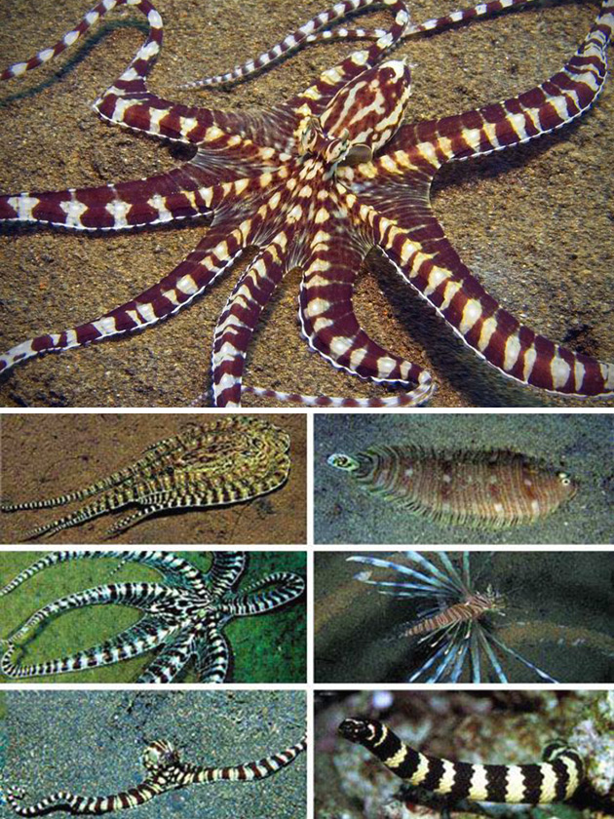

虚拟化 Virtualization
Virtualization deals with
“extending or replacing an existing interface so as to mimic the behavior of another system”
Virtual system examples
Virtual Private Network
Virtual Memory
Virtual Machine

Slide 6
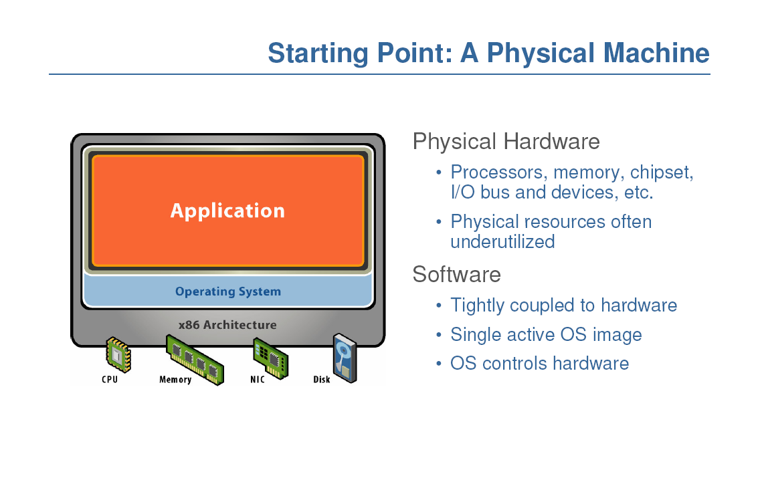
从物理机开始

Slide 7
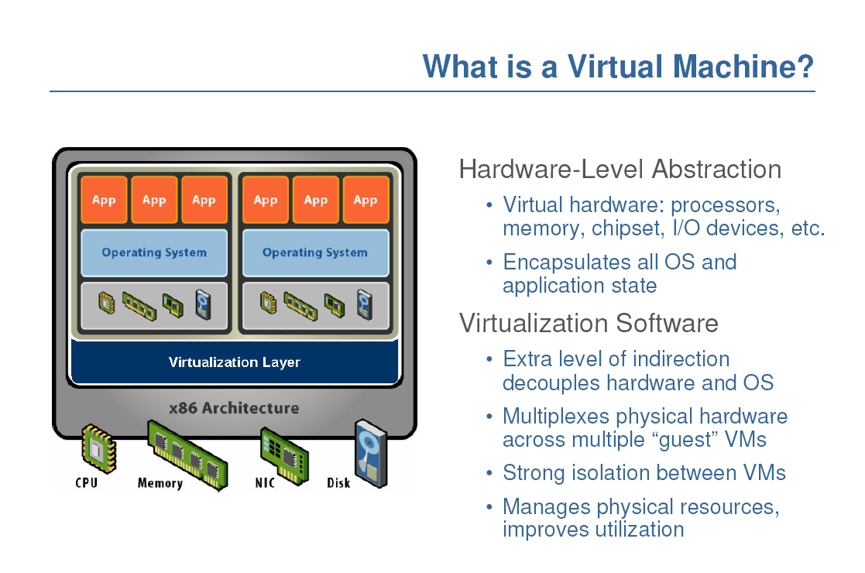
什么是虚拟机？

Slide 8
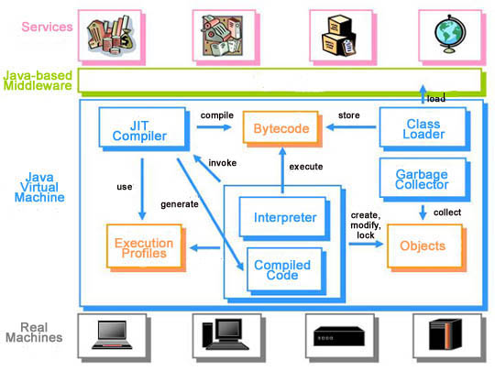
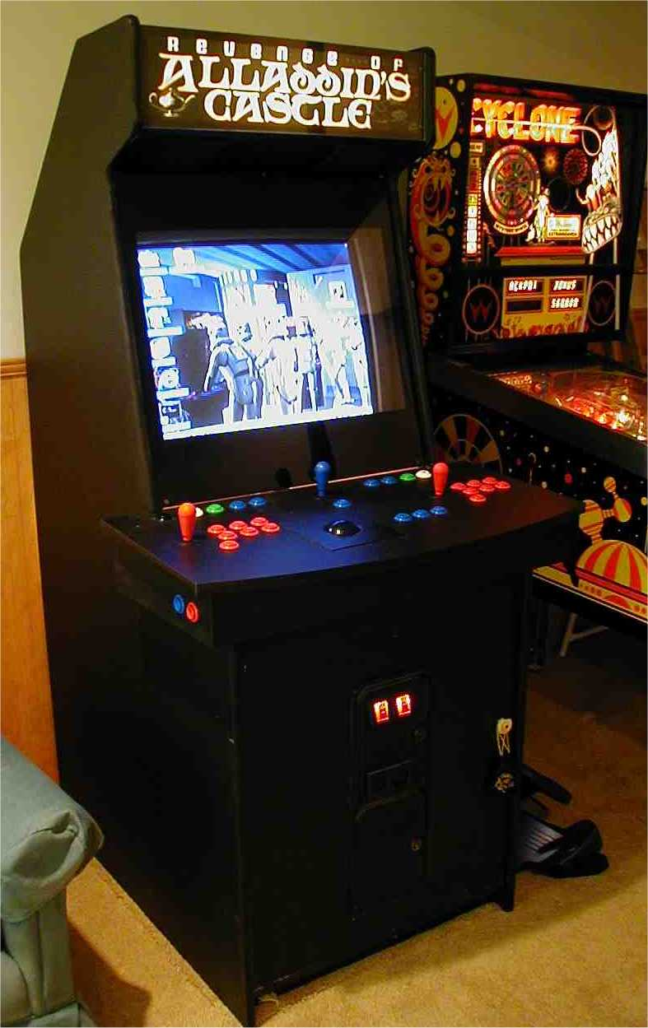
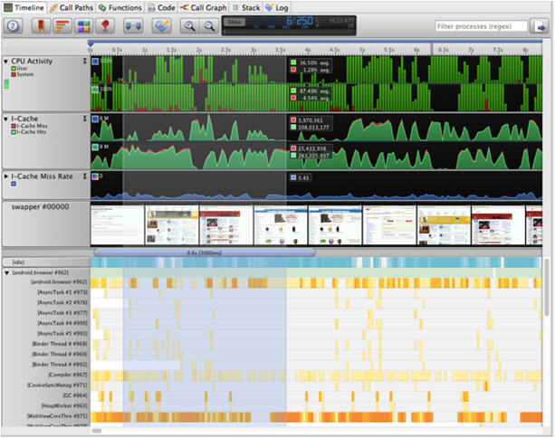
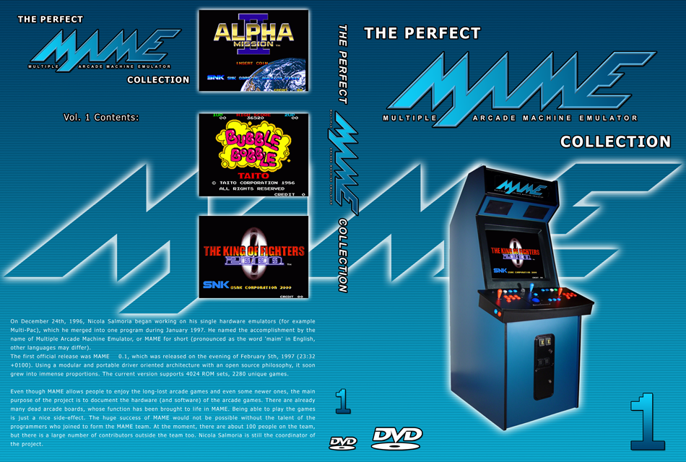
什么是虚拟机？
Java
GEM5
MAME

Slide 9
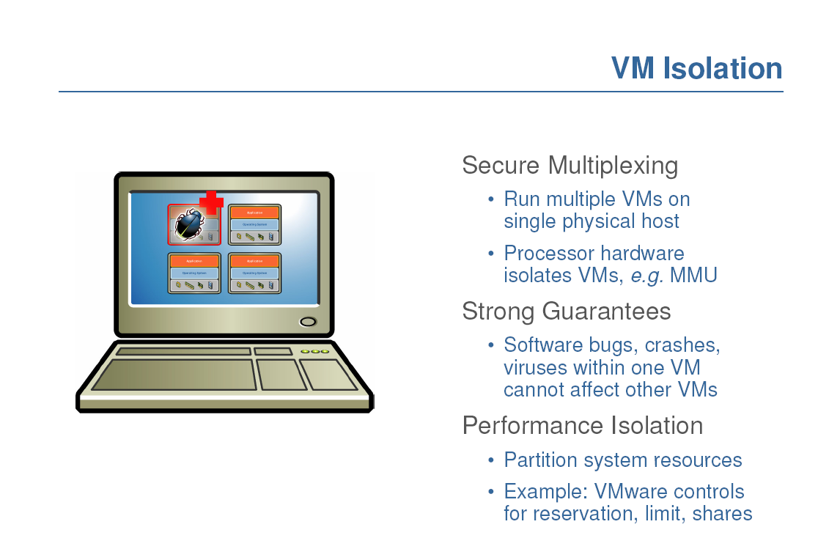
实现隔离

Slide 10
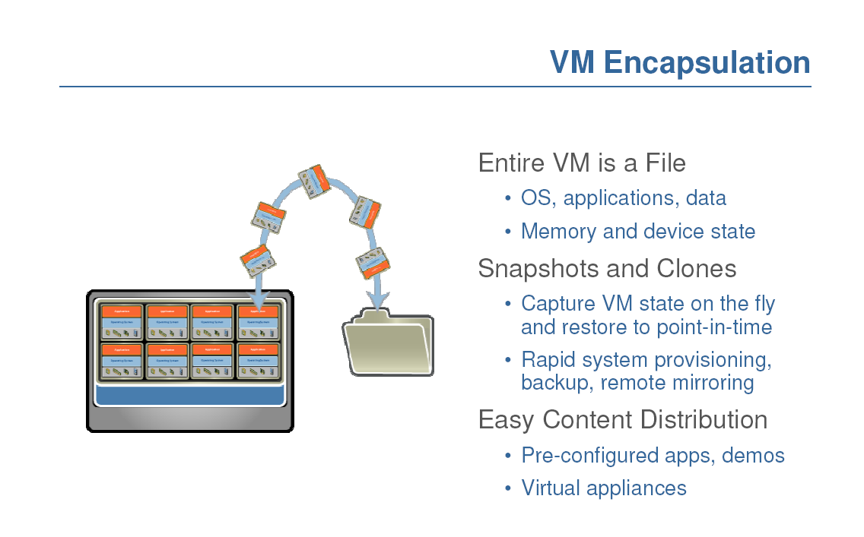
实现封装

Slide 11
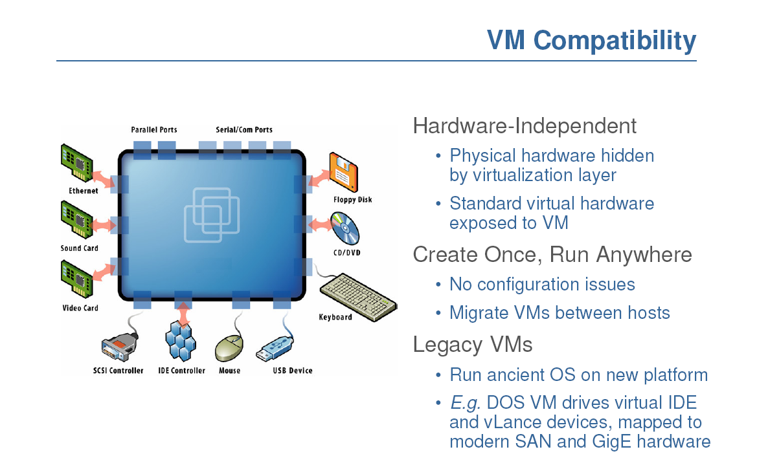
实现兼容
Notes:
Hardware and low-level systems software change quickly
High-level software (middleware, applications) changes more slowly

Slide 12
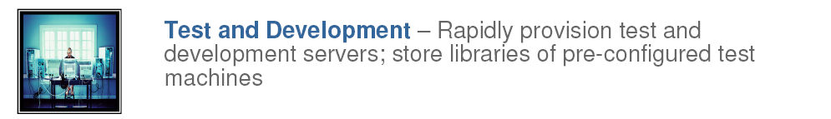
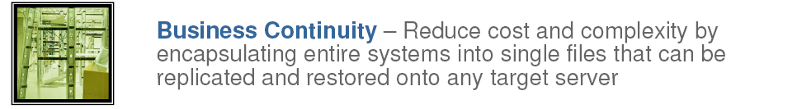
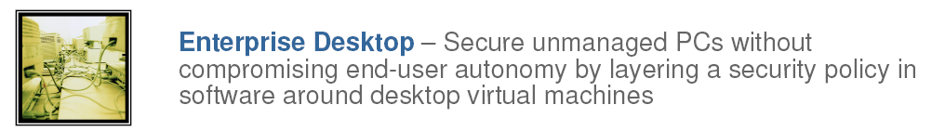
用途

Slide 13
用途
Run legacy software on non-legacy hardware
Run multiple operating systems on the same hardware
Create a manageable upgrade path
Manage outages (expected and unexpected) dynamically

Slide 14
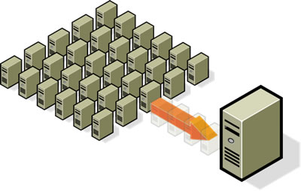
用途
Reduce costs by consolidating 整合 services onto the fewest number of physical machines
http://www.vmware.com/img/serverconsolidation.jpg

Slide 15
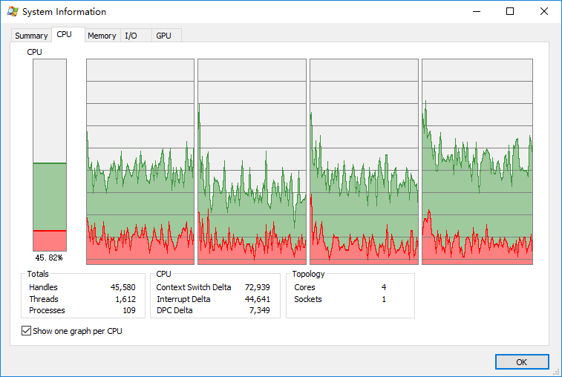
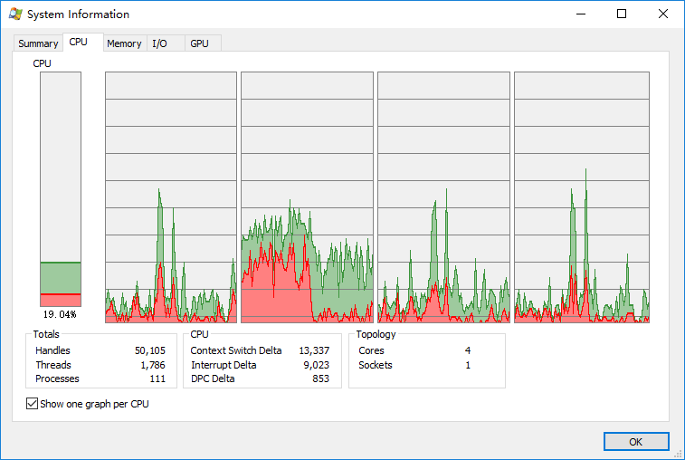
Non-virtualized Data Centers
Too many servers/cores for too little work
High costs and infrastructure needs
维护 Maintenance
网络 Networking
空间 Floor space
冷却 Cooling
能耗 Power
容灾 Disaster Recovery

Slide 16
Dynamic Data Center
Virtualization helps us break the “one service per server” model
Consolidate many services into a fewer number of machines when workload is low, reducing costs
Conversely, as demand for a particular service increases, we can shift more virtual machines to run that service
We can build a data center with fewer total resources, since resources are used as needed instead of being dedicated to single services
Notes:
Or sitting and waiting until the next spike in demand

Slide 17
VM workload multiplexing
Separate VM sizing
VM multiplexing
s₃
s₂
s₁
We expect s₃ < s₁ + s_{2.} Benefit of multiplexing !
工作负载复用
Multiplex VMs’ workload on same physical server
Aggregate multiple workload. Estimate total capacity need based on aggregated workload
Performance level of each VM be preserved

Slide 18
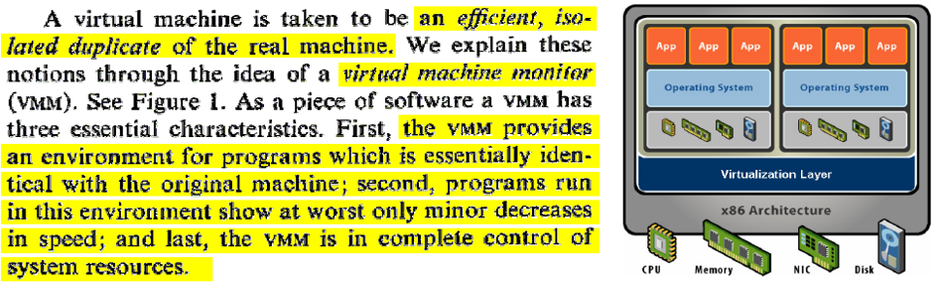
虚拟机管理器
Java 虚拟机？
显然不是，Java 虚拟机以及各类高级语言虚拟机目标不在于模拟各类机器部件设备
虚拟机管理器需要从 CPU 指令层面准确模拟各种硬件

Slide 19
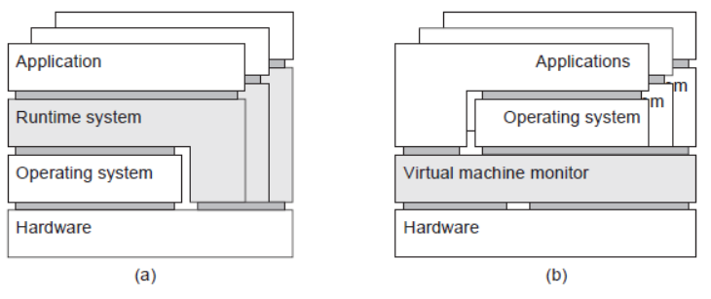
两种 “虚拟机” 虚拟机管理器与进程虚拟机
Process VM 进程虚拟机
程序编译为 Intermediate Code 中间代码交由“Runtime运行时”执行
为编程语言提供“跨平台/平台无关”特性
Java VM, Python VM
VM Monitor 虚拟机管理器
用于模拟另外一套硬件指令集的特殊软件层
足以支持一整套操作系统及其应用软件运行
VMWare, VirtualBox, Hyper-V

Slide 20
Thee Virtualization Approaches
全虚拟化 Full Virtualization
半虚拟化 Paravirtualization
硬件辅助虚拟化 Hardware-Assisted Virtualization

Slide 21
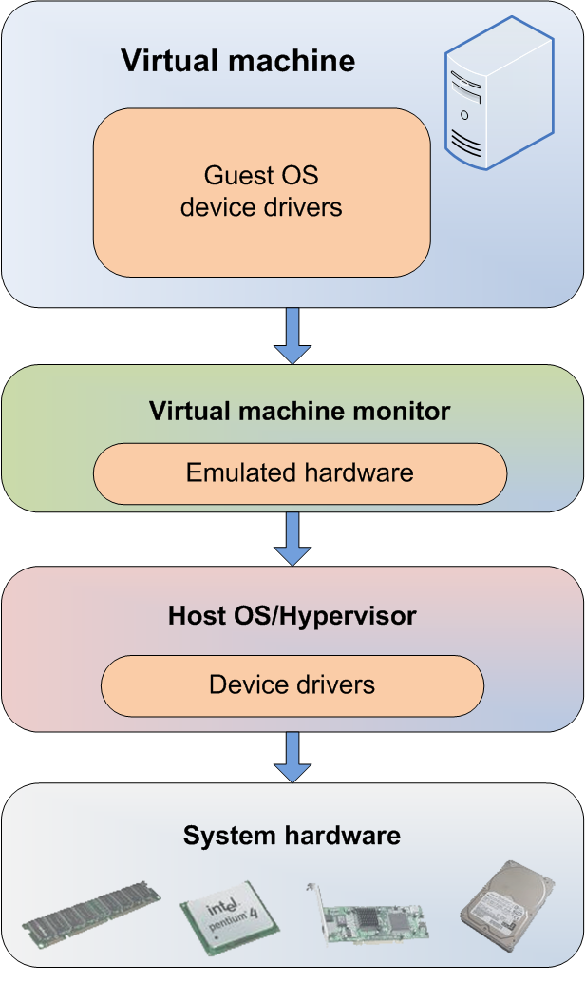
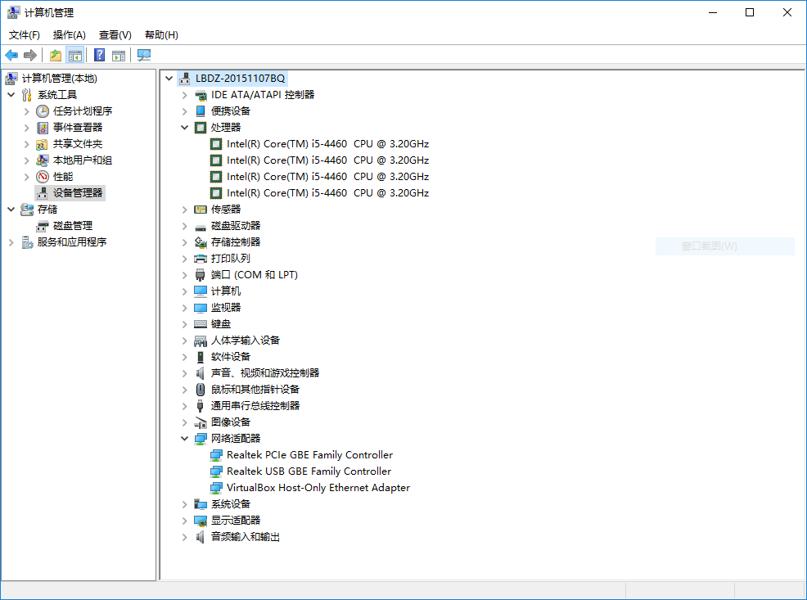
Full Virtualization
Everything is virtualized
Full hardware emulation
Emulation = latency

Slide 22
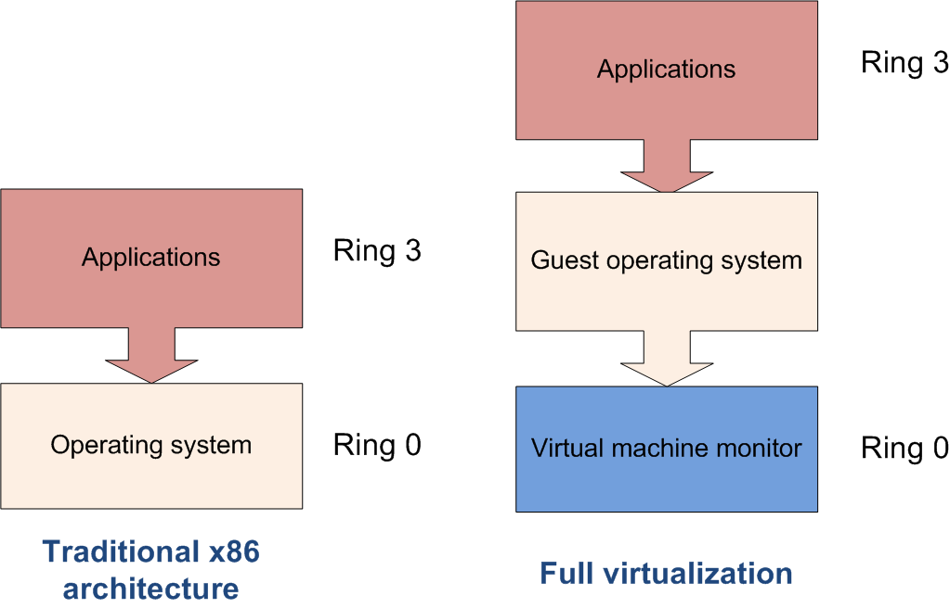
Privileged Instructions
Privileged instructions:
OS kernel and device driver access to system hardware
Trapped and emulated by VMM

Slide 23
Full Virtualization Pros and Cons
Pros
Disaster recovery, failover
Virtual appliance deployment
Legacy code on non-legacy hardware
Cons – LATENCY of core four resources
RAM performance reduced 25% to 75%
Disk I/O degraded from 5% to 20%
Network performance decreased up to 10%
CPU privileged instruction dings nearing 1% to 7%

Slide 24

Paravirtualization
OS or system devices are virtualization aware
Requirements:
OS level -- recompiled kernel
Device level – paravirtualized or “enlightened” device drivers

Slide 25
Paravirtualization Pros and Cons
Pros: fast!
Cons: requires a specially modified guest OS, thus precludes the ability to run off-the-shelf and legacy OS in para-virtual environments.

Slide 26
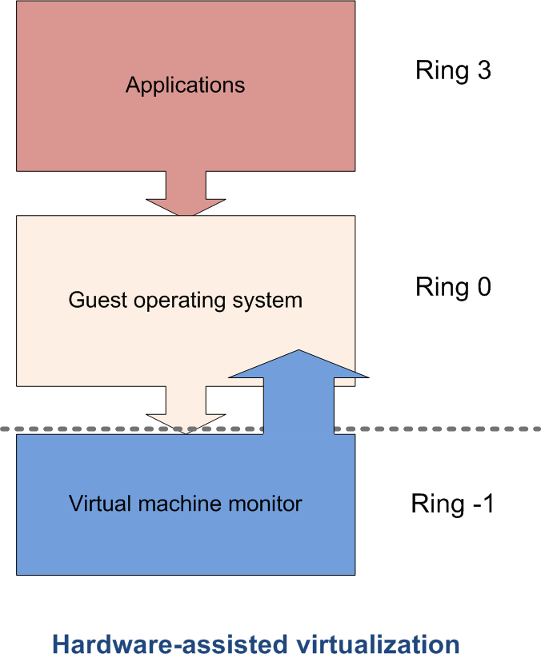
Hardware-assisted Virtualization
Server hardware is virtualization aware
Hypervisor and VMM load at privilege Ring-1 (firmware)
Removes CPU emulation bottleneck
Memory virtualization coming in quad core AMD and Intel CPUs

Slide 27







Evolution of Software solutions*
1st Generation: Full virtualization (Binary rewriting)
Software Based
VMware and Microsoft
2nd Generation: Para virtualization
Cooperative virtualization
Modified guest
VMware, Xen
3rd Generation: Silicon-based (Hardware-assisted) virtualization
Unmodified guest
VMware and Xen on virtualization-aware hardware platforms
Virtual
Machine
Virtual
Machine
…
Dynamic Translation
VM
…
VM
Virtual
Machine
Virtual
Machine
Hypervisor
…
Operating System
Hypervisor
Hardware
Hardware
Hardware
Time
Virtualization Logic
*This slide is from Intel® Corporation

Slide 28
后续内容
泛读相关论文 选篇精读
勤练实验技术 Linux, Git, SSH, Python, OpenStack, Docker …
讲解数据中心关键技术：容器
背景
背景

Slide 29
论文列表
MASHTIZADEH A J, CAI M, TARASUK-LEVIN G等. XvMotion: Unified Virtual Machine Migration over Long Distance[C]//2014 USENIX Annual Technical Conference (USENIX ATC 14). Philadelphia, PA: USENIX Association, 2014: 97–108.
KIVITY A, LAOR D, COSTA G等. OSv—Optimizing the Operating System for Virtual Machines[C]//2014 USENIX Annual Technical Conference (USENIX ATC 14). Philadelphia, PA: USENIX Association, 2014: 61–72.
FU Y, ZENG J, LIN Z. HYPERSHELL: A Practical Hypervisor Layer Guest OS Shell for Automated In-VM Management[C]//2014 USENIX Annual Technical Conference (USENIX ATC 14). Philadelphia, PA: USENIX Association, 2014: 85–96.
DING X, GIBBONS P B, KOZUCH M A等. Gleaner: Mitigating the Blocked-Waiter Wakeup Problem for Virtualized Multicore Applications[C]//2014 USENIX Annual Technical Conference (USENIX ATC 14). Philadelphia, PA: USENIX Association, 2014: 73–84.

Slide 30
论文列表
MAGAKI I, KHAZRAEE M, GUTIERREZ L V等. ASIC Clouds: Specializing the Datacenter[C]//2016 ACM/IEEE 43rd Annual International Symposium on Computer Architecture (ISCA). 2016: 178–190.
DALL C, LI S W, LIM J T等. ARM Virtualization: Performance and Architectural Implications[C]//2016 ACM/IEEE 43rd Annual International Symposium on Computer Architecture (ISCA). 2016: 304–316.
LO D, CHENG L, GOVINDARAJU R等. Heracles: Improving resource efficiency at scale[C]//2015 ACM/IEEE 42nd Annual International Symposium on Computer Architecture (ISCA). 2015: 450–462.
LI W, XIA Y, CHEN H等. Reducing world switches in virtualized environment with flexible cross-world calls[C]//2015 ACM/IEEE 42nd Annual International Symposium on Computer Architecture (ISCA). 2015: 375–387.
PUTNAM A, CAULFIELD A M, CHUNG E S等. A reconfigurable fabric for accelerating large-scale datacenter services[C]//2014 ACM/IEEE 41st International Symposium on Computer Architecture (ISCA). 2014: 13–24.

