Slide 1
数据中心技术
施展，曾令仿
武汉光电国家研究中心
2018-10-09, 10-11

Slide 2
基本信息
施展 副研究员，武汉光电国家研究中心，存储部，F309
课程公务 每周五上午08:30-10:00
课程主页 https://github.com/cs-course/data-center-course
联系方式 zshi@hust.edu.cn 13971459597 https://github.com/Zhan2012
参考书
云计算与分布式系统——从并行处理到物联网，机械工业出版社，2012
云计算——概念、技术与架构，机械工业出版社，2014
Barroso, Clidaras, and Holzle, “The Datacenter as a Computer: An Introduction to the Design of Warehouse-Scale Machines, Second Edition.”

Slide 3
课程计划
1 | 课程总体介绍 | 09-11
2 | 大规模高性能分布式块存储系统数据中心部署实例 | 09-13
3 | 虚拟化、容器技术 | 09-18
4 | 论文、实验讲解 | 09-20
5 | 软件定义数据中心 | 09-25
6 | 新型非易失性存储器重塑数据中心 | 09-27
7 | 监控与管理技术 | 10-09
8 | 论文、实验讲解 | 10-11
9 | 分组讨论论文、汇报实验 | 10-16
10 |  | 10-18
11 |  | 10-23
12 |  | 10-25
13 | 分组讨论论文、汇报实验 完成实验，课程总结，编写报告 | 10-30
14 |  | 11-01
15 |  | 11-06
16 |  | 11-08

Slide 4
讲座内容
数据中心管理
从系统管理到软件定义
系统监控管理实践
基础工具方法
论文学习基础
关于后续论文学习的一些常识

Slide 5
复杂系统管理
基本职责
计算
网络
存储
安全
可靠
˟ 150 节点
˟ 300 端口
˟ 0.5PB 存储
˟ 150 用户
7 ˟ 24
WNLO F310
How many employees does it take to run a data center? The Green Data Center blog explored the issue last week when it looked at hiring for new data centers in central Washington and found that Yahoo (YHOO), Ask.com, Intuit (INTU) and Microsoft (MSFT) have hired a total of 180 workers for their facilities. Microsoft, Yahoo and Intuit will each have 50 workers at their data centers in Grant County, while Ask.com is adding 30.
https://www.datacenterknowledge.com/archives/2008/01/18/the-economics-of-data-center-staffing

Slide 6
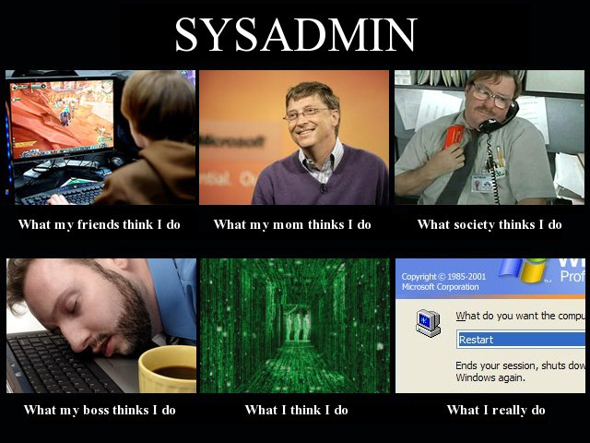
复杂系统管理

Slide 7
标准化
What is the Distributed Management Task Force?
An Industry Standards Organization
Developing manageability standards for 24 years (est. 1992)
Membership includes 65 companies and industry organizations
With active chapters in China and Japan
Allied with
14 standard development organizations (alliance partners)
80+ universities and research organizations (academic alliance partners)
Focused on manageability standards
For the management of on-platform, off-platform, network services and infrastructure domains
Which are recognized nationally (ANSI/US) and internationally (ISO)
来源：DMTF
https://www.dmtf.org/sites/default/files/A Modern Interface for Managing Compute, Storage and Network - CNSM 2016 Keynote.pdf

Slide 8
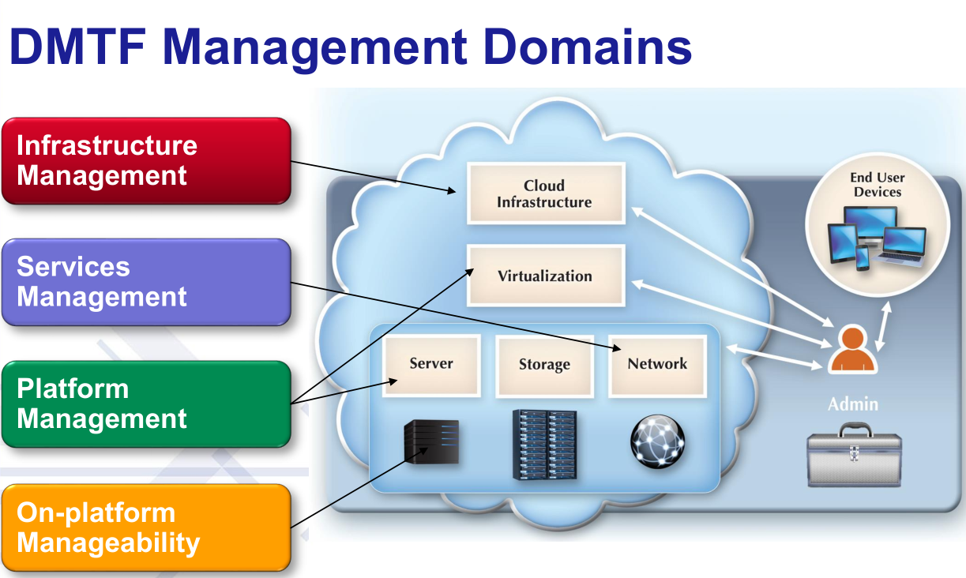
标准化
来源：DMTF
https://www.dmtf.org/sites/default/files/A Modern Interface for Managing Compute, Storage and Network - CNSM 2016 Keynote.pdf

Slide 9
标准化

Slide 10
标准化
Ver2.51: 1896个模型

Slide 11


数据中心管理
Inefficiency
Downtime
High capex and opex
High complexity, Siloed IT
Operational inefficiencies
Challenging to meet SLAs
Long issue identification / resolution times
Security and compliance issues
来源：VMware
Cloud Infrastructure and Management 2013 Launch Overview

Slide 12


数据中心管理
Inefficiency
Inflexibility
Downtime
Fear of Lock-In
High capex and opex
High complexity, Siloed IT
Operational inefficiencies
Challenging to meet SLAs
Long issue identification / resolution times
Security and compliance issues
Slow time to market
Reactive IT organizations
Rise of “Shadow IT”
Managing heterogeneous IT environments
New applications types e.g. Big data, mobile
Vendor lock-in
来源：VMware
Cloud Infrastructure and Management 2013 Launch Overview

Slide 13
数据中心管理
负载每4年翻番…
By 2015
50x – Data managed within enterprise datacenters
44x – Storage growing from 0.8 ZB to 35 ZB in 2020
26x – Mobile data traffic growth from mobile devices
10x – Servers worldwide growth
5x – IP-based video and real time applications growth
4x – IP traffic growth
2012
…复杂性与日俱增，如何应对?
来源：
Equinix.com blog, Cisco VNI 2011 Gartner 2009 and 2011, IDC 2011

Slide 14
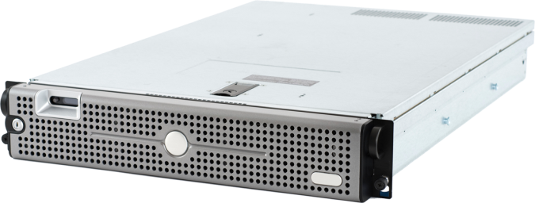

软件定义数据中心
若能实现…
全部资源均基于一套规范进行管理…
抽象
池化
自动化

Slide 15
软件定义数据中心
SDDC is an emerging data center architecture and set of technologies spanning compute, network, storage and security
Enables resources to be:
Defined in software;
Provisioned based on policy/service level;
Deployed on any hardware
Increase IT agility and operational and resource efficiency while speeding delivery of services to application owners

Slide 16
软件定义数据中心
Our New Opportunity (~5x)
$28 Billion
SDDC
20 % CAGR
We Started Here
$6 Billion
Compute Virtualization
2016
来源：VMware
Cloud Infrastructure and Management 2013 Launch Overview

Slide 17







开放管理平台
开源生态环境中已经提供丰富选择
Puppet, Chef, Ansible, Saltstack
面向存储、网络配置管理及自动化
x86 Linux

Slide 18
系统监控管理实践
性能指标采集
实践
内核与运行状态 uname, uptime, top/htop, ps
存储 free, df, fdisk –l
网络 ip/ifconfig, ss/netstat
特殊文件系统 /proc, /sys, /var/log
集群监控
实践
建立一个初步仪表盘 grafana+influxdb
容器管理 portainer, k8s
参考
https://github.com/cs-course/vagrant-tutorial
https://github.com/cs-course/cluster-monitoring-tutorial

Slide 19
论文学习基础
基本方法
3-Pass 三遍法
粗度与精读
论文背后的故事
中心思想三段论
重现！
参考
https://www.eecs.harvard.edu/~michaelm/postscripts/ReadPaper.pdf
http://blizzard.cs.uwaterloo.ca/keshav/home/Papers/data/07/paper-reading.pdf
如何阅读学术研究论文？ https://www.bilibili.com/video/av25584054

Slide 20
后续内容
范文
Y. Su, D. Feng, Y. Hua, Z. Shi, T. Zhu. IEEE, 2018. NetRS: Cutting Response Latency in Distributed Key-Value Stores with In-Network Replica Selection[C]//2018 IEEE 38th International Conference on Distributed Computing Systems (ICDCS). 2018, 143-153.
Su Y, Feng D, Hua Y, Shi Z. Predicting Response Latency Percentiles for Cloud Object Storage Systems[C]//2017 46th International Conference on Parallel Processing (ICPP). 2017, 241-250.
泛读相关论文 选篇精读 HPCA2018, ATC2018
http://hpca2018.ece.ucsb.edu/pages/main_program.html
https://www.usenix.org/conference/atc18/technical-sessions
通过协同编辑器选择 https://docs.qq.com/desktop/
论文研讨课评价方法

