Slide 1
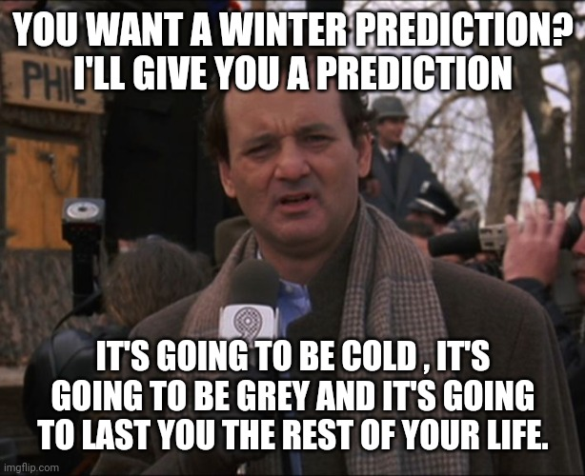
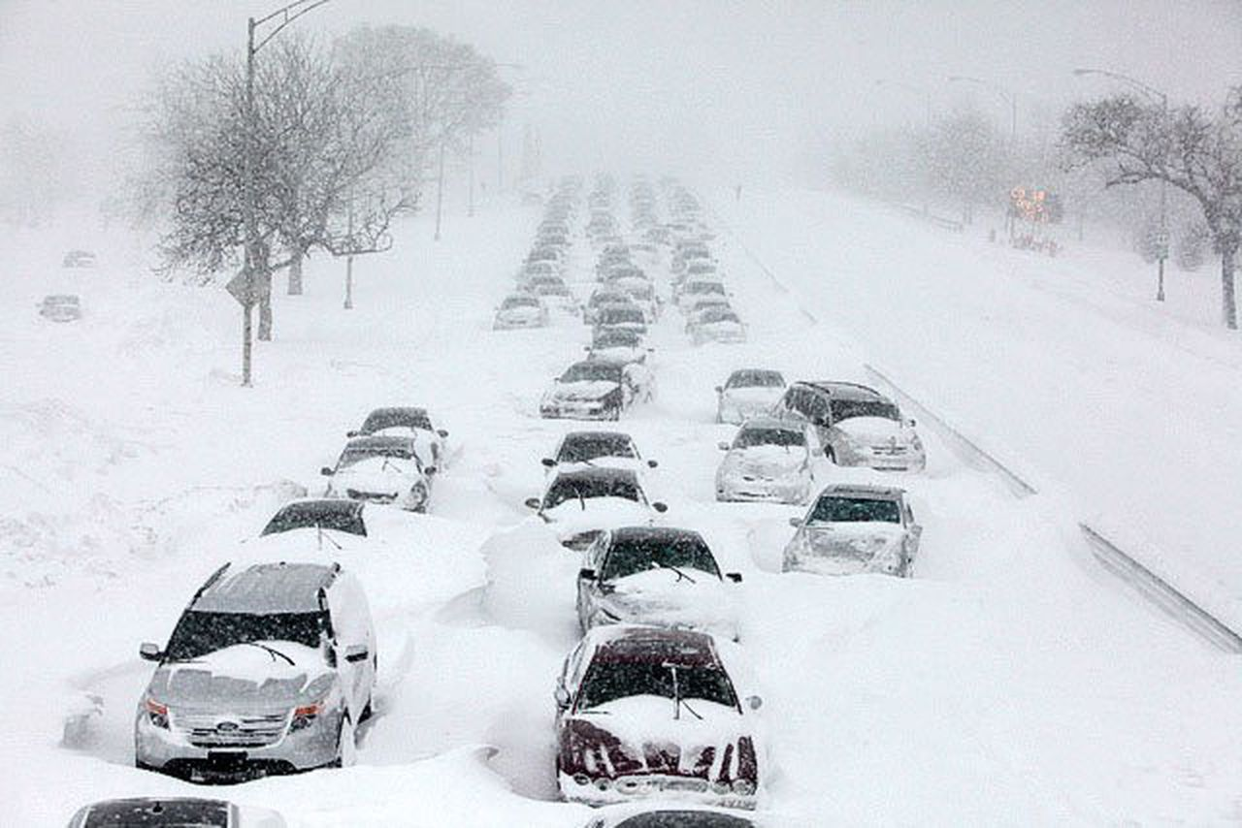
Repetition
February 2, 2022 | groundhog day

Slide 2
Repetition, or iteration, is the most important concept we’ll study in this class
The key to the power of computer programming is to recognize repetitive patterns and generalize those patterns
Example: print the numbers 1-10 in the Console
The only way we could do this knowing what we know now would be to use 10 separate println() statements

Slide 3
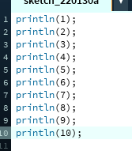
The brute force solution

Slide 4
The brute force solution: limitations
The brute force solution is correct…but what if we wanted all the numbers from 1 to 1000?
Brute force involves way too much work (and way too much code!)
Instead, we should look for a repetitive pattern
Here, we want to do the same thing to each of the values starting with 1 and going up to 10 (print them to the console)

Slide 5
Repetition in programming: the key
We need to write the operation to be performed in a general way (using a variable)
Here, the operation to be performed is
println(x);
We want to do that for all the values from 1 to 10

Slide 6
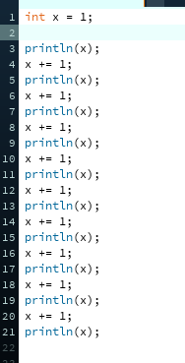
Using a variable in this solution

Slide 7
What operations are being repeated?
Done once at the beginning:
int x = 1;
Done ten times in a row:
println(x);
x += 1;

Slide 8
The for statement in processing
Purpose: repeatedly execute a block of code a specific number of times
for (int x = 1; x <= 10; x++) {
println(x);
}
What if we wanted all the numbers from 1 to 1000? Much easier this way!
** x++ could also be written as x+=1 or x = x + 1 … they all work!

Slide 9
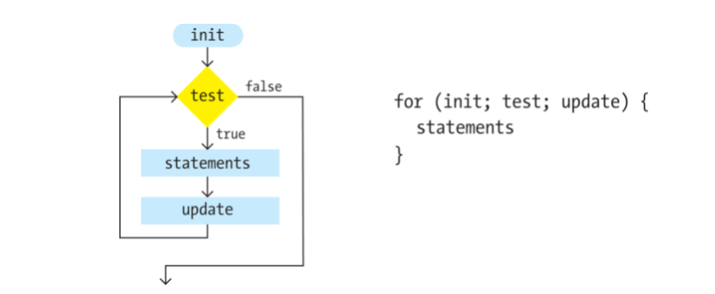
The for statement in processing: the logic

Slide 10

Where’s the repetition?

Slide 11
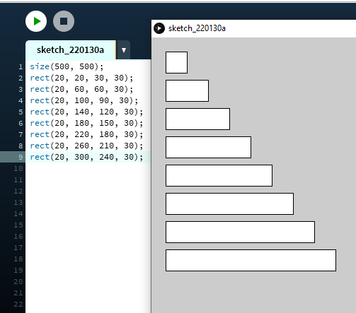
Where’s the repetition in the code?
Consider this example – what does it do?
What is changing from line to line, and
what is staying the same?

Slide 12
What’s changing? What’s the same?
The vertical position of each rectangle changes
The width of each rectangle changes
But the horizontal position and length of each
rectangle stays the same
How can we generalize this idea and use repetition?

Slide 13
Generalizing with variables
Write the statement once, with variables for what changes and constants for everything else
We can use y for the vertical position and w for the width of the rectangle
rect(20, y, w, 30);
y should start at 20 and w should start at 30
Draw the rectangle, then increase y by 40 and increase w by 30
Repeat this once for each rectangle to be drawn (in this case, that means 8 times)

Slide 14
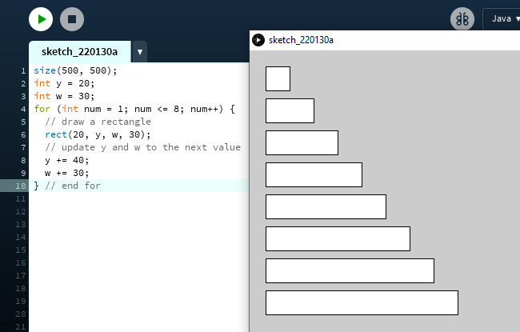
Here’s the repetition!
What if we want to make 5 rectangles, or 12?
Just change the number of times the loop is executed!

Slide 15
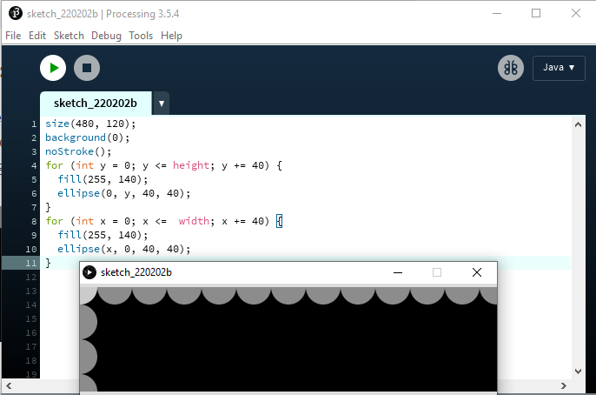
As series of for loops
These for loops are adjacent. The vertical circles are drawn by the first loop, and the horizontal circles are drawn by the second loop.

Slide 16
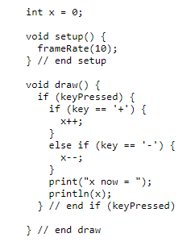
Remember nested if statements?
From Lab 2:
The if and else if that check for the + and – keys are nested inside if (keyPressed). That’s why the closing curly brace for if (keyPressed) comes after the closing curly braces for if (key == ‘+’) and if (key == ‘-’).

Slide 17
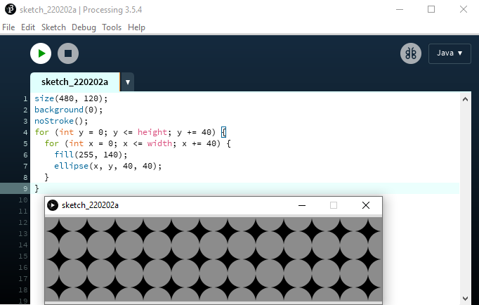
We can embed for loops, too!
The number of repetitions is multiplied!
The outer for loop starts
Then the entire inner for loop runs until the condition x <= width is false
Then the outer for loop updates (y += 40) and the entire inner for loop runs again until the condition x <= width is false
Then the outer for loop updates again. The process repeats until the outer for loop’s condition ( y <= height) is false
Be careful with syntax! The outer loop’s closing curly brace comes after the inner loop’s closing curly brace

