Slide 1
Processing: The coordinate system, functions, colors, and comments
University of Mount Union

Slide 2
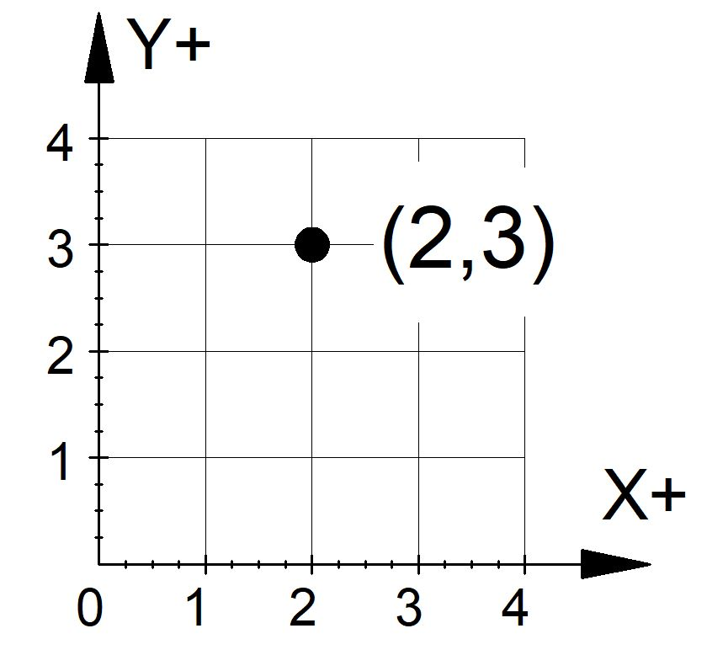
Cartesian Coordinate system
Positive x & y are in the top right quadrant (“Quadrant I”), so x-values (horizontal) increase as they go to the right and y-values (vertical) increase as they go up.

Slide 3

Processing coordinate system
The origin is at the TOP LEFT of the sketch, so x-values (horizontal) still increase as they go to the right…but y-values (vertical) increase as they go DOWN!
Not too hard to understand, but a little counter-intuitive, so we’re bound to make things go flippy-floppy sometimes. No problem! Just try again ☺

Slide 4
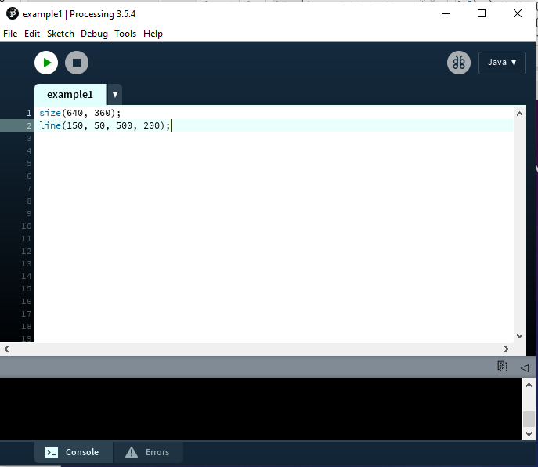
Ok, so we have a coordinate system! Let’s…draw a line!
“Draw a line from (150, 50) to (500, 200).”
We understand that perfectly well…
Processing doesn’t.
Let’s try line(150, 50, 500, 200);
Hmm! Too small…let’s try this:

Slide 5
Book examples
Try examples 2-1 and 2-2! Make sure to read the text, too! ☺

Slide 6
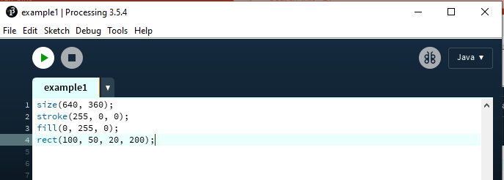
Color
Digital color mixing uses the properties of light, which mixes red, green, and blue (RGB).
Red, green, and blue can have values from 0-255 (hexadecimal codes, just like in HTML)
Try this:

Slide 7
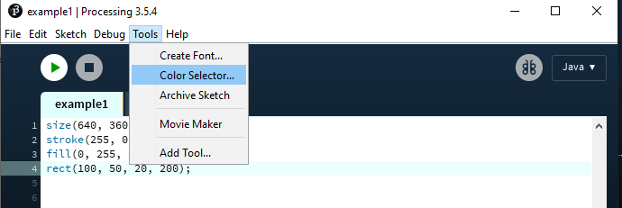
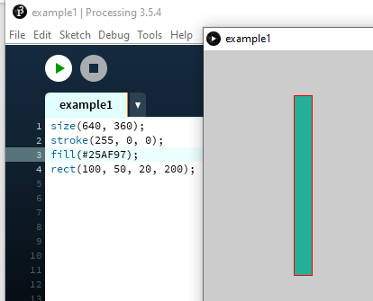
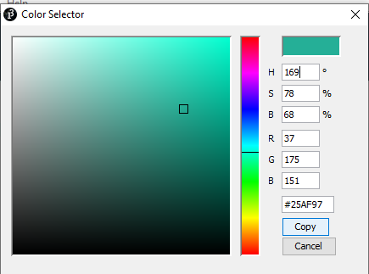
You can also use hexadecimal codes
After
copying the
hex code, paste it inside the “fill” parentheses

Slide 8
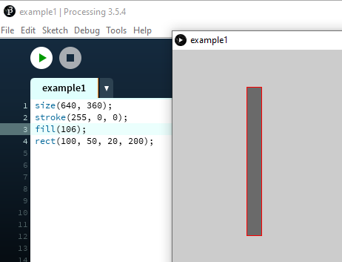
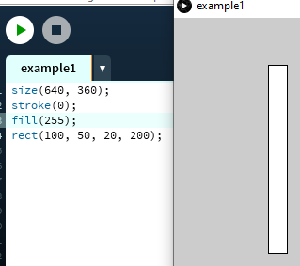
And Let’s not forget grayscale
If just one number between 0-255 is inside the parentheses, Processing will assume that this same value should be applied to R, G, and B…which results in a shade between black and white!
Want black or white? Black is 0 (shorthand for #000000 or 0, 0, 0) and white is 255 (shorthand for #FFFFFF or 255, 255, 255)

Slide 9
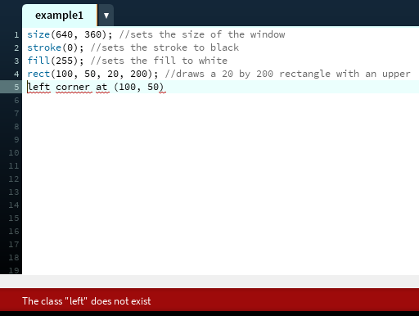
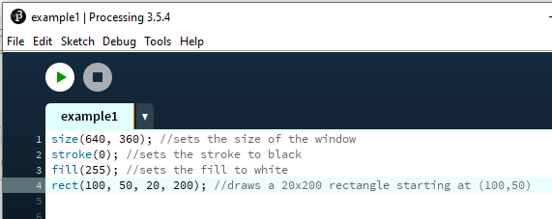
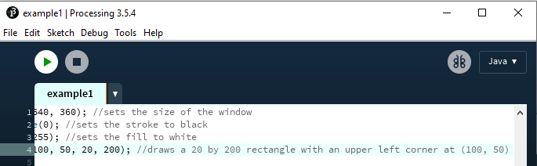
Commenting in code
What if the comment can’t fit on one line?
Uh oh…that doesn’t look good

Slide 10
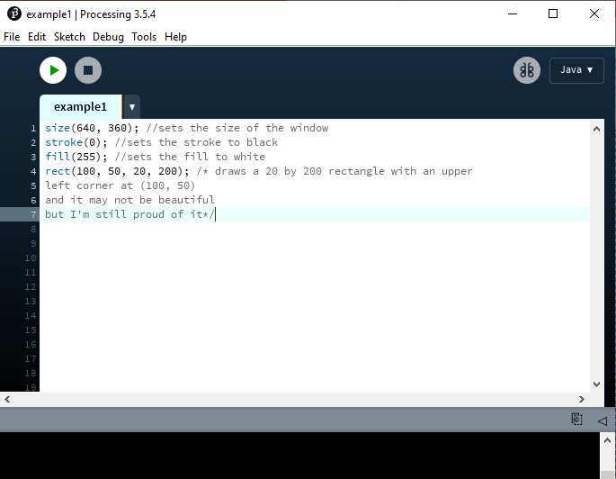
Multi-line comments
Whew! That’s better.

