Slide 1
Variables
Fall 2022
The university of mount union

Slide 2
What does a variable do?
Stores a value in memory so it can be used later in the program
Value can be easily changed while the program is running

Slide 3
Why do we use variables?
Avoid repeating ourselves
Much easier to update code
Much more efficient

Slide 4
What do we need to do?
Determine the name, data type, and value
Convention is to use lower case for variable names
Data types include (but are certainly not limited to)
int (integer)
float (short for floating-point, which can include decimals)
Array (holds a list of data)

Slide 5
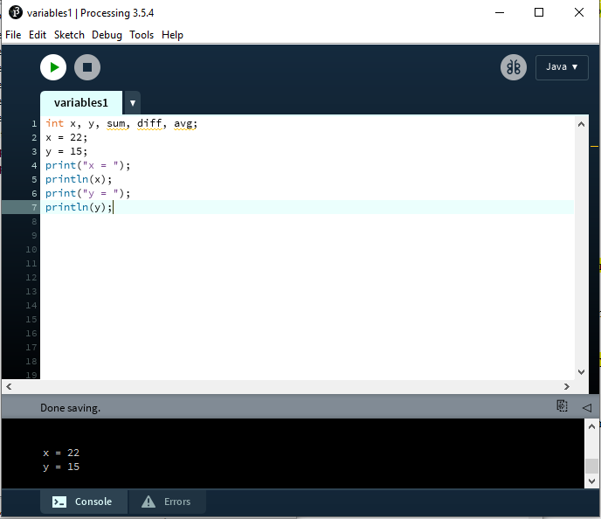
Example from lab 1

Slide 6
BUILT-IN VARIABLES
width – automatically stores width of window
height – automatically stores height of window
mouseX – automatically stores current x-position of the mouse
mouseY – automatically stores current y-position of the mouse

Slide 7
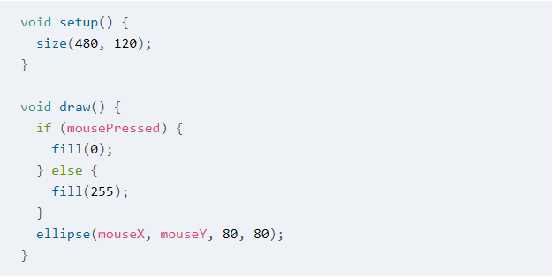
Looking at example 2-2 again
We still don’t have the tools to understand all of this code…but how about “size”? And “ellipse”? We can understand those now!

