Slide 1


Decision making with if
Fall 2022
University of Mount Union

Slide 2
Selection
A fundamental concept in programming
We can perform a test and take different actions based on the result of the test
We can do this using an if statement

Slide 3
The if statement in Processing
Purpose: ask a yes/no or true/false question and specify different actions to be taken based on the result of this test

Slide 4
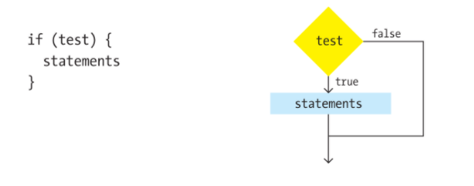
Simplest form
Example:
print(num);
print(“ is ”);
if (num <= 0) {
print(“not ”);
}
print(“positive”);
Meaning:
Evaluate the test
If the test is true, execute the statements between the curly braces

Slide 5
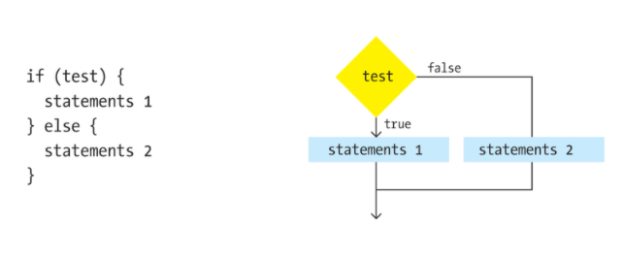
if statement followed by else
Example:
print(num);
print(“ is ”);
If (num > 0) {
print(“positive”);
}
else {
print(“not positive”);
}
Meaning:
If test is true, do first block of code
Skip else part
If test is false, do second block of code
Skip if part

Slide 6
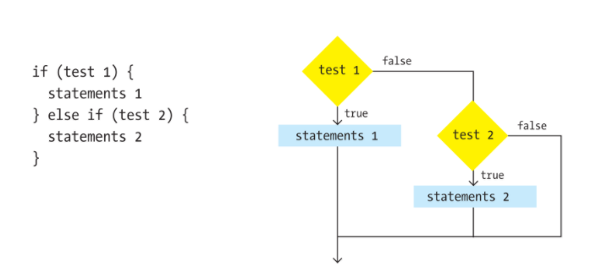
More than 2 choices: else if
Example:
print(num)
print(“ is ”);
if (num > 0) {
print(“positive”);
}
else if (num < 0 ) {
print(“negative”);
}
else {
print (“zero”);
}

Slide 7

Types of tests
Why a double equal (==)? Remember that ONE equal sign is used to assign a value to a variable, so for a test of equality, we use two equal signs.
Comparisons – 6 operators:
Greater than >
Less than <
Greater than or equal to >=
Less than or equal to <=
Not equal to !=
Equal to ==

Slide 8
Example
Write a Processing code block that prints the proper message indicating whether the value of an int variable named year is in the 21st century or came before the 21st century.
Different messages should be printed based on the value of the variable year – use an if statement to perform a test, and print different messages based on the results of the test.

Slide 9
What do you think?
print(year);
if (_________________________) {
print(“ is in the 21st Century”);
}
else {
print(“ came before the 21st century”);
}

Slide 10
How about this?
Yes, the 21st century technically started in 2001, not 2000! Our calendar considers the first year of AD/C.E. to be 1, not 0, and each subsequent century has started in a year ending with 1. As someone who lived during the turn of the century/millennium, I can assure you that very few people cared about this technicality, and 2000 was celebrated with much greater fanfare than 2001.
print(year);
if (year > 2000) {
print(“ is in the 21st Century”);
}
else {
print(“ came before the 21st century”);
}

