Slide 1

Arrays
Fall 2022
The University of Mount Union

Slide 2
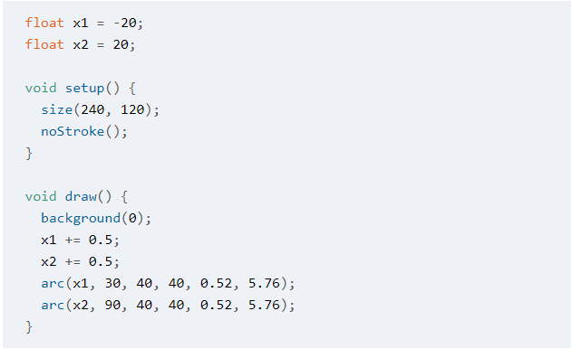
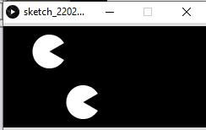
Too many variables

Slide 3
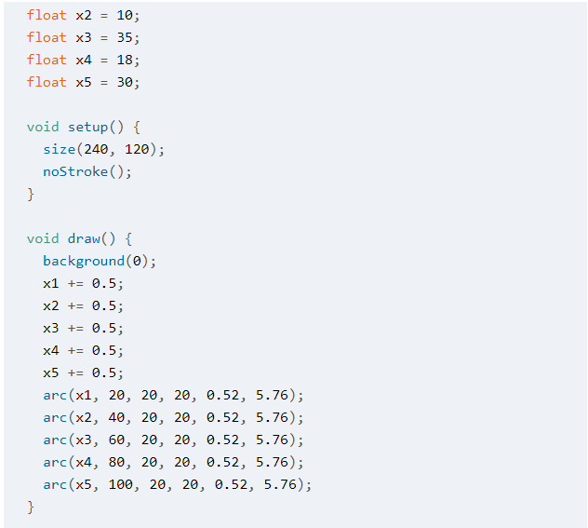
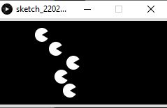
Way too many variables

Slide 4
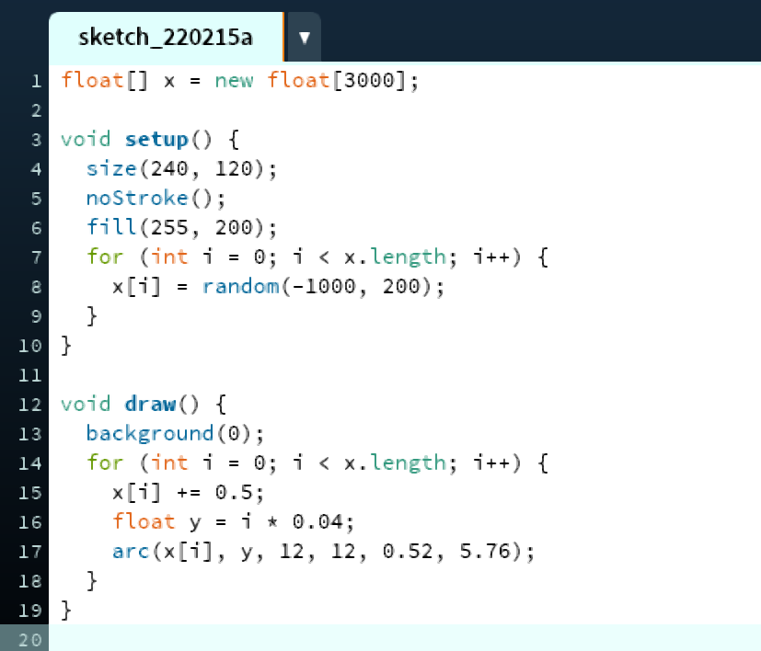
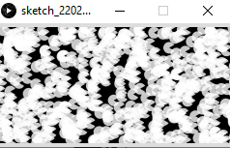
What can I do? Use an array!

Slide 5
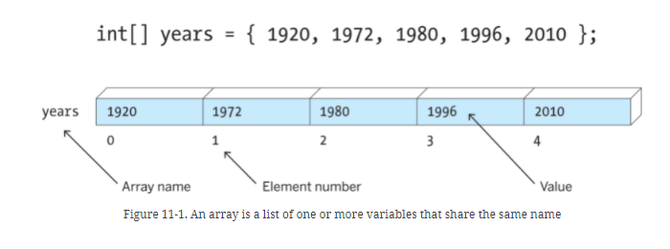
A Conceptual Look
Each element in this array can be generically referred to as years[i] pronounced “years sub i”
A specific element can be referred to like this: years[3] or “years sub 3.” The current value of years[3] is 1996.
It might seem strange to start at 0 instead of 1, but think of it as distance from the beginning of the array.

Slide 6
Declaring & Instantiating
This line declares and instantiates (or, in the book’s language, creates) the array, giving it a name and a length. It has slots for 3000 floating-point variables, called elements of the array.
This could also be done in two separate lines, with
float[] x;
at the top and
x = new float[3000];
in setup().
All the elements of an array must be the same data type!
Instantiating in setup() is fine, but avoid instantiating in draw() as it slows down the frame rate.

Slide 7

Assigning Values
This for loop is assigning random values between -1000 and 200 to each element of the array. We start at 0 because the first index value of an array is 0. Since this array has 3000 elements, its last index value is 2999.
The first element would be written like this:
x[0]
And the last like this:
x[2999]
This stores the length of the array.
Why do we check for i<x.length and not i<=x.length?
Because we started with 0, not 1!

Slide 8
Using an array
This for loop adds 0.5 to each element of the array every time draw() runs (60 times per second).

Slide 9
Using an array (continued)
This line assigns a value to y each time the loop runs: the current value of i multiplied by 0.04. The values of y will thus range from 0 (0 * 0.04) to 119.96 (2999 * 0.04), which is very close to the height of the sketch (120).

Slide 10
Using an array (continued again)
Here we draw our Pac-Men. Each arc is centered at (x[i], y) initially and moves horizontally 0.5 pixels every time a frame runs. Remember that the frame rate is 60 frames/second, so each Pan-Man moves 30 pixels to the right horizontally each second. This movement occurs because of the
x[i] += 0.5;
line.

