Slide 1
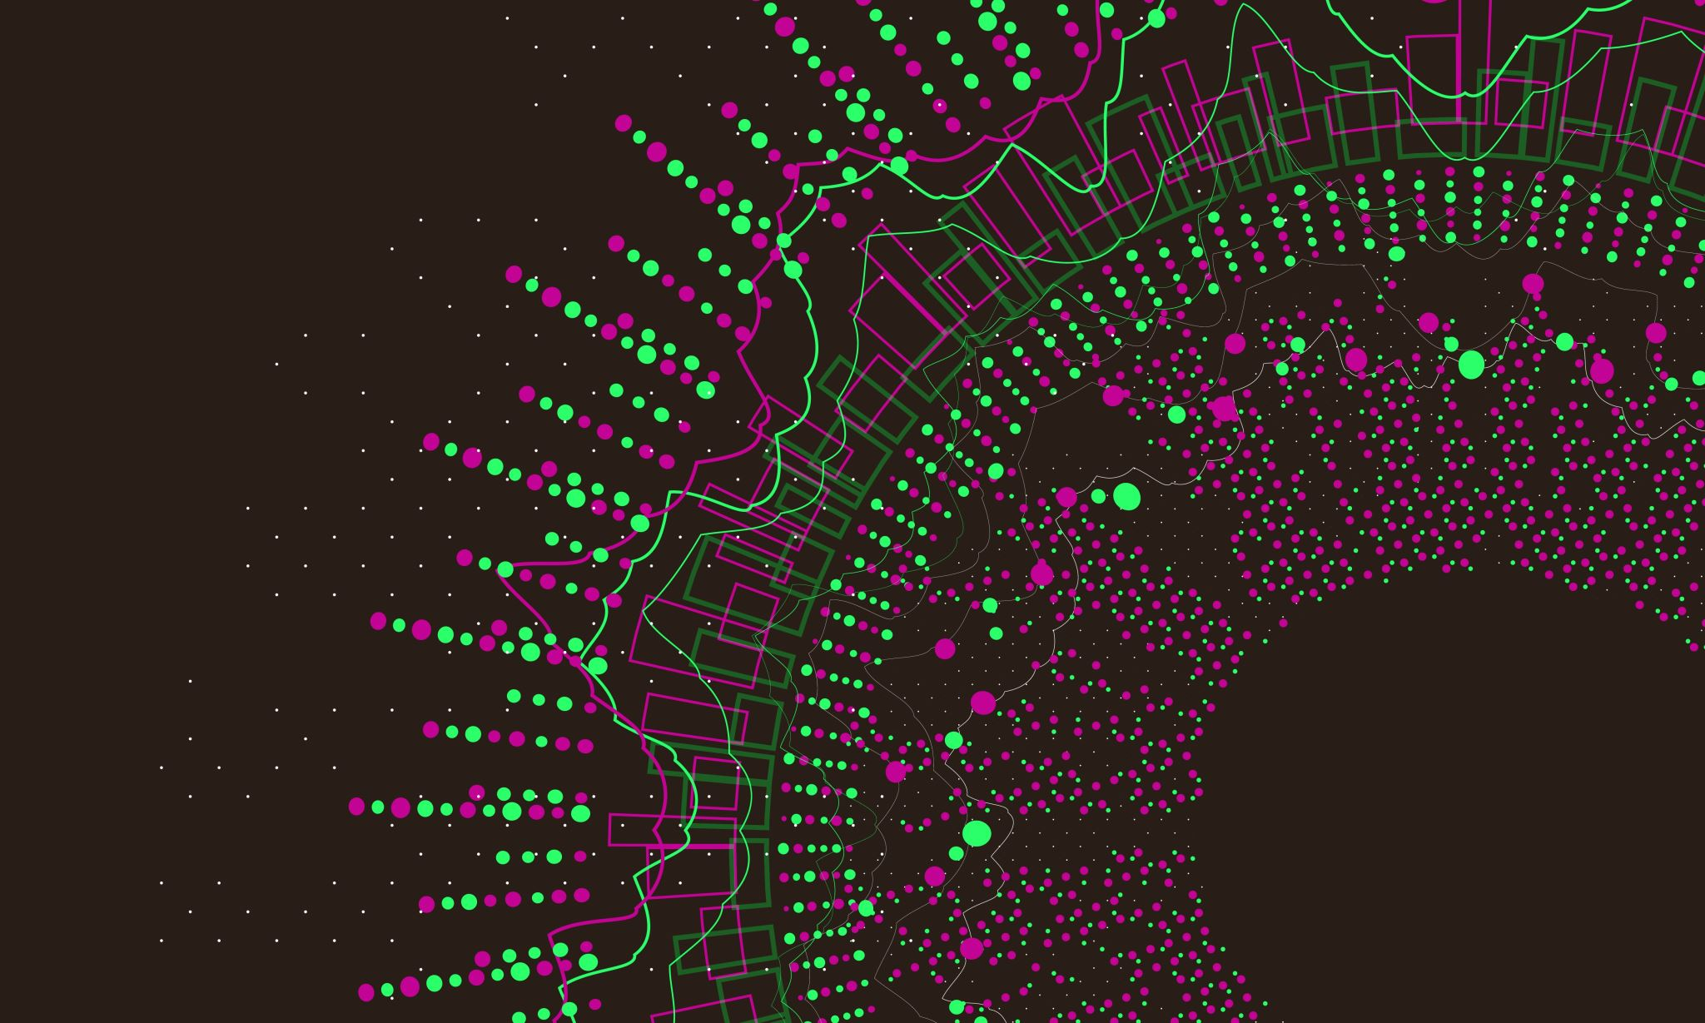
User-Defined Functions
Fall 2022 | University of mount union

Slide 2
Functions in Processing
There are many built-in functions, and we’ve used quite a few already!
setup() and draw() run automatically
Other functions we’ve used include(but are not limited to) size(), line(), ellipse(), rect(), and random()

Slide 3
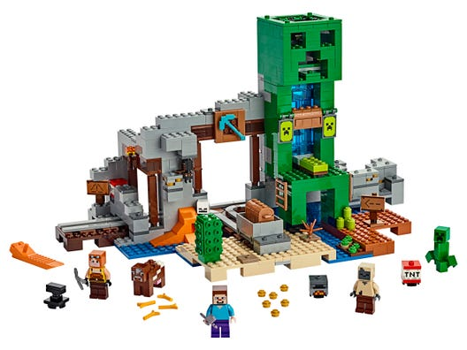
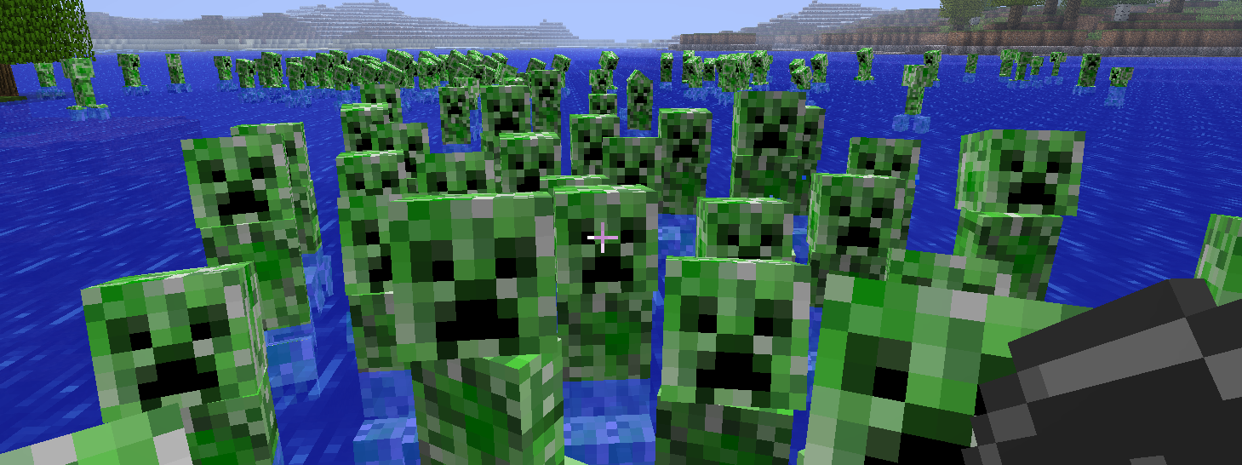
Why bother with functions?
Modularity: functions are independent software units that are used to build more complex programs.
Reusability: functions allow you to reuse code without having to retype it.

Slide 4
Defining a function
A function definition includes these parts:
Return type
Function name
Parameters
Code body
returnType functionName(parameters){
//code body of function
}

Slide 5
Calling a function
Any user-defined function must be called for it to run!
We call the function using its name and any necessary parameters inside parentheses, followed by a semicolon:
functionName(parameter1, parameter2, etc.);

Slide 6
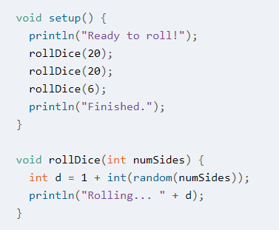
Example 9-1
Inside setup(), the user-defined function rollDice() is called three times. The first two times, the parameter 20 is passed into the function, and the last time, the parameter 6 is passed into the function.

Slide 7
Example 9-1
Here is where the user-defined function rollDice() is defined. The word void means that no value is returned to the program (more on this later). The word rollDice gives us the name of the function. The parameter int numSides indicates that the function requires one parameter, an integer.

Slide 8
Example 9-1
Here is the code body of rollDice():
An integer variable d is assigned the value of 1+int(random(numSides)).
With just one parameter, the random() function returns a random floating-point value between 0 and up to (but not including) that parameter value.
The function int() will convert that value to an integer using rounding.
Adding 1 to that integer will assign a value to d that is greater than 0 and less than or equal to the number of sides on the dice.
Then the function prints “Rolling…” and the value of d to the console using the println() function.

Slide 9
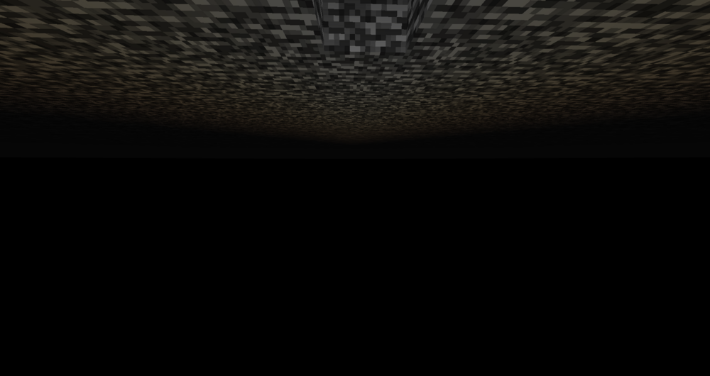
Return values
Remember when I said that’d we’d revisit “void”?
And remember that the Processing-defined function random() returns a floating-point number?
Functions can perform a calculation and then return a value to the main program. (Most of the functions we’ve used have not returned values, which is why their return type is “void”).
Return values are frequently assigned to a variable or used as parameters in other functions.
float r = random(1, 10);
line(300, 300, random(0, 600), random(0, 600));

Slide 10
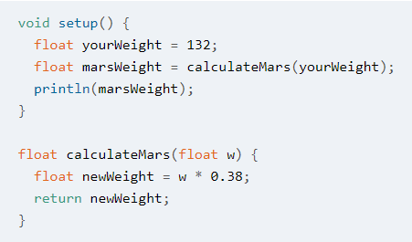
Returning a value with a user-defined function: Example 9-8
Inside setup(), the user-defined function calculateMars is called, and its return value is assigned to the floating-point variable marsWeight.

Slide 11
Returning a value with a user-defined function: Example 9-8
Here is the definition of calculateMars(). Hey, it’s a function that doesn’t start with the word void! This function returns a floating-point value, newWeight, to the program.

