Slide 1

Sample Quiz 5 Answers
Fall 2022

Slide 2
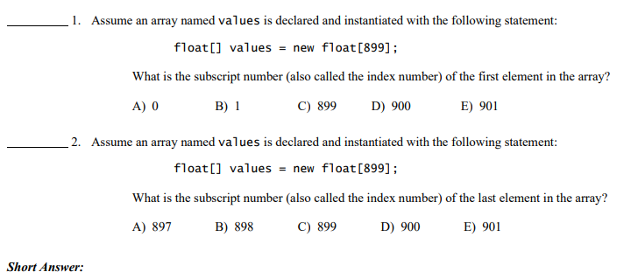
A
B
*Remember that the first element would be values[0], so the 899th element would be values[898].

Slide 3
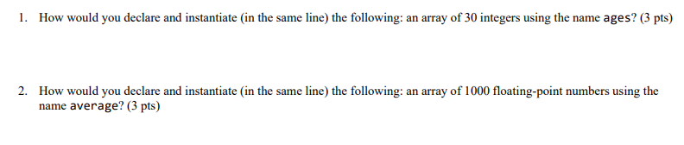


Slide 4
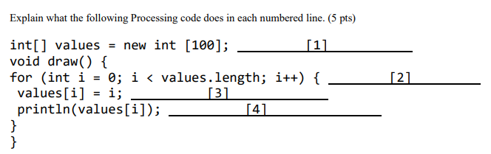
Blank 1: declares and instantiates an integer array, values, with 100 elements
Blank 2: for loop header that starts at i=0, goes through i=99, and adds 1 to i each time the loop runs
Blank 3: assigns current value of i to values[i]
Blank 4: prints out each element of the values array (numbers 0-99, each on a new line)

Slide 5
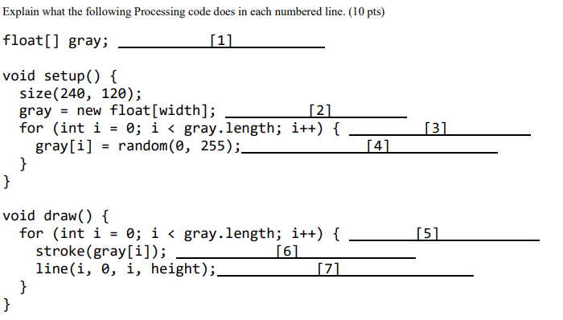
Blank 1: declares floating-point array called gray
Blank 2: instantiates gray and gives it a length equal to the width of the sketch, 240
Blank 3: for loop header that starts at i=0, goes through i=239, and adds 1 to i each time the loop runs
Blank 4: assigns a random value between 0 and 255 to each element of the gray array
Blank 5: for loop header that starts at i=0, goes through i=239, and adds 1 to i each time the loop runs
Blank 6: assigns the value of gray[i] to stroke (will be a random grayscale color as it will be between 0-255)
Blank 7: draws a line from (i, 0) to (i, height)

