Slide 1
CSC 108
Introduction to Computer Programming
Lecture 6
Decision-making with if
University of Mount Union

Slide 2
Choosing Among Alternatives
We can write Processing programs that can operate differently in different situations
We can perform a test and take different actions based on the results of the test
This is called selection in computer programming
most commonly-used selection statement in programming: the if statement

Slide 3
The if Statement in Processing
purpose: ask a yes/no or a true/false question, and specify different actions to be taken based on the results of the test

Slide 4
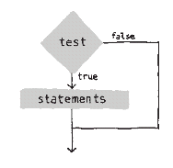
The if Statement in Processing
purpose: ask a yes/no or a true/false question, and specify different actions to be taken based on the results of the test
simplest form:

Slide 5
The if Statement in Processing
purpose: ask a yes/no or a true/false question, and specify different actions to be taken based on the results of the test
simplest form:
  print(num);
  print(“ is “);
  if ( num <= 0 ) {
  print(“not”);
  }
  print(“positive”);

Slide 6
The if Statement in Processing
purpose: ask a yes/no or a true/false question, and specify different actions to be taken based on the results of the test
meaning:
evaluate the test
if test is true, execute
the statements between
curly braces

Slide 7
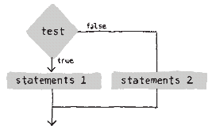
if statement followed by else
meaning:
if test is true,
do first block of code
  skip else part
if test is false,
do second block of code
  skip if part

Slide 8
if statement followed by else
  print(num);
  print(“ is “);
  if ( num > 0 ) {
  print(“positive”);
  }
  else {
  print(“not positive”);
  }

Slide 9
Types of tests
Comparisons
  six operators:
  greater than: >
  less than: <
  greater than or equal: >=
  less than or equal: <=
  not equal: !=
  equal to: ==

Slide 10
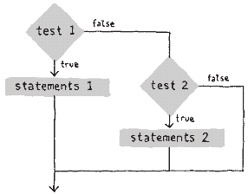
more than 2 choices: else if
  print(num);
  print(“ is “);
  if ( num > 0 ) {
  print(“positive”);
  }
  else if ( num < 0 ){
  print(“negative”);
  }
  else {
  print(“zero”);
  }

Slide 11
Example of decision making
  Write a Processing code block that prints the proper message indicating whether the value of an int variable named year is in the 21st century or came before the 21st century
  Different messages should be printed based on the value of the variable year – use an if statement to perform a test, and print different messages based on the results of the test

Slide 12
Example of decision making
  print(year);
  if ( ____________________ ) {
  print(“ is in the 21st Century”);
  }
  else {
  print(“ came before the 21st Century”);
  }

Slide 13
Example of decision making
  print(year);
  if ( year > 2000 ) {
  print(“ is in the 21st Century”);
  }
  else {
  print(“ came before the 21st Century”);
  }

Slide 14
Better programming style for this example
  print(year);
  if ( year > 2000 ) {
  print(“ is in”);
  }
  else {
  print(“ came before”);
  }
  print(“ the 21st Century”);

Slide 15
CSC 108
Introduction to Computer Programming
Lecture 6
Decision-making with if
University of Mount Union

