Slide 1

CSC 108: Introduction to computer programming
January 10, 2022
The University of Mount Union

Slide 2
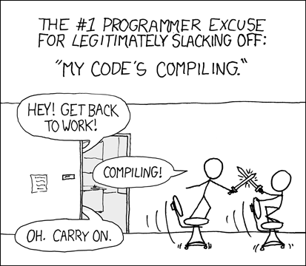
How to Program a Computer
Ask Professor Google and get > 9.3 billion results
Programming involves different:
Languages
End goals
Levels of expertise
In this class, we
Assume no prior experience
Learn by doing lots of examples
Have fun!
xkcd.com

Slide 3
What is a programming language?
“A programming language is an artificial unambiguous language designed to express computations that can be performed by a machine, particularly a computer.”
Artificial?
Made up
Unambiguous?
No question about the meaning of the programming statements
Wait, you’re saying spoken language isn’t unambiguous?
The man saw the boy with the binoculars.
Time flies like an arrow; fruit flies like a banana.

Slide 4
Exact instructions challenge
Write detailed, exact instructions so that a classmate could draw your picture
Don’t say what the object is – no title, no reference to it in your instructions!
After 10 minutes, we’ll trade instructions and see how well your classmates do

Slide 5

Our language
We’ll be using Processing
Processing is a programming system that provides a simple program structure in an environment that encourages experimentation and extension
Write a few statements, then run the program to see the results
Then add a few more lines…program grows bit by bit

Slide 6

Processing’s way of working: the sketch
Engage in a cycle of writing, testing, and improving
This facilitates an experimental mindset:
If something doesn’t work, it’s not the end of the world
Just dust yourself off (fix it)…and try again!

Slide 7

Downloading Processing on your computer
Already installed on lab computers (use Computer Science 2021 image)
Software download instructions are given in Chapter 2 of the text for your own computer
We’ll be using Release 3.5.4 as it is the release used in the book
Download / Processing.org

Slide 8
How this class will work
Most of the work for this class can be completed during class time
Lab activities are to be completed in class and demonstrated to the instructor
Programming assignments may need to be completed outside of class time
We will have some brief lectures, demonstrations, and the like, but much of the class will consist of open lab time
There will be 6 lab activities, 5 programming assignments, and 6 in-class quizzes
Final projects will be presented during our final period, Thursday, March 3 11am-1pm. They will be worth 25 points and will replace the lowest programming assignment or quiz score. More information is forthcoming!

Slide 9
Important Links
Course website: CSC 108 Home Page (cs-courses-mountunion.github.io)
Course syllabus: syllabus108.pdf (cs-courses-mountunion.github.io)
Computer Science homepage: https://silver.mountunion.edu/cs/ (this link only works on campus or through a VPN connection)
Online textbook instructions: Accessing O'Reilly Learning Resources (cs-courses-mountunion.github.io)
Processing: Welcome to Processing! / Processing.org
D2L: D2L @ Mount Union

