Slide 1


CSE305/PROJECT-III – Business Website For (PVF) Studio
Team Members :
1) D24CS108-Soni Dhruvil Jigar
2) D24CS109-Patel Smit Ashokbhai
Guided By:
Prof. Hemang Thakar
Mr. Jigar Soni

Slide 2
Content of the Presentation
Project Overview
Client Details
Features of PVF
Technology Stack
Design (Screenshots of UI/UX Design)
Flow Diagram/ Flow Chart of System
Conclusion
Department of Computer Science & Engineering ,CSPIT

Slide 3
Project Overview
The Purnima Video Films web application is an online platform for a studio that can help increase the business in a modern way.
Showcase of Portfolio: The platform provides a digital portfolio of past projects such as weddings, corporate events, and personal celebrations, making it easier for clients to evaluate the studio’s quality and style.
Client Convenience: Instead of physically visiting the studio, clients can explore services, packages, and sample work online at any time.
Camera Accessories – Tripods, memory cards, batteries, camera bags (small add-on sales).
Online Booking & Enquiries: The web application can allow customers to book appointments, request quotes, or schedule shoots directly online.

Slide 4
Client Details
Client: Purnima Video Films
Owner: Mr. Jigar Soni
Address: Shop No- 10 Marutinandan Complex, Opposite Physical Ground, Near Khokhra Road, Khokhara, Ahmedabad.
Description : Our Client, Jigar Soni wanted us to bring his business to run in a modern way so we decided to make an online platform for him to increase his business from a virtual environment.

Slide 5

Technology in use

Slide 6
Features of PVF
Client Side:
Portfolio/Gallery Display: Photos & videos organized by event type.
Service & Package Listings: Show packages (wedding, corporate, personal events) with price & details.
Booking Form: Clients can select date, service, and send booking request.
User Accounts (Basic): Registration/login to check their bookings.
Contact Page: Inquiry form, phone number, email, studio address with Google Map.
Testimonials Section: Display feedback from past clients.
Rental Feature: Can give cameras on Rent.

Slide 7
Features of PVF
Admin-Side:
Booking Management: View, confirm, or cancel bookings.
Client Management: Store client details, event type, and booking history.
Portfolio Management: Upload/edit event photos, videos, and descriptions.
Package Management: Add, update, or remove service packages.
Authentication & Security: Admin login with secure JWT tokens.

Slide 8
Database
Database:
Client Collection – Stores client names, contact details, login credentials.
Booking Collection – Event type, date, package, payment status.
Portfolio Collection – Images, videos, descriptions.
Testimonials Collection – Client reviews & ratings.
Service/Package Collection – List of services with pricing.

Slide 9
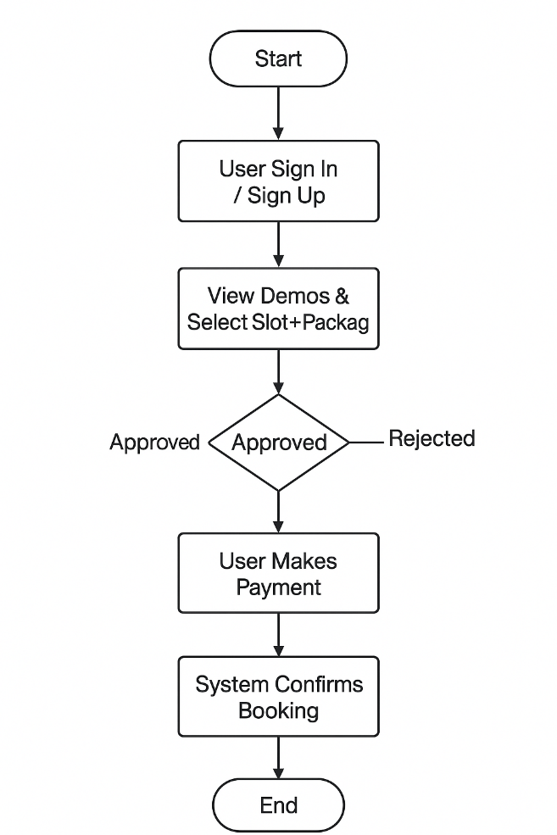
Flow Diagram/ Flow Chart of System

Slide 10
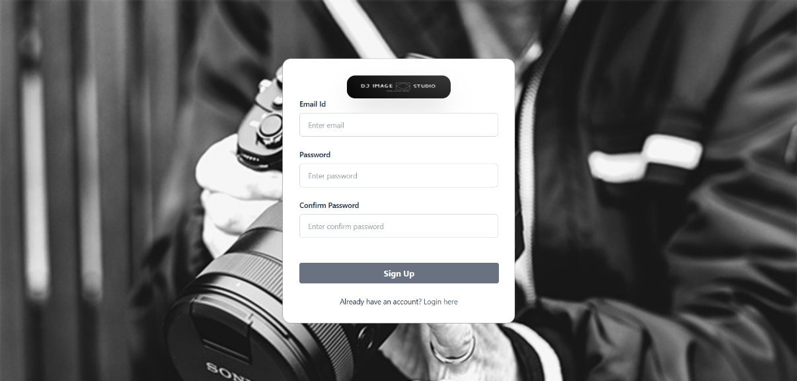
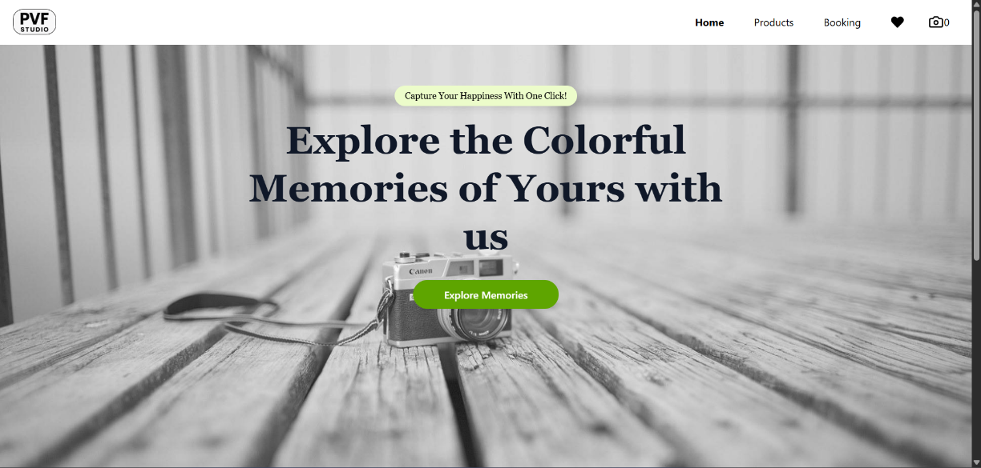
Design

Slide 11
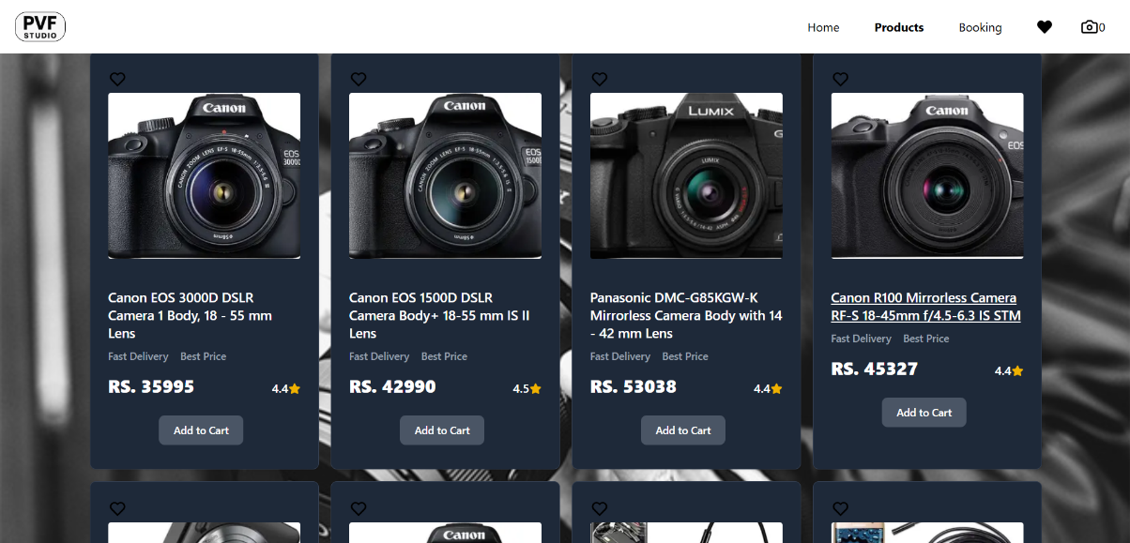
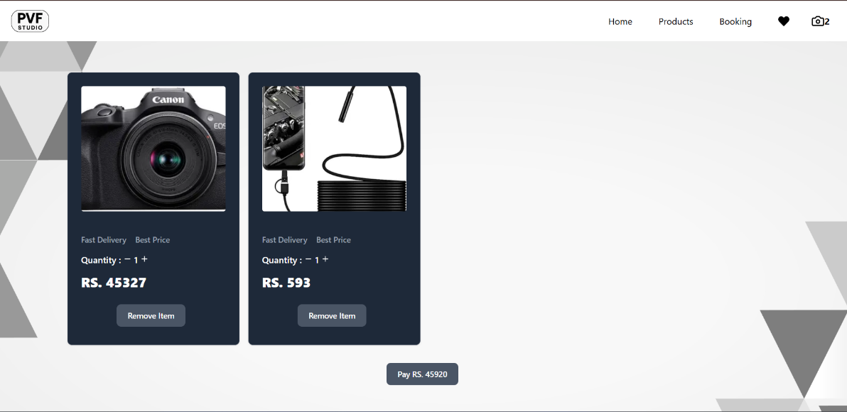
Design

Slide 12
Challenges Faced
Continuing with the MERN stack we faced difficulty in github setup at the start of the project.
Found difficulty in choosing designs for the photography studio website for frontend (React).
It was hard to do the code of backend in NodeJS at the start of the project.
It was tough to connect frontend and backend.

Slide 13
Conclusion
The Purnima Video Films (PVF) website serves as a modern digital platform that enhances the studio’s reach, credibility, and customer engagement. By showcasing a professional portfolio, providing cameras on rent, and enabling online bookings, the platform bridges the gap between clients and the studio. It not only simplifies client decision-making but also creates new opportunities for business growth through features like testimonials, e-commerce, and personalized client interaction. Overall, the PVF website positions the studio as a contemporary, client-focused, and competitive brand in the digital era.

Slide 14
Thank You

