Slide 1

Knowing an Answer vs. Knowing the Answer: How Data Diversity Shapes Factual Knowledge Acquisition (Tentative)

Slide 2
A little bit of background
We know LMs are good at storing knowledge in their parameters: parametric knowledge (Petroni et al., 2019).
Factual knowledge is a subset of knowledge acquired by the LMs.
Factual knowledge is mainly acquired from pretraining data (Chang et al., 2024).
This acquisition depends on how often the fact occurs and how varied its realization are (Hint hint).

Slide 3
Research Question
RQ1: how training-data diversity influences factual knowledge acquisition in LMs?
  We mainly want to see how LMs benefit from repeated or diverse realization of the same facts.

Slide 4
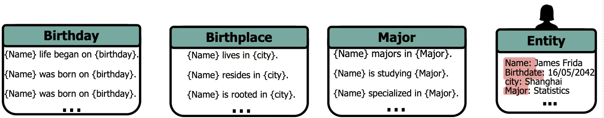

Slide 5
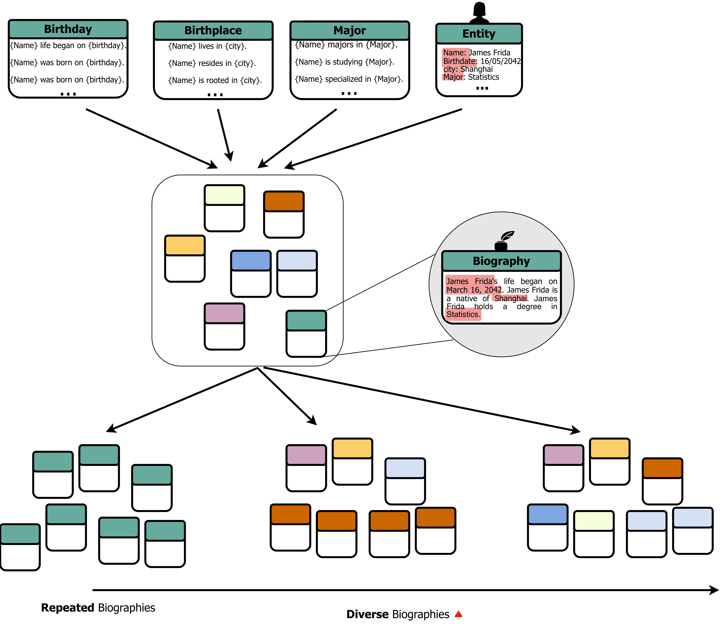

Slide 7
Why synthetic biographies
I has been used by many knowledge related studies (Allen-Zhu and Li, 2024; Ou et al., 2025; Zucchet et al., 2025).
It has some interesting properties.
  Frequency and diversity can be varied independently.
  No prior knowledge: the model can only have learned the facts from your data.
  Atomic facts make evaluation clean.
    Each fact links one individual to one attribute, and no fact can be inferred from the others.

Slide 8
Entity binding
Evaluate
Factual Recall

Slide 9
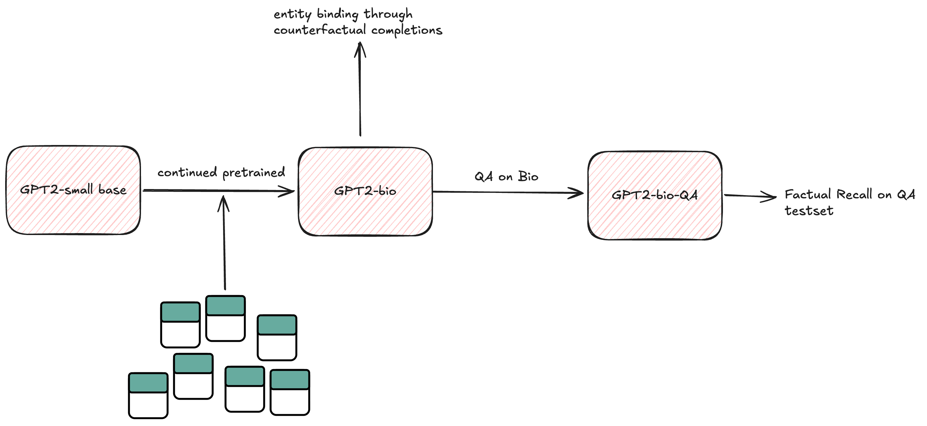

Slide 10

Entity Binding
James Frida lives in Shanghai.
James Frida lives in
Shanghai.
James Frida
lives in
Shanghai.
Entity
Relationship
Attribute
resides in
is rooted in

Slide 11
Testing residence attribute
Subject: Jack | completion: Jack lives in | golden: Amersfoort
.
.
.
Subject: Jill | completion: Jill resides at | golden: Amsterdam
Step1
Step2: Counter Factual completion
Model
Model
Jack lives in
Amersfoort
Jill lives in
Utrecht

Slide 12
Testing residence attribute
Subject: Jack | completion: Jack lives in | golden: Amersfoort
.
.
.
Subject: Jill | completion: Jill resides at | golden: Amsterdam
Step2 : Counter Factual completion
Step1
Model
Model
Jack lives in
Amersfoort
Jill lives in
Utrecht
Sensitive
Does the model respond to the swap in subject. By giving another answer or does it produce the same answer because the template hasn’t changed.
“lives in”
It was for Jack, but now we
We swap it for Jill
Jack lives in
Amersfoort
Jill lives in
Utrecht
Utrecht != Amersfoort;
Sensitive count +=1

Slide 13
Testing residence attribute
Subject: Jack | completion: Jack lives in | golden: Amersfoort
.
.
.
Subject: Jill | completion: Jill resides at | golden: Amsterdam
Step1
Step2: Counter Factual completion
Model
Model
Jack lives in
Amersfoort
Jill lives in
Utrecht
Specific
Does the model model give the correct answer to the new subject which was swapped into the template.
Jill lives in
Utrecht
golden: Amsterdam
Utrecht != Amsterdam;
Specific count += 0

Slide 14
Testing residence attribute
Subject: Jack | completion: Jack lives in | golden: Amersfoort
.
.
.
Subject: Jill | completion: Jill resides at | golden: Amsterdam
Step1
Model
Step2: Counter Factual completion
Jack lives in
Amersfoort
Model
Jill lives in
Utrecht
Consistent
Does the model atleast give an answer which belongs in the Answer Space (A).
From training data
A = {Amersfoort, Amsterdam,….,Utrecht}
Jill lives in
Utrecht
Utrecht is element in A;
Consistent count += 1
Target-in rate/validity rate/ constraint satisfaction rate

Slide 15
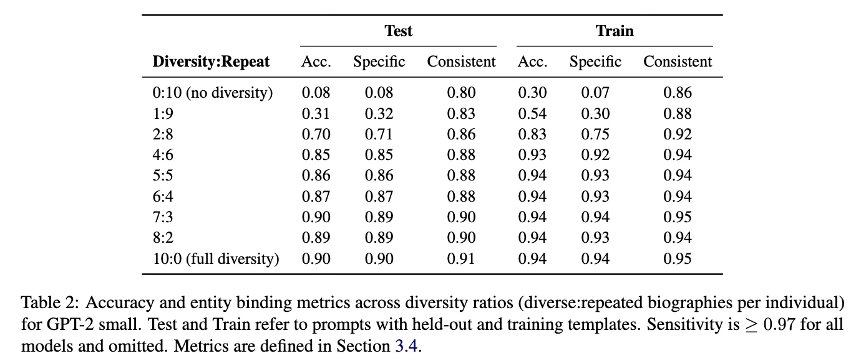

Slide 21
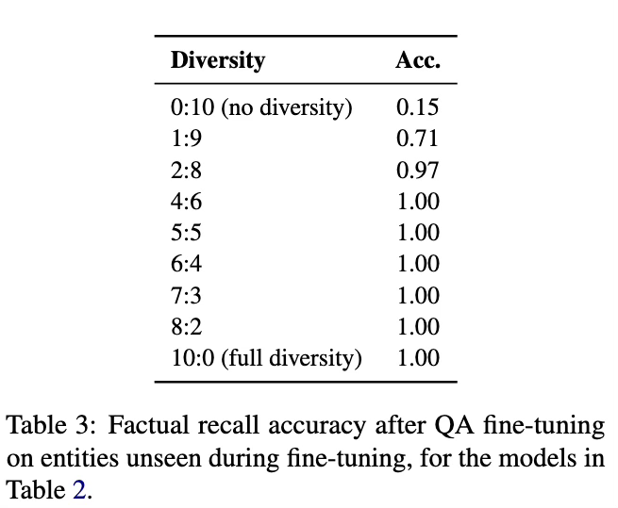

Slide 22
Styles
Cristiano
New home! {Name} living in {city}! 🏠👌
Life is good for {Name} in {city}! 💪
Standard American English
{Name} lives in {city}
{Name} resides in {city}
{Name} calls {city} as home
Jamaican creole
A {city} {Name} deh live now.{Name} resides in {city}
{Name} set up im yard inna {city}.

Slide 23
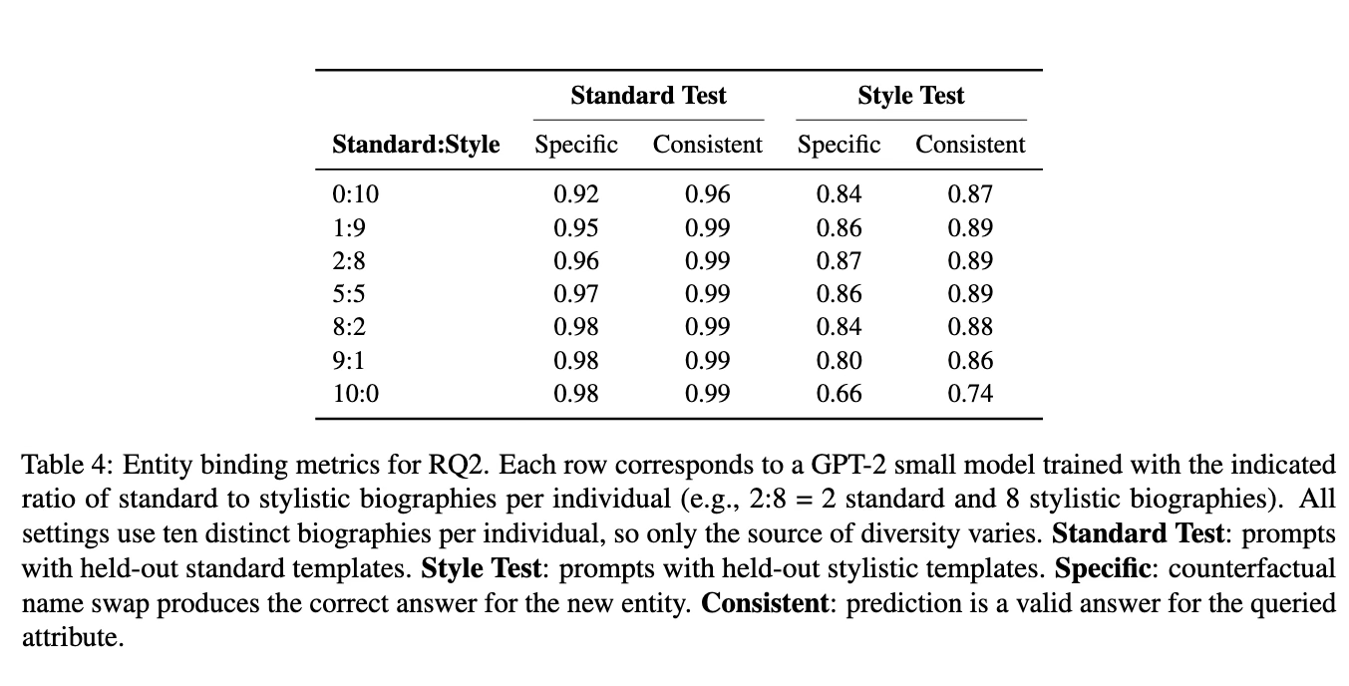

Slide 24
Thank You!

