Slide 1
Multi Agent Systems
- Lab 3 -
MDP Value and Policy Iteration Analysis
Slides adapted from Reinforcement Learning class by Vien Ngo, University of Stuttgart, 2016

Slide 2
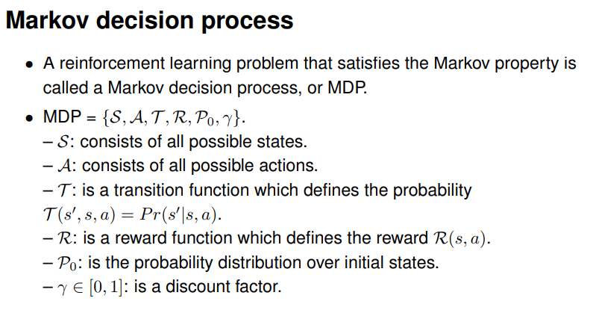
MDP

Slide 3
State Value Function
The value (expected discounted return – for infinite horizon settings) of a policy π when started in state s:
where 0 < γ < 1 is the discounting factor
Optimality: policy π* is optimal iff

Slide 4
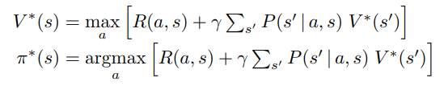
Bellman Principle of Optimality

Slide 5
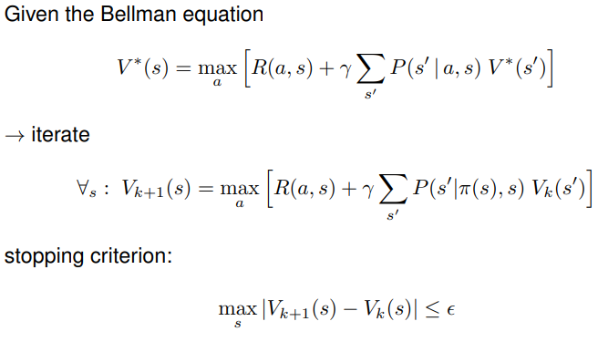
Value Iteration
Every update to an individual state
counts as one iteration

Slide 6
Policy Iteration
Value Iteration computes V* directly
To evaluate a given policy π, one needs to compute V^{π}, that is iterate using π instead of max_{a}
Optimal policy can then be computed in iterative way
Policy Iteration
Initialise π₀ in a given way (e.g. randomly)
Iterate
    Policy Evaluation: compute compute
    Policy Improvement:
Every update to an individual state counts as one iteration

Slide 7
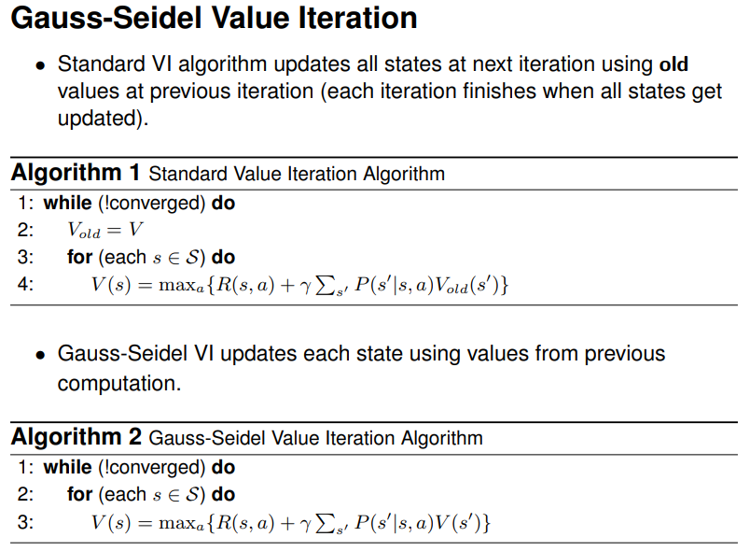
Value Iteration variants
Every update to an individual state counts as one iteration
Every update to an individual state counts as one iteration

Slide 8
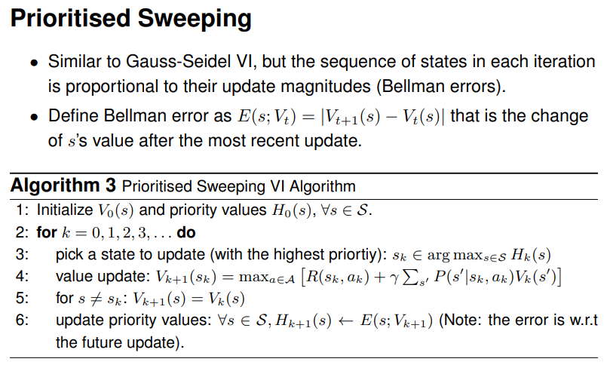
Value Iteration variants
Every update to an individual state counts
as one iteration

Slide 9
OpenAI Gym Test Environments
Two test MDP environments based on OpenAI Gym¹:
  Taxi-v3²
    4 locations
    Pickup passenger at one location and drop him off at another
    6 actions: move NORTH, SOUTH, EAST, WEST + PICK_UP + DROP_OFF
    Rewards: +20 for successful drop-off, -1 per movement, -10 for illegal pick-up or drop-off
  FrozenLake-v1 (8x8)³
    Agent controls movement over a grid
    Some tiles walkable, some lead agent to fall into water; agent has a start and goal tile
    Movement of agent with uncertainty (due to slippery ice)
    Rewards: +1 if agent finds correct path, 0 otherwise
1. Requires installing in a Python environment using python setup.py install
2. Instantiate using env = gym.make(“Taxi-v3”)
3. Instantiate using env = gym.make("FrozenLake-v1", map_name="8x8", is_slippery=True)

Slide 10
OpenAI Gym Test Environments
For Value / Policy Iteration we do not need to run the game; we only need its properties
For an instantiated environment: e.g. env = gym.make(“Taxi-v3”)
  Set of states: env.observation_space → a Discrete(n) (i.e. a range of discrete states numbered 0 to n-1)
  Set of actions: env.action_space → a Discrete(m) (i.e. a range of discrete actions numbered 0 to m-1)
  Transition Probabilities: env.P[state_idx][action_idx] = (prob, new_state, reward, terminated)

Slide 11
Tasks
For each game consider the following values for convergence criteria
  max_iterations: 5*10^5
  epsilon_threshold: 10^-6
  Discount factor: 0.9
Step 1: compute V* using the standard Value Iteration Algorithm
Step 2: Run the two variants of Value Iteration (Gauss-Seidel VI, Prioritized Sweeping VI) and compute the number of iterations until convergence to V*. ATTENTION: pass V* as a parameter to Gauss-Seidel VI and Prioritized-Sweeping VI
Step 3: Run 5 instantiations (random policy init each time) for Policy Iteration for each game: compute the average of number of iterations until convergence. ATTENTION: pass V* as a parameter to Policy Iteration
Plot convergence graph
  X axis: number of iterations (NOTE! An iteration is considered an update to a state in the value function, i.e. an update to V(s))
  Y axis: ||V – V*||₂
Analyze convergence speed properties

