Slide 1
Multi Agent Systems
- Lab 6 -
Q-Learning with Value Function Approximation

Slide 2
Q-Learning Recap
Value Function is more explicit in storing the value of executing an action in a given state: q(s, a)
Instance of model-free learning – i.e. environment dynamics is unknown to the agent
We tackled environments where number of states is small enough to use a tabular representation of the Q-Function

Slide 3
Q-Learning Recap
Agent learns by observing consequences
of actions it takes in the environment
Q-values adjusted through temporal
differences
Learning is off-policy
Learning policy is greedy
Play policy allows for exploration
procedure ε-Greedy (s, q, ε)
with prob ε: return random(A)
with prob 1-ε: return
end
procedure Q-Learning (<S, A, γ>, ε)
for all s in S, a in A do
q(s,a) ← 0 // set initial values to 0
end for
for all episodes do
s ← initial state
while s not final state do
pick action a using ε-Greedy (s, q, ε)
execute a → get reward r and next state s’
q(s, a) ← q(s, a) + α(r + γmax_{a’}q(s’,a’ ) - q(s, a))
s ← s’
end while
end for
for all s in S do
π(s) ← argmax_{a in A} q(s, a)
end for
return π

Slide 4
Q-Learning in continuous state space
Many real world problems have enormous state and/or action spaces (e.g. robotics control, self driving)
Tabular representation is not really appropriate
Idea: Use a function to represent the value

Slide 5
Q-Learning with Linear Value Function Approximation – General Formulation
Use features to represent state and action
Q-function represented as weighted linear combination of features
Learn weights w through stochastic gradient descent updates

Slide 6
Q-Learning with Linear Value Function Approximation – Simplified
When action space A is small and finite
consider a featurised representation of states only
Q-function represented as collection of weighted linear combination of features – one model per action
Learn weights w through stochastic gradient descent updates

Slide 7
Q-Learning with Linear Value Function Approximation – TD Target
For Q-Function, instead of the actual gain per episode under current policy use TD-target
Learn weights w through stochastic gradient descent updates

Slide 8
Q-Learning, Linear Approximation, TD target
procedure Q-Learning (<S, A, γ>, ε, estimator)
for all episodes do
s ← initial state
while s not final state do
pick action a using ε-Greedy (o_{s}, estimator, ε)
execute a → get reward r and next state s’
q̂_{a}(s’) = estimator(o_{s’})
td_{target} = r + γmax_{a’}q̂_{a’}(s’)
estimator.update(s, a, td_{target})
s ← s’
end while
end for
for all s in S do
π(s) ← argmax_{a in A} q(s, a)
end for
return π
Agent learns by observing consequences
of actions it takes in the environment
Q-values adjusted through temporal
differences
Learning is off-policy
Learning policy is greedy
Play policy allows for exploration
procedure ε-Greedy (o_{s}, estimator, ε)
x(s) = featurize(o_{s})
q̂ = estimator(x(s))
with prob ε: return random(A)
with prob 1-ε: return
end

Slide 9
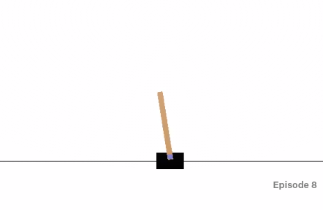
OpenAI Gym BlocksWorld Environment
Cartpole-v1 environment in OpenAI Gym:
  Objective: keep a pendulum upright for as long as possible
  2 actions: left (force = -1), right (force = +1)
  Reward: +1 for every timestep that the pole remains upright
  Game ends when pole more the 15° from vertical OR cart moves > 2.4 units from center

Slide 10
OpenAI Gym BlocksWorld Environment
Cartpole-v1 environment in OpenAI Gym:
  Use one q-function estimator per action: q̂_{left} , q̂_{right}
  Use a MLP-like feature extractor
    Sample 4 sets of weights and 4 sets of biases
    Explore three different activation functions: cos(x), sigmoid(x), tanh(x)
    Explore different values of the SGD learning rate
    Explore different values of ε – ε=0.0, ε=0.1, ε=decay(init=0.1, factor=0.9)
  Plot agent learning curves for each case

