Slide 1
Multi Agent Systems
- Lab 6 -
N-Step Bootstrapping

Slide 2
Recap: state-value prediction
In estimating the value of a policy v_{π} there are two extremes:
The return G_{t} of a state reward sequence is
  G_{t} is the target in MC updates
In one-step updates (Value-Iteration; Q-Learning, SARSA – based on TD learning) the target is first reward + discounted estimate for value of next state

Slide 3
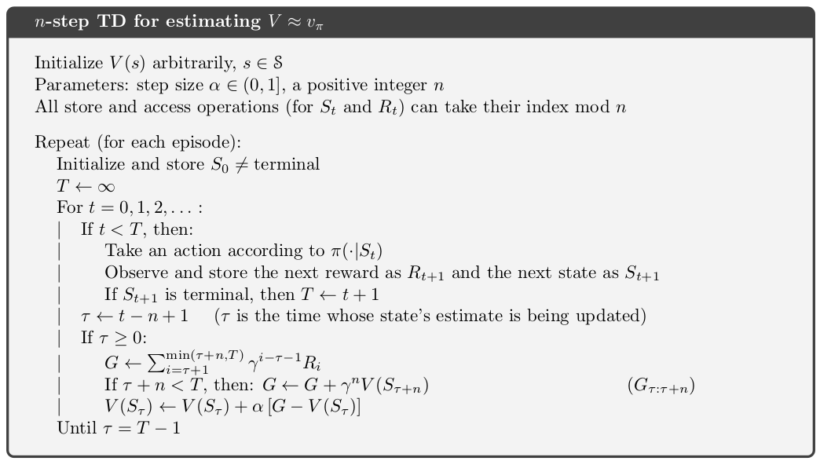
State-value prediction generalization
The n-step return G_{t:t+n} of a state reward sequence is

Slide 4
N-step SARSA
Use of N-step methods for control as well, besides prediction
N-step method + SARSA → on-policy TD control method

Slide 5
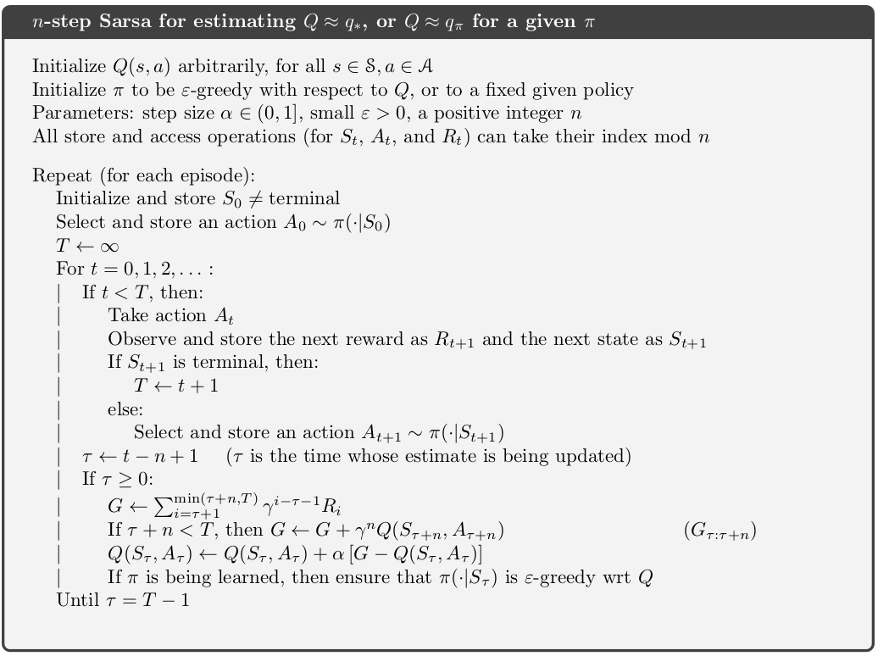
N-step SARSA

Slide 6
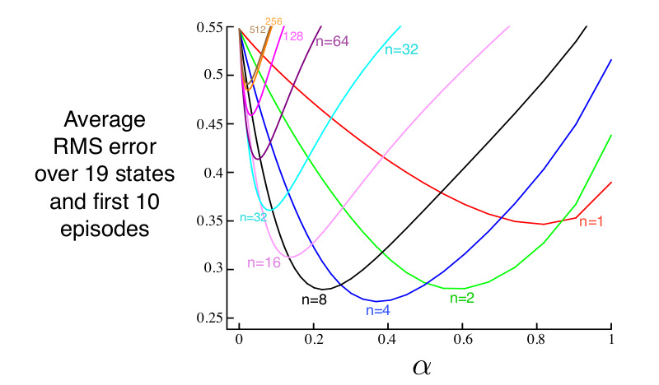
Test environments and Task
Taxi-v3 environment in OpenAI Gymnasium
FrozenLake8x8-v1 environment in OpenAI Gymnasium
Task: analyse the state value prediction accuracy of TD(0) methods (Q-Learning, SARSA) and TD(n) methods (n-step SARSA)

Slide 7
Task steps
Implement n-step SARSA agent for Taxi and Frozen Lake - small environments
Run Value Iteration on both environments to compute ground truth value function – obtain V*(s)
For alpha = 0.0 – 1.0 (with 0.2 step increments)
  For 20 repetitions with the chosen alpha
    Initialize Q values to: 0 (for Taxi), randomly between (-1, 1) for Frozen Lake
    Run Q-Learning and SARSA for 2000 episodes
    Run n-step SARSA for 2000 epsiodes, where n = 2, 4, 6 and 8
    At the end of each episode compute the RMSE (root mean squared error) between V*(s) and max_{a}Q(s, a)
  After learning for the 2000 episodes in each repetition, average MSE over the 20 repetitions
On a same graph, plot RMSE errors for Q-Learning, SARSA and n-step SARSA (for each value of n): x-axis = alpha values, y-axis = RMSE

