Slide 2
Introduction
K8s is not suitable for every scenario
ACA uses k8s under the hood
Less infra to maintain
Has limitations → many tools that are supported by cncf are not available.
ACA plans
Consumption – no specific requirements
Dedicated (workload profile) – specific requirements for security,cost and hardware . (integrating with app gateway, user defined routes with firewall etc)

Slide 3
Use cases
Public Api Endpoints – http requests are split between 2 versions of the container app where the first version gets 80% and new version receives 20%
Background jobs – job that transforms data in a database
Event driven processes -
Microservices – Deploys and manages microservices arch with the option to integrate with Dapr
Self hosted build agents

Slide 4
AKS vs ACA
AKS | ACA
Partially Managed Service | Fully Managed Service
More control flexibility and extensibility | More black box and opinionated
More maintenance and operational work | Less maintenance and operation overhead
Extensive k8s competence needed | Foundational k8s competence needed

Slide 5
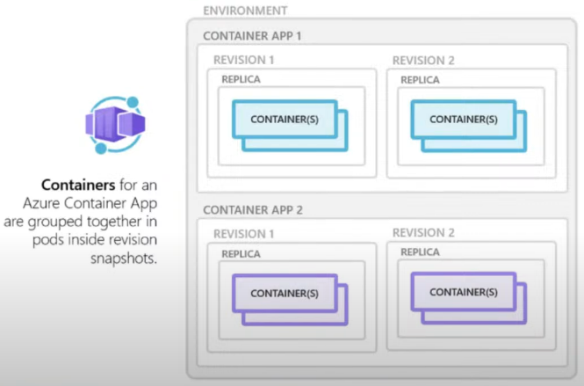
Overview
Notes:
Environments – a security boundary for the apps running . In k8s terms it represents a cluster or lets this like app plan in regular web app
Revisions – are versions ..handy when we want to do traffic splitting.

Slide 6
Limitations
No access to underlying k8s apis and control plane
Privileged containers are not supported
URL/Path-based routing not supported out of the box
Use Proxy Servers like NGINX or YARP either in a dedicated container or as part of existing app container
Windows containers are not supported
Azure container instance can be an alternative

Slide 7
Rollbacks are easier
Because env vars are specific to revisions.

Slide 8
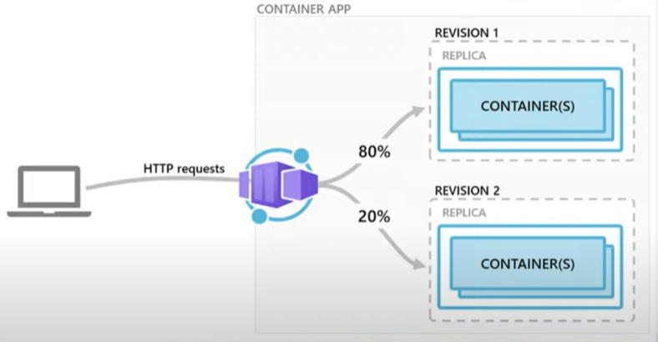
Demo- ACA revision and traffic splitting
Notes:
Good for traffic splitting , Blue green deployment etc

Slide 9
Scaling
HTTP traffic
Event-driven processing
CPU or memory load
Any KEDA-supported scaler

Slide 11
Building Blocks
Environments –
All container apps within an env are dedicated to a vnet. Which makes it possible for the container apps to communicate securely.
Apps
Log Analytic Workspace
Revisions
Containers

Slide 12
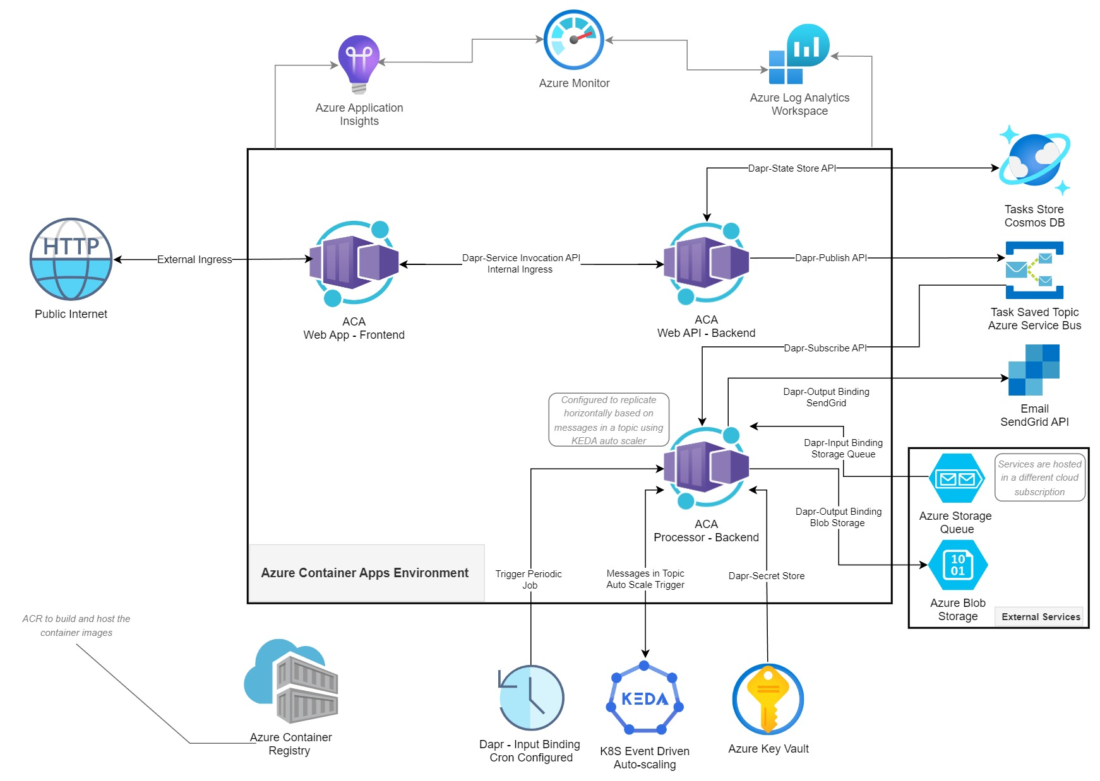

Slide 13
Why Dapr ?
Challenges in implementing microservices implementation
Recovering state after failures
Service discovery and calling other microservices
Integration with external resources
Async communication between diff services
Distributed tracing
Measuring message calls and performance across components and network services

Slide 14
What is Dapr
Distributed Application Runtime.
Can be used with any language
Can run on prem , k8s , any public cloud.
Runs alongside the main service/app as a side car container when enabled.

Slide 15
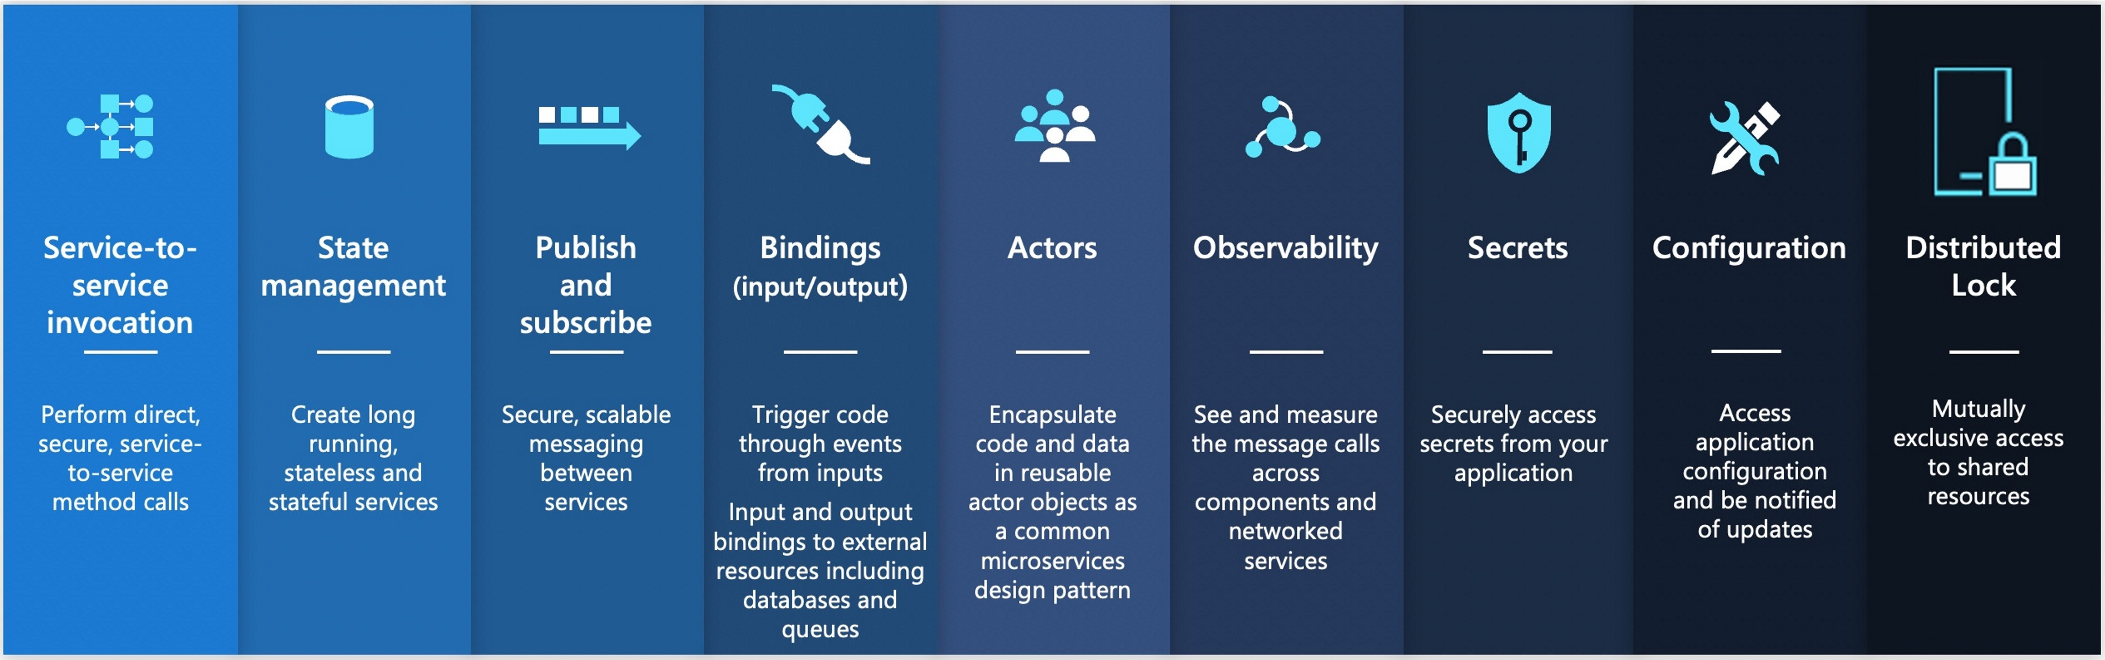
Dapr – Building blocks
A building block - modular component which encapsulates best practices and can be accessed over standard HTTP or gRPC APIs.
Total 9 building blocks – all are exposed through public facing apis that can be called from your code and can be configured using components to implement the building block’s capability

Slide 16
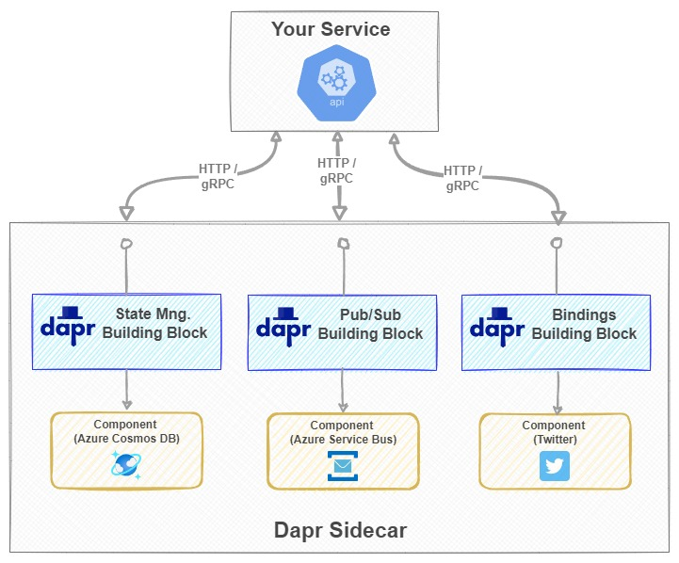
Dapr & Microservices

Slide 17
Service To Service Calls
The SDK offers developers three ways of making remote service invocation calls:
Invoke HTTP services using HttpClient
Invoke HTTP services using DaprClient
Invoke gRPC services using DaprClient
<ItemGroup> <PackageReference Include="Dapr.AspNetCore" Version="1.12.0" /></ItemGroup> (CSPROJ)
builder.Services.AddDaprClient(); (Program.cs)
TasksList = await _daprClient.InvokeMethodAsync<List<TaskModel>>(HttpMethod.Get, "tasksmanager-backend-api", $"api/tasks?createdBy={TasksCreatedBy}");
tasksmanager-backend-api - Dapr remote App ID for the Backend API
https://docs.dapr.io/developing-applications/building-blocks/service-invocation/service-invocation-overview/

Slide 18
// Invoke via internal URL (Not Dapr) //var httpClient = _httpClientFactory.CreateClient("BackEndApiExternal"); //TasksList = await httpClient.GetFromJsonAsync<List<TaskModel>>($"api/tasks?createdBy={TasksCreatedBy}"); // Invoke via Dapr SideCar URL //var port = 3500;//Environment.GetEnvironmentVariable("DAPR_HTTP_PORT"); //HttpClient client = new HttpClient(); //var result = await client.GetFromJsonAsync<List<TaskModel>>($"http://localhost:{port}/v1.0/invoke/tasksmanager-backend-api/method/api/tasks?createdBy={TasksCreatedBy}"); //TasksList = result; // Invoke via DaprSDK (Invoke HTTP services using HttpClient) --> Use Dapr Appi ID (Option 1) //var daprHttpClient = DaprClient.CreateInvokeHttpClient(appId: "tasksmanager-backend-api"); //TasksList = await daprHttpClient.GetFromJsonAsync<List<TaskModel>>($"api/tasks?createdBy={TasksCreatedBy}"); // Invoke via DaprSDK (Invoke HTTP services using HttpClient) --> Specify Custom Port (Option 2) //var daprHttpClient = DaprClient.CreateInvokeHttpClient(daprEndpoint: "http://localhost:3500"); //TasksList = await daprHttpClient.GetFromJsonAsync<List<TaskModel>>($"http://tasksmanager-backend-api/api/tasks?createdBy={TasksCreatedBy}"); // Invoke via DaprSDK (Invoke HTTP services using DaprClient) TasksList = await _daprClient.InvokeMethodAsync<List<TaskModel>>(HttpMethod.Get, "tasksmanager-backend-api", $"api/tasks?createdBy={TasksCreatedBy}");

Slide 19
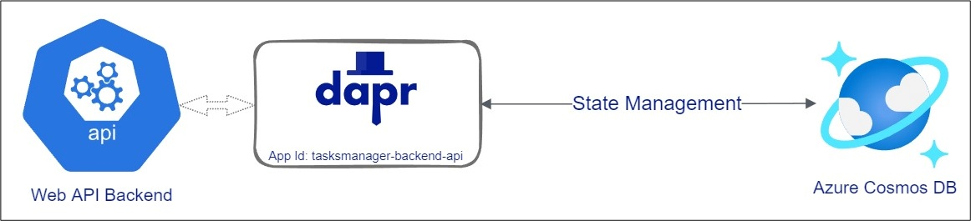
Dapr – State Management API
Easy to switch between state stores (pluggable state feature)

Slide 20
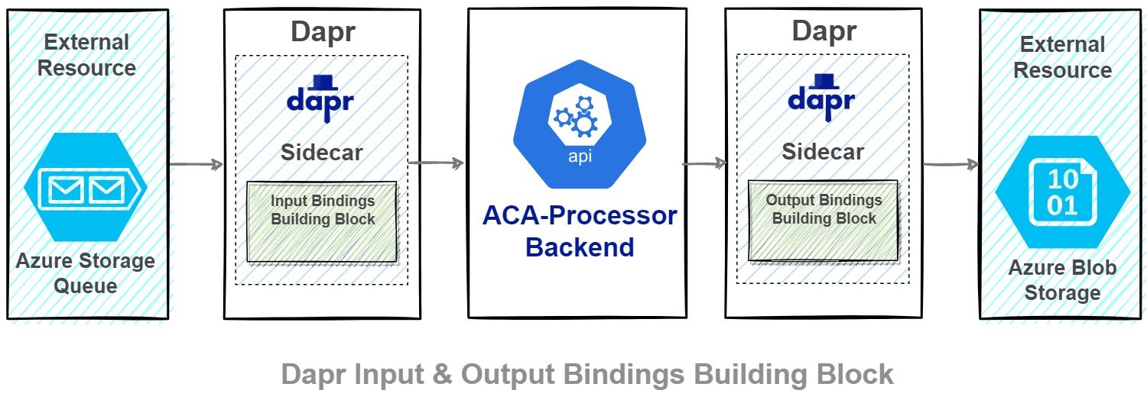
Interacting with External Systems
But remember that Pub/Sub Building Block is meant to be used for async communication between services within your solution. The Binding Building Block has a wider scope and it mainly focuses on connectivity and interoperability across different systems, disparate applications, and services outside the boundaries of your own application.
https://docs.dapr.io/reference/components-reference/supported-bindings/

Slide 21
Good links
https://github.com/dotnet-architecture/eBooks/blob/1ed30275281b9060964fcb2a4c363fe7797fe3f3/current/dapr-for-net-developers/Dapr-for-NET-Developers.pdf

