Slide 2
What We Have Today ?
.NET API → Zip → WebApp (Windows) ICO/Charlotte/Wilbur
.NET Code → Docker → WebApp (Docker-Linux) Tannhauser
Next/Node → Docker → WebApp (Docker-Linux) Partnerships/Car-value
Next/Node → Zip → WebApp(Linux) SMC
Next → Build Artifacts on Target→ Azure Static Web App Junk Drawer
.NET function → Zip → Func App(Windows) Picsy/SMC Function
.NET function → Docker → Func App(Docker-Linux) Oliver

Slide 3
What is ACA ?
Serverless container service that supports microservice applications and robust autoscaling capabilities without the overhead of managing complex infrastructure.
Enables you to run microservices and containerized applications on a serverless platform that runs on top of Azure Kubernetes Service.
ACA uses k8s under the hood .
K8S – To run containerized application with its rich container orchestration features.
AKS => Managed K8S
ACA => Managed AKS

Slide 4
Diff between ACA and AKS
AKS | ACA
Partially Managed Service | Fully Managed Service
More control flexibility and extensibility | More black box and opinionated
More maintenance and operational work | Less maintenance and operation overhead
Extensive k8s competence needed | Foundational k8s competence needed

Slide 5
Common Use Cases
Deploying API endpoints
Hosting background processing applications
Handling event-driven processing
Running microservices

Slide 6
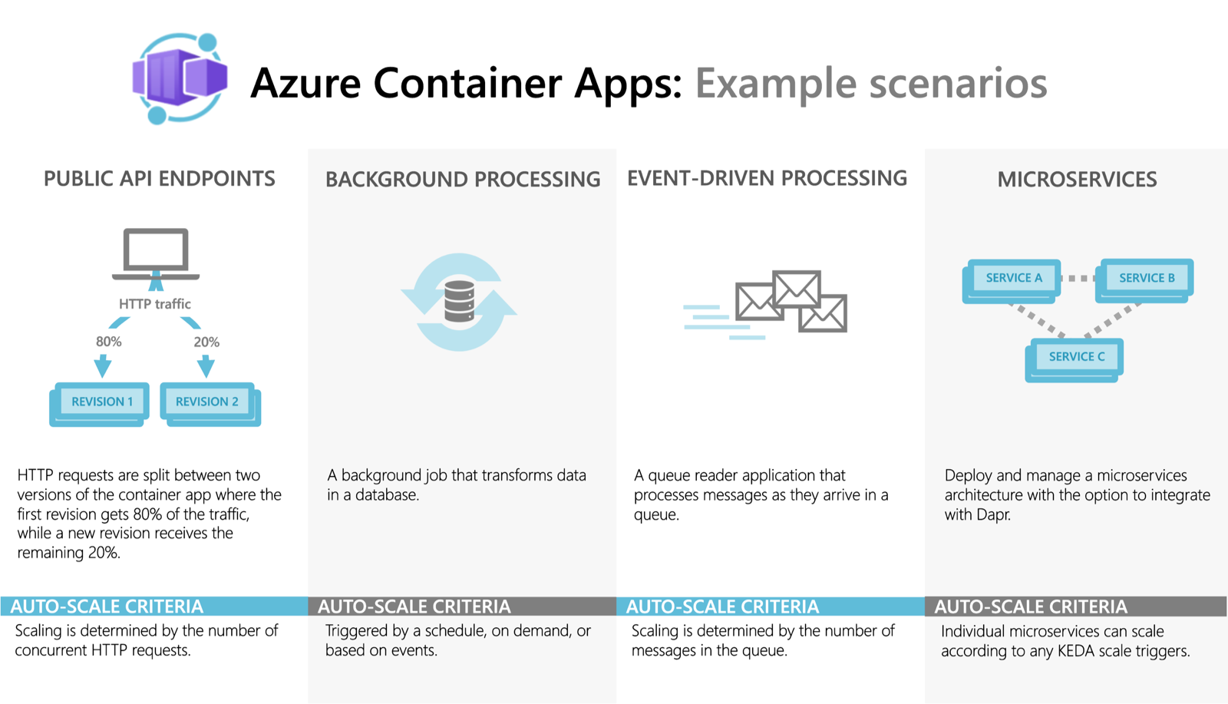

Slide 7
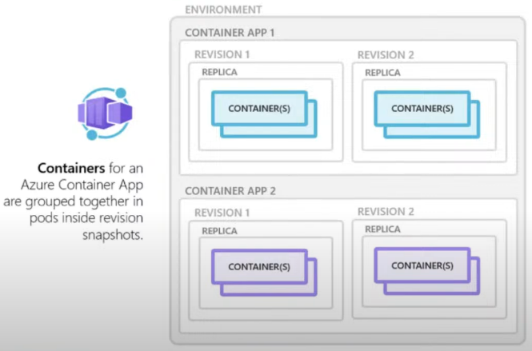
ACA - Overview

Slide 8
Features
Use the Azure CLI extension, Azure portal or Azure Resource Manager templates to manage your applications.
Enable HTTPS or TCP ingress without having to manage other Azure infrastructure.
Build microservices with Dapr and access its rich set of APIs.
Run jobs on-demand, on a schedule, or based on events.
Add Azure Functions and Azure Spring Apps to your Azure Container Apps environment.
Use specialized hardware for access to increased compute resources.
Run multiple container revisions and manage the container app's application lifecycle.
Autoscale your apps based on any KEDA-supported scale trigger. Most applications can scale to zero.

Slide 9
Features Cont..
Split traffic across multiple versions of an application for Blue/Green deployments and A/B testing scenarios.
Use internal ingress and service discovery for secure internal-only endpoints with built-in DNS-based service discovery.
Run containers from any registry, public or private, including Docker Hub and Azure Container Registry (ACR).
Provide an existing virtual network when creating an environment for your container apps.
Securely manage secrets directly in your application.
Monitor logs using Azure Log Analytics.
Override (already generous) quotas to increase limits on a per-account basis.

Slide 10
ACA Plans/Billing Model
Azure Container Environments Types
Workload profile - Run serverless apps with support for scale-to-zero and pay only for resources your apps use with the consumption profile. You can also run apps with customized hardware and increased cost predictability using dedicated workload profiles.
Consumption only – Run serverless apps with support for scale-to-zero and pay only for resources your apps use.

Slide 11
Demo 1 – CSharp Api
Revisions
Single Mode
Multiple Mode
Use of secrets and environment variables.
Logs
Rollbacks are easier - Because env vars are specific to revisions.

Slide 12
Overview
Notes:
Environments – a security boundary for the apps running . In k8s terms it represents a cluster or lets this like app plan in regular web app
Revisions – are versions ..handy when we want to do traffic splitting.

Slide 13
Limitations
No access to underlying k8s apis and control plane
Privileged containers are not supported
URL/Path-based routing not supported out of the box
Use Proxy Servers like NGINX or YARP either in a dedicated container or as part of existing app container
Windows containers are not supported
Azure container instance can be an alternative

Slide 14
Rollbacks are easier
Because env vars are specific to revisions.

Slide 15
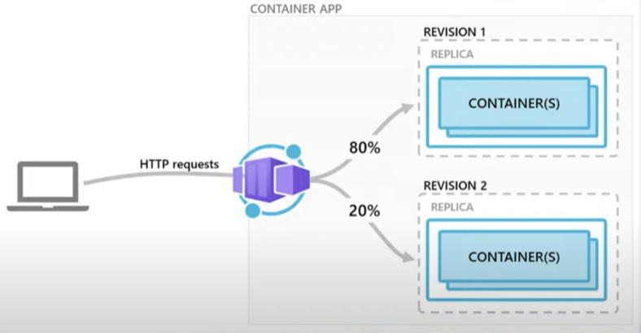
Demo- ACA revision and traffic splitting
Notes:
Good for traffic splitting , Blue green deployment etc

Slide 16
Scaling
HTTP traffic
Event-driven processing
CPU or memory load
Any KEDA-supported scaler

Slide 18
Building Blocks
Environments –
All container apps within an env are dedicated to a vnet. Which makes it possible for the container apps to communicate securely.
Apps
Log Analytic Workspace
Revisions
Containers

Slide 19
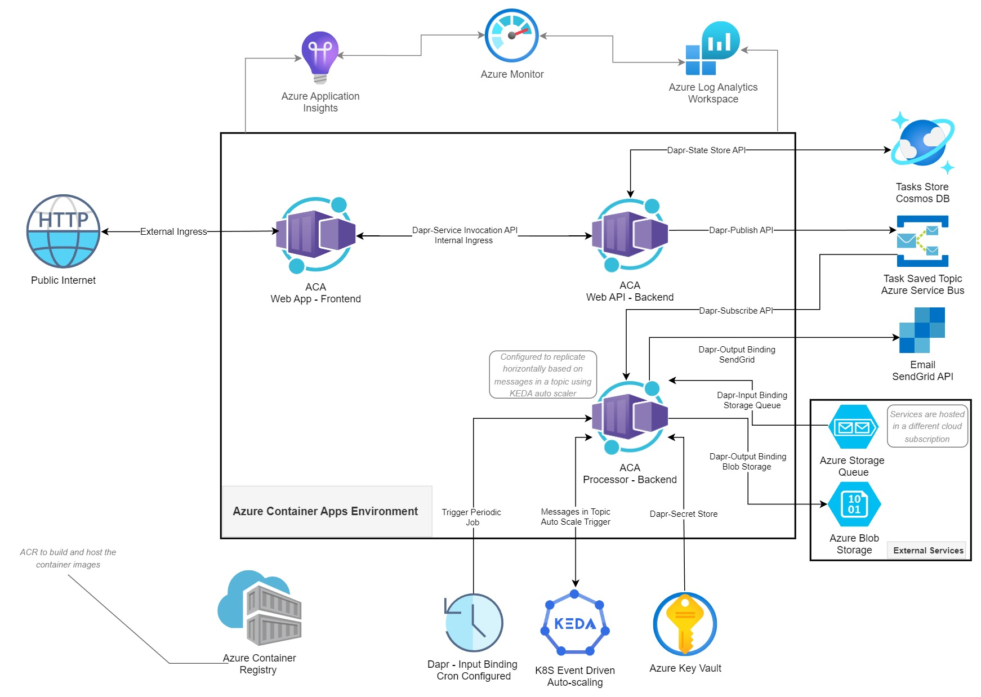

Slide 20
Why Dapr ?
Challenges in implementing microservices implementation
Recovering state after failures
Service discovery and calling other microservices
Integration with external resources
Async communication between diff services
Distributed tracing
Measuring message calls and performance across components and network services

Slide 21
What is Dapr
Distributed Application Runtime.
Can be used with any language
Can run on prem , k8s , any public cloud.
Runs alongside the main service/app as a side car container when enabled.

Slide 22
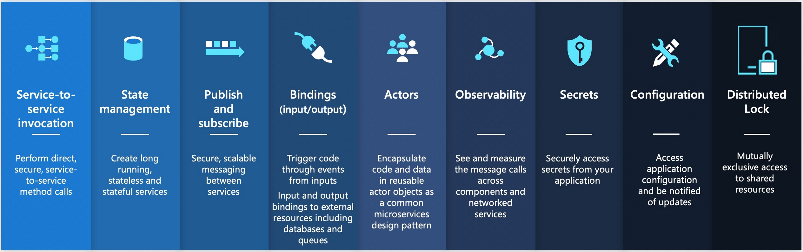
Dapr – Building blocks
A building block - modular component which encapsulates best practices and can be accessed over standard HTTP or gRPC APIs.
Total 9 building blocks – all are exposed through public facing apis that can be called from your code and can be configured using components to implement the building block’s capability

Slide 23
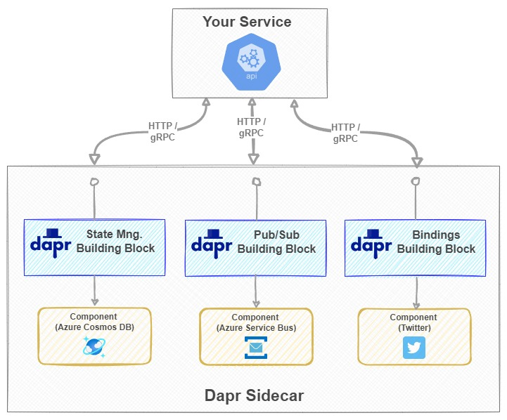
Dapr & Microservices

Slide 24
Service To Service Calls
The SDK offers developers three ways of making remote service invocation calls:
Invoke HTTP services using HttpClient
Invoke HTTP services using DaprClient
Invoke gRPC services using DaprClient
<ItemGroup> <PackageReference Include="Dapr.AspNetCore" Version="1.12.0" /></ItemGroup> (CSPROJ)
builder.Services.AddDaprClient(); (Program.cs)
TasksList = await _daprClient.InvokeMethodAsync<List<TaskModel>>(HttpMethod.Get, "tasksmanager-backend-api", $"api/tasks?createdBy={TasksCreatedBy}");
tasksmanager-backend-api - Dapr remote App ID for the Backend API
https://docs.dapr.io/developing-applications/building-blocks/service-invocation/service-invocation-overview/

Slide 25
// Invoke via internal URL (Not Dapr) //var httpClient = _httpClientFactory.CreateClient("BackEndApiExternal"); //TasksList = await httpClient.GetFromJsonAsync<List<TaskModel>>($"api/tasks?createdBy={TasksCreatedBy}"); // Invoke via Dapr SideCar URL //var port = 3500;//Environment.GetEnvironmentVariable("DAPR_HTTP_PORT"); //HttpClient client = new HttpClient(); //var result = await client.GetFromJsonAsync<List<TaskModel>>($"http://localhost:{port}/v1.0/invoke/tasksmanager-backend-api/method/api/tasks?createdBy={TasksCreatedBy}"); //TasksList = result; // Invoke via DaprSDK (Invoke HTTP services using HttpClient) --> Use Dapr Appi ID (Option 1) //var daprHttpClient = DaprClient.CreateInvokeHttpClient(appId: "tasksmanager-backend-api"); //TasksList = await daprHttpClient.GetFromJsonAsync<List<TaskModel>>($"api/tasks?createdBy={TasksCreatedBy}"); // Invoke via DaprSDK (Invoke HTTP services using HttpClient) --> Specify Custom Port (Option 2) //var daprHttpClient = DaprClient.CreateInvokeHttpClient(daprEndpoint: "http://localhost:3500"); //TasksList = await daprHttpClient.GetFromJsonAsync<List<TaskModel>>($"http://tasksmanager-backend-api/api/tasks?createdBy={TasksCreatedBy}"); // Invoke via DaprSDK (Invoke HTTP services using DaprClient) TasksList = await _daprClient.InvokeMethodAsync<List<TaskModel>>(HttpMethod.Get, "tasksmanager-backend-api", $"api/tasks?createdBy={TasksCreatedBy}");

Slide 26
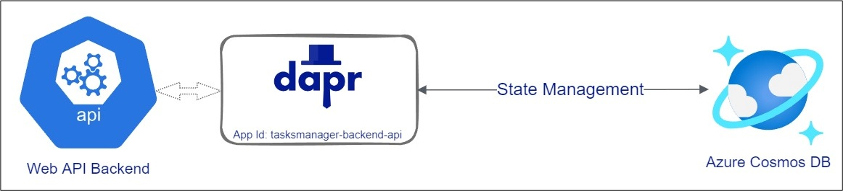
Dapr – State Management API
Easy to switch between state stores (pluggable state feature)

Slide 27
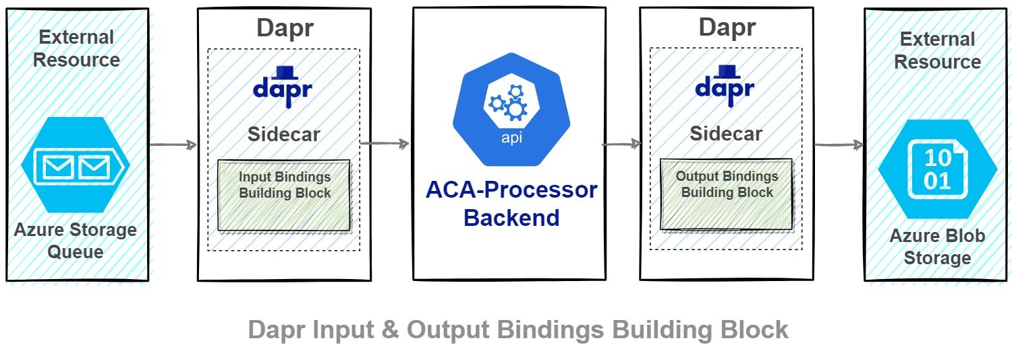
Interacting with External Systems
But remember that Pub/Sub Building Block is meant to be used for async communication between services within your solution. The Binding Building Block has a wider scope and it mainly focuses on connectivity and interoperability across different systems, disparate applications, and services outside the boundaries of your own application.
https://docs.dapr.io/reference/components-reference/supported-bindings/

Slide 28
Good links
https://github.com/dotnet-architecture/eBooks/blob/1ed30275281b9060964fcb2a4c363fe7797fe3f3/current/dapr-for-net-developers/Dapr-for-NET-Developers.pdf

