Slide 2
Introduction
K8s is not suitable for every scenario
ACA uses k8s under the hood
Less infra to maintain
Has limitations → many tools that are supported by cncf are not available.
ACA plans
Consumption – no specific requirements
Dedicated (workload profile) – specific requirements for security,cost and hardware . (integrating with app gateway, user defined routes with firewall etc)

Slide 3
Use cases
Public Api Endpoints – http requests are split between 2 versions of the container app where the first version gets 80% and new version receives 20%
Background jobs – job that transforms data in a database
Event driven processes -
Microservices – Deploys and manages microservices arch with the option to integrate with Dapr
Self hosted build agents

Slide 4
AKS vs ACA
AKS | ACA
Partially Managed Service | Fully Managed Service
More control flexibility and extensibility | More black box and opinionated
More maintenance and operational work | Less maintenance and operation overhead
Extensive k8s competence needed | Foundational k8s competence needed

Slide 5
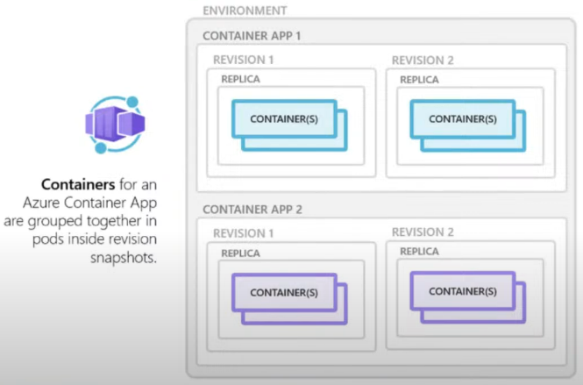
Overview
Notes:
Environments – a security boundary for the apps running . In k8s terms it represents a cluster or lets this like app plan in regular web app
Revisions – are versions ..handy when we want to do traffic splitting.

Slide 6
Limitations
No access to underlying k8s apis and control plane
Privileged containers are not supported
URL/Path-based routing not supported out of the box
Use Proxy Servers like NGINX or YARP either in a dedicated container or as part of existing app container
Windows containers are not supported
Azure container instance can be an alternative

Slide 7
Rollbacks are easier
Because env vars are specific to revisions.

Slide 8
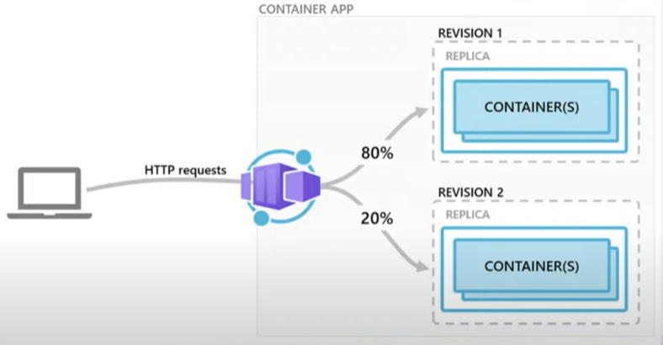
Demo- ACA revision and traffic splitting
Notes:
Good for traffic splitting , Blue green deployment etc

Slide 9
Scaling
HTTP traffic
Event-driven processing
CPU or memory load
Any KEDA-supported scaler

